Slide 1

EXPLOSIVE ELECTRON EMISSION:
PHYSICS AND TECHNOLOGY
International Congress
ENERGY FLUXES and RADIATION EFFECTS,
Tomsk, Russia, September 16-22, 2018
Academician Gennady A. Mesyats

Slide 2


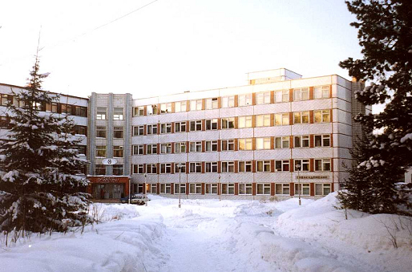
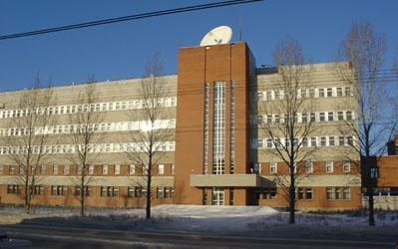
EXPLOSIVE ELECTRON EMISSION:
PHYSICS AND TECHNOLOGY
P. N. Lebedev Physical Institute, RAS (Moscow)
Tomsk Polytechnic University
Institute of High Current Electronics,
SB, RAN (Tomsk)
Institute of Electrophysics,
UB, RAN (Yekaterinburg)
EFRE 2018

Slide 3
50 years since the discovery of the phenomenon of
explosive electron emission at Tomsk Polytechnic Institute
1. June 15, 1966: G. A. Mesyats submitted his doctoral thesis on Investigations on the generation of nanosecond high-power pulses to the Scientific Council of TPU.
2. July 2, 1966: The paper entitled “Electrooptical observations of the initiation and development of the breakdown of a short vacuum gap” was submitted to the editorial office of Zhurnal Tekhnicheskoi Fiziki (published in Zh. Tekh. Fiz., 1967, vol. 37, No. 12, pp. 2206–2208).
EFRE 2018

Slide 4
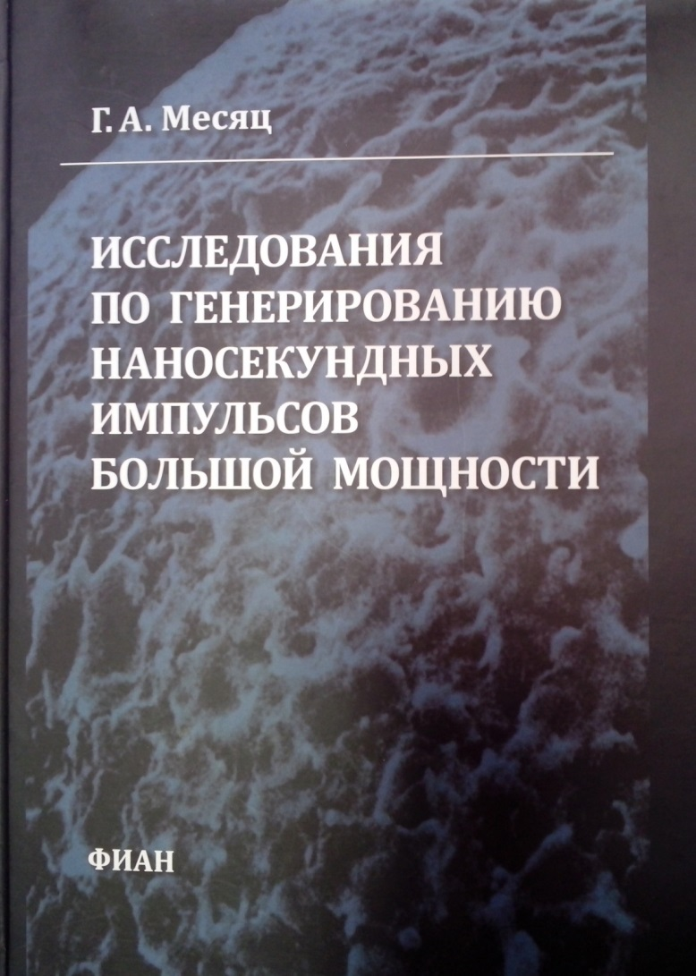
G. A. Mesyats,
Investigations on the Generation of
Nanosecond High-Power Pulses
EFRE 2018

Slide 5
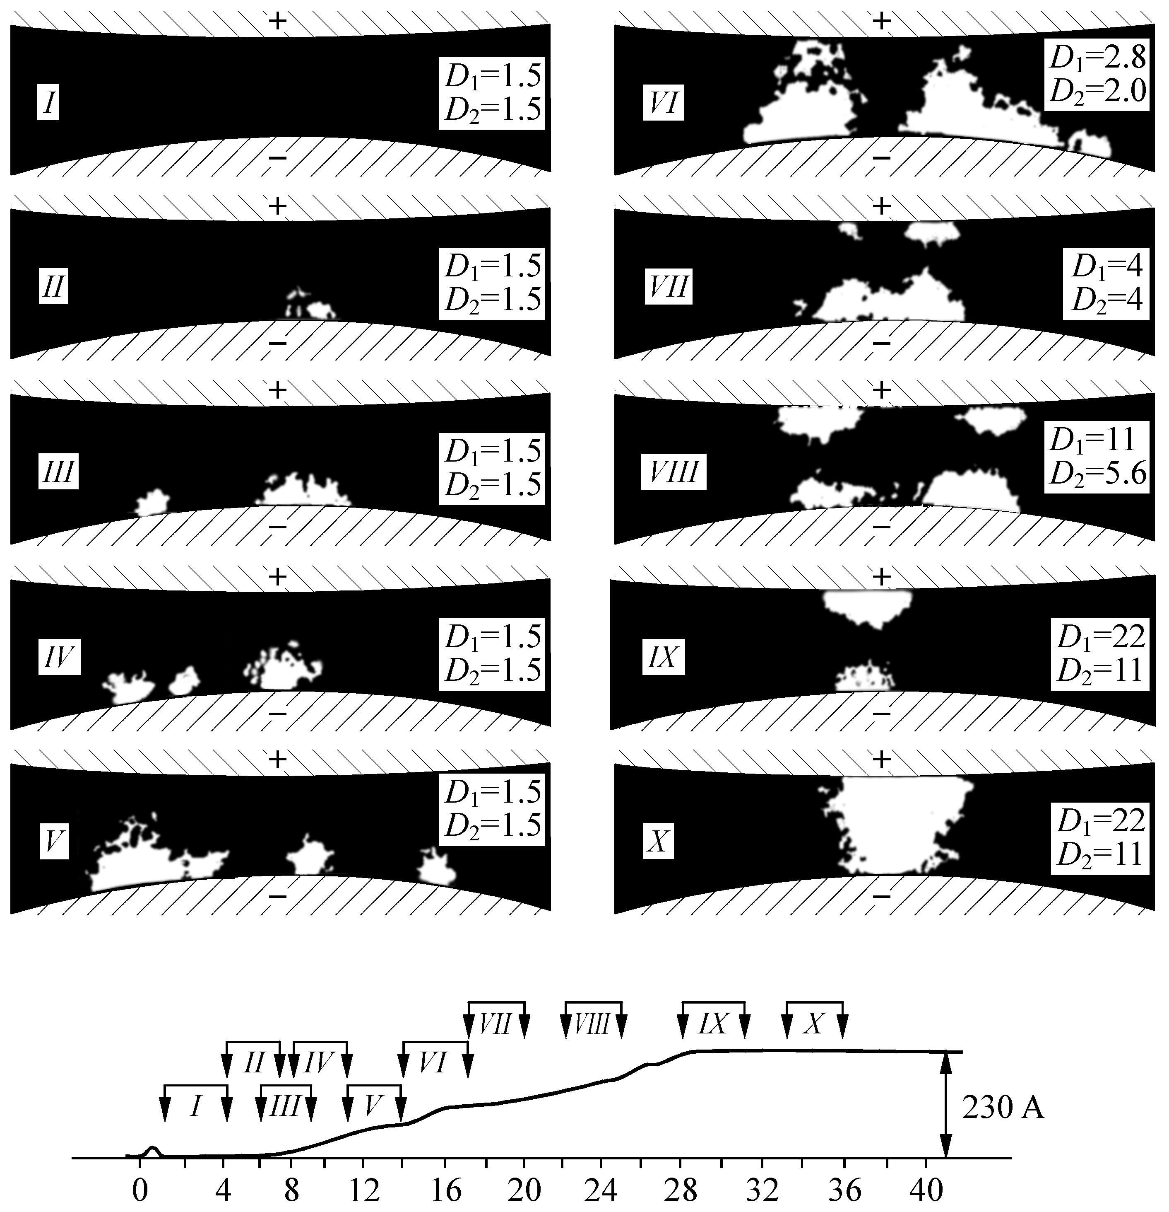
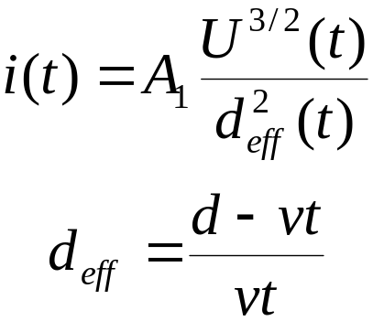
PHENOMENOLOGY OF EXPLOSIVE ELECTRON EMISSION
Typical photos
of the luminescence in a vacuum gap taken at different stages of breakdown
G. A. Mesyats and
D. I. Proskurovsky Pulsed Electrical Discharge in Vacuum 1989 (Berlin: Springer Verlag)
EFRE 2018

Slide 6
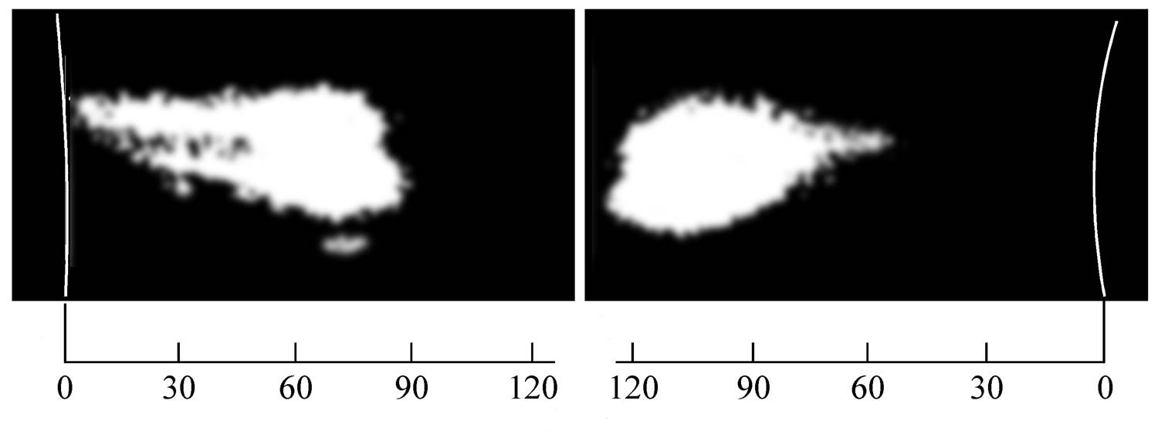
BREAKDOWN DEVELOPMENT
t [ns]
Streak picture of
the cathode glow
Streak picture of
the anode glow
EFRE 2018

Slide 7
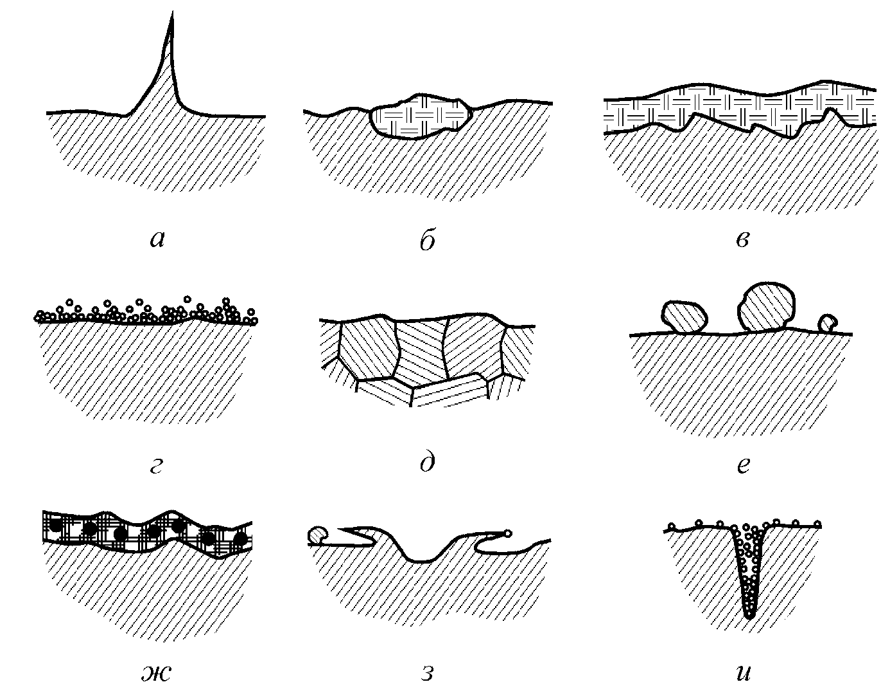
EMISSION CENTERS
a
b
c
d
e
f
g
h
i
Microprotrusions (a); dielectric inclusions (b); oxide and other inorganic dielectric films (c); adsorbed gas layers (d); grain boundaries emerged at the surface (e); microparticles (f); oil vapor cracking products (g); edges of craters formed upon breakdowns (h); pores and cracks (i)
EFRE 2018

Slide 8

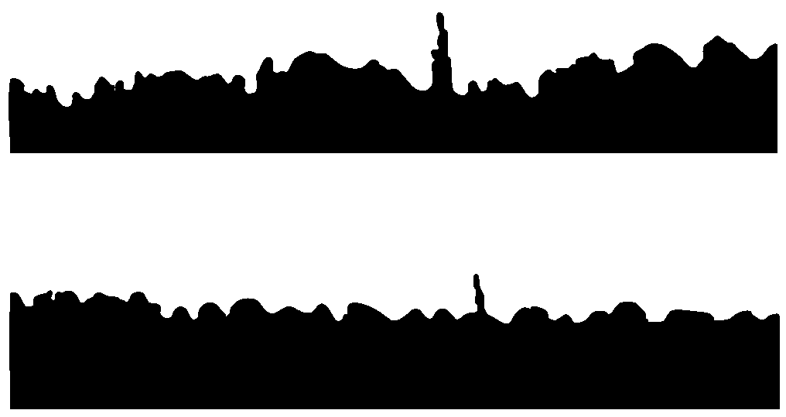
Microirregularities on electrode surfaces
j = AE ² exp (-B/E)
EFRE 2018

Slide 9
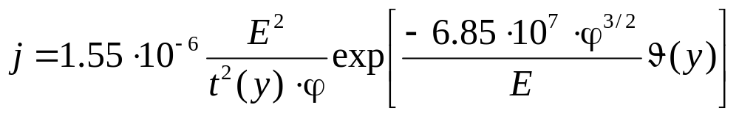



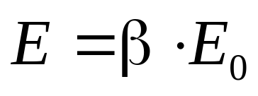
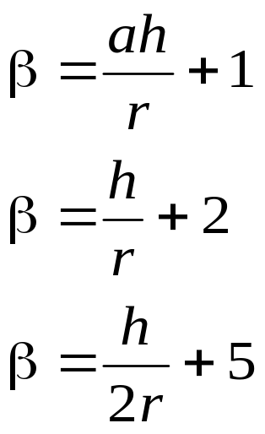
FIELD EMISSION
FOWLER-NORDHEIM FORMULAS
Factor of electric field enhancement
– Elipsoid
– Cylinder with a spherical tip
– Cone with a spherical tip
(cone angle θ ~ 5–10°)
EFRE 2018

Slide 10
FIELD EMISSION –
EXPLOSIVE ELECTRON EMISSION TRANSITION
I(t)
9.23 kV
Field Emission
0
+600 V
Explosive Electron Emission Pulse
10 ns
1 A
9.83 kV
0
t_{expl}
EFRE 2018

Slide 11
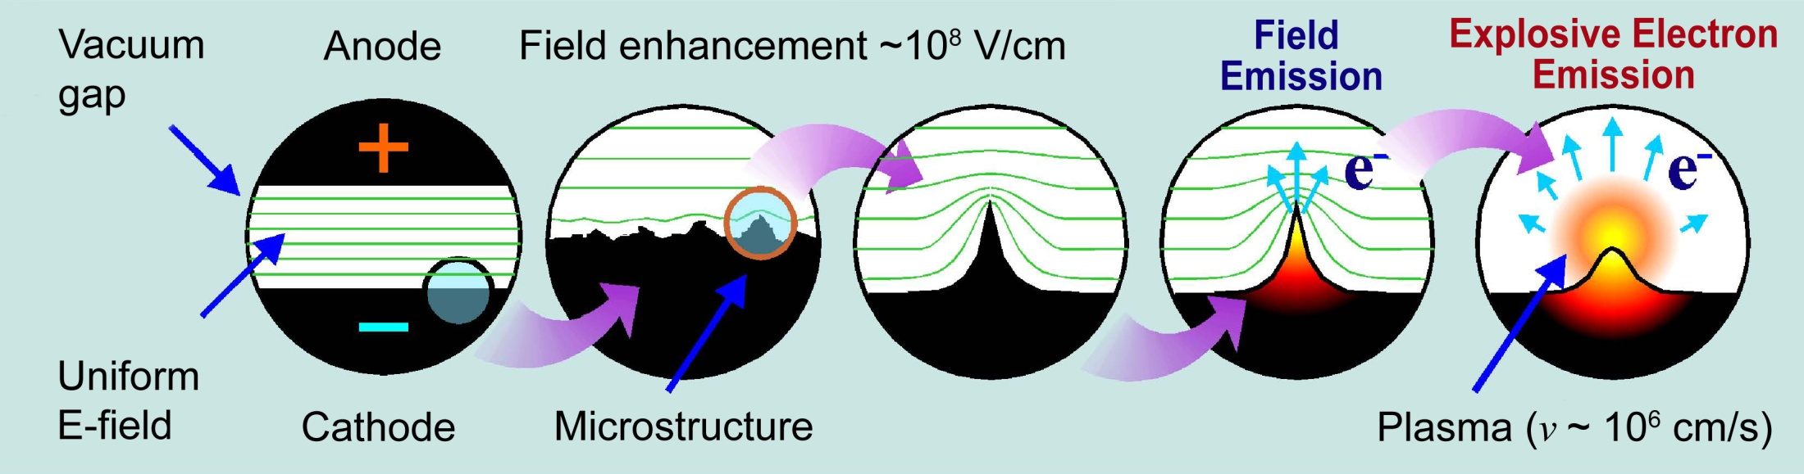
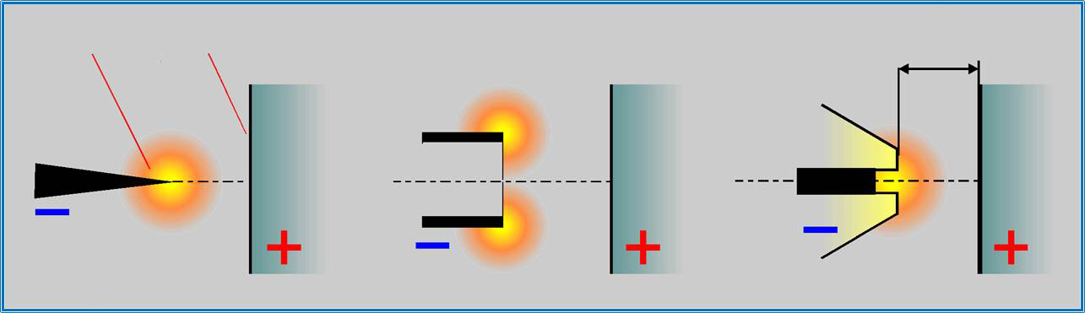
FIELD EMISSION –
EXPLOSIVE ELECTRON EMISSION TRANSITION
C
A
d
EFRE 2018

Slide 12
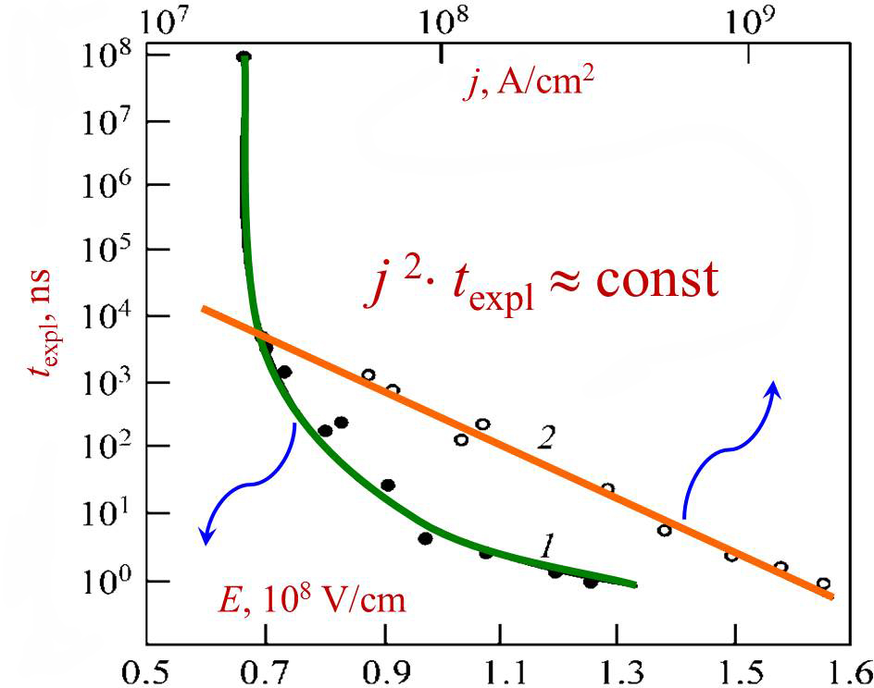
FIELD EMITTER EXPLOSION
Breakdown delay time measured from the application
of a voltage pulse to the explosion of the emitter
EFRE 2018

Slide 13
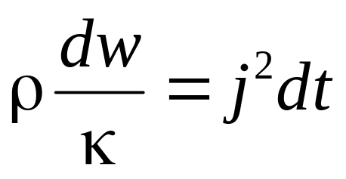
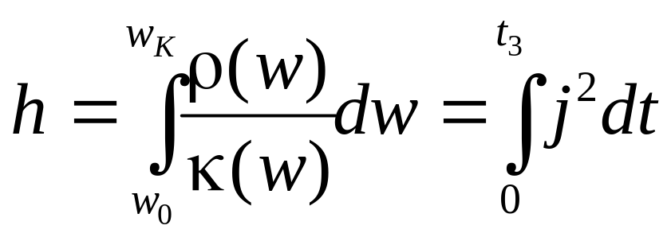
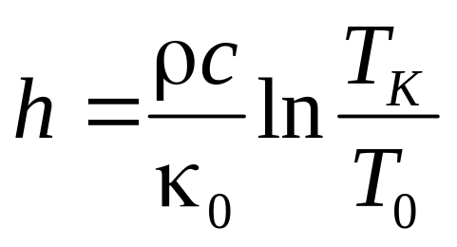
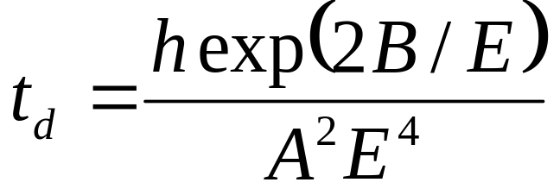
ELECTRICAL EXPLOSION
To transfer a material from one energy state to another,
a certain current action is required:
where κ – resistivity, ρ – mass density, w – input energy density.
For the conditions of adiabatic heating κ = κ(w), ρ = ρ(w)
where h – specific action of current.
For c = const, κ = κ₀T
EFRE 2018

Slide 14
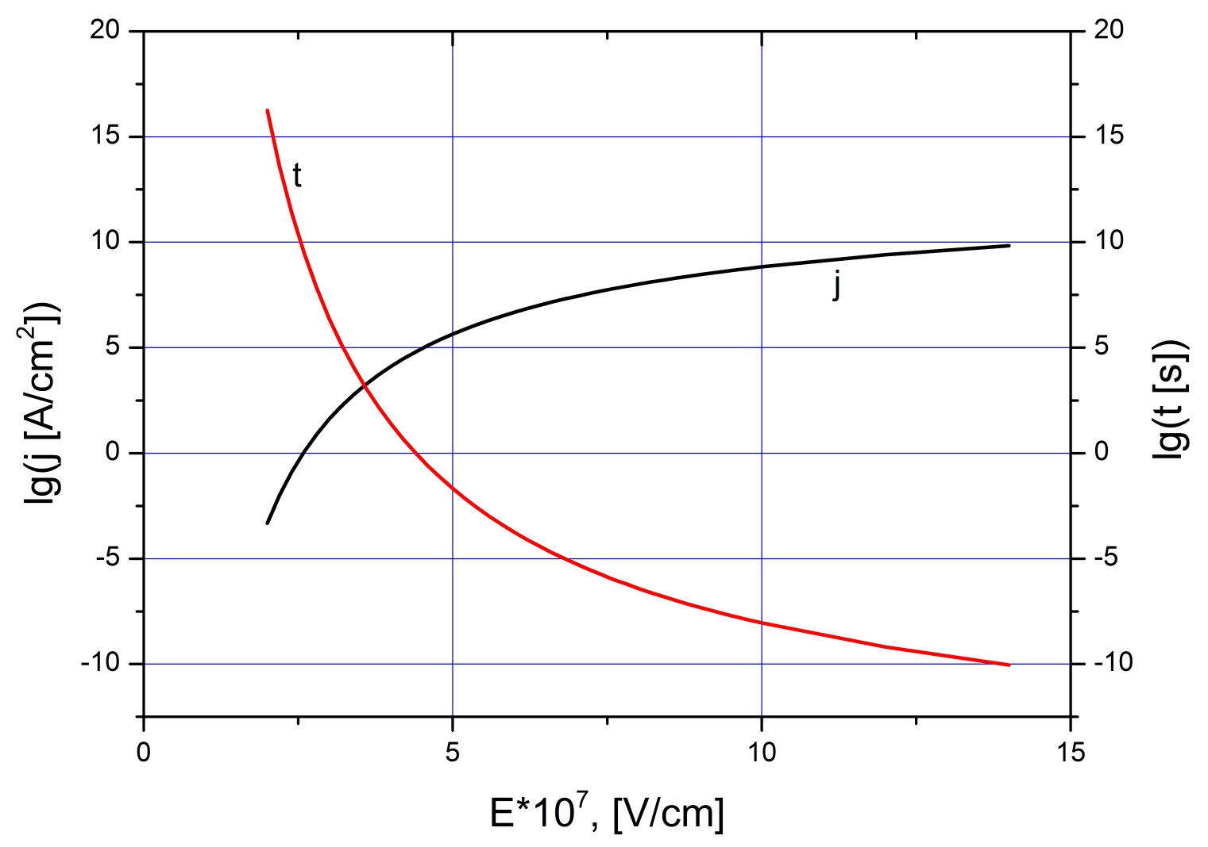
Current density j and micropoint explosion delay time t versus electric field E
EFRE 2018

Slide 15
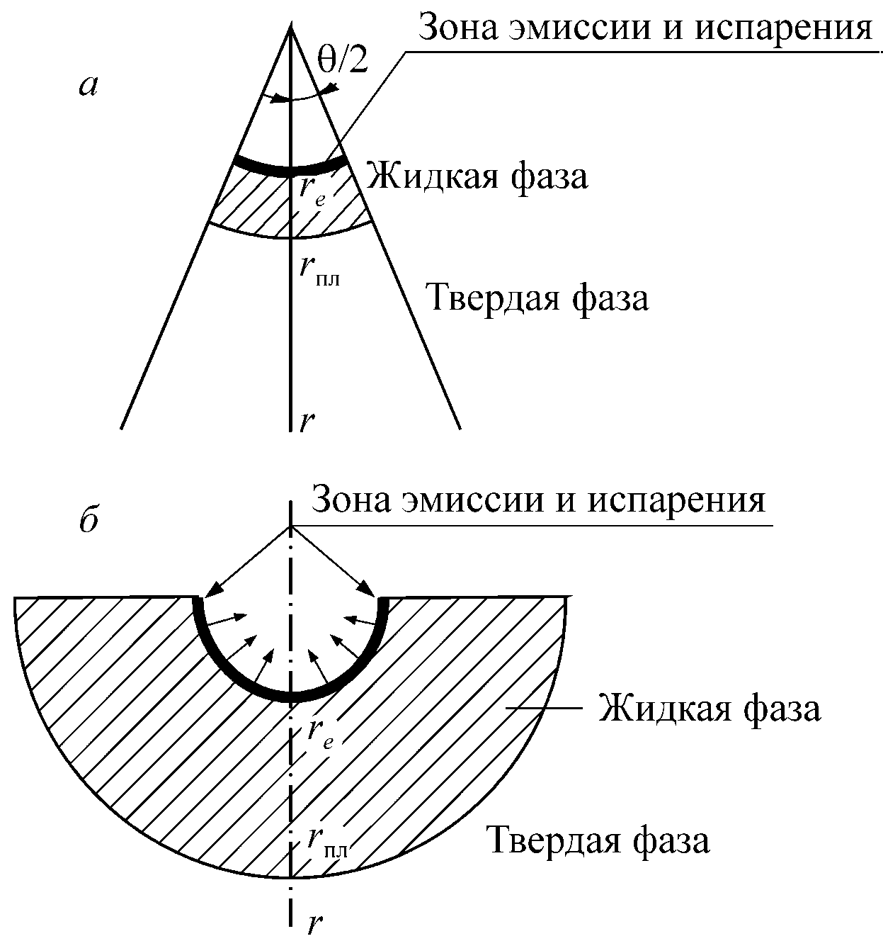
ECTON PARAMETERS
Emission & evaporation zone
Liquid phase
p
Solid phase
b
Emission & evaporation zone
Liquid phase
p
Solid phase
EFRE 2018

Slide 16
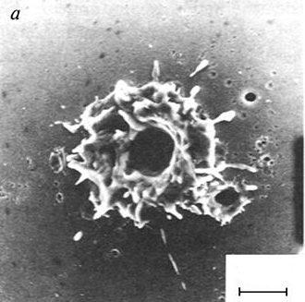
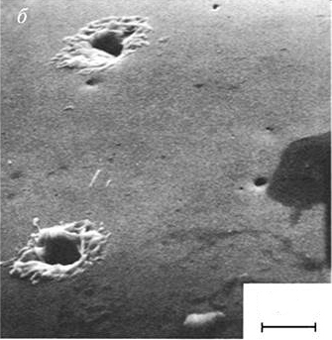
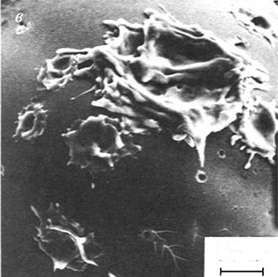
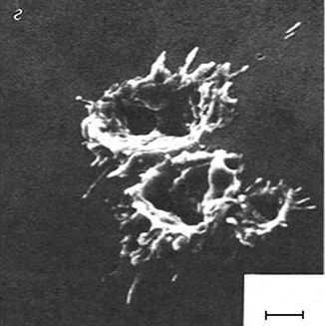
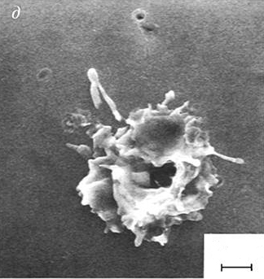
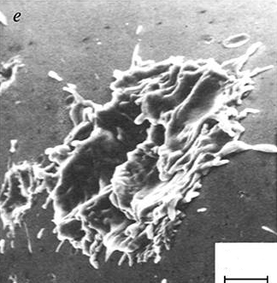
20 ns
50 ns
100 ns
5 μm
5 μm
5 μm
300 ns
1300 ns
5000 ns
2 μm
2 μm
5 μm
EFRE 2018

Slide 17
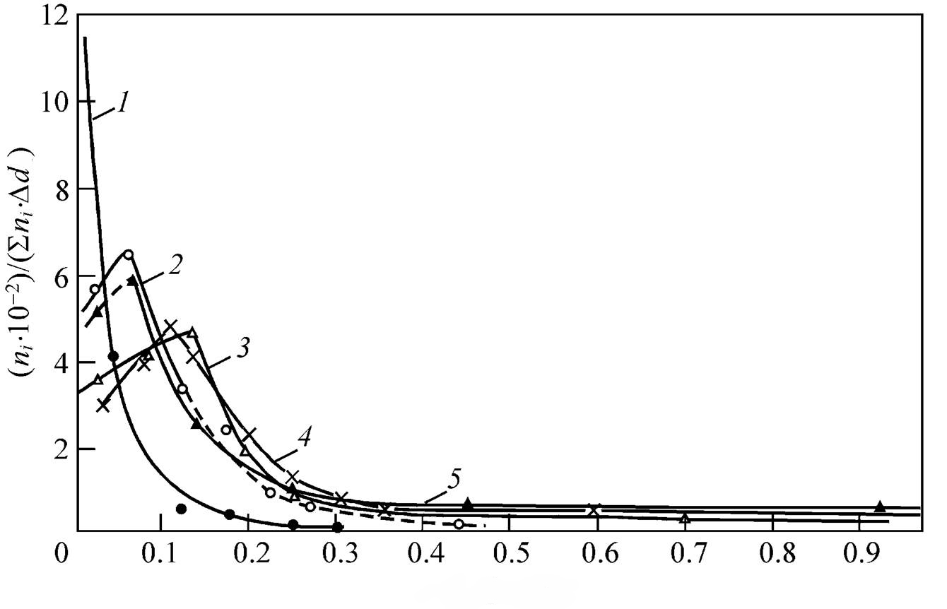
Dimensions of droplets
t_{p} = 10ns
t_{p} = 35ns
t_{p} = 50ns
t_{p} = 100ns
t_{p} = 300ns
d [μm]
Droplet diameter
EFRE 2018

Slide 18
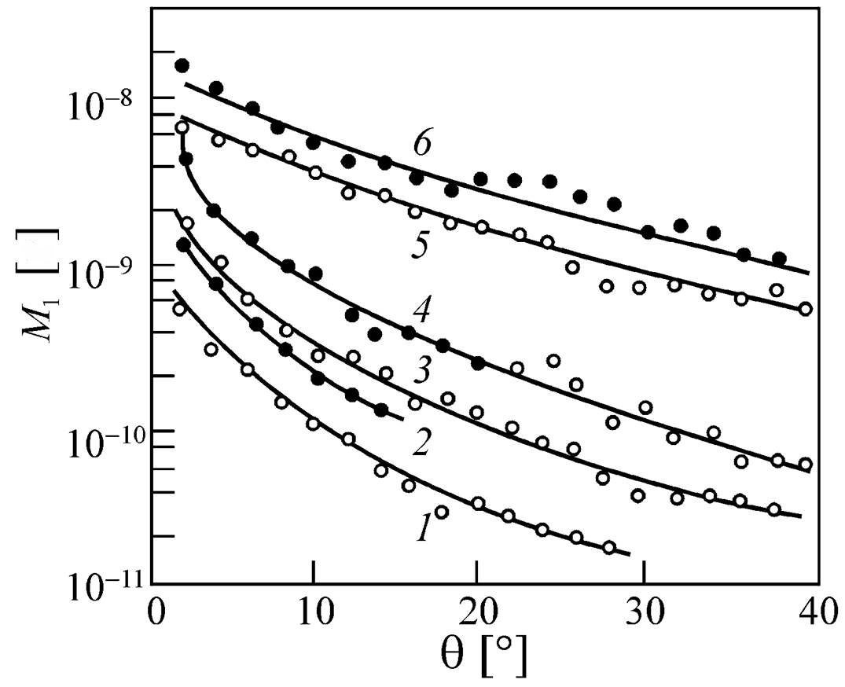
Removed mass
80ns
Mo
g
40ns
W
Mo
5ns
W
Mo
Mo
Cone angle
EFRE 2018

Slide 19
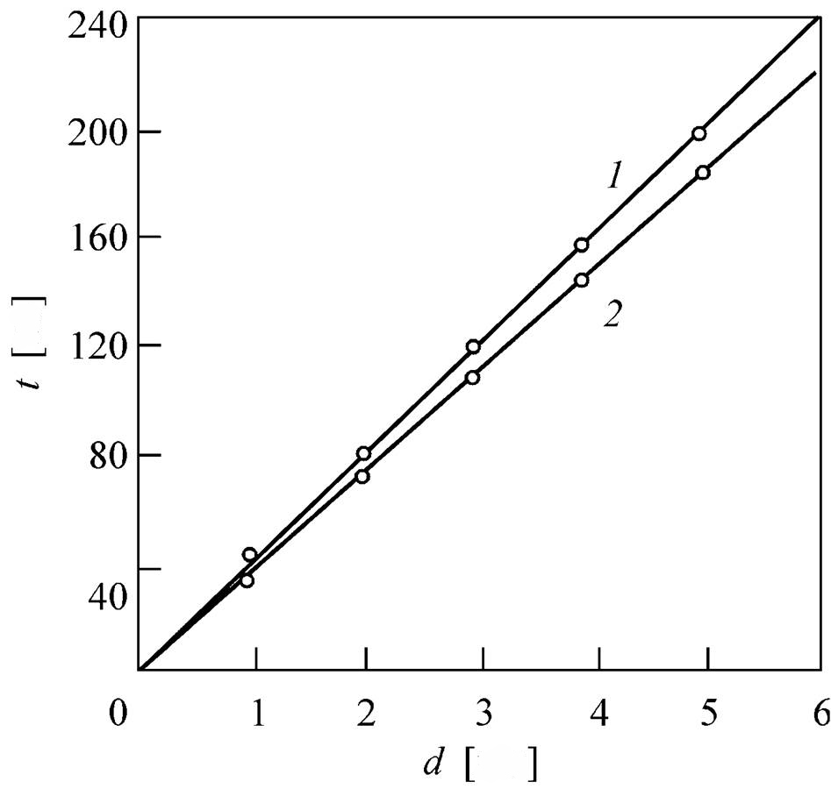
Breakdown development
Gap closure time
ns
v = d/t ≈ 2.5⋅10⁶cm/s
X-ray pulse duration
mm
Gap spacing
EFRE 2018

Slide 20
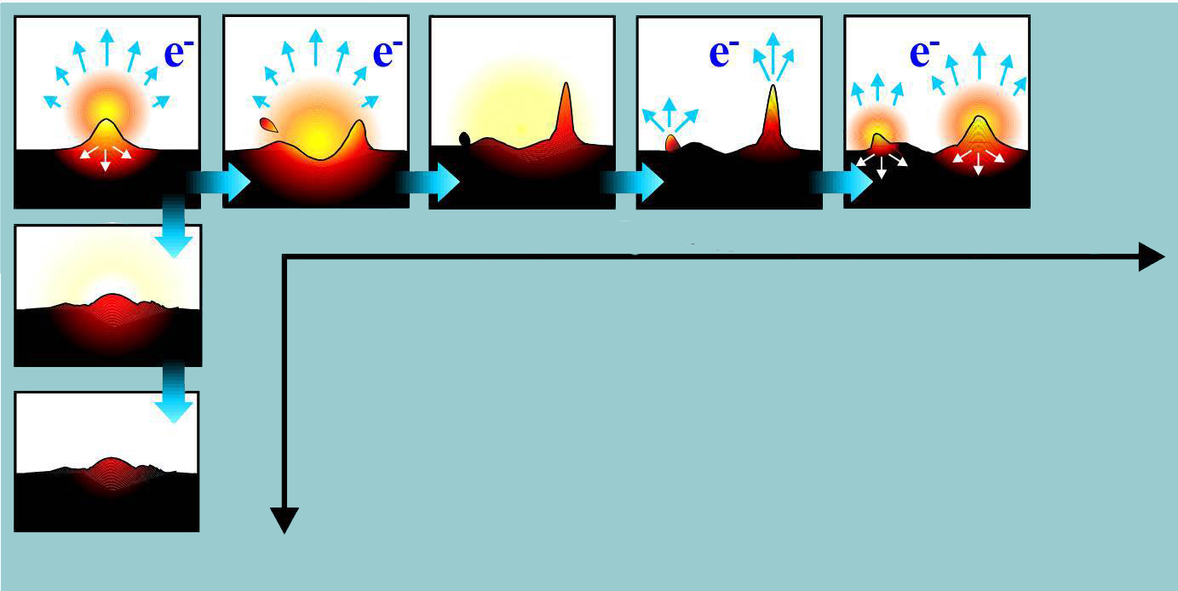
REGENERATION OF EXPLOSIVE EMISSION CENTERS
t, [ns]
Cathode “polishing”
Regeneration of emission centers on a cathode
t, [ps]
EFRE 2018

Slide 21
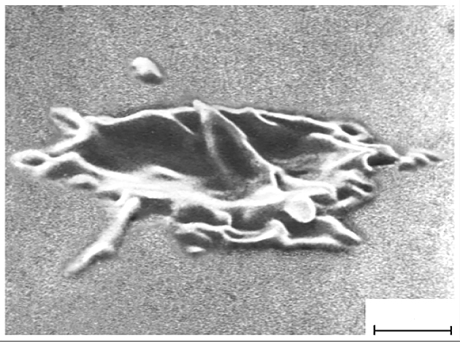
STRUCTURE OF VACUUM ARC CATHODE SPOT
1 μm
EFRE 2018

Slide 22
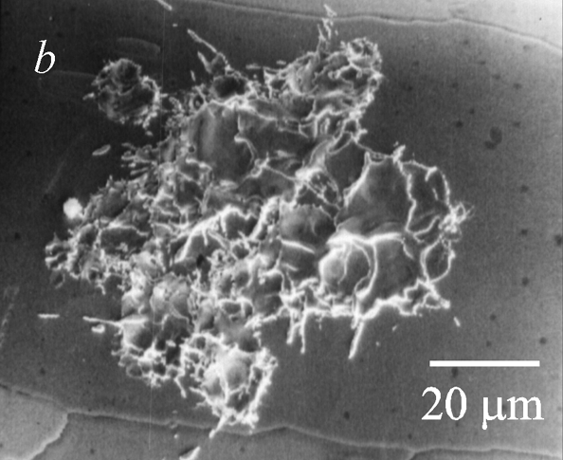
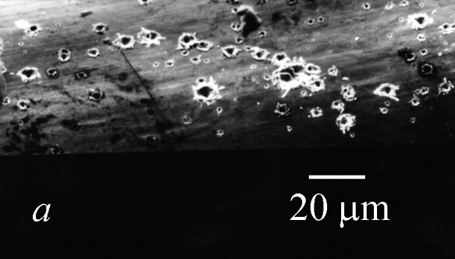
STRUCTURE OF VACUUM ARC CATHODE SPOT
Arc trace of cathode spot of first type (a) and second type (b).
gold cathode, current 5 A (a);
tungsten cathode, current 23 A, operation time 1.3 µs (b).
M.B. Bochkarev, A.M. Murzakaev, Proc. XVIIIth ISDEIV 244 (1988)
EFRE 2018

Slide 23
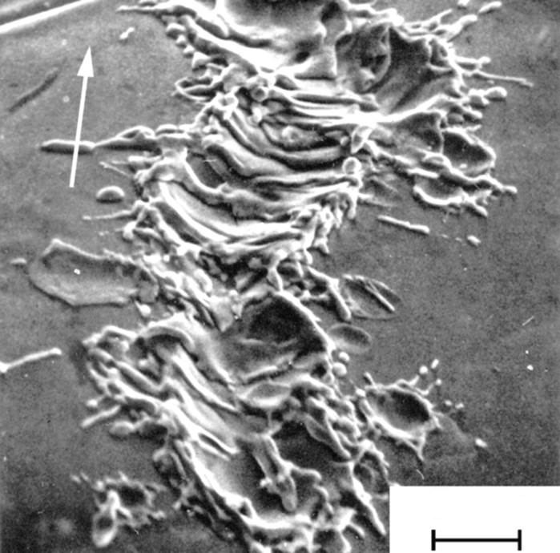
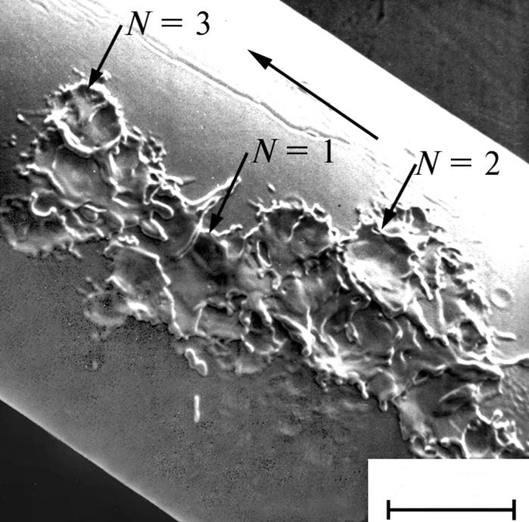
MOTION OF A CATHODE SPOT
B
B
Current = 45 А
N = number of spots
3 μm
25 μm
Retrograde (“anti-Ampere”) direction of motion
EFRE 2018

Slide 24
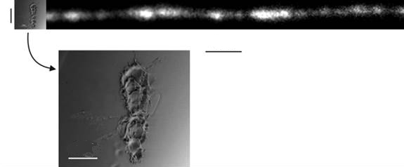
20 μm
10 ns
10 μm
Micrograph of the trace of a cathode spot and
a streak picture of the spot light (left to right)
for a 4-A arc
EFRE 2018

Slide 25
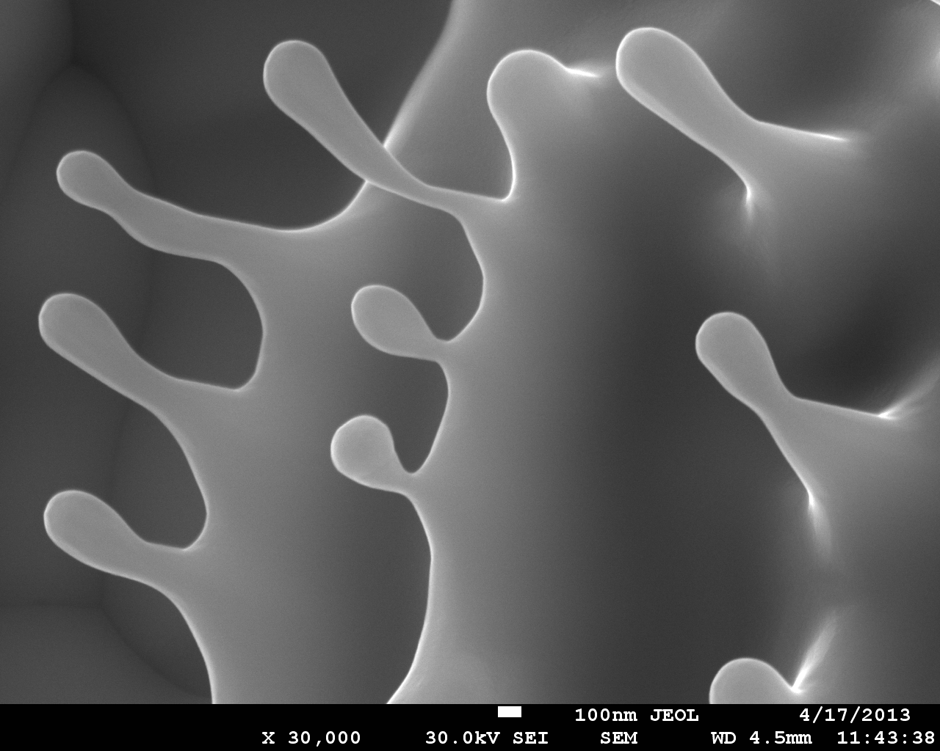
Fragment of a cathode spot on a tungsten cathode
EFRE 2018

Slide 26
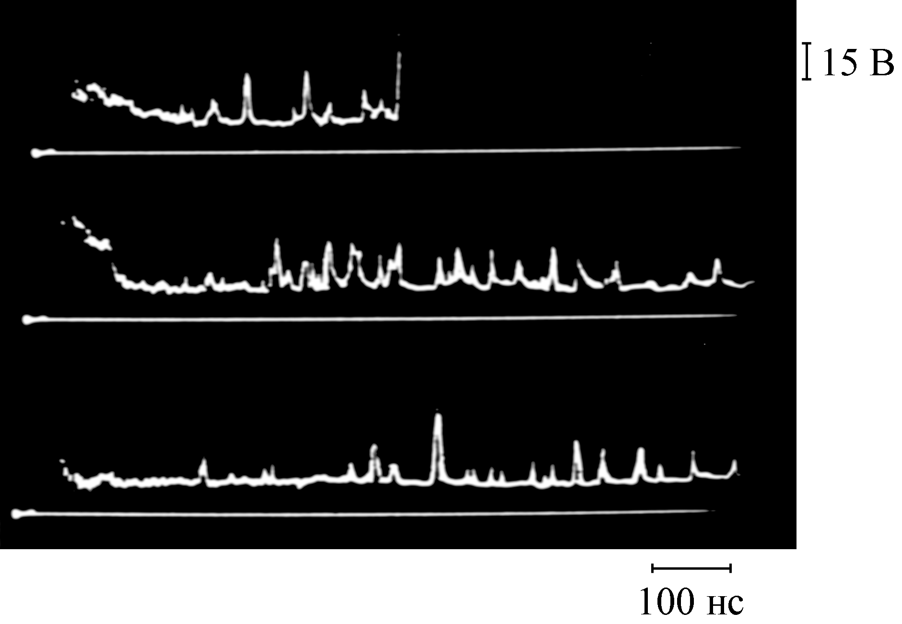
Voltage Fluctuations in a short arc
15 V
100 ns
EFRE 2018

Slide 27
Ectons in the physics of electrical discharges
Vacuum breakdown
Vacuum spark
Vacuum arc
Processes in electric contacts
Deviations from Paschen’s curve
Glow-to-arc transition
Unipolar arcs
Dielectric flashover
Runaway electrons in gas discharges
EFRE 2018

Slide 28
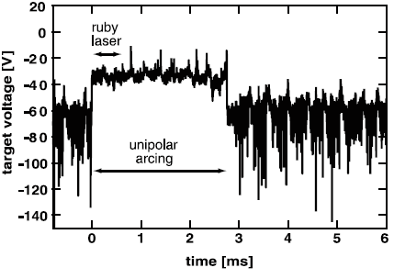
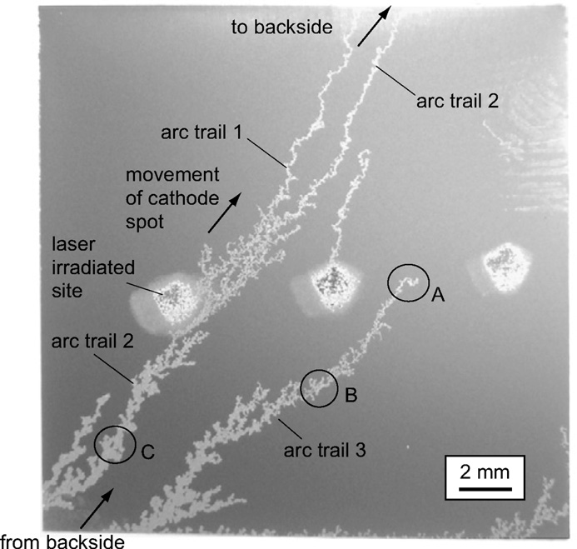
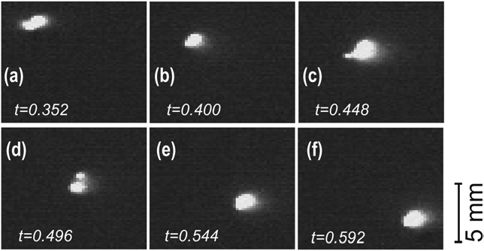
PROMPT IGNITION OF A UNIPOLAR ARC
S Kajita et al.
Nucl. Fusion 2009 49 032002, Phys. Lett. A 2009 373 4273.
Laser spot
EFRE 2018

Slide 29
Electron beam generators designed to produce high-power
x-ray, microwave, and pulsed lasers
EFRE 2018

Slide 30
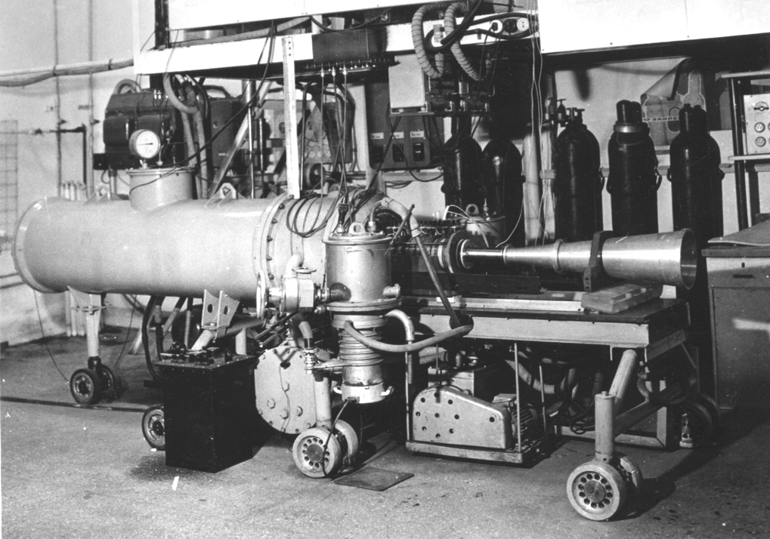
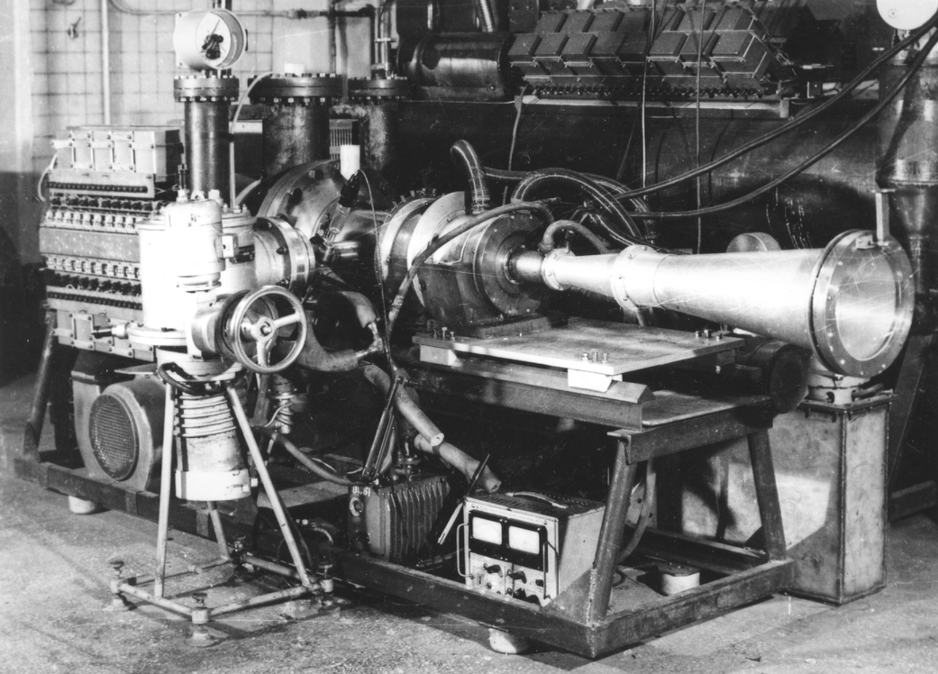
SINUS: REPETITIVELY PULSED HIGH-CURRENT ELECTRON ACCELERATORS (1970s–1980s)
SINUS-4, SINUS-5
Electron energy 370–420 keV
Beam current 2.5 kA
Pulse duration 25 ns
Pulse repetition rate up to 100 Hz
The accelerators were used
to produce high-power cm/mm
microwave pulses
EFRE 2018

Slide 31
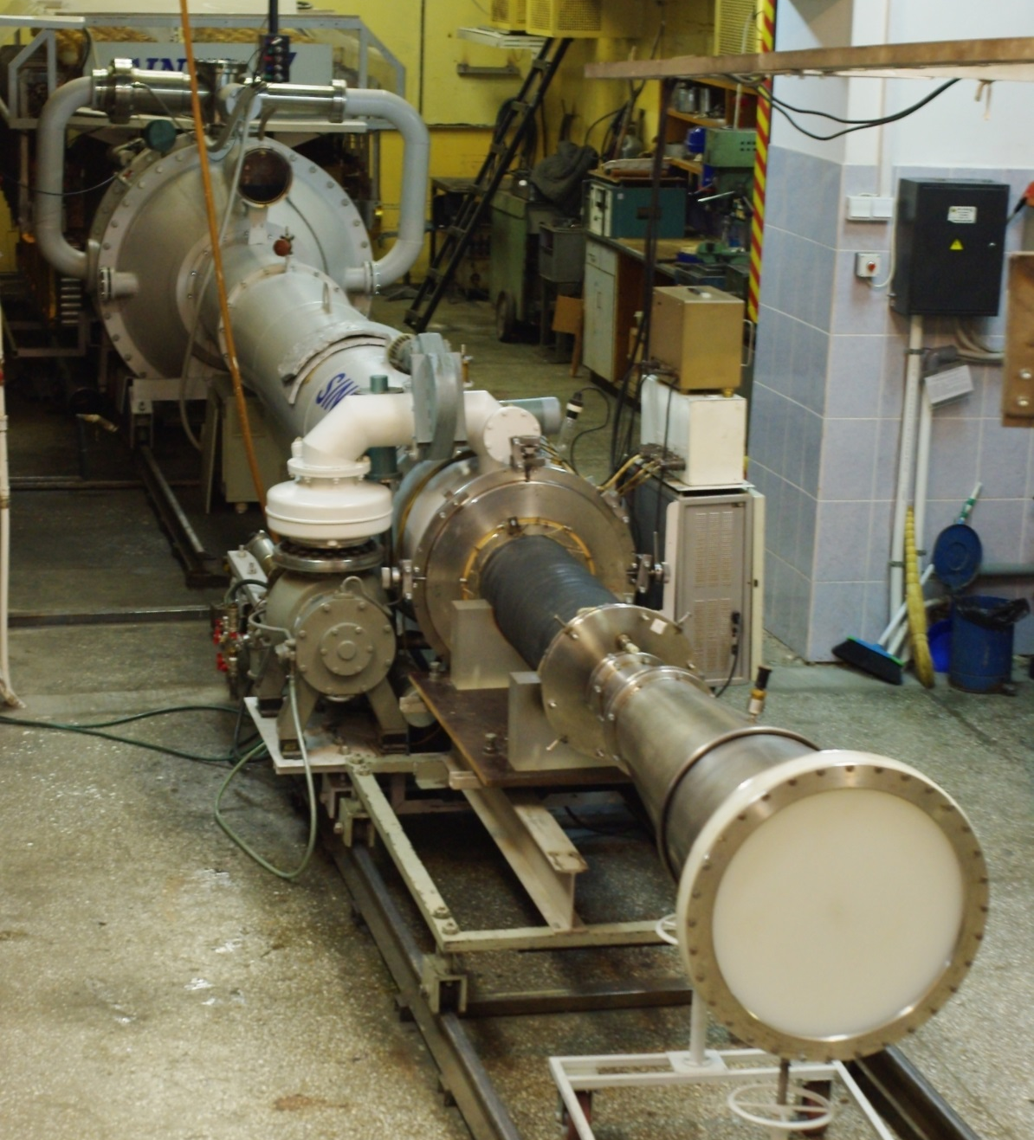
SINUS-7: REPETITIVELY PULSED HIGH-CURRENT ELECTRON ACCELERATOR
Spark gap gas flow system
Energy storage capacity
up to 2 kJ
Electron energy up to 2 MeV
Beam current up to 20 kA
Pulse duration 50 ns
Pulse repetition rate up to 100 Hz
The accelerator is being actively
used in experiments on
the generation of gigawatt
microwave pulses
Cm/dm microwave pulse
power up to 5–6 GW
Transmission line
Vacuum diode
Pulse-forming line
Solenoid and Microwave oscillator
Vacuum pumping system
Microwave radiating horn
EFRE 2018

Slide 32
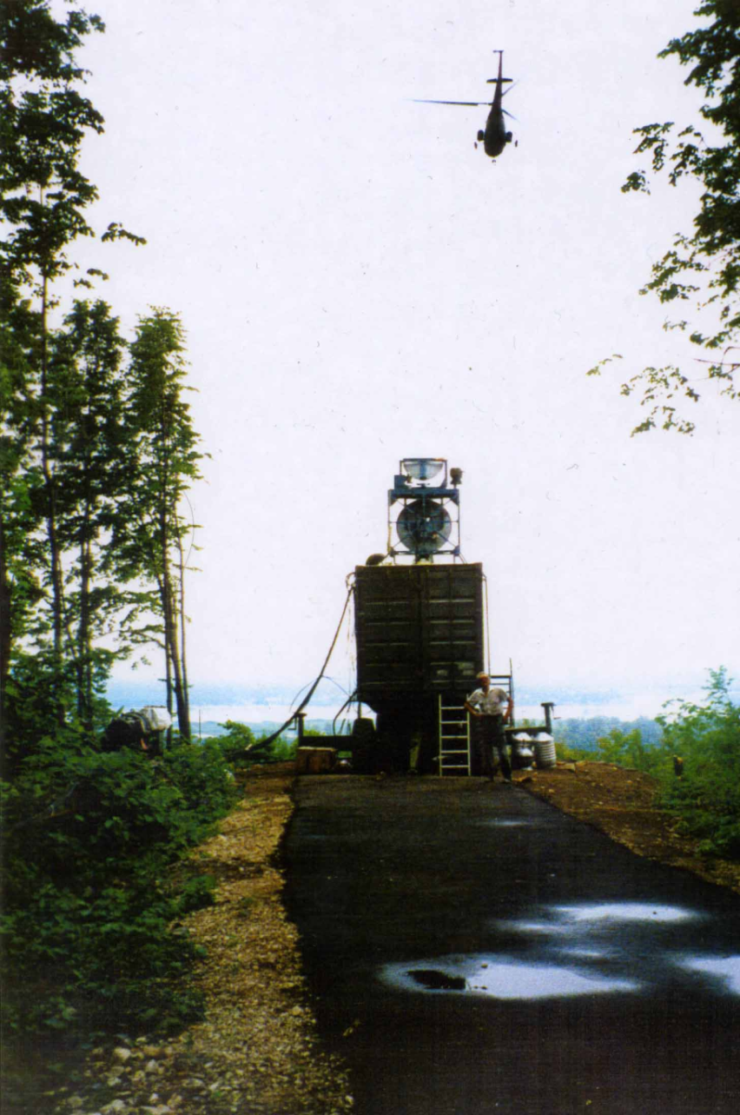
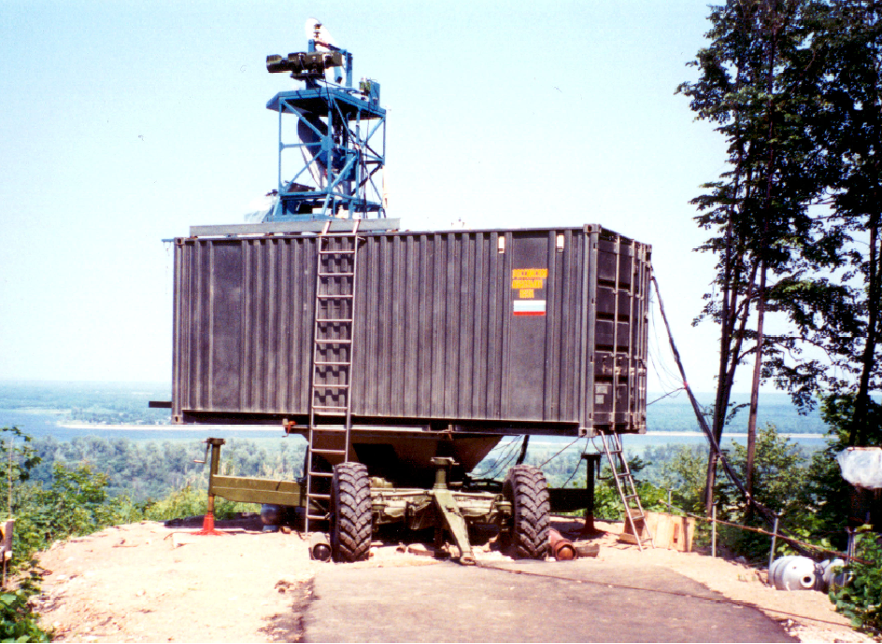
Magnetically insulated diodes of microwave oscillators
Experimental pulse radar prototype
based on a 10-GHz relativistic
microwave oscillator with a stable
explosive-emission electron injector
EFRE 2018

Slide 33
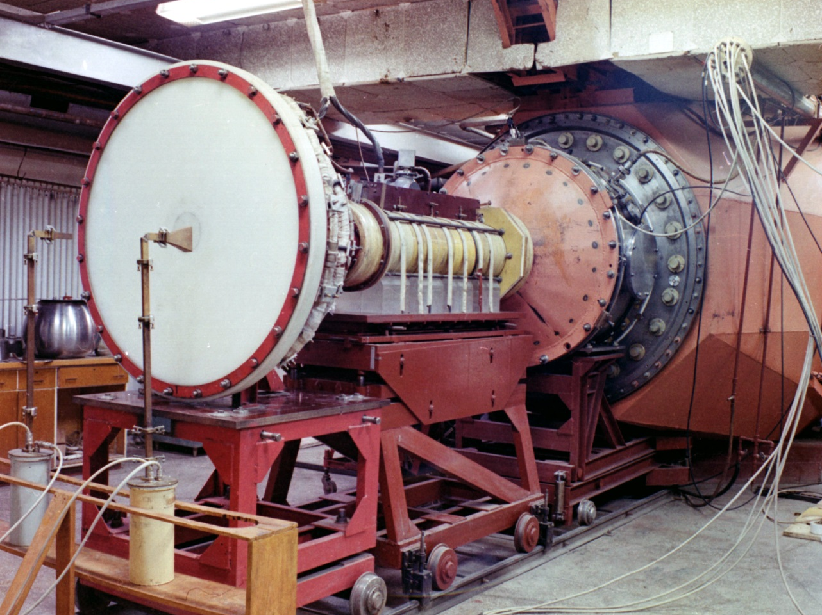
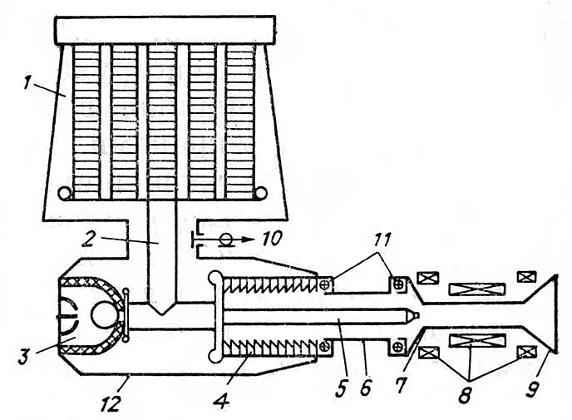
GAMMA: ELECTRON ACCELERATOR (1980s)
The electron accelerator is
based on a Marx generator.
Electron energy up to 2.2 MeV.
Beam current 30–100 kA.
Pulse duration 1–15 µs.
The electron accelerator was
used in experiments on the
generation of multigigawatt
microwave pulses
2
9
8
12
Output section of the accelerator
Schematic diagram of the GAMMA accelerator:
1 – Marx generator, 2 – transmission line,
3 – chopping spark gap, 4 – vacuum insulator,
5 – cathode holder, 6 – vacuum chamber,
7 – drift tube, 8 – solenoid, 9 – collector,
10 – voltage probe, 11 – current probe, 12 – case
EFRE 2018

Slide 34
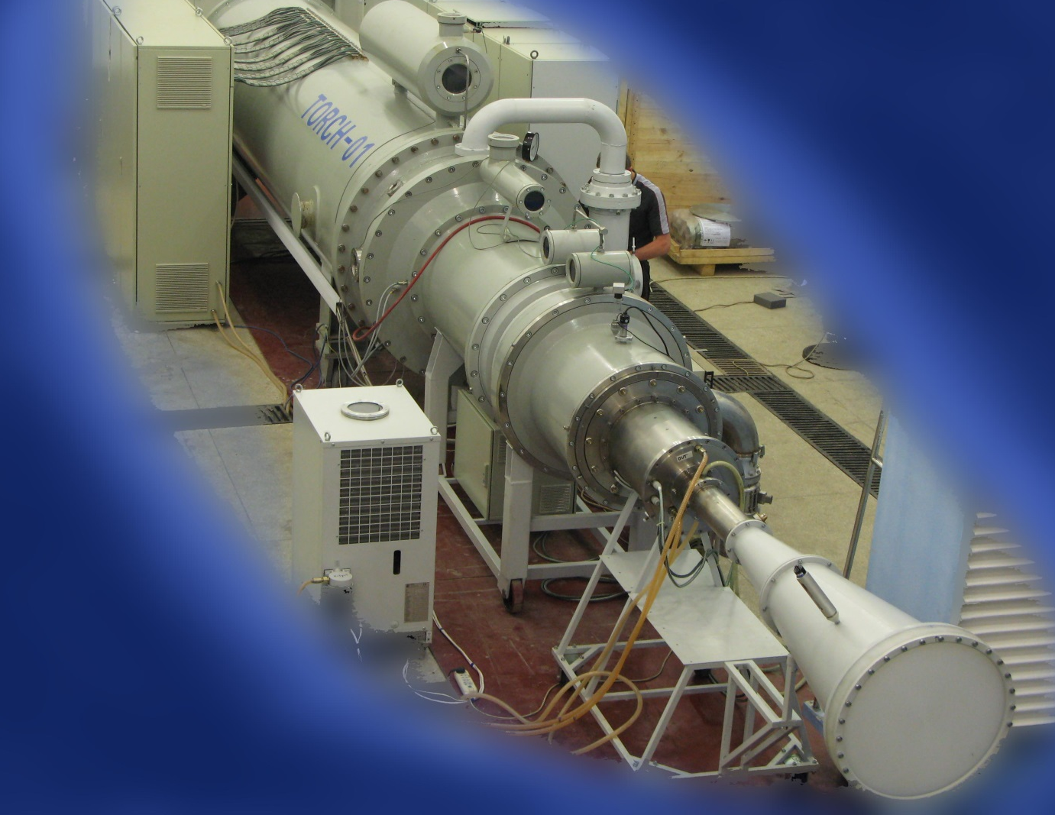
Microwave oscillator based on the SINUS 1200/50 high-current electron accelerator (delivered to China)
Beam current up to 20 kA, electron energy up to 1.7 MeV, pulse duration 55 ns
Peak radiation power up to 5 GW (1.6 GW at 100 Hz pulse repetition rate)
EFRE 2018

Slide 35
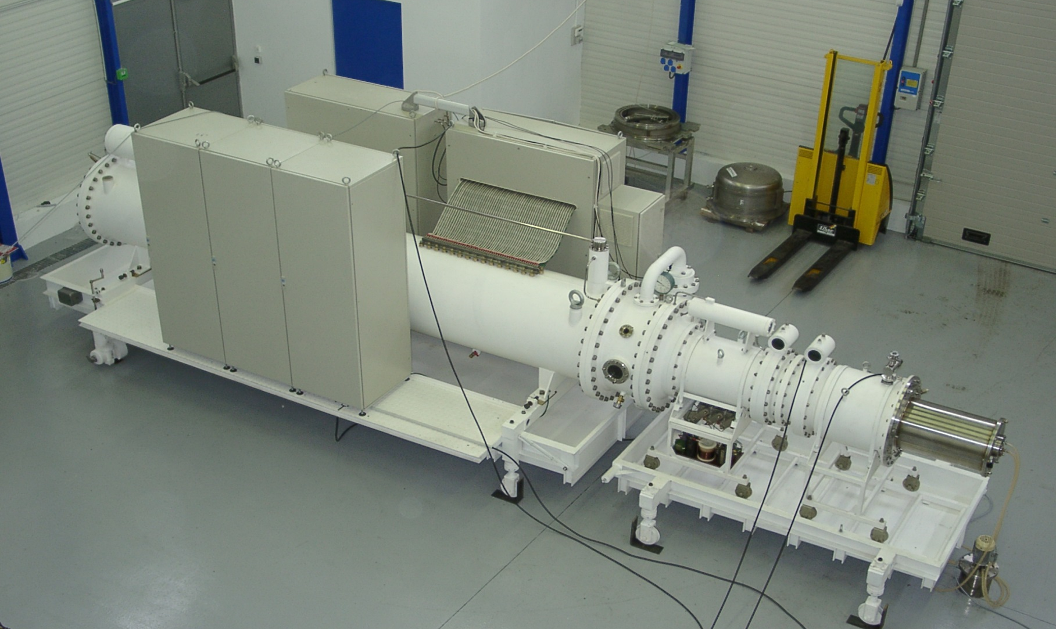
SINUS-90: Repetitively pulsed high-voltage generator (delivered to France)
Gas-flow spark gap
Load
Repetitive pulsed power supply
Pulse-forming line
Electron energy 450 keV, beam current 7.5 kA
Pulse duration 100 ns, pulse repetition rate 200 Hz
EFRE 2018

Slide 36


Participation of the Institute of High Current Electronics, SB, RAN in the SYRINX international project (France, Russia, USA, Israel, 1995)
The 10-stage Marx generator:
charge voltage 90 kV,
energy storage capacity 160 kJ,
current rise time 700 ns,
response time jitter 3 ns.
Load: plasma opening switch
Line pulse transformer modules:
voltage 90 kV, current 1 МА,
energy storage capacity 32 kJ,
current rise time 1 µs
EFRE 2018

Slide 37




High-power XeCl (308 nm) laser system producing 0.5 kJ of energy per pulse (2004)
PHOTON-5 (final amplifier)
Energy per pulse: 500 J in free oscillation
mode and 250 J in amplification mode.
The gas mixture is pumped by
an electron beam (500 keV, 300 kA)
PHOTON-4
Energy
per pulse 100 J
Pulse duration
200 ns
Active gas
volume 60 liters
(Ar–Xe–HCl,
2 bar)
PHOTON-3
Energy per pulse 10 J
Pulse duration 300 ns
Active gas volume
9×7×100 cm³ (Ne–Xe–HCl, 3–4 bar)
X-ray preionization
PHOTON-1
Energy
per pulse 3 J
EFRE 2018

Slide 38


Femtosecond XeF(C–A) laser amplifier (delivered to LPI, RAS)
Vacuum
Vacuum chamber
Xe
Cathode
XeF₂ + N₂
Foil
Xe chamber
Laser Cell
Lead from
Marx generator
Window
(CaF₂)
Schematic of the cross-sectional
area of the amplifier output unit
EFRE 2018

Slide 39


Multiterawatt laser pulse amplifier with a gaseous active medium (XeF(C–A), 475 nm)
(final amplifier of the THL-100 hybrid laser system)
High-current pulse source:
two line transformers.
An electron beam (500 keV, 300 kA)
injected into xenon generates VUV
radiation (170 nm), which is used for
photodissociation pumping of
the C-level of XeF excimer molecules
Line pulse transformers
Schematic of one of
the transformers and
the center laser unit
with a vacuum diode
EFRE 2018

Slide 40

The final amplifier of the THL-100 laser system forms
an indigo radiation pulse of power 20 TW and duration 50 fs
EFRE 2018

Slide 41

Simplified schematic of the output unit of a laser pumped by a high-current electron beam (coaxial version)
explosive-
emission
cathode
to Marx generator
foil
window
electron beam
semireflecting
mirror
totally
reflecting
mirror
gaseous
active
medium
laser radiation
vacuum
to Marx generator
EFRE 2018

Slide 42


RADAN: COMPACT PULSE GENERATORS
Generator characteristics:
Impedance……………20–50 Ω
Output voltage……....150–300 kV
Pulse duration……….2–5 ns
Pulse repetition rate..10–100 Hz
Pulse power………….300–800 MW
Mass……………………8–27 kg
RADAN-150 –
RADAN-220 series
Loads: sealed-off electron and
x-ray tubes, wide-aperture
electron diodes, and magnetically
insulated diodes
RADAN-303
EFRE 2018

Slide 43

Magnetically insulated diodes of microwave oscillators
Compact relativistic 38-GHz and 70 GHz microwave oscillators
with stable cold-cathode electron injectors
EFRE 2018

Slide 44

RADAN-303B-based sterilizer
The dual radiation source
with the case removed
RADAN-303B-based desktop setup
for laboratory elaboration of radiation
processing and surface sterilization
technologies.
Electron energy 150 keV, mass 60 kg
Protection cell with the door open
EFRE 2018

Slide 45



CATHODOLUMINESCENCE SPECTRUM ANALYZER
Luminosity of the crystal luminescence centers is proportional to the power of the exciting e-beam.
A short high-power electron beam is used for nondestructive precision spectral analysis.
Natural
corundum
Synthetic
corundum
Luminosity
Luminosity
Impurity
crystals
Wavelength, nm
Wavelength, nm
EFRE 2018

Slide 46


RADAN: PORTABLE HIGH-POWER MILLIMETER MICROWAVE OSCILLATORS
Quasistationary relativistic
8-mm BWT:
Microwave power 20–100 MW
Pulse duration 3 ns
Pulse repetition rate up to 10 Hz
Nonstationary relativistic
8-mm BWT:
Microwave power 300–1000 MW
Pulse duration 0.3 ns
Pulse repetition rate
up to 3.5 kHz
EFRE 2018

Slide 47








PORTABLE PULSED X-RAY GENERATORS
The small-sized portable nanosecond and
subnanosecond 100–200-keV generators
are intended for research and practical uses
Portable x-ray flaw detector
Self-contained x-ray introscope
X-ray Film
Cassette
Subnanosecond x-ray apparatus
EFRE 2018

Slide 48

PROCESSING SYSTEMS BASED ON NANOSECOND
ELECTRON ACCELERATORS
The SINUS-6 accelerator
as a unit of the stand
for thorough elaboration of
laquer coating polymerization
technology
Electron energy: 400 keV
E-beam current: 8 kA
Pulse duration: 25 ns
Pulse repetition rate: up to 400 Hz
EFRE 2018

Slide 49

PROCESSING SYSTEMS BASED ON NANOSECOND
ELECTRON ACCELERATORS
Electron-beam sterilizers
for powder materials
based on compact accelerators
of the SINUS series
Designated areas:
drug and food production
Can be used for sterilization
of thermolabile powders
EFRE 2018

Slide 50










Since 1970s…

Slide 51
THANKS FOR ATTENTION !

