Slide 1
HIRING AND FIRING
Tomsk Polytechnic University
Institute of International Education and Language Communication
Language Training Resource Centre
Tomsk - 2016

Slide 2

REAL READING 1 with answers
Feel more confident reading in English. A range of tasks based on real-life situations and texts will give you confidence in any situation
Develop strategies for reading difficult texts.
Learning tips throughout the book will help you develop the reading skills that you need.
Check your progress.
A unit-by-unit checklist, based on the ALTE Can-do statements, lets you see what you have learned - and feel proud of it!
This book also gives you:
- cultural notes, helping you to feel comfortable in the English-speaking world
- the chance to take your learning off the page and into your daily life, through extra "real world" practice tasks. - extra tasks for pair and group work, giving you even more opportunities to get it right!
Published 2010

Slide 3
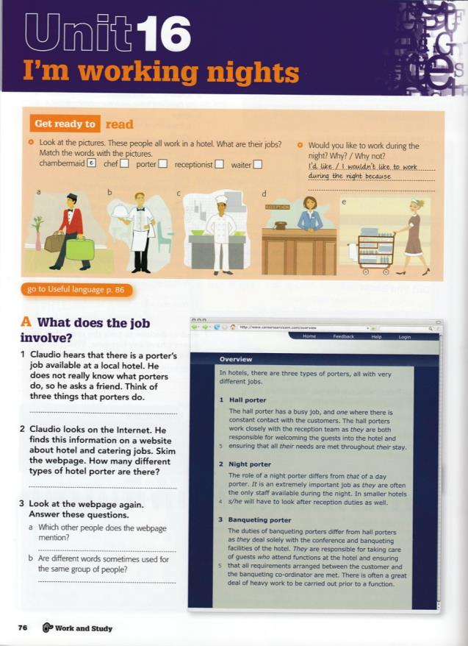
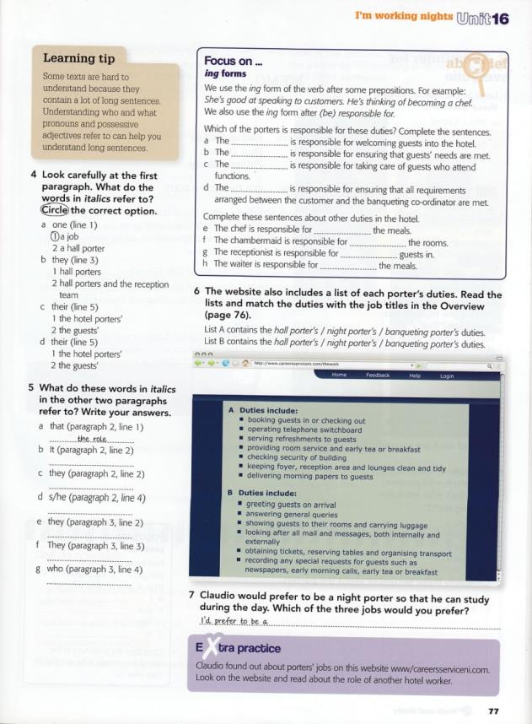
REAL READING 1 with answers

Slide 4

REAL READING 3 with answers
Learners can develop the skills they need to read English confidently wherever they are - at home, at work, travelling, studying or just in social situations with English-speaking friends. This edition comes with answers
Real-life topics and situations give learners a sense of purpose, right from the start
‘Did you know?’ boxes provide cultural notes to help learners put what they’ve learned into context
‘Class bonus’ tasks for pair and group work allow teachers to adapt materials to suit their classes and give students even more opportunities to get it right!
Published 2010

Slide 5
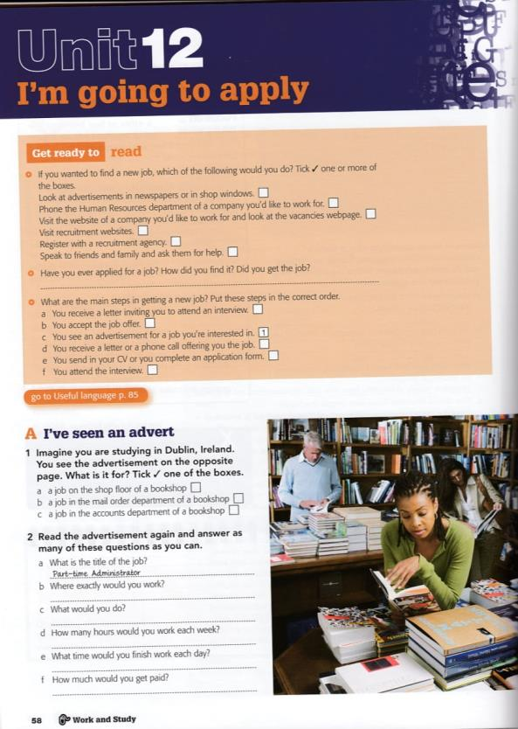
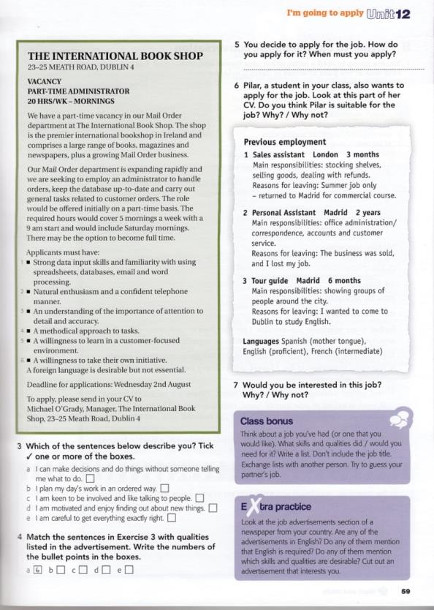
REAL READING 3 with answers

Slide 6

REAL WRITING 4 with answers
Do you feel unprepared for everyday life in an English-speaking world? REAL WRITING is just what you need
You can develop the skills you need to write confidently in any situation - whether you're completing a form or sending an email
Activities based around the themes of Social and Travel and Work and Study cover a range of everyday situations and really help you to feel sure of the English you're using in your daily life
Published 2010

Slide 7
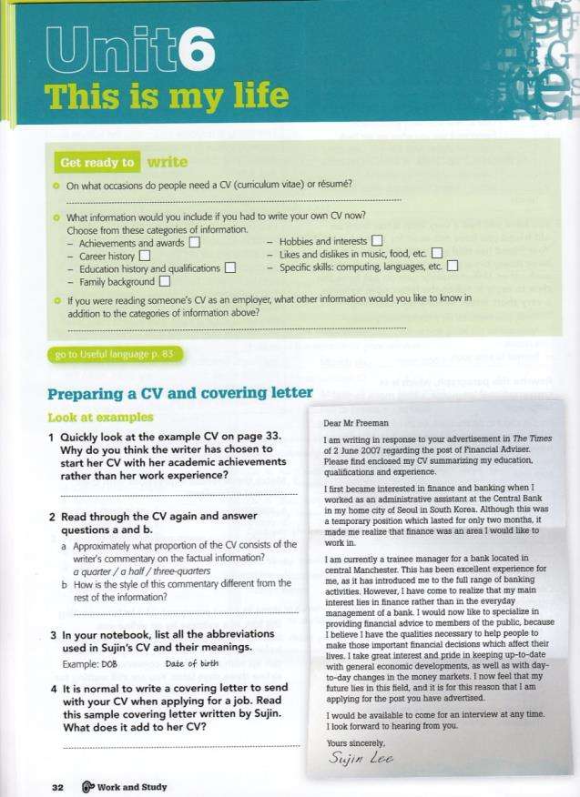
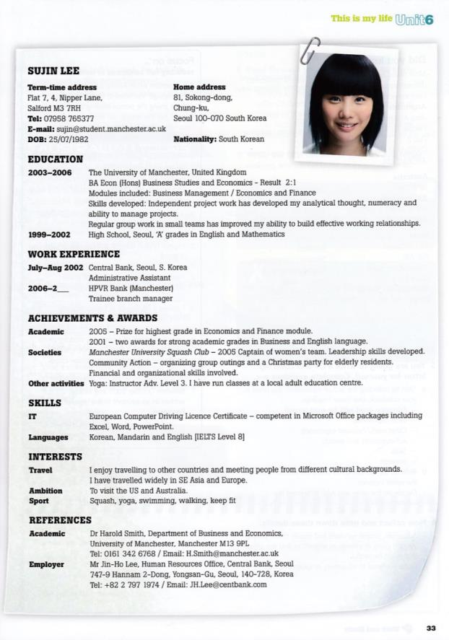
REAL WRITING 4 with answers

Slide 8

ENGLISH FOR BUSINESS STUDIES
English for Business Studies is a course for upper-intermediate and advanced level students who need to understand and talk about the key concepts in business and economics
The Second Edition of this best-selling business English course contains two new units, Information technology and electric commerce and Enterpreneurs and venture capital.
Each of the 30 units provides two to three hours’ work, with content that develops all four skills
Core reading texts to explain the basic content
Authentic interviews for listening comprehension
Systematic vocabulary development
Variety of speaking activities
Published 2002

Slide 9
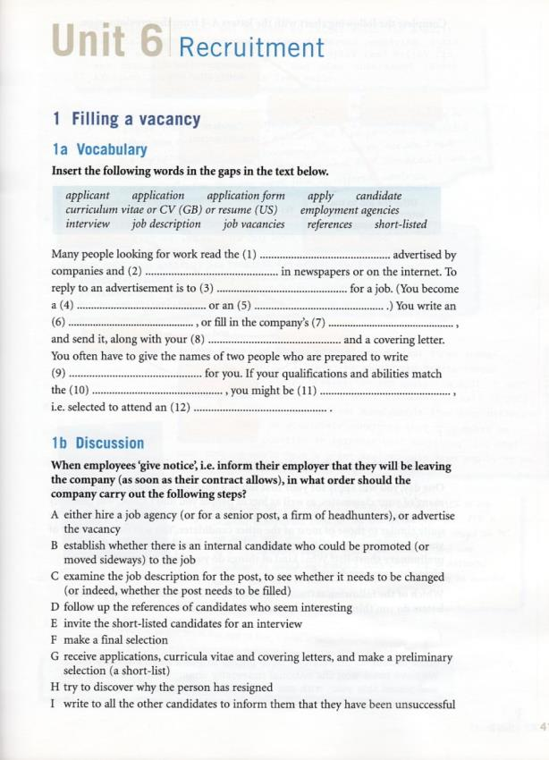
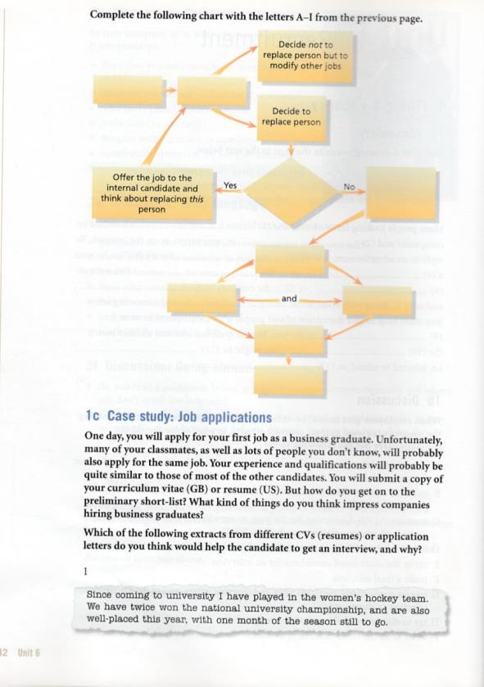
ENGLISH FOR BUSINESS STUDIES

Slide 10
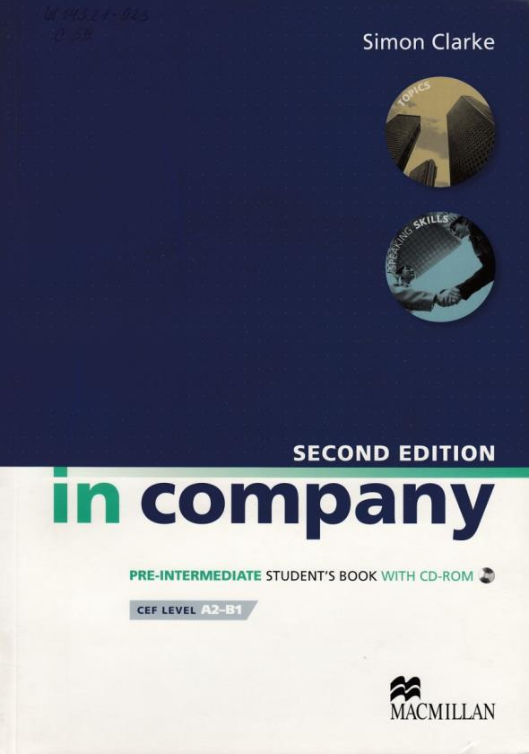
IN COMPANY pre-intermediate
In is the English course for professionals because of its immediate results through topic-based content, active skills, and real-world tasks that are instantly relevant to everyday business life development.
In Company Second Edition contains 20 units with a host of new features:
Phrase banks for reference and revision
5 new case studies (Student's Book)
Clearly defined topic- or skills-based units (Student's Book)
A variety of global accents (Class Audio) Tips for 1:1 teaching (Teacher's Book)
Interactive glossary and class audio as an MP3 download (Student's Book CD-ROM)
Photocopiable case studies for all levels (In Company Case Studies)
Published 2010

Slide 11

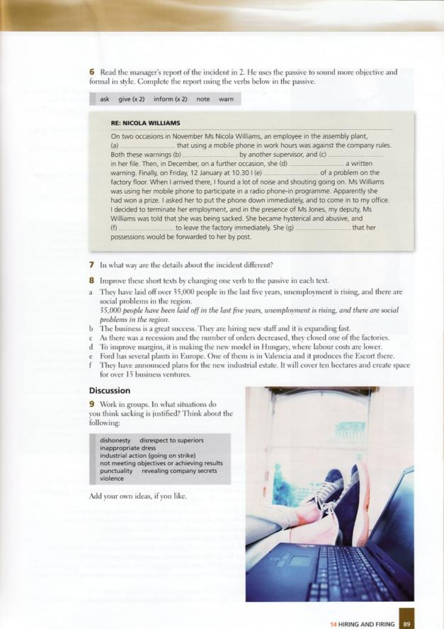
IN COMPANY pre-intermediate

Slide 12

BUSINESS ONE:ONE advanced
Business one:one is the first business English course written specifically for teaching and learning one-to-one
Business one:one encourage teacher and learner to work together as equal partners
Includes discussion, reading, listening and grammar banks.
Published 2008

Slide 13
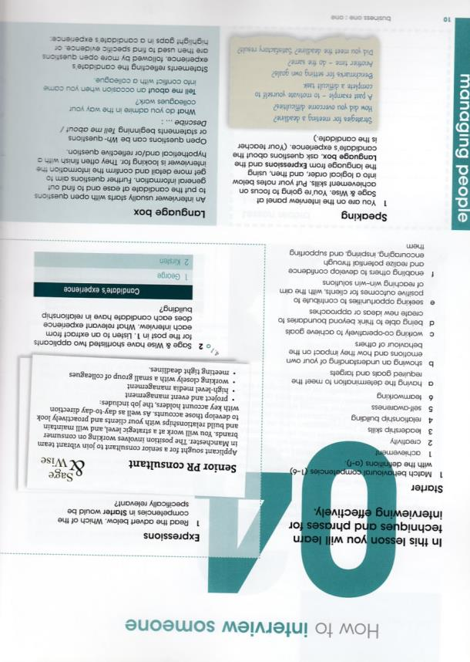
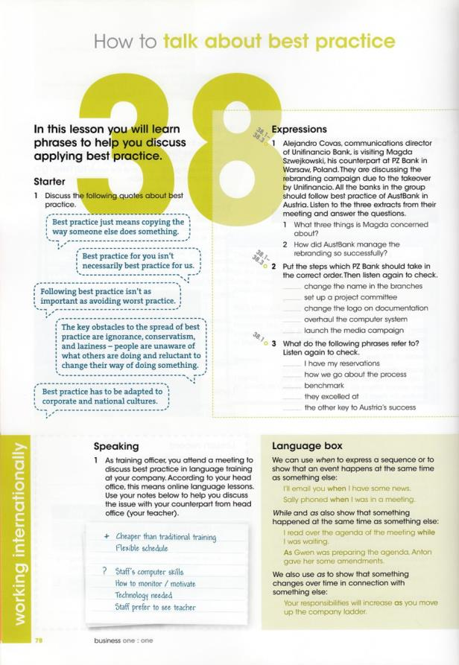
BUSINESS ONE:ONE advanced

Slide 14

ProFILE intermediate
Profile is a three-level course for people who want to discuss different areas of business – and improve their business English at the same time.
Profile has the right combination of specialist language and business content to help students to communicate in English
Contains 12 units dealing with a range of business topics: communication, marketing. Innovation, etc.
Published 2008

Slide 15
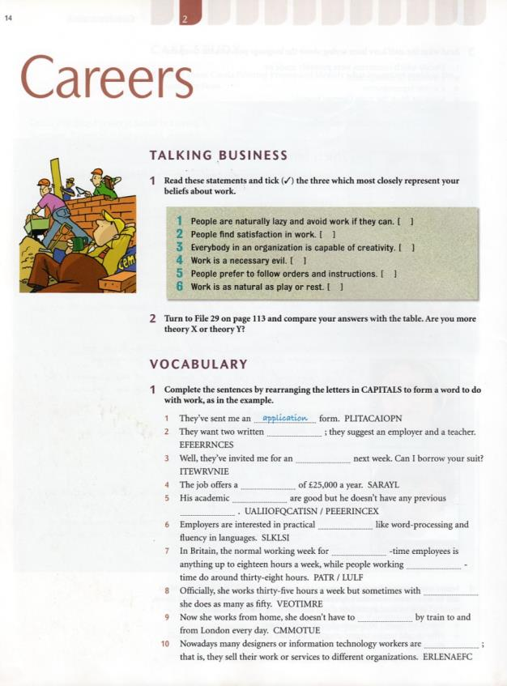
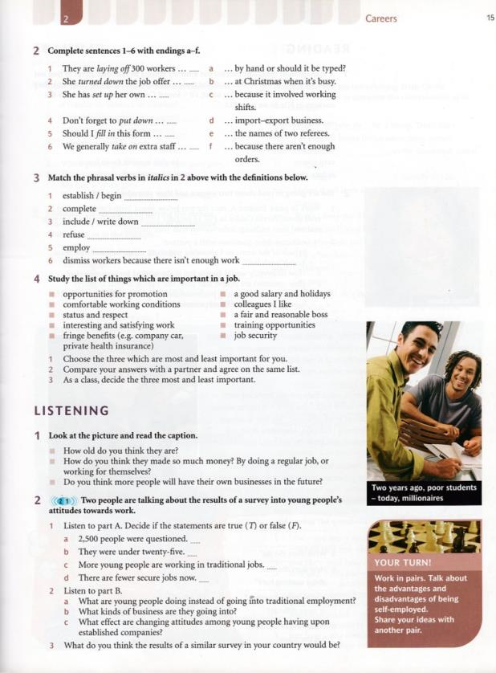
ProFILE intermediate

Slide 16

NEW ENGLISH FILE intermediate
The Intermediate course that gets students talking, and that helps teachers and students more than any other
Fun, motivating lessons that work
A complete package for teachers and students
Grammar-Bank with rules and exercises
Illustrated Vocabulary Bank and Sound Bank
Published 2006

Slide 17
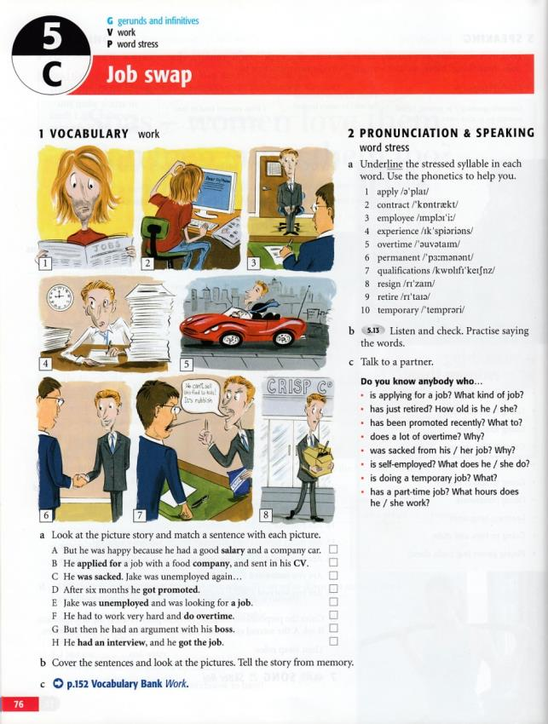
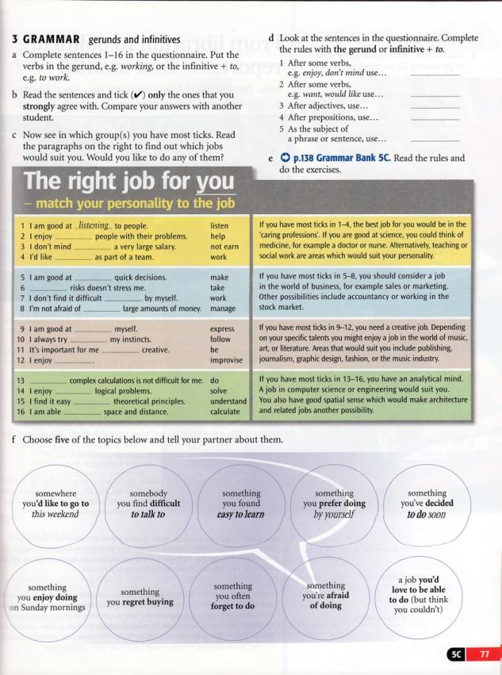
NEW ENGLISH FILE intermediate

Slide 18

UPSTREAM pre-intermediate
Upstream is a modular course for learners of the English language at CEF B1 level.
Upstream comprises theme-based units form a wide variety of authentic sources in 5 modules
A variety of cross cultural topics
Lexical exercises
Stimulating reading and listening tasks
Study skills tips
Curricular and Self-Assessment sections at the end of each module
Grammar sections
Songs
Published 2011

Slide 19
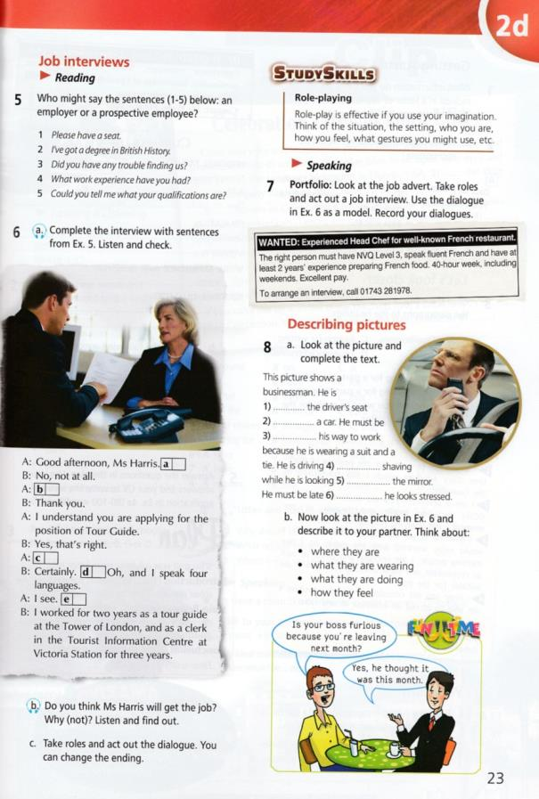
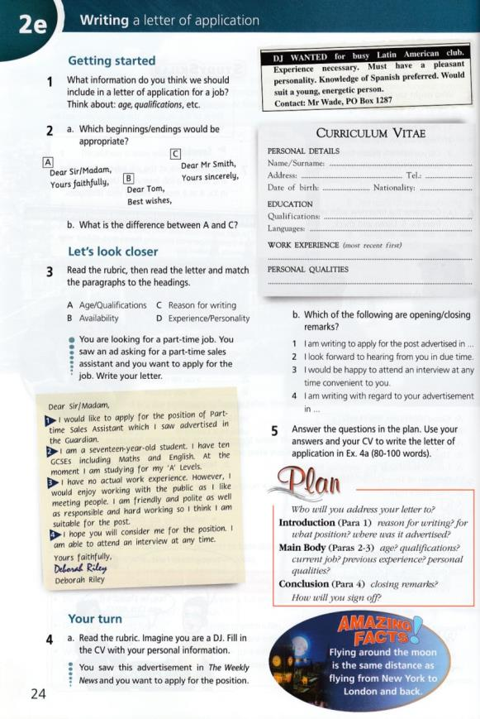
UPSTREAM pre-intermediate

Slide 20

Upstream advanced
Upstream is a modular secondary-level course for learners of the English language at CEF C1 level.
The series combines active English learning with a variety of lively topics presented in themed units.
Exam and study skills tips
Systematic development of all 4 language skills through realistic, challenging tasks
Practice in exam-style exercises for all 5 papers in the CAE exam
Published 2007

Slide 21
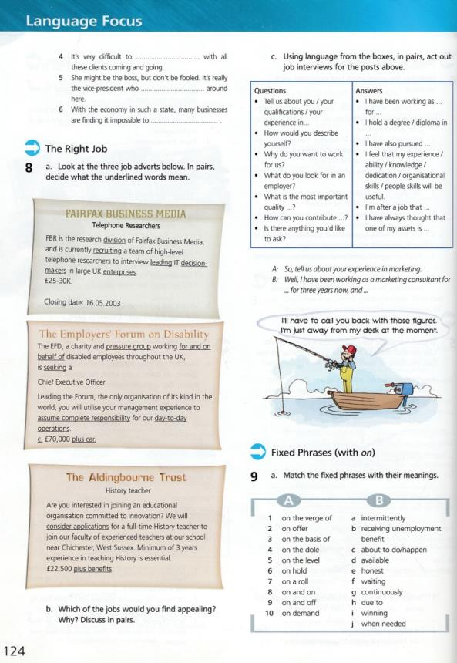
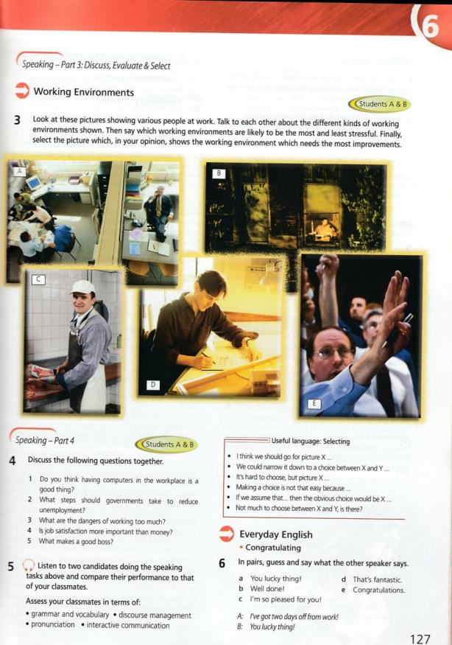
Upstream advanced

Slide 22

JOB-HUNTING
The aim of Cambridge English for Job-hunting is to develop the English language and communication skills you need to get the job you want
The book comprises 6 stand-alone units which cover all of the following areas and more:
Researching the market
Preparing a CV
Writing a cover letter
Answering interview questions
Telephoning interviews
Negotiating terms and conditions of service
Published 2010

Slide 23
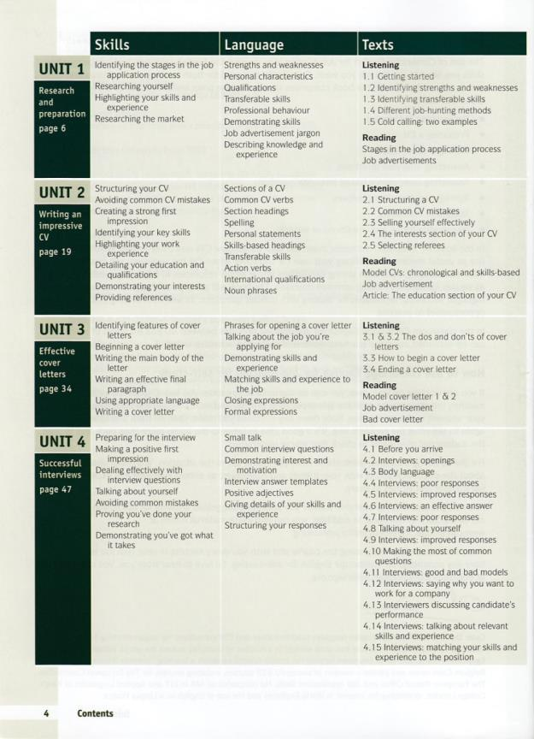
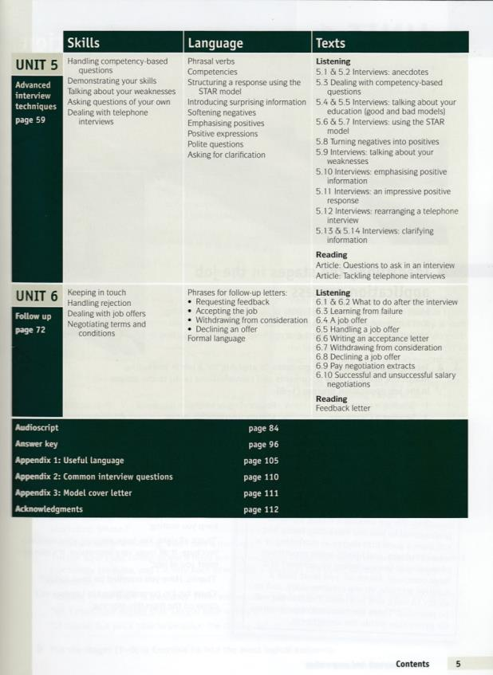
JOB-HUNTING

Slide 24
THANK YOU FOR ATTENTION!

