Slide 1
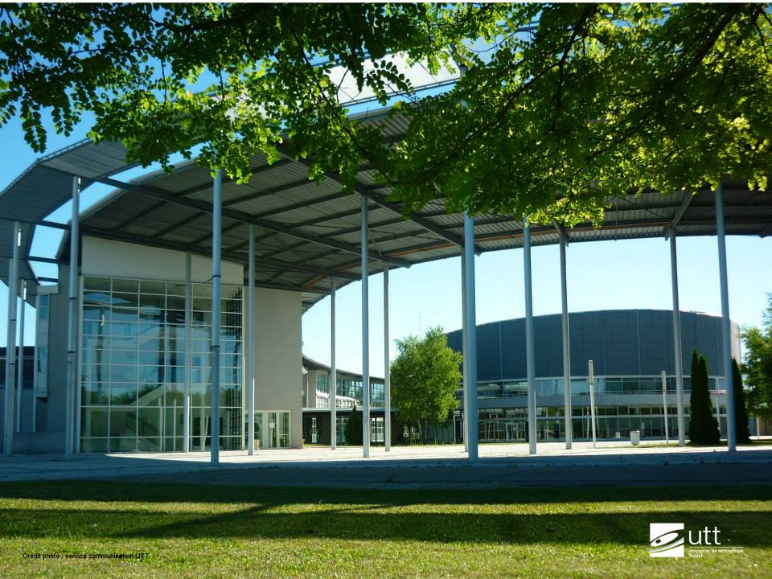
Программа академического обмена
Технический университет города Труа
Весенний семестр 2015

Slide 2
Study included
INTER SEMESTRE PROGRAMME: 22.01.15 - 13.02.15
Intensive french course 5 hours per day +
Project management (In English) 2hours per day
Both subjects are included into individual study plan
SEMESTRE: 13.02.15 – 30.06.15
HOLIDAYS (twice)
02.03.15 – 08.03.15
27.04.15 – 03.04.15

Slide 3
University
Big, modern and innovative building
Big library with places to work by yourself or with a team
Student card system which allow you
  To enter to the university (some doors are locked)
  To buy food (if you have money on the card)
  To print and copy papers with a help of a special photocopier in library (if you have credits, also put money on it but have 50 credits gift first time)
Medical office (if you have some health problems you can go there at any time. And if have some big problems, for example with arms, you even can get extra time for your exams)
University restaurant
Parking space for bicycles

Slide 4
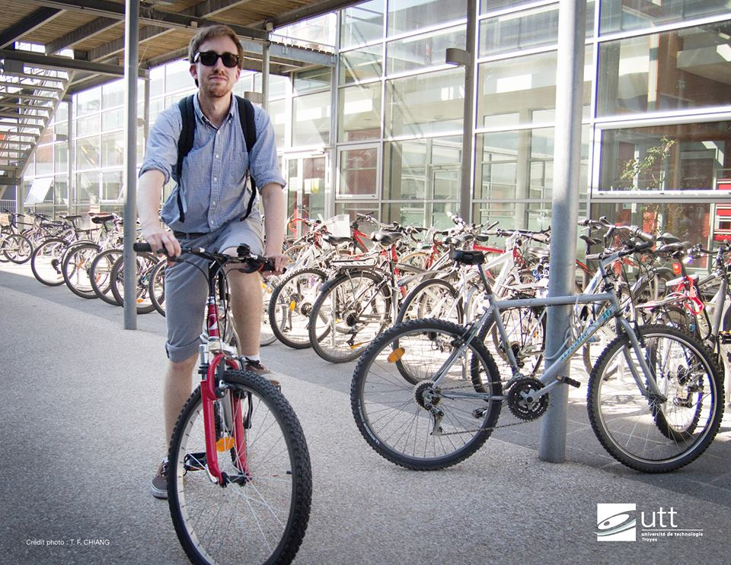
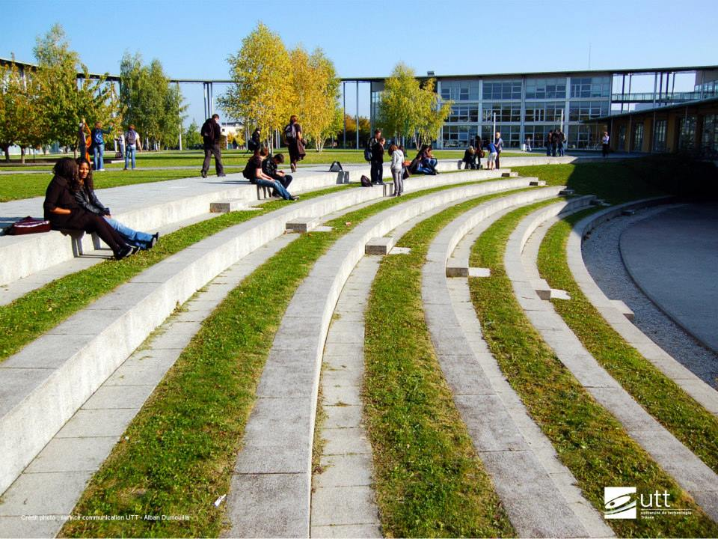
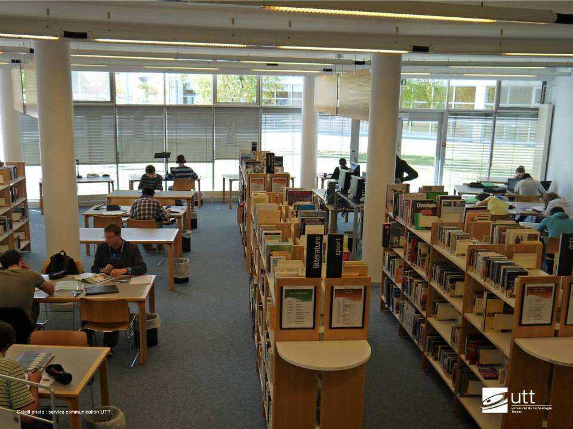
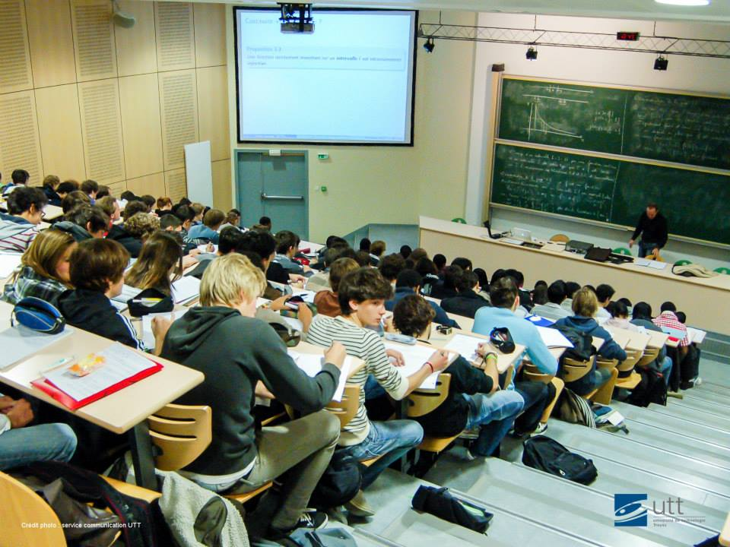
University

Slide 5
Studying
Hard, but exciting
Project team work
Teachers are always in dialog with students even during lectures
Lectures of some subjects are recorded
Moodle system with personal information, recorded lectures and another information for your subjects. You also can download your work there and communicate with other students.
A lot to learn on your own, but If you need help just ask
Written examinations and verbal presentation of the projects

Slide 6
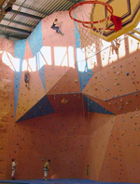
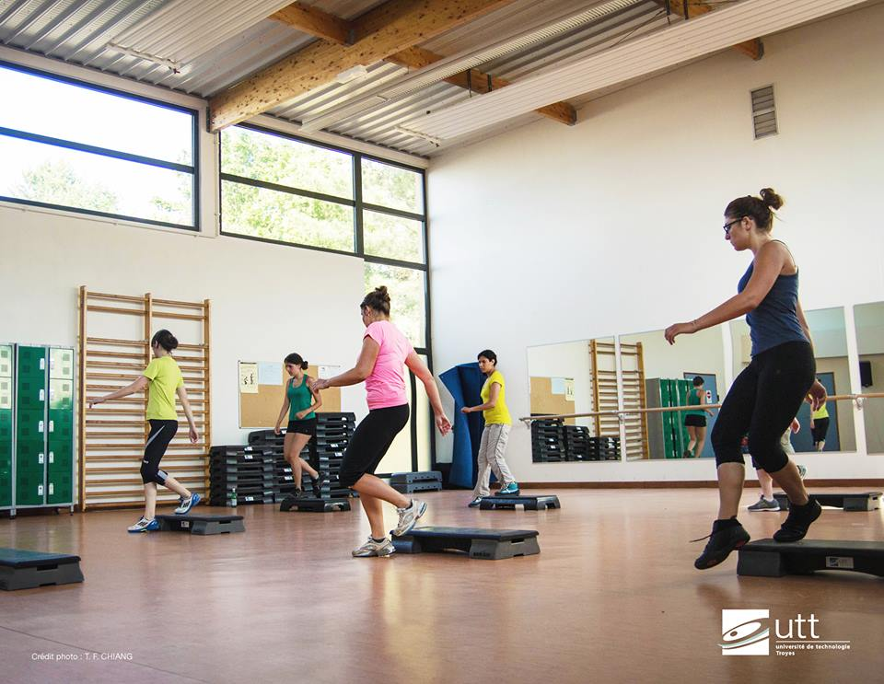
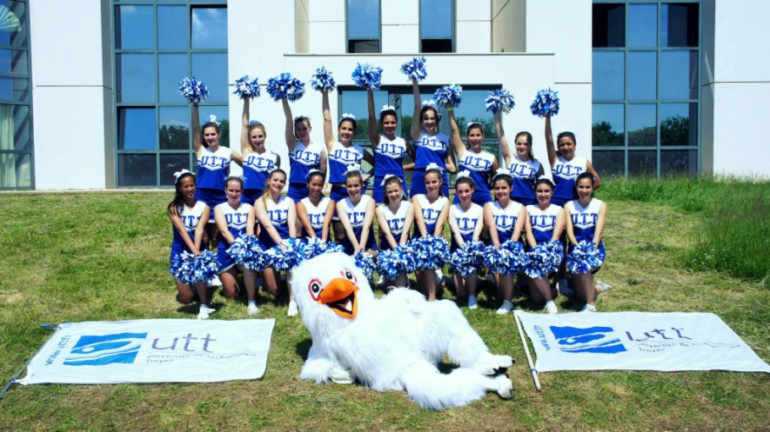
Sport activities
You pay 23 euro for the semester and get unlimited access to
  Basketball, volleyball, football, handball,
  Orienteering, horse riding, archery, badminton, golf
  Judo, boxing, karate
  Squash, tennis
  Swimming, water polo, rowing
  Climbing, skiing
  Fitness and dance
  …

Slide 7
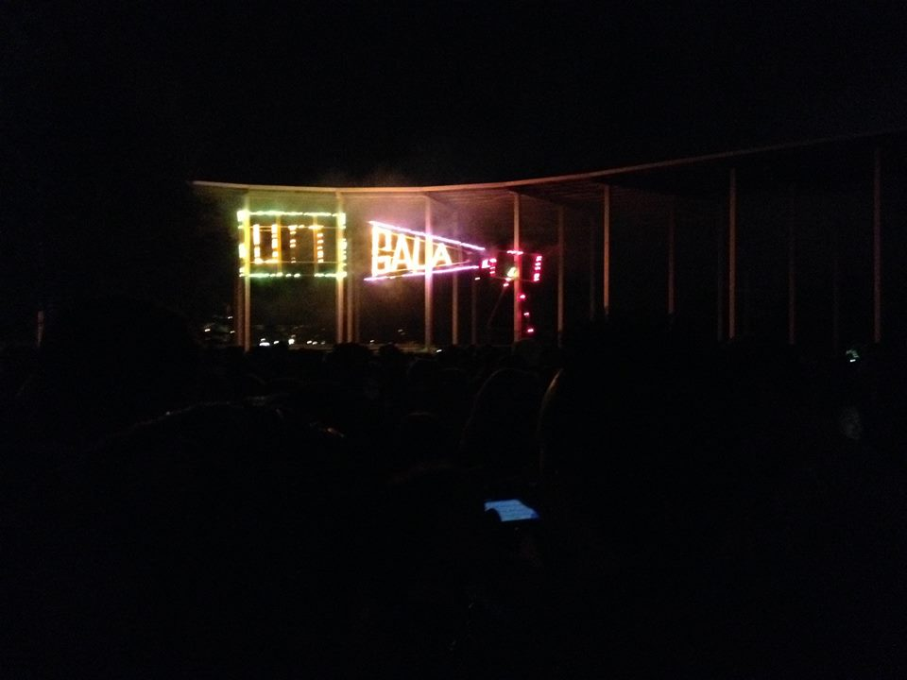
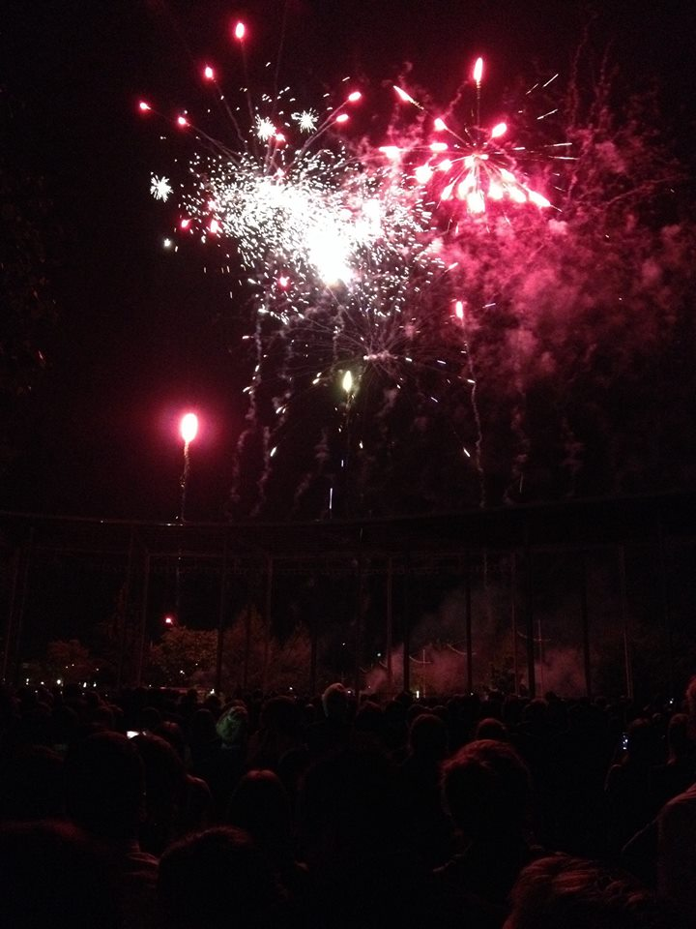
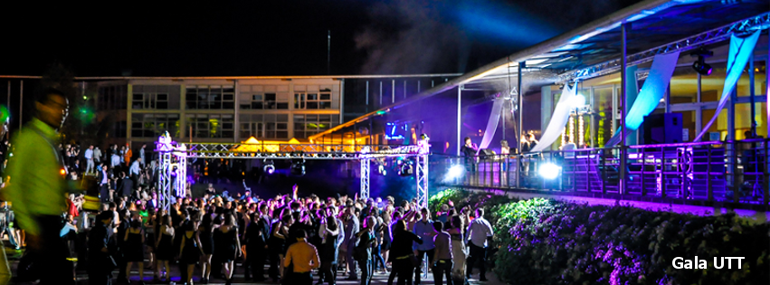
Gala UTT
University hosts an annual ball for students

Slide 8
Accommodation and university restaurant on the campus
+
Studio or room with private shower and toilets but with shared kitchen on the campus
Price 306 euro per month
Furnished, free and unlimited Internet, electricity included
3 euro for lunch with dessert in university restaurant
4 euro for the laundry
-
Deposit 306 euro for all period
Need to buy or to bring bed linen, dishes and some home appliances sometimes

Slide 9
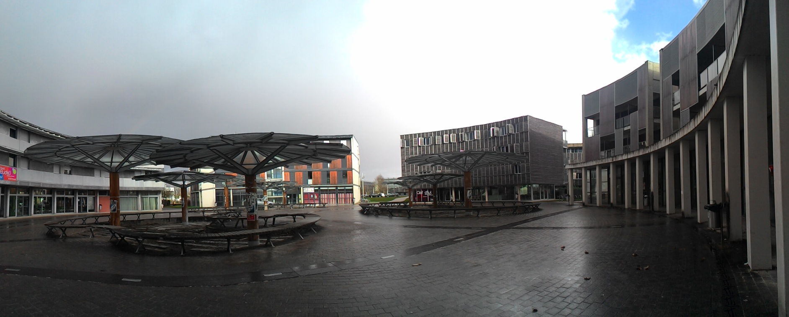
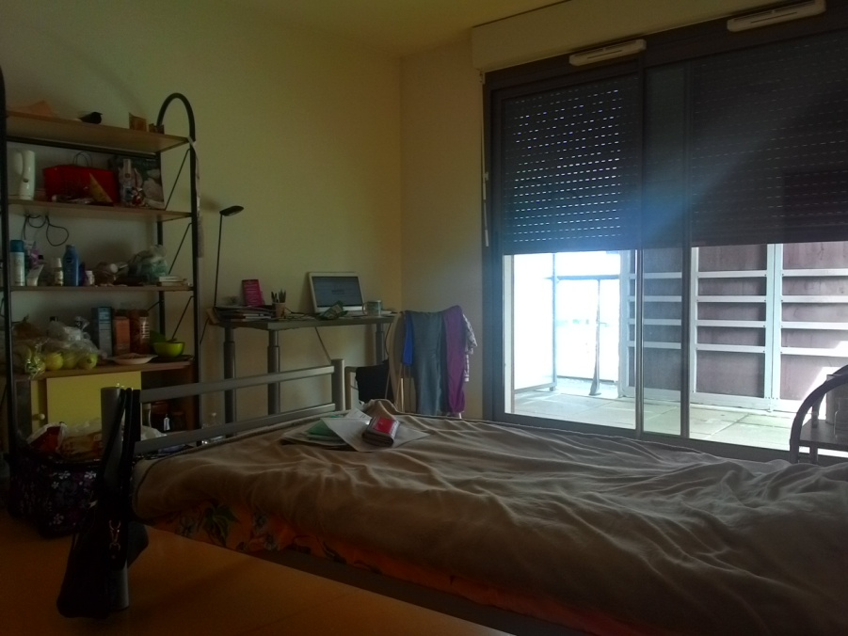
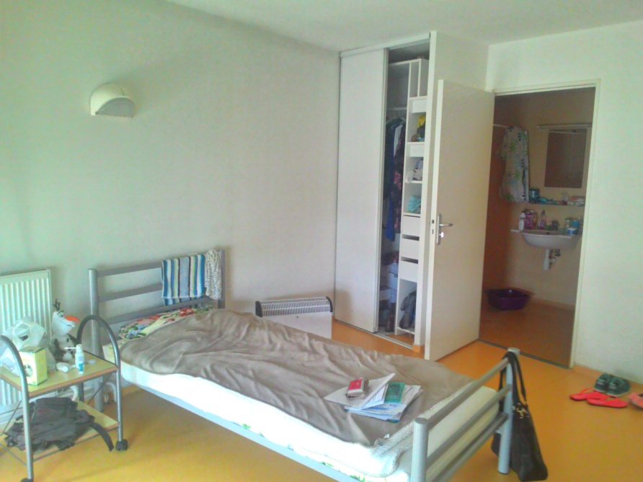
Accommodation

Slide 10
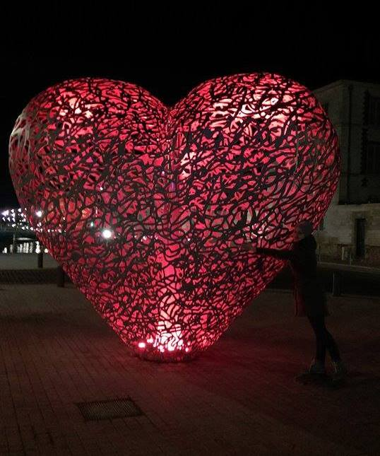
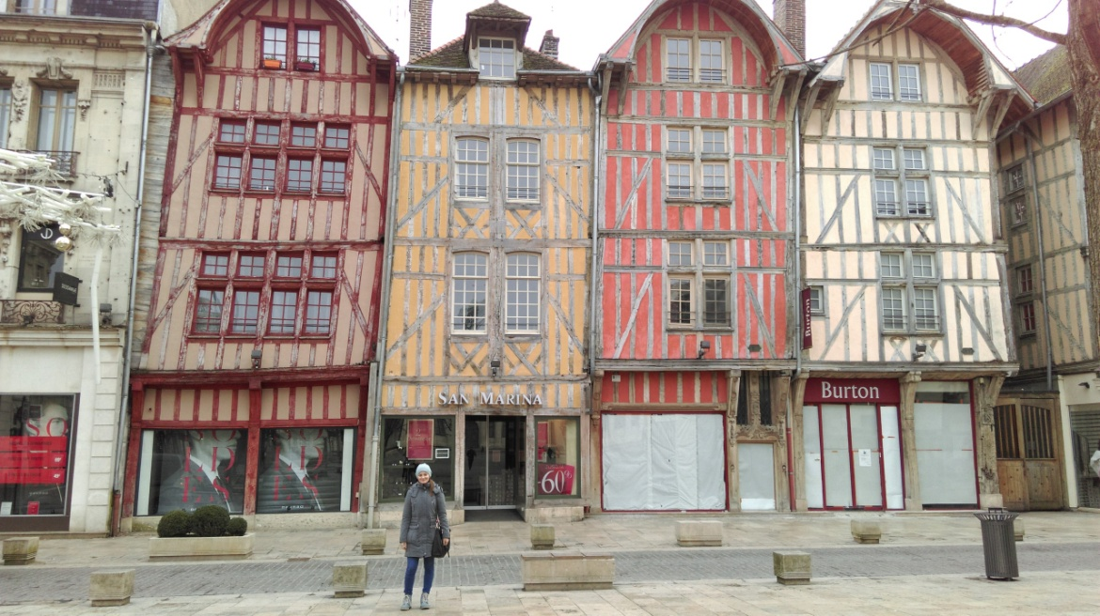
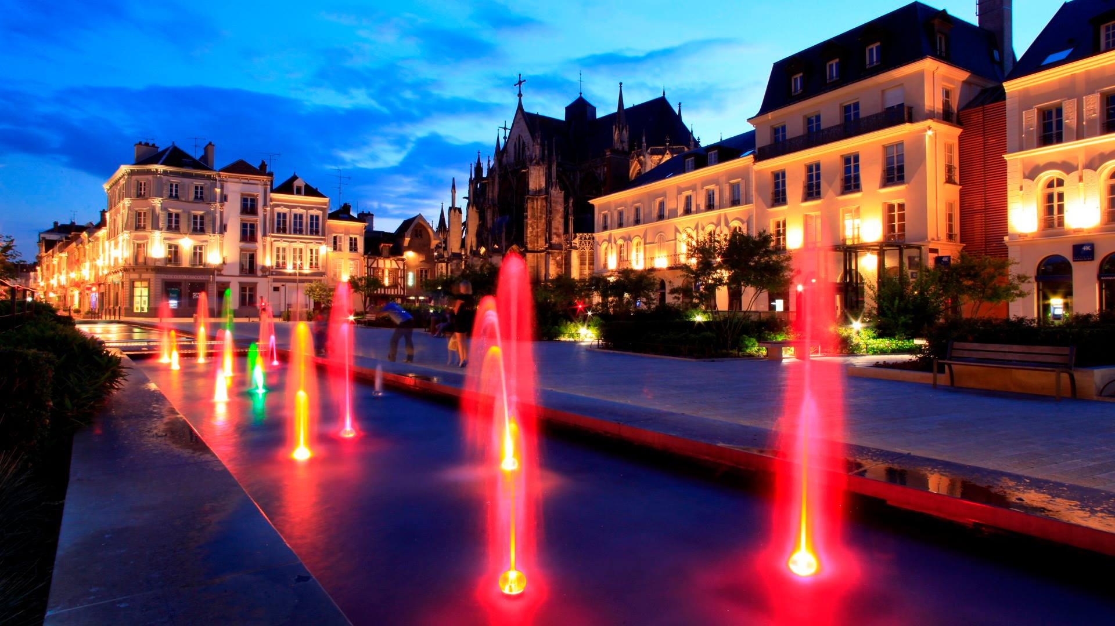
Troyes

Slide 11
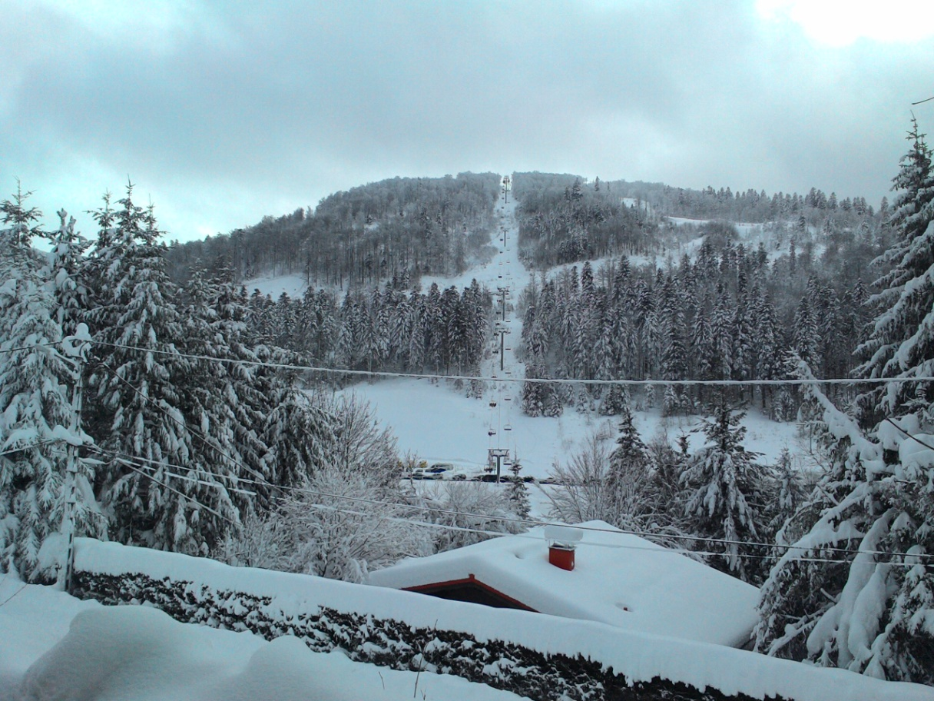
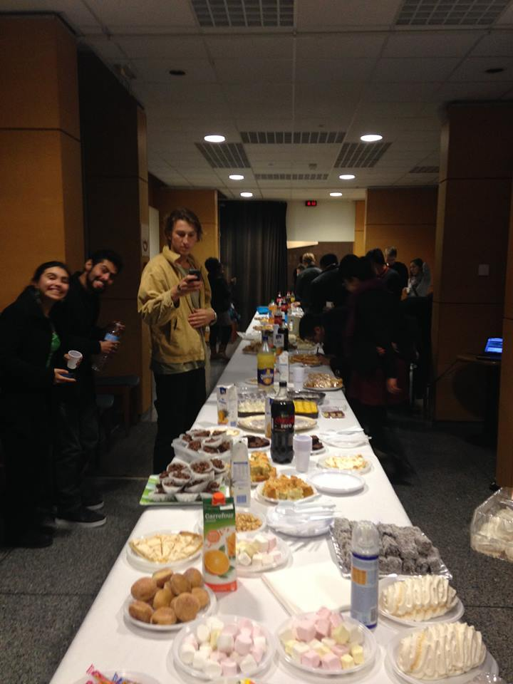
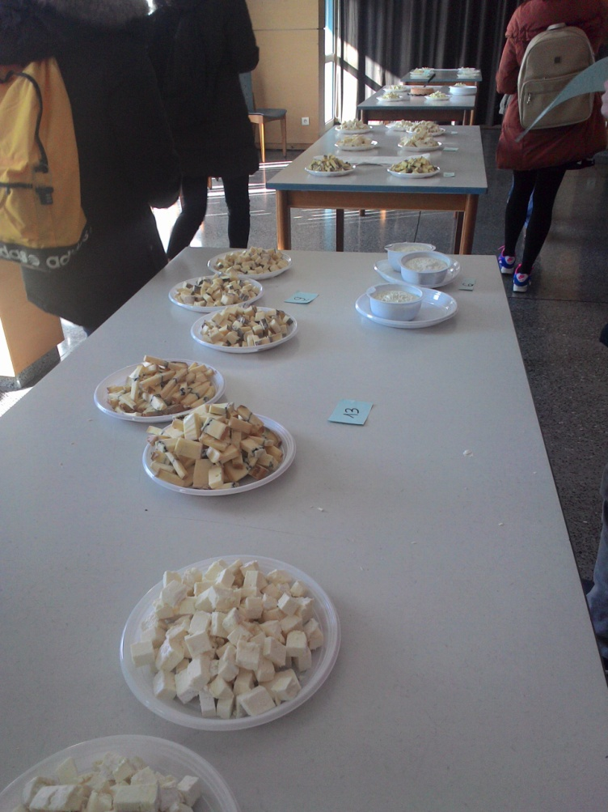
International office
Buddy programe
La bresse trip
International
dinner
Cheese degustation
Raclette(cheese) party

Slide 12

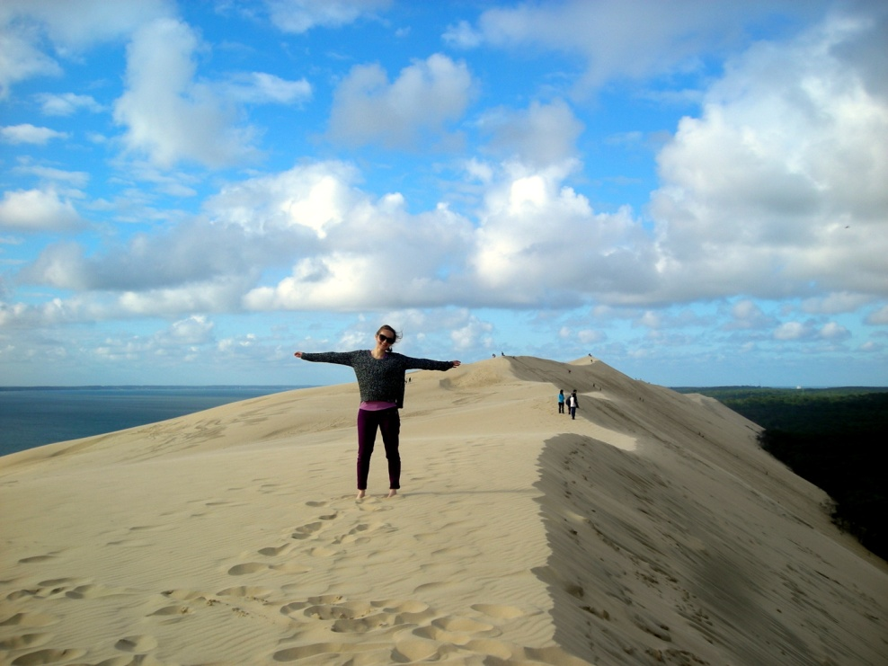
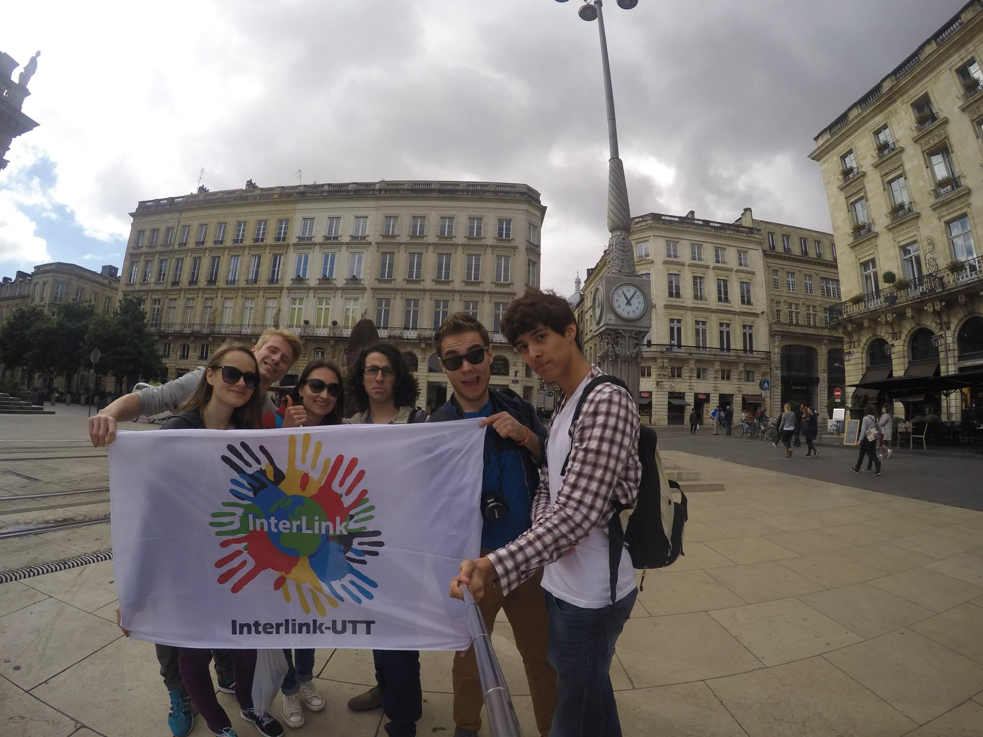
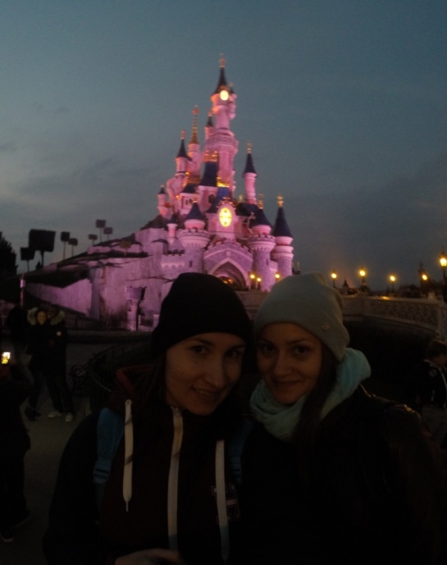
Interlink and BDE student clubs
Trip to Bordeaux, Arcachon
and Dune du Pilat
Trip to Disneyland

Slide 13
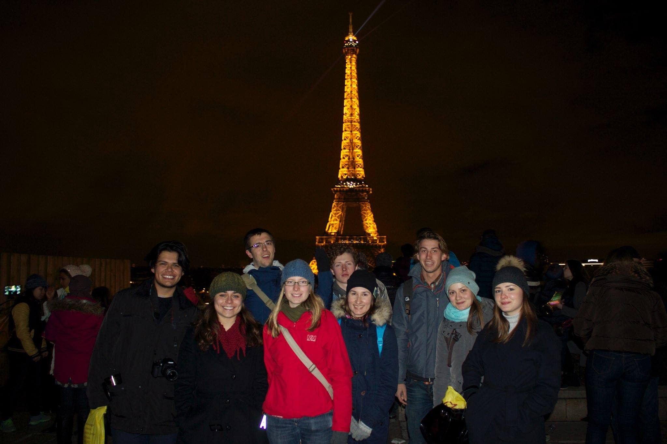
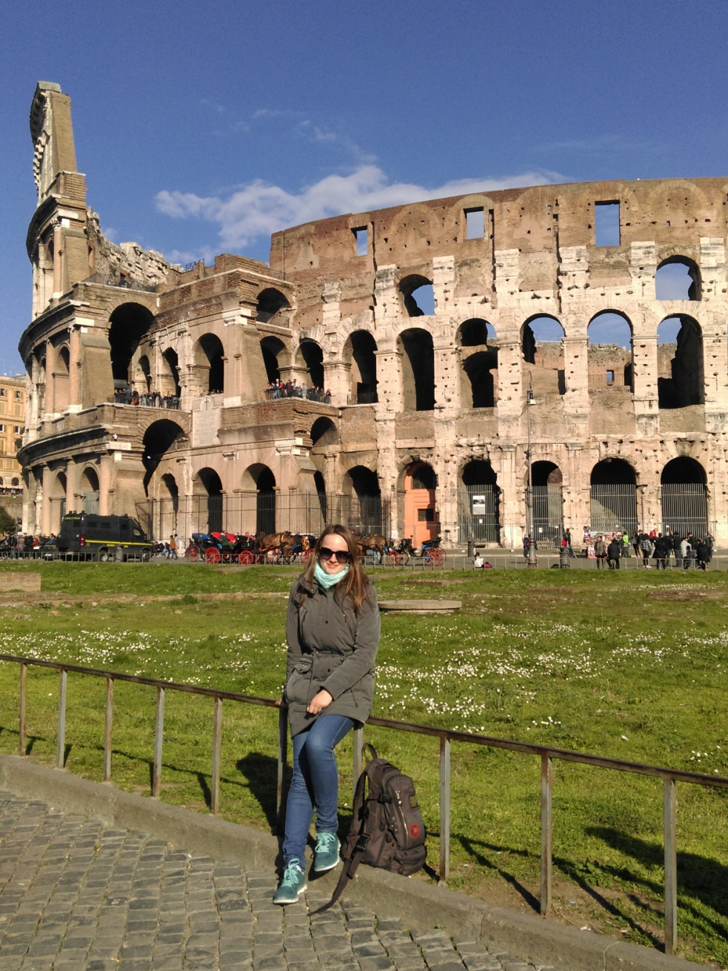
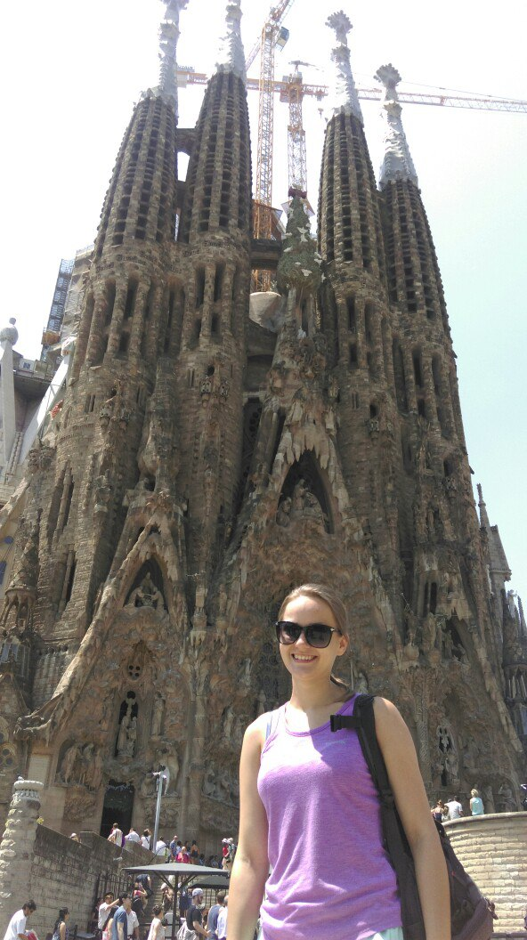
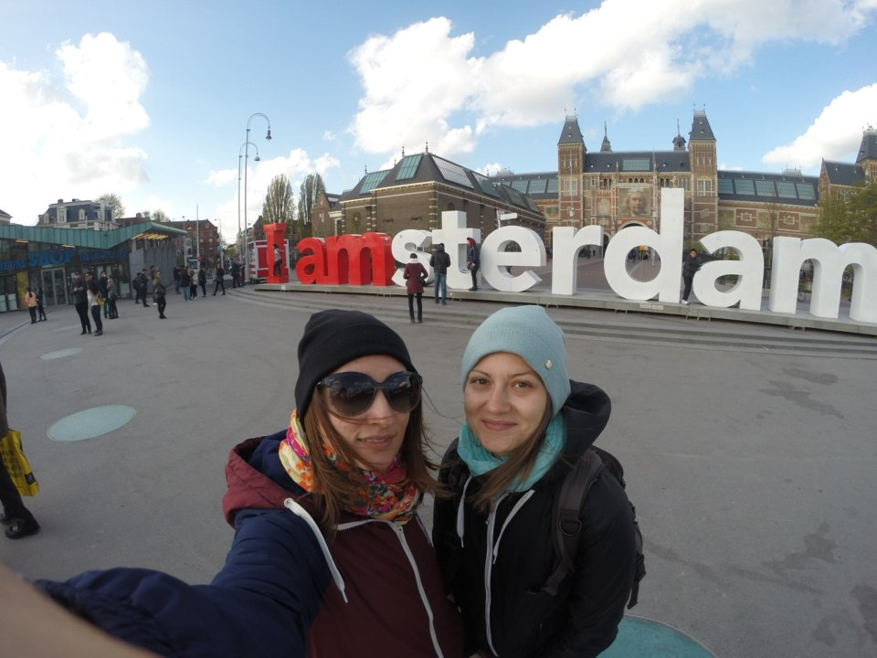
Self-organized trips

Slide 14
Thank you for your attention!

