Slide 1
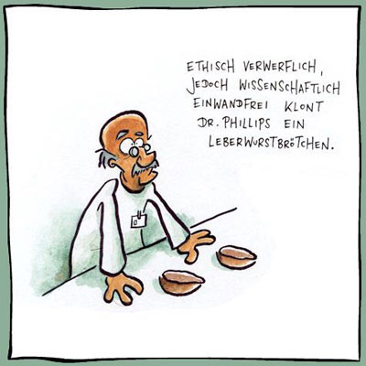
TASK № 4
Put the verbs into correct Passive Form:
Logic systems _________ (to use) to sequence mechanical operations in many applications.
In most applications of on–off feedback control, some consideration needs _________ (to give) to other costs, such as wear and tear of control valves and maybe other start-up costs when power _________ (to reapplied) each time the MV "measured variable" drops.
Our boiler plant automation _________ ( to equip) with latest techniques and provides more prominent results.
Mitsubishi programmable logic controllers (PLCs) and human machine interfaces (HMIs) _________ ( to integrate) into a system that _________ ( to develop) by a specialist maritime supply and service company which aims to keep ships productively at sea by minimising the time that needs _________ (to spend) in harbour and maintenance yards.
Poor water treatment can cause overhauling operation which _________ (to schedule) every 4-5 years throughout the ship's life to prevent water contamination before it can _________ (to develop).

Slide 2
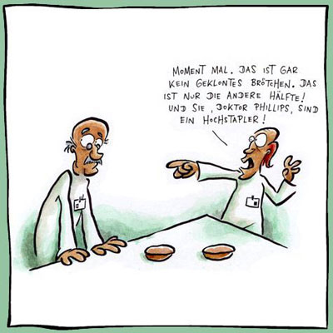
TASK № 4
6. In the stirred batch reactor an HTF (heat transfer fluid) must not _________ (to use) at temperatures above the manufacturer’s recommended maximum. It_________ (to consider) good practice to select a fluid with temperature capabilities at least 20°C (36°F) higher than the required process maximum to safeguard against fluid breakdown.
7. Method for preparing granular polycrystalline silicon using fluidized bed reactor relates to a method for mass preparation of granular polycrystalline silicon in a fluidized bed reactor, comprising (a) a reactor tube, (b) a reactor shell encompassing the reactor tube, (c) an inner zone formed within the reactor tube, where a silicon particle bed ___________(to form) and silicon deposition occurs, and an outer zone formed in between the reactor shell and the reactor tube, which____________ (to maintain) under an inert gas atmosphere.
8. Alternatively, a fluidized bed reactor recently_______(to develop) to prepare granular polycrystalline silicon with a size of 0.5-3 mm.
9. Over the past two decades, several advances ____________(to make) in micromachined sensors and actuators.
10.Measurement systems ____________(to use) to generate improved understanding about a real world system; or a virtual representation of it.

Slide 3
To write an annotation it is necessary:
Its purpose is to characterize the publication in such a way that the reader can decide whether or not to read the complete work.
The following points provide guidance for writing annotations. As appropriate each of these issues might be assessed and commented on in the annotation:
1. Qualifications of the author, unless very well known.
2. The scope and main purpose of the publication (e.g., book, article, web site).
3. The intended audience and level of reading difficulty.
4. The author's bias or assumptions, upon which the work's rationale rests.
5. The method of obtaining data or doing research.
6. The author's conclusions.
7. Comparison with other works on the same subject.
8. The work's importance or usefulness for the study of a subject.

Slide 4
To write an abstract it is necessary:
An abstract is a summary in your own words, of an article, chapter, or book. It is not evaluative and must not include your personal opinions. The purpose of an abstract is to give a reader sufficient information for him or her to decide whether it would be worthwhile reading the entire article or book. An abstract should aim at giving as much information as possible in as few words as possible.
The abstract should include:
Complete bibliographic information
A clear statement of the scope and purpose of a work
A summary of the contents
A statement of the conclusion or results

Slide 5
Abstract and Annotation peculiarities, differences.
Annotation
Abstract
The aim is to inform the reader about the content of the book, article or report listed;
To state the scope, the purpose and the general idea of the text (author, sources);
To formulate the aim of the research; Do not try to summarize the whole work;
To announce research, to disseminate an idea, to convince the reader on an issue;
To what is the presentation, objective or biased; the evidence of the work;
Showing agreement and discrepancy\ advantages and drawbacks;
Conclusion to express personal attitude towards the text.
TO STATE THE PURPOSE AND GENERAL IDEA OF THE TEXT;
TO FORMULATE THE AIM OF THE RESEARCH;
DISCUSSING THE CHARACTERISTIC FEATURES OF THE PROBLEM;
METHODS AND MATERIALS DESCRIBING METHOD; EQUIPMENT AND CONDITIONS OF EXPERIMENTS;
RESULTS-OBTAINING RESULTS.

Slide 6
To write an annotation or abstract it is necessary to differentiate:
Annotation
Abstract
An annotation is a brief summary of a book, article, or other publication.
An annotated bibliography helps the reader understand the particular usefulness of each item.
The ideal annotated bibliography shows the relationships among individual items and may compare their strengths or shortcomings.
It is evaluative and must include your personal opinions.
An abstract is also a summary, but there is a difference between the two.
An abstract is simply a summary of a work, whereas the purpose of an annotation is to describe the work in such a way that the reader can decide whether or not to read the work itself.
It is not evaluative and must not include your personal opinions.

Slide 7
How to Write an Annotated Bibliography
An annotated bibliography adds a brief summary of the contents of each item on the list;
Placed just below the facts of publication, the annotation describes the essential details of the work and its relevance to the topic;
It will help future researchers determine whether or not to consult the work;
Provide enough information in about three sentences for a reader to have a fairly clear image of the book's purpose, contents, and special value;
AN ANNOTATED BIBLIOGRAPHY is one in which the basic entries are followed by a paragraph describing and/or commenting on the work listed.
SAMPLE ANNOTATED BIBLIOGRAPHY ENTRY
Gibson, Walker. Tough, Sweet, and Stuffy. Bloomington: Indiana UP, 1966.
This essay on modern prose styles describes the three extreme styles: tough talk, sweet talk, and stuffy talk. Samples in the appendix are especially helpful.
*Adapted from materials developed by the libraries at Earlham College and Xavier University.

Slide 8
Abstract and Annotation peculiarities, differences.
Annotation
Abstract
The aim is to inform the reader about the content of the book, article or report listed;
To state the scope, the purpose and the general idea of the text (author, sources);
To formulate the aim of the research; Do not try to summarize the whole work;
To announce research, to disseminate an idea, to convince the reader on an issue;
To what is the presentation, objective or biased; the evidence of the work;
Showing agreement and discrepancy\ advantages and drawbacks;
Conclusion to express personal attitude towards the text.
TO STATE THE PURPOSE AND GENERAL IDEA OF THE TEXT;
TO FORMULATE THE AIM OF THE RESEARCH;
DISCUSSING THE CHARACTERISTIC FEATURES OF THE PROBLEM;
METHODS AND MATERIALS DESCRIBING METHOD; EQUIPMENT AND CONDITIONS OF EXPERIMENTS;
RESULTS-OBTAINING RESULTS.

Slide 9
Annotation to the Text “ТЕПЛОТА: ТЕРМОДИНАМИКА „
The present paper is concerned with smth….
The purpose of the present paper is to introduce the readers to the smth. …
The purpose of this paper is to present... (to investigate the relationship/ difference between ...and ..., to describe ..., to show ..., to develop ...)
This article provides a brief outline of...
The article puts forward the ideas to determine ...
Special attention is given to ...
Then follows the detailed analyses of...
Next the author tries to indicate that...
Further on, the author goes on to the problem of...
After that the author turns to ...
The next paragraph deals with ...
The final paragraph states that...
The author concludes with .../draws the conclusion that...
The author concludes that... «In conclusion the author...
The paper is of great (little, no) importance (very/rather/not informative).
The information provided is valuable (up-to-date, out-of-date, useful, useless).

