Slide 1
Perception of the world and a sense of beauty in Japanese culture/design
Lecture 6

Slide 2
The Nihonjinron phenomenon
The Nihonjinron is specificity of national identity. Literally it means “to think about Japanese, think in Japanese”
Kosaki Yoshino highlights a basic concept for ideas about Japanese uniqueness:
a unique model of interpersonal communication, based on silence, illogicality, ambiguity, situational ethics and emotionality of speech

Slide 3
V.M.Alpatov: “Language myths”
Special attention to one's own language and its problems
The idea on the uniqueness of the Japanese language
Exaggeration of the difficulty of the Japanese language ("Japanese language - for the Japanese)
The idea on the special reachness, diversity of the Japanese language and the emphasis on the "culture of silence" that distinguishes the Japanese language from other languages.

Slide 4
Human/culture/nature
For Europeans, nature is the antithesis of urban space, from which it defends itself (the idea of a landscape).
For Japanese, nature is the habitat. They adapt human life to nature, but does not rebuild nature for their own purpose.
In architecture: not to compete with nature, but to strive to become the part of it

Slide 5
Human/culture/nature
There are no clear boundaries between the internal and external interior (sliding screens, house and garden) in Japanese houses.
There is no rigid antithesis of nature // culture (landscape lyrics, painting, landscape art, Ikebana, stone garden, bonsai, sakei, bonsacki, bonkai)

Slide 6
Japanese house
The house has no walls. Landscape is a natural extension of the interior. From the inside the house is divided not into the rooms, but into the functional areas (with the help of screens, curtains, due to differences in the level of the floor).
The basis of the Japanese interior is emptiness, emphasizing the inner elegance of the little that is in the house.
Therefore, the fundamental feature of the Japanese style is minimalism.

Slide 7
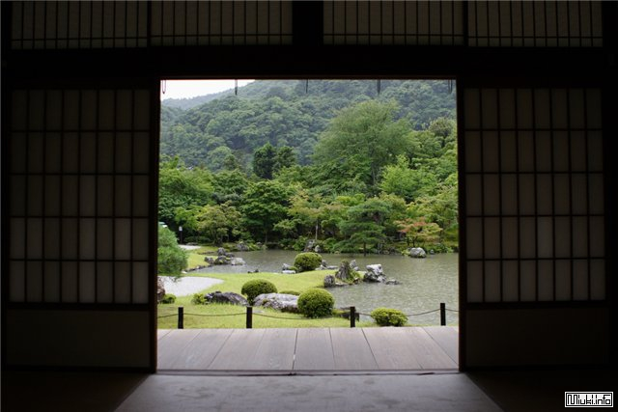
doors-partitions made from paper and bamboo (shoji)

Slide 8
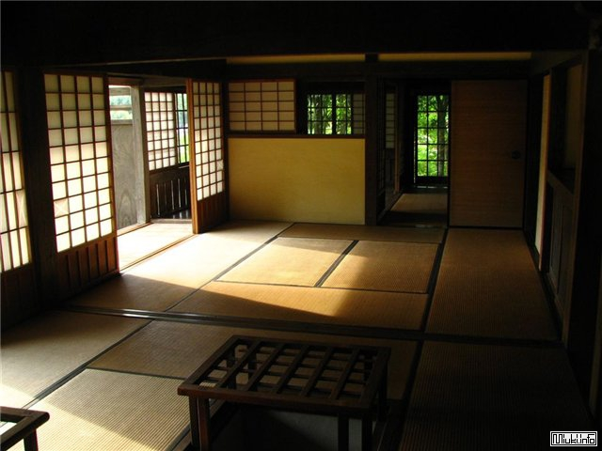
The screens make the apartment space light and transparent

Slide 9
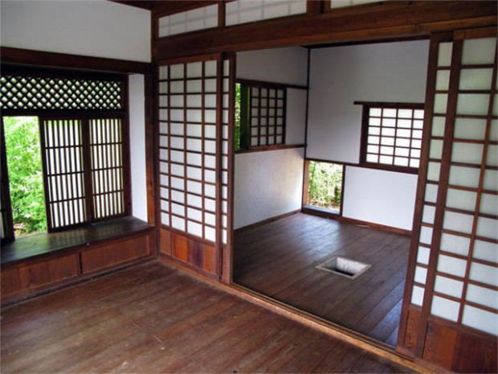
The traditional house

Slide 10
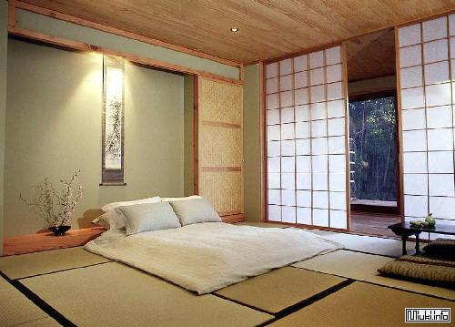
Modern interior

Slide 11
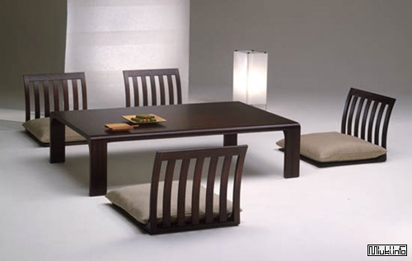
Modern interior

Slide 12
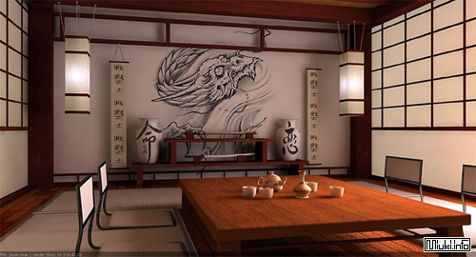
Modern interior

Slide 13
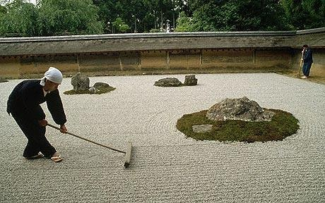
Stone garden

Slide 14
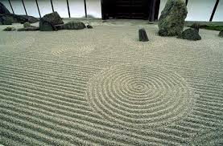
Stone garden

Slide 15
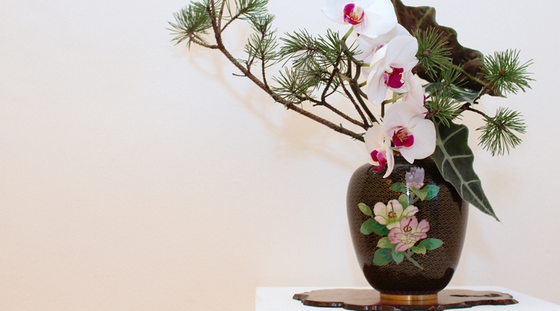
Ikebana – the art of flower’s design

Slide 16
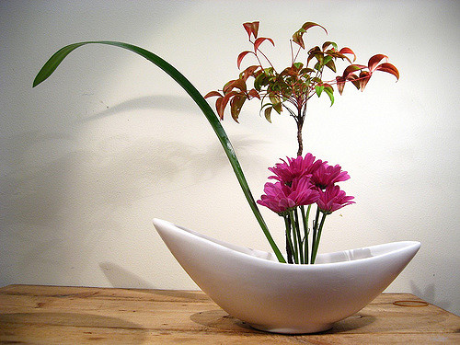
Ohara school

Slide 17
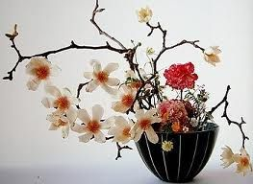
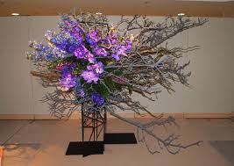
Ikebana

Slide 18
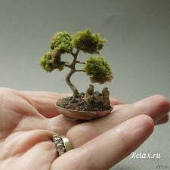
Bonsai
Bonsai literally translates from Japanese as "grown in a tray" and involves the process of growing an exact copy of a large tree of a certain type in miniature.

Slide 19
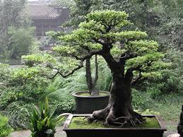
Bonsai

Slide 20
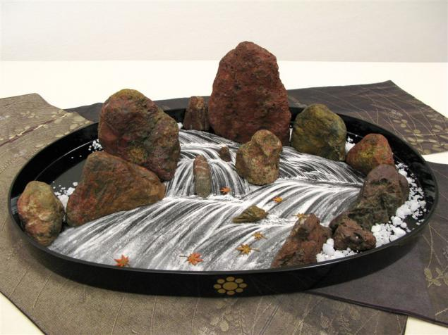
Bonsaki
Bonsaki - literally means "tray-stone." It is the art of depicting a miniature landscape (mountains, seas, lakes, waterfalls) on a flat, usually black, using sand, gravel and stones.
Bonsaki is a temporary composition that is created for the wedding, the New Year or some ceremony.

Slide 21
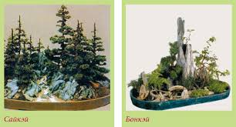
Saikei/Bonkei

Slide 22
Japanese Professional Design
Professional design in Japan has no more than 60 years. The main stimulus for its development seems to be the special economic conditions that prevailed in Japan in the post-war period.
For several decades, Japanese design came out on top in the world. Its development is just as rapid as the general process of Japan's postwar industrialization.

Slide 23
Japanese Professional Design
Since the early 1950's. The Japanese Association for the Promotion of Export Trade Development, JETHRO regularly sent Japanese designers to study at the highest art and design schools in the US and Germany (Chicago, Los Angeles, Ulm).
Many designers regularly trained in the US, Italy, France, England, Scandinavian countries, getting acquainted with the latest design achievements.

Slide 24
SONY
Modern electronics, which is so famous for Japan, in the period of the formation of Japanese design was completely new for the country's field of production, not related to the past neither functions nor forms. But it became the most mass field of practice of Japanese design
"In the evening of May 7, 1946, about twenty people gathered on the fourth floor of a charred department store in the war-devastated center of Tokyo,"

Slide 25
SONY
"Sony" is famous for the harmonious combination of the latest scientific and technical achievements in its products with highly professional design.
Akio Morita (1921-1999), responsible for the commercial activities of the firm, described the history of its creation and recovery. He showed himself as a talented engineer and designer.

Slide 26

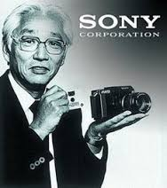

Slide 27

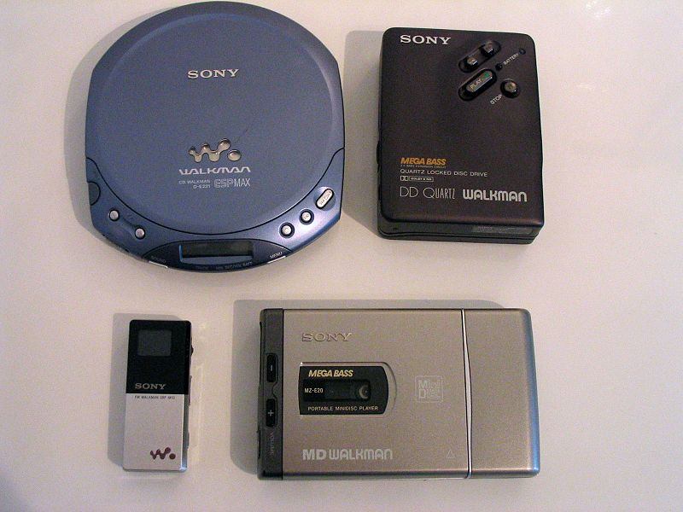

Slide 28

The first corporate symbolism: the circle of red color symbolized the rising Sun, the blue color - the sky. The slogan of that time - "Sincerity brings success."

Slide 29
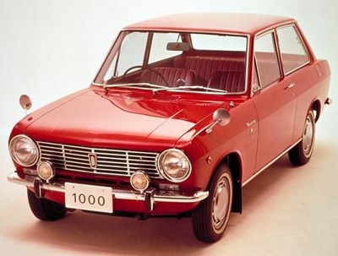


Slide 30
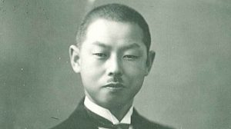
NISSAN
In 1928, Yoshisuke Aikawa (1880-1967) received an offer to lead the restructuring of the firm Kuhara Kogyo.
One of the first steps of Aikawa was the choice of a new name. He called the renewed company Nihon Sangyo (Nihon - Japan, Sangyo - industry).
He believed that since the company belongs to shareholders from all over Japan, it should also reflect the interests of Japanese society in its name

Slide 31

Nissan — model Type 70., 1939

Slide 32
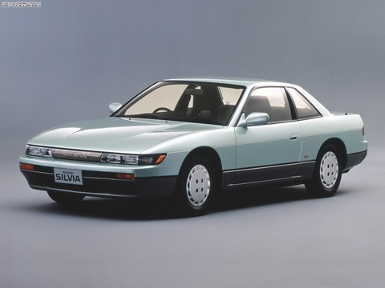
Nissan Silvia Q‘s, 1988

Slide 33



NISSAN

Slide 34


Slide 35


Slide 36
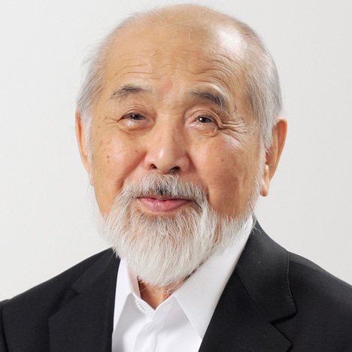
Kenji Ekuan (born in 1929)
Kenji Ekuan (born in 1929) is a prominent Japanese designer, the president of the Association of Japanese
Designers, president of ICSID
«The creative thought of Japanese designers develops in the sphere of three vital problems:
lack of territory,
overpopulation and
traditions of spiritual culture."

Slide 37
Kenji Ekuan
The first design principle is "less is more". In terms of design, this means: with minimal means should be achieved the highest technical and aesthetic qualities of the product, which will constitute its special "strength."
The second principle is multifunctionality, which he refers to as "the simplicity of the complex" (or "complex simplicity").
Most things in the Japanese way of life are like that - they are constructively simple, they correspond to a wide range of functions.

Slide 38
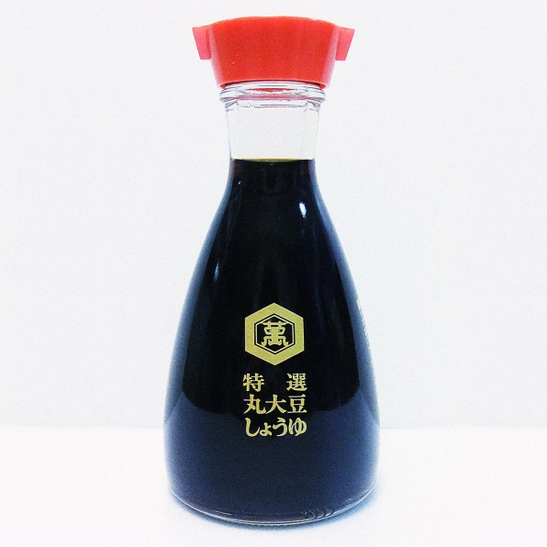
Kikkoman soy sauce dispenser

Slide 39
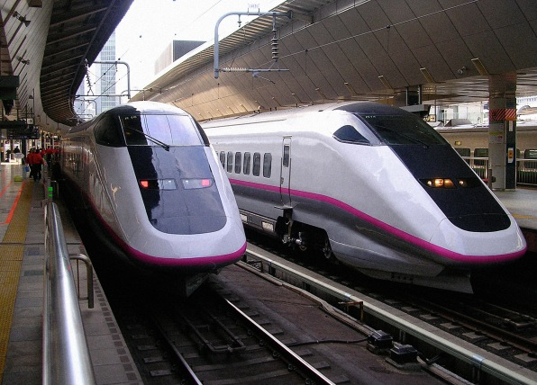
Komachi Bullet Train

Slide 40
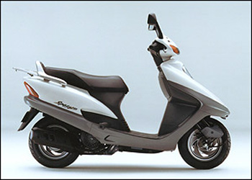
HONDA SPACEY 125

Slide 41
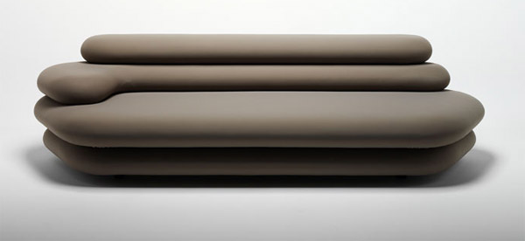
Sofa Stratos, Makio Hasuike

Slide 42
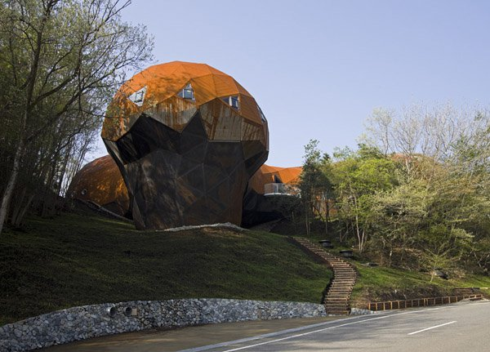
Architecture: Japanese architectural studio Shuhei Endo succeeded in combining advanced design techniques with the traditions of Japanese culture, having built an environmental center for studying the environment in the Japanese prefecture of Hyogo.

Slide 43
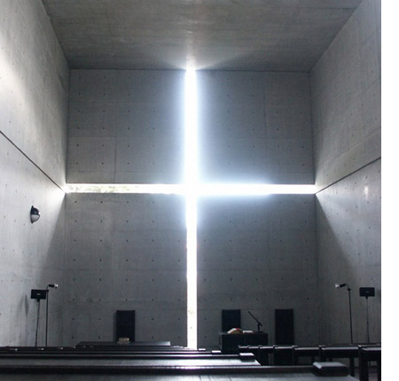
Tadao Ando. Church of the Light, 1989

Slide 44
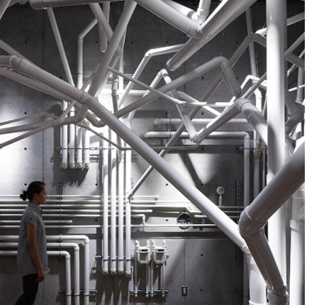
Makoto Tanjiri, brand store Diesel

Slide 45
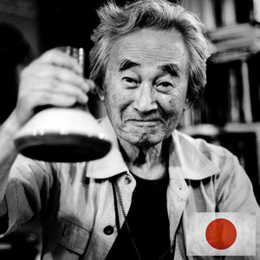
Sori Yanagi

Slide 46
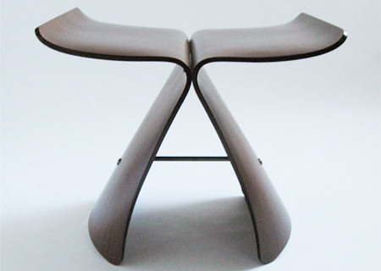
Stool-chair "Butterfly

Slide 47
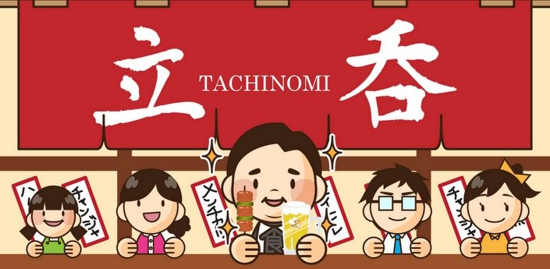
Tashinomi (bars where you can only stand) - a signboard

Slide 48
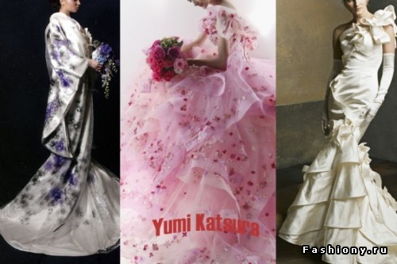
Yumi Katsura

Slide 49
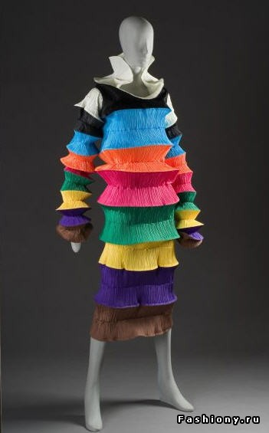
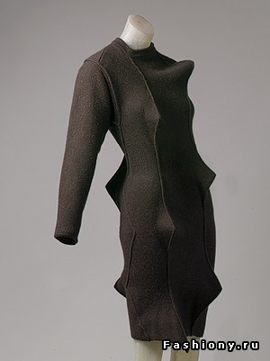
Isi Miyaki

Slide 50
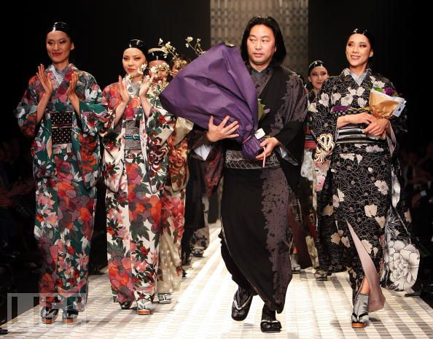
Jitaro Saito

