Slide 1
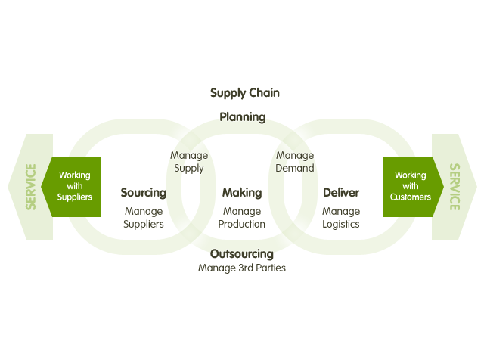
Supply Chain Management

Slide 2
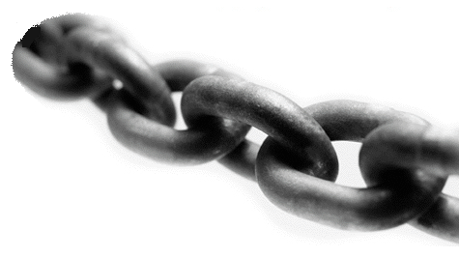
What is Supply Chain?

Slide 3
What is Supply Chain?
A supply chain is the system of organizations, people, activities, information and resources involved in moving a product or service from supplier to customer.
An integrated group of processes to “source,” “make,” and “deliver” products.
Supply chain activities transform raw materials and components into a finished product that is delivered to the end customer.

Slide 4







Supply Chain Illustration
Supplier
Manufacturer
Distributor
Retailer
Customers

Slide 5
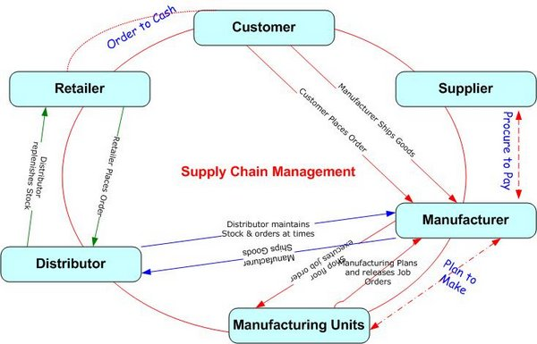
Supply Chain Flow

Slide 6
Meaning of SCM
It is the process of planning, implementing and controlling the operations of the supply chain with the purpose to satisfy customer requirements as efficiently as possible.
Supply chain management manages all movement and storage of raw materials, work-in-process inventory, and finished goods from point-of origin to point-of-consumption.

Slide 7
Definition of SCM
According to the Council of supply chain Management Professionals, Supply chain Management encompasses the planning and management of all activities involved in sourcing and procurement, conversion, and all logistics management activities.
Importantly, it also includes coordination and collaboration with channel partners, which can be supplier, intermediaries, third party service providers, and customers.

Slide 8
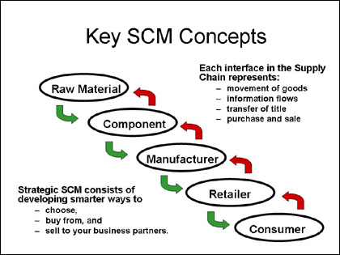

Slide 9


Supply Chain Goals
Efficient supply chain management must result in tangible business improvements. It is characterized by a sharp focus on
  Revenue growth
  Better asset utilization
  Cost reduction.

Slide 10
Different from Logistic Management
Some experts distinguish supply chain management and logistics management, while others consider the terms to be interchangeable.
Logistic management can be termed as one of its part that is related to planning , implementing , and controlling the movement and storage of goods, services and related information between the point of origin and the point of consumption. But supply chain management includes more aspects apart from the logistics function.

Slide 11

Opportunities enabled by SCM
Proper implementation of SCM helps to use the following strategic areas to their full advantage:
Fulfillment:-
Ensure the right quantity at the right time.
It makes sure that the right quantities are ordered.
2. Logistics:
Keep the cost of transporting materials as low as possible consistent with safe and reliable delivery.
Constant contact with its distribution team.

Slide 12

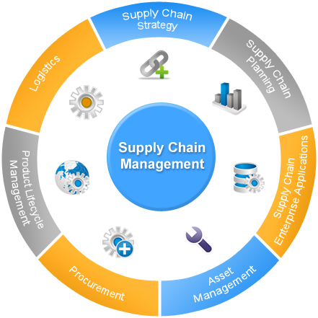
3. Production:
Ensure production lines function smoothly.
4.Reduced Cost of
a. Inventory carrying cost
b. Internal and external failure cost
c. Purchase cost
5. Revenue & Profit
No Sales are lost and flexible to respond unforeseen changes

Slide 13
Implementation: Points to keep in mind
Recognize the difficulty of change.
Prepare a blueprint for change that maps linkages among initiatives.
Assess the entire supply chain from supplier relationships to internal operations to the market place, including customers, competitors and industry as a whole.

Slide 14
SUPPLY CHAIN Levels
Supply Chain Design
Resource Acquisition
Long Term Planning (1 Year ++)
Strategic
Production/ Distribution Planning
Resource Allocation
Medium Term Planning (Qtrly,Monthly)
Tactical
Production Scheduling
Resource Scheduling
Performance tracking
Short Term Planning (Weekly,Daily)
Operational

Slide 15
Problems faced by supply chain Management
Issue | Details
Distribution network configuration | Number and location of suppliers, production facilities, distribution centers, warehouses and customers
Distribution strategy | Centralized versus decentralized, direct shipment, pull or push strategy
Information | Integrate system and processes though the supply chin to share valuable information, including demand signals, forecast
Inventory management | Quantity and location of inventory including raw materials, work in process and finished goods.

Slide 16
Bullwhip Effect
Meaning: The Bullwhip effect or Whiplash effect is an observed phenomenon in forecast-driven distribution channels.
Because customer demand is rarely perfectly stable, businesses must forecast demand in order to properly position inventory and other resources. Forecast are based on rarely perfectly accurate statistics.

Slide 17
Factors Contributing Bullwhip Effect
Forecast Errors
Lead Time Variability
Batch Ordering
Price Fluctuations
Product Promotions
Inflated Orders
Methods Intended to reduce Uncertainty, variability, and lead time i.e., Just in time replenishment and strategic partnership

Slide 18
Inventory: Bullwhip Effect
The magnification of variability in orders in the supply-chain.
Retailer’s Orders
Wholesaler’s Orders
Manufacturer’s Orders
Order
Quantity
Order
Quantity
Order
Quantity
Time
Time
Time
A lot of retailers each with little variability in their orders….
…can lead to greater variability for a fewer number of wholesalers, and…
…can lead to even greater variability for a single manufacturer.

Slide 19

Thank You!
Suggestions are welcomed to improve quality of presentation.

