Slide 1
Stack applications
Reverse a word.
Palindrome strings
  “A man, a plan, a canal—Panama!”
  “Able I was ere, I saw Elba.”
  “Won ton? Not now!”
  “Madam, I’m Adam.”

Slide 2


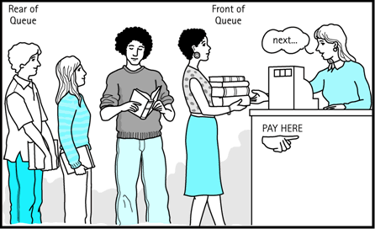


Queues
FIFO
Enqueue()
Dequeue()
Peek()

Slide 3
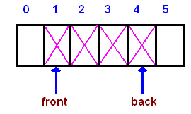
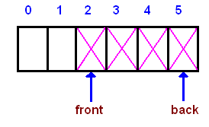
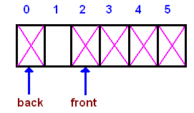
Array-based implementation

Slide 4
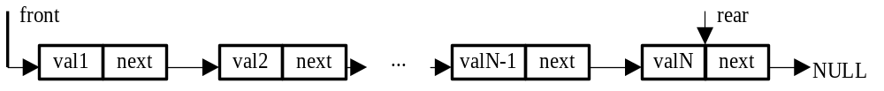
Linked List-based implementation
struct QUEUE{
int dann;
QUEUE *next;
};
QUEUE* front=NULL;
QUEUE* rear=NULL;

Slide 5
Operations
Placing an item at the back of the queue
void Enqueue(int a)
{QUEUE *q;
q=new QUEUE;
if (front==NULL) front=q;
else rear->next=q;
q->dann=a;
rear=q;
rear-> next =NULL;
}

Slide 6
Removing the item from the queue
int Dequeue(void)
{QUEUE *q;
int temp=-1;
if (!front) cout << "\nQueue is empty";
else {temp=front->dann;
q=front-> next;
delete front;
front=q;
}
return temp;
}

Slide 7
Retrieving the item at the front of the queue
int Peek(void)
{int temp;
if (!front) {
cout << "\nQueue is empty";
return -1;
}
temp=front->dann;
return temp;
}

Slide 8
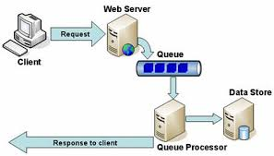
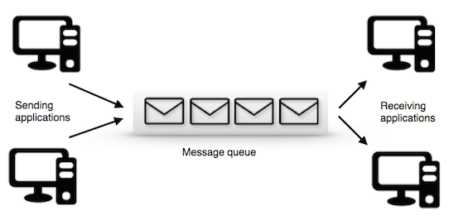
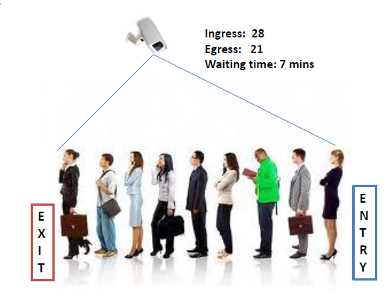
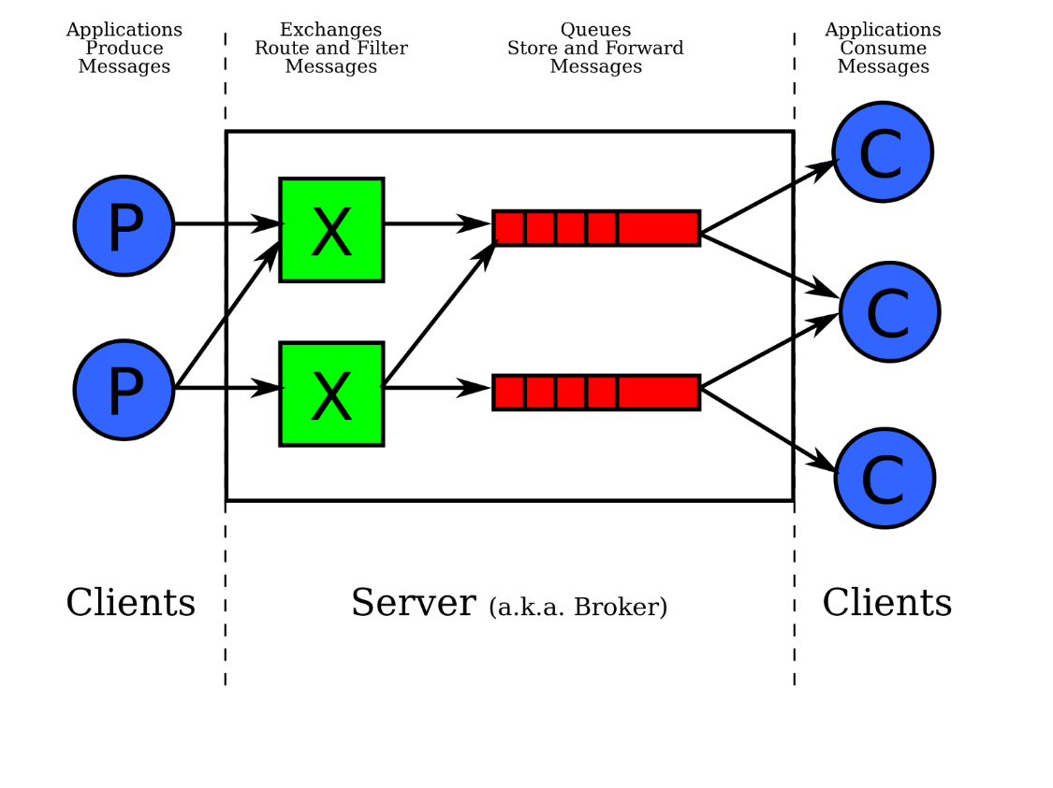
Queue applications

Slide 9
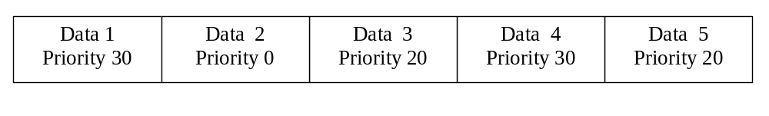
Priority Queue
front
front
front
A
D
B
F
C
E
G
0
0
1
1
2
2
2
NULL

Slide 10
Deques (double-ended queue)
Two types of deques:
1. Input restricted deque (Insertion at one end)
2. Output restricted deque (Deletion at one end)
B
D
A
C
A
B
C
D
E
F
E
F
G

