Slide 1
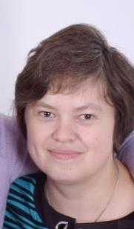
INSTRUCTIONS
In writing the part
Financial Management of Diploma research paper
Lector/instructor: Spicyna Lubov Yurievna,
Associate Professor
Division for Social Sciences and Humanities
TPU School of Core Engineering Education
e-mail: spicyna@tpu.ru
phone: +7(909)549 3711

Slide 2
THE GOALS AND THE ORDER OF WRITING FINANCIAL MANAGEMENT PART (FMP) OF DIPLOMA RESEARCH PAPER
The goal of writing FMP:
To explain the reasons of your technical solutions choice (calculation of technical and economic efficiency, SWOT analysis).
To describe the parameters of your diploma research (the team of executors, buyers of the final goods/services of your project, limitations and requirements for the results of your research).
To create the time plan of your research project realization.
To calculate the costs for performing of your research and promoting its results to the market.

Slide 3
YOU NEED to begin from reading the file Instruction for diploma section Financial Management (available at my personal site https://portal.tpu.ru/SHARED/s/SPICYNA/eng/academics/Tab3)
And to fill in the ASSIGNMENT FOR THR DIPLOMA PROJECT SECTION «FINANCIAL MANAGEMENT, RESOURCE EFFICIENCY AND RESOURCE SAVING» (available at my personal site https://portal.tpu.ru/SHARED/s/SPICYNA/eng/academics/Tab3).
IT WOULD BE BETTER to ask your Supervisor at writing diploma research to help you in fixing the limitation required at these Assignments which would be specific for every master’s student theme of research.

Slide 4
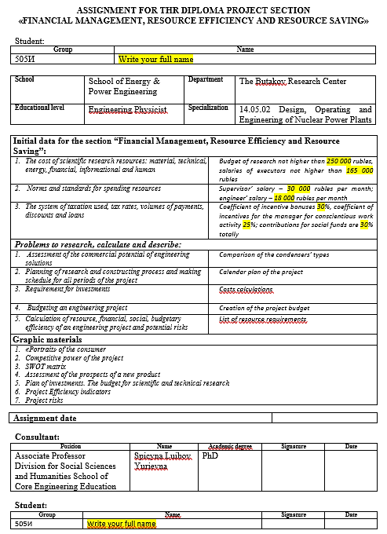
HOW to fill in the ASSIGNMENT FOR THR DIPLOMA PROJECT SECTION «FINANCIAL MANAGEMENT, RESOURCE EFFICIENCY AND RESOURCE SAVING» (available at my personal site https://portal.tpu.ru/SHARED/s/SPICYNA/eng/academics/Tab3)
You need to write the parameters of your own assignment for diploma research in the gaps marked yellow
The parameters must include the limitations or the meanings used in the calculations
The data in Assignment must be equal to the data and results of your Financial Management section!!!

Slide 5
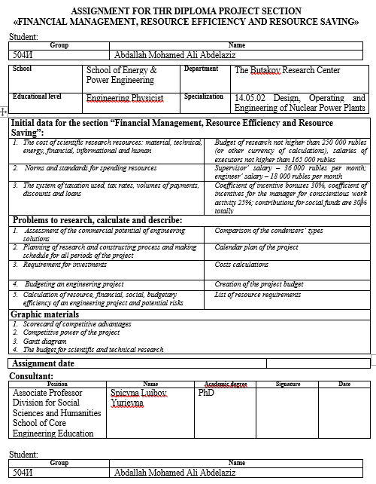
Example

Slide 6
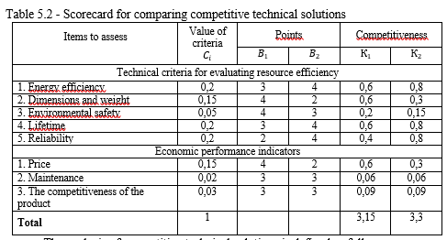
HOW to describe the technical solutions choice
You need to find most convenient(or possible) types of equipment and their combinations to solve the problems of your scientific research, give their short but understandable descriptions in the text of your FMP and then explain your decision basing on the results of analysis according to the instructions or your own one (as shown in the file that I will send you):

Slide 7
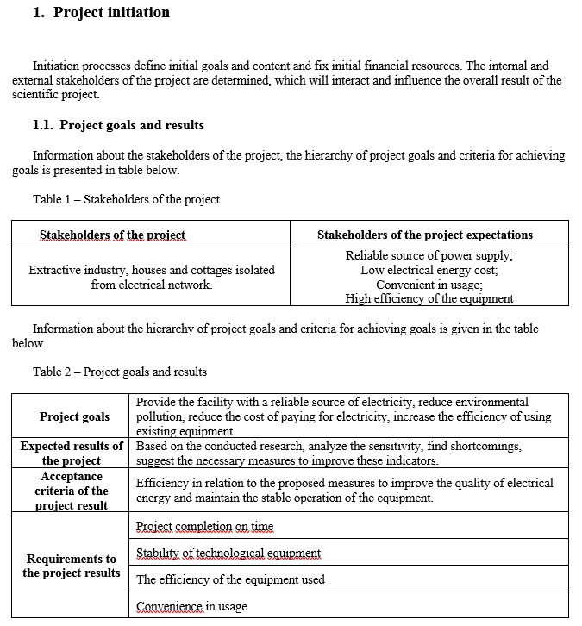
HOW to describe the project parameters and its competitiveness
Every research theme has its particular limitations and requirements which are known from your general diploma research assignment given you by your supervisor.
You need to describe them in the point “Project initiation” using the order given in your instructions’ file (and example file):

Slide 8
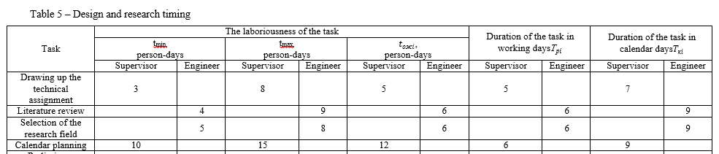
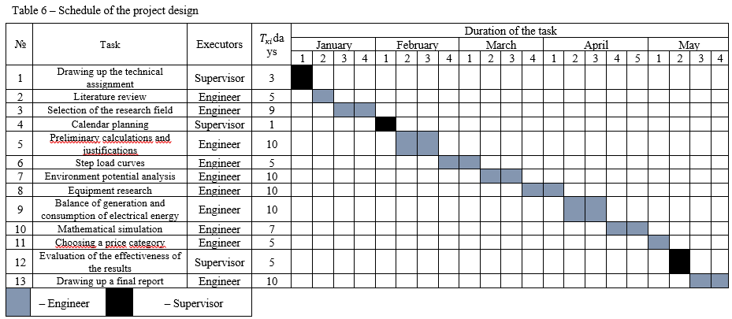
Then you need to plan your events and steps of research and draw the timetable and Gantt diagram. This process is necessary to calculate the time used by your working team to perform the investigations within your project

Slide 9
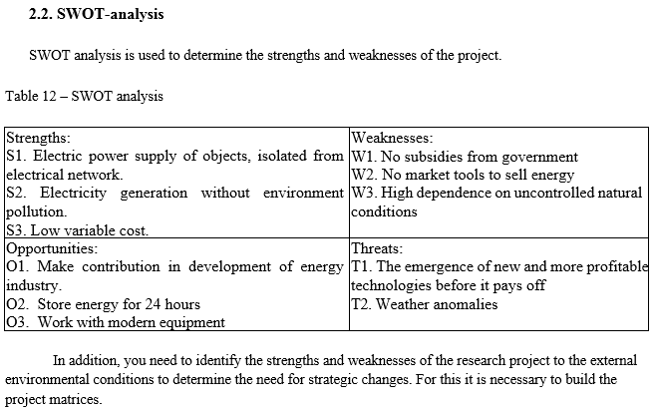
To show the strong and weak sides of your project you are to perform SWOT analysis as described in your instructions’ file (or in the example file).

Slide 10
To calculate the research and project budget as described in your instructions’ file (or in the example file).
!!! You have to realize that the research budget differs from the project budget.
Research budget includes all the costs of your research (electricity, internet, using computer and other equipment, payable computer programs, salaries of the supervisor and you as a designer and engineer, etc.)
Project budget includes the costs for market selling of final results of your project (for example, constructing of nuclear power plant based on your research).
Taking into account your research features, if it is impossible to promote your research results to the market, it would be enough to calculate research budget to be assessed positively for your FMP!

