Slide 1


The basic vales of Russian State
By Natalia Skakovskaya

Slide 2
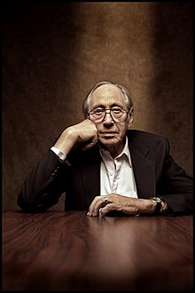
Elvin Toffler
1928 – 2016

Slide 3
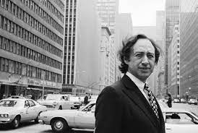
Alvin Eugene Toffler (1928 –2016) was an American writer, futurist, and businessman known for his works discussing modern technologies, including the digital revolution and the communication revolution, with emphasis on their effects on cultures worldwide. He is regarded as one of the world's outstanding futurists.

Slide 4

Toffler was an associate editor of Fortune magazine. In his early works he focused on technology and its impact, which he termed "information overload".
In 1970, his first major book about the future, Future Shock, became a worldwide best-seller and has sold over 6 million copies.

Slide 5
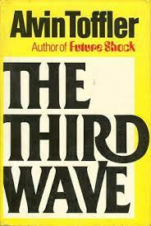
He and his wife Heidi Toffler, who collaborated with him for most of his writings, moved on to examining the reaction to changes in society with another best-selling book, The Third Wave, in 1980.
In it, he foresaw such technological advances as cloning, personal computers, the Internet, cable television and mobile communication.

Slide 6
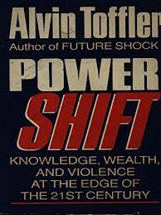
His later focus, via their other best-seller, Powershift, (1990), was on the increasing power of 21st-century military hardware and the proliferation of new technologies.

Slide 7

https://tofflerassociates.com/#
He founded Toffler Associates, a management consulting company, and was a visiting scholar at the Russell Sage Foundation, visiting professor at Cornell University, faculty member of the New School for Social Research, a White House correspondent, and a business consultant. Toffler's ideas and writings were a significant influence on the thinking of business and government leaders worldwide, including China's Zhao Ziyang, and AOL founder Steve Case.

Slide 8
Ideas and opinions
Toffler stated many of his ideas during an interview with the Australian Broadcasting Corporation in 1998.
"Society needs people who take care of the elderly and who know how to be compassionate and honest," he said. "Society needs people who work in hospitals. Society needs all kinds of skills that are not just cognitive; they're emotional, they're affectional. You can't run the society on data and computers alone.

Slide 9
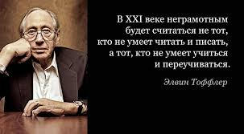
His opinions about the future of education, many of which were in Future Shock, have often been quoted. An often misattributed quote, however, is that of psychologist Herbert Gerjuoy: "Tomorrow's illiterate will not be the man who can't read; he will be the man who has not learned how to learn."

Slide 10

Early in his career, after traveling to other countries, he became aware of the new and myriad inputs that visitors received from these other cultures.
He explained during an interview that some visitors would become "truly disoriented and upset" by the strange environment, which he described as a reaction to culture shock.

Slide 11

From that issue, he foresaw another problem for the future, when a culturally "new environment comes to you ... and comes to you rapidly."
That kind of sudden cultural change within one's own country, which he felt many would not understand, would lead to a similar reaction, one of "future shock", which he wrote about in his book by that title.

Slide 12


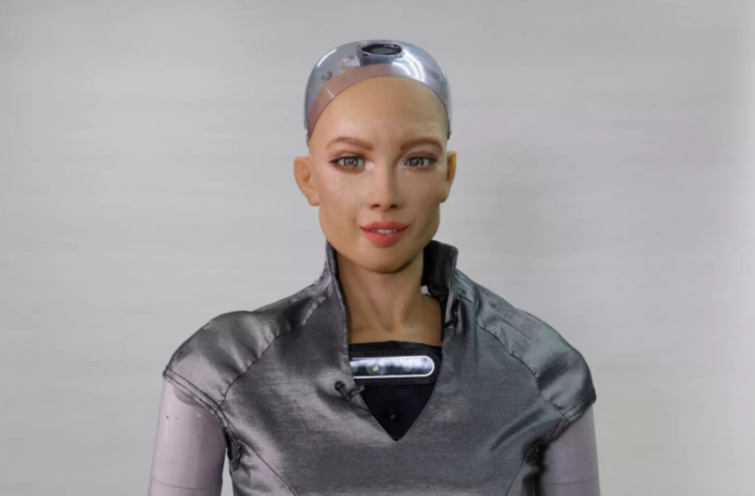

Toffler writes:
We must search out totally new ways to anchor ourselves, for all the old roots —
religion,
nation,
community,
family,
or profession —
are now shaking under the hurricane impact of the accelerative thrust.

Slide 13

In The Third Wave, Toffler describes three types of societies, based on the concept of "waves"—
each wave pushes the older societies and cultures aside.

Slide 14
He describes the "First Wave" as the society after agrarian revolution and replaced the first hunter-gatherer cultures.
The "Second Wave," he labels society during the Industrial Revolution (ca. late 17th century through the mid-20th century). That period saw the increase of urban industrial populations which had undermined the traditional nuclear family, and initiated a factory-like education system, and the growth of the corporation.

Slide 15
Elvin Toffler
The Second Wave Society is industrial and based on mass production, mass distribution, mass consumption, mass education, mass media, mass recreation, mass entertainment, and weapons of mass destruction.
You combine those things with standardization, centralization, concentration, and synchronization, and you wind up with a style of organization we call bureaucracy.

Slide 16
The "Third Wave" was a term he coined to describe the post-industrial society, which began in the late 1950s. His description of this period dovetails with other futurist writers, who also wrote about the Information Age, Space Age, Electronic Era, Global Village, terms which highlighted a scientific-technological revolution. The Tofflers claimed to have predicted a number of geopolitical events, such as the collapse of the Soviet Union, the fall of the Berlin Wall and the future economic growth in the Asia-Pacific region.

Slide 17


Influences and popular culture

Slide 18
Toffler often visited with dignitaries in Asia, including China's Zhao Ziyang, Singapore's Lee Kuan Yew and South Korea's Kim Dae Jung, all of whom were influenced by his views as Asia's emerging markets increased in global significance during the 1980s and 1990s. Although they had originally censored some of his books and ideas, China's government cited him along with Franklin Roosevelt and Bill Gates as being among the Westerners who had most influenced their country.

Slide 19
The Third Wave along with a video documentary based on it became best-sellers in China and were widely distributed to schools. The video's success inspired the marketing of videos on related themes in the late 1990s by Infowars, whose name is derived from the term coined by Toffler in the book.

Slide 20
Toffler's influence on Asian thinkers was summed up in an article in Daedalus, published by the American Academy of Arts & Sciences: Where an earlier generation of Chinese, Korean, and Vietnamese revolutionaries wanted to re-enact the Paris Commune as imagined by Karl Marx, their post-revolutionary successors now want to re-enact Silicon Valley as imagined by Alvin Toffler

Slide 21
https://m.youtube.com/watch?v=CJVVihtebFo

