Slide 1

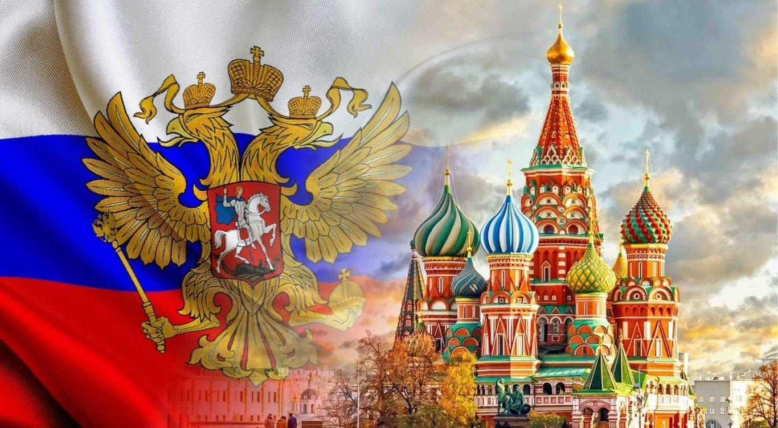
The basic vales of Russian State
By Natalia Skakovskaya

Slide 2
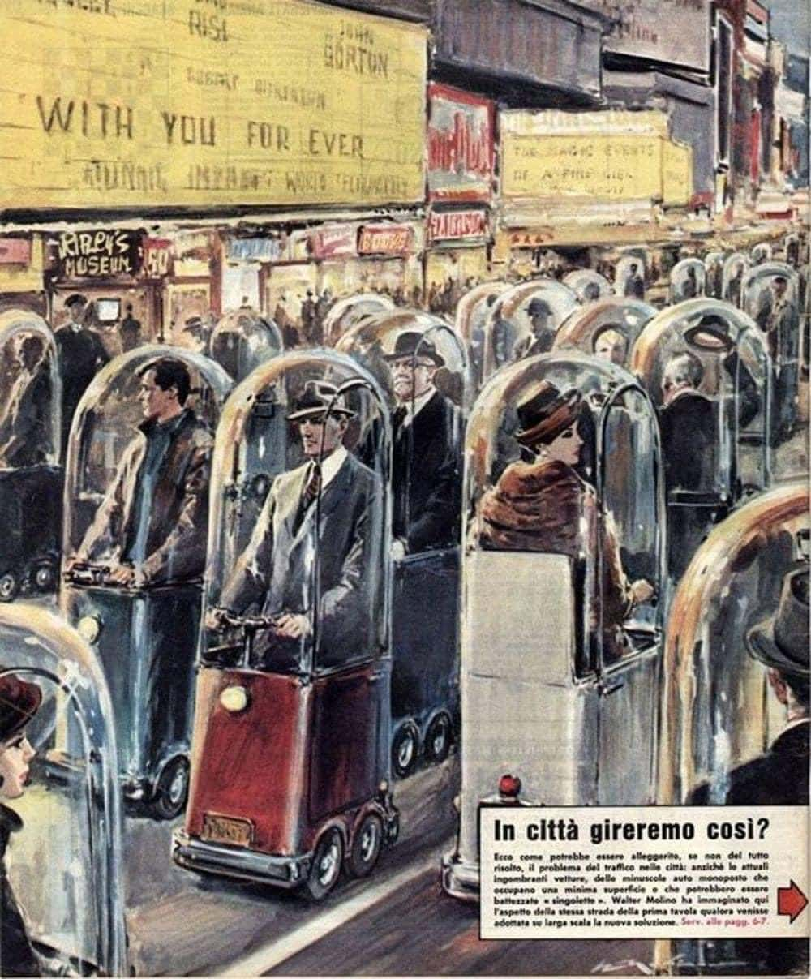
Lecture 2. Russia: trials and heroes
How 1962 imagined life in 2022

Slide 3
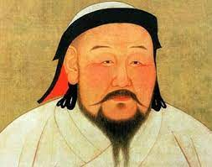
1.1. Mongol ivasion
1223 Battle of Kalka
Kyiv, Rostov, Galich, Chernigov, Ryazan and other centers of Russia were wiped off the face of the earth.
It took Russian lands more than a hundred years to recover from the devastating invasion.
13 th century GenghisKhan

Slide 4
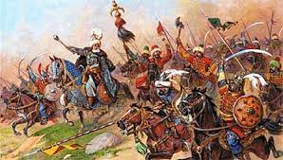
3 June 1571 гoдa
Turkish-Tatar army
Moscow burned downThe Kremlin survived up to 150 thousand Russian people were taken captive and subsequently sold into slavery.

Slide 5
Time of Troubles 1598 – 1613
This dark period was not caused by an attack or threat from outside, but it was a combination of misfortune, war and bad policy that led to the Time of Troubles.

Slide 6
The main reason for the Time of Troubles was the end of the Rurik dynasty - Ivan the Terrible’s son Fedor had no children, and Ivan the Terrible’s last son Dmitry Uglichsky died or was killed under mysterious circumstances.
There was no legitimate heir to the throne, and the throne was taken by Boris Godunov, the brother of Tsar Feodor's wife.
Time of Troubles 1598 – 1613

Slide 7
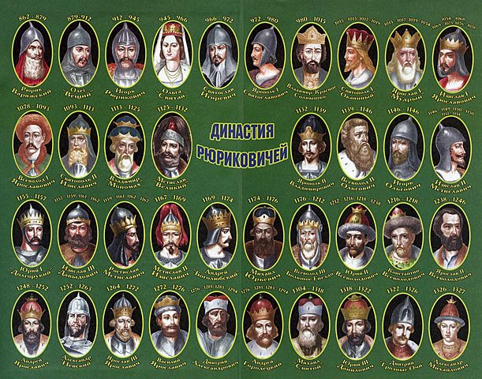

Slide 8
In the last years of the reign of Ivan the Terrible and Fyodor Fedorovich, serfdom acquired a systemic character in Russia, tying peasants to the land and increasing social disasters. But serfdom did not save the Russians from the great famine of 1601–1603.

Slide 9
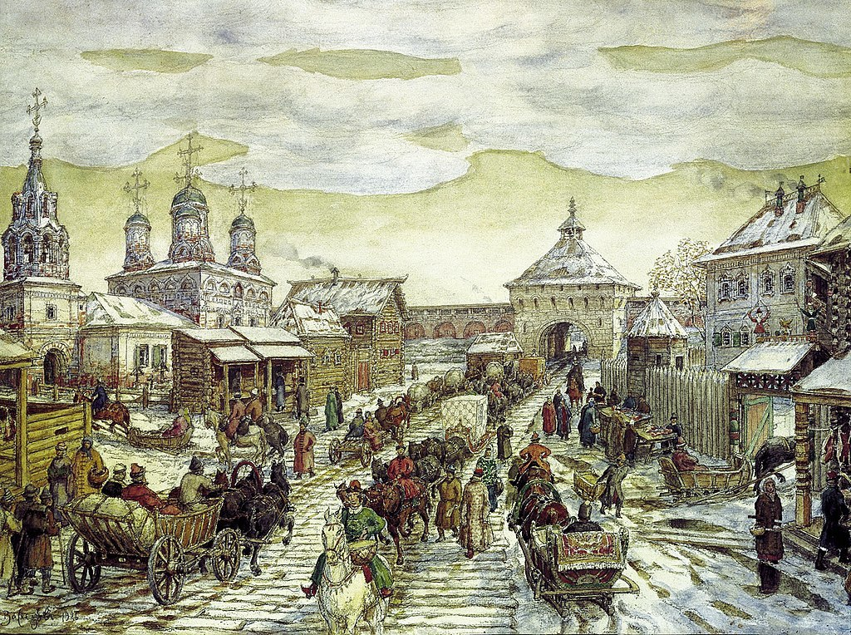
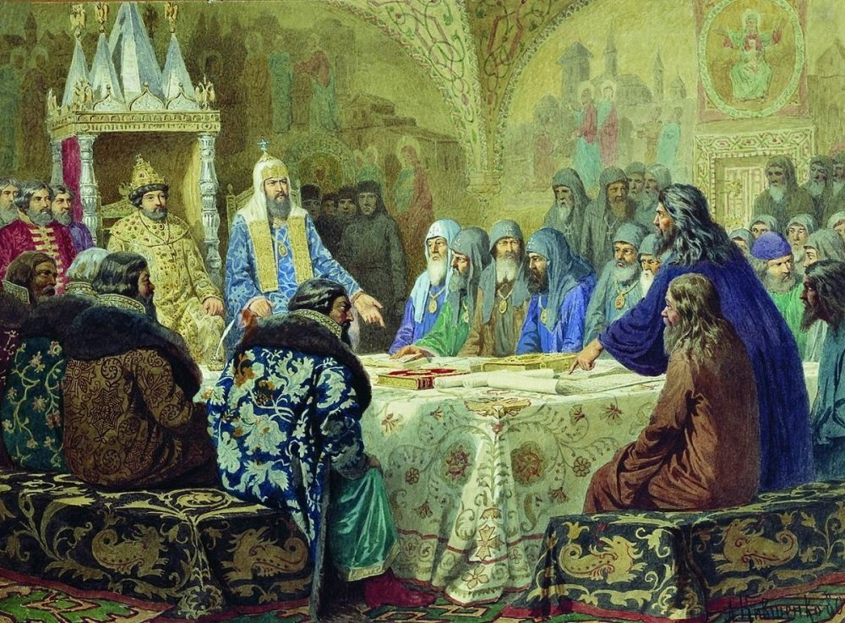
Plague 1653-1654
1653 Church reform
1654 plague epidemic

Slide 10
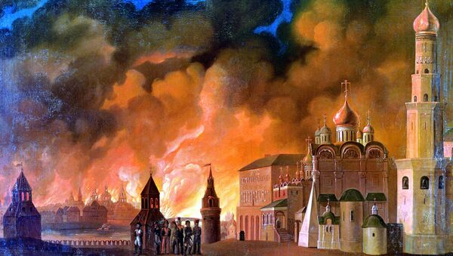
Patriotic war 1812
Napoleon Bonaparte
Battle of Borodino
3rd of September 1812
Fire in Moscow

Slide 11
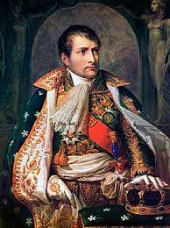
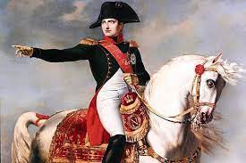
1769 -1821Napoleon Bonaparte

Slide 12
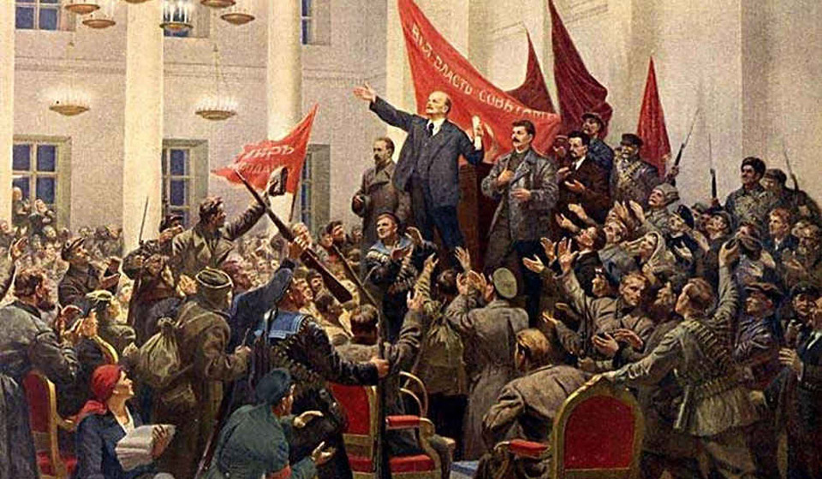
Three revolutions, World War I and Civil War
война с Японией в 1905
первая русская революция 1905 года
World War I
February revolution 1917
October revolution1917 года
Civil War (1917–1923)

Slide 13
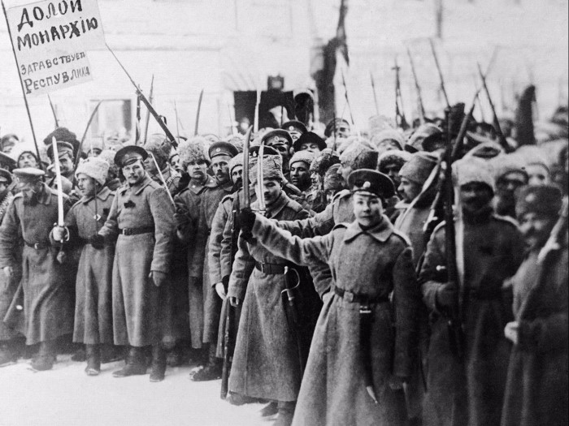
Civil War (1917–1923)

Slide 14
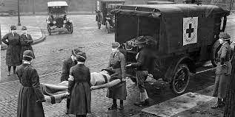
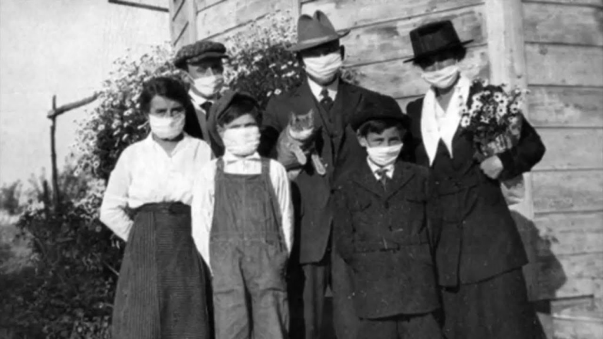
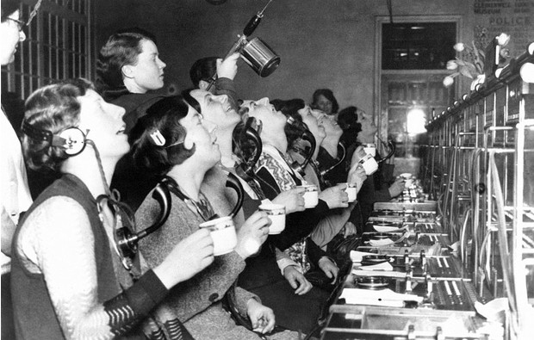
Spanish flu pandemic 1918

Slide 15
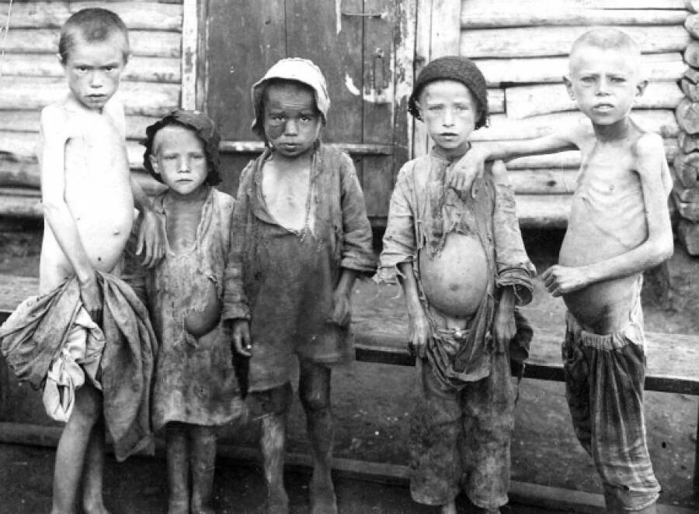
Great hunger 1921–1922

Slide 16
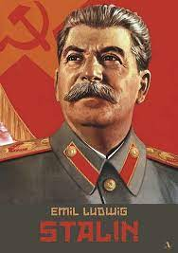
Iosiv Stalin (Dzhugashvili) (Georgia)
Soviet political, state, military and party leader, Russian revolutionary. The actual leader of the USSR.
In 1928-1929 he initiated the transition from the course of the new economic policy
1878- 1953

Slide 17
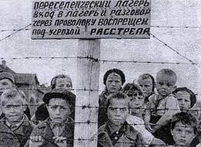
Stalin’s regime
Mass collectivization of agriculture (1928–1940)
Big and small peasant uprisings
Massive hunger 1932–1933

Slide 18
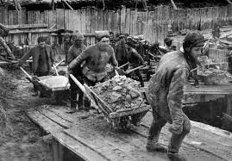
In the Special Camps, prisoners convicted under Article 58 of treason, espionage, terrorism and other political crimes, as well as Trotskyists, Bukharinists, Mensheviks, Socialist Revolutionaries, anarchists, nationalists, were supposed to serve their sentences.

Slide 19
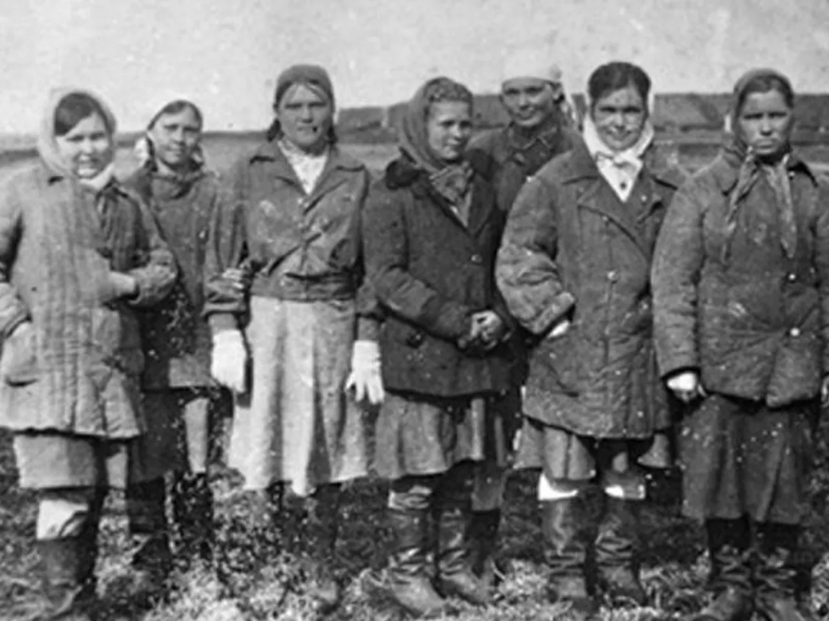

Slide 20
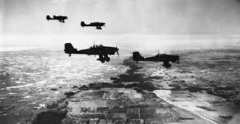
Second World War
22 of June 1941

Slide 21
Terroristic attics of ХХ century
В 1995-м группа террористов из 195 человек под командованием Шамиля Басаева захватила 1200 жителей города Буденновска, которых согнали в местную больницу.
в 2006-м в России приняли закон «О противодействии терроризму».
В сентябре 1999-го произошла серия взрывов жилых домов в Москве, Буйнакске и Волгодонске

Slide 22
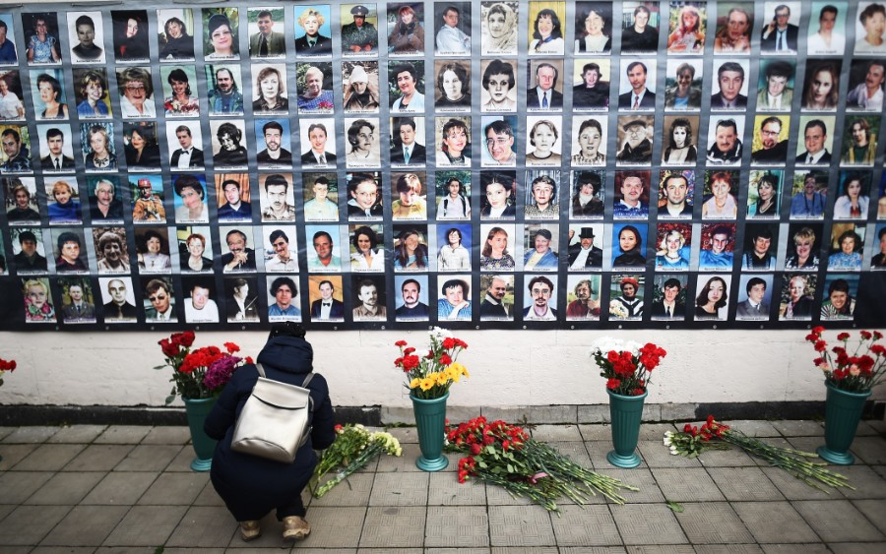
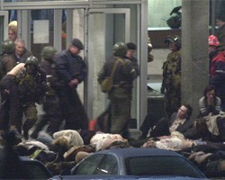
Theatre
2002 Moscow
Musical «Норд-Ост»

Slide 23
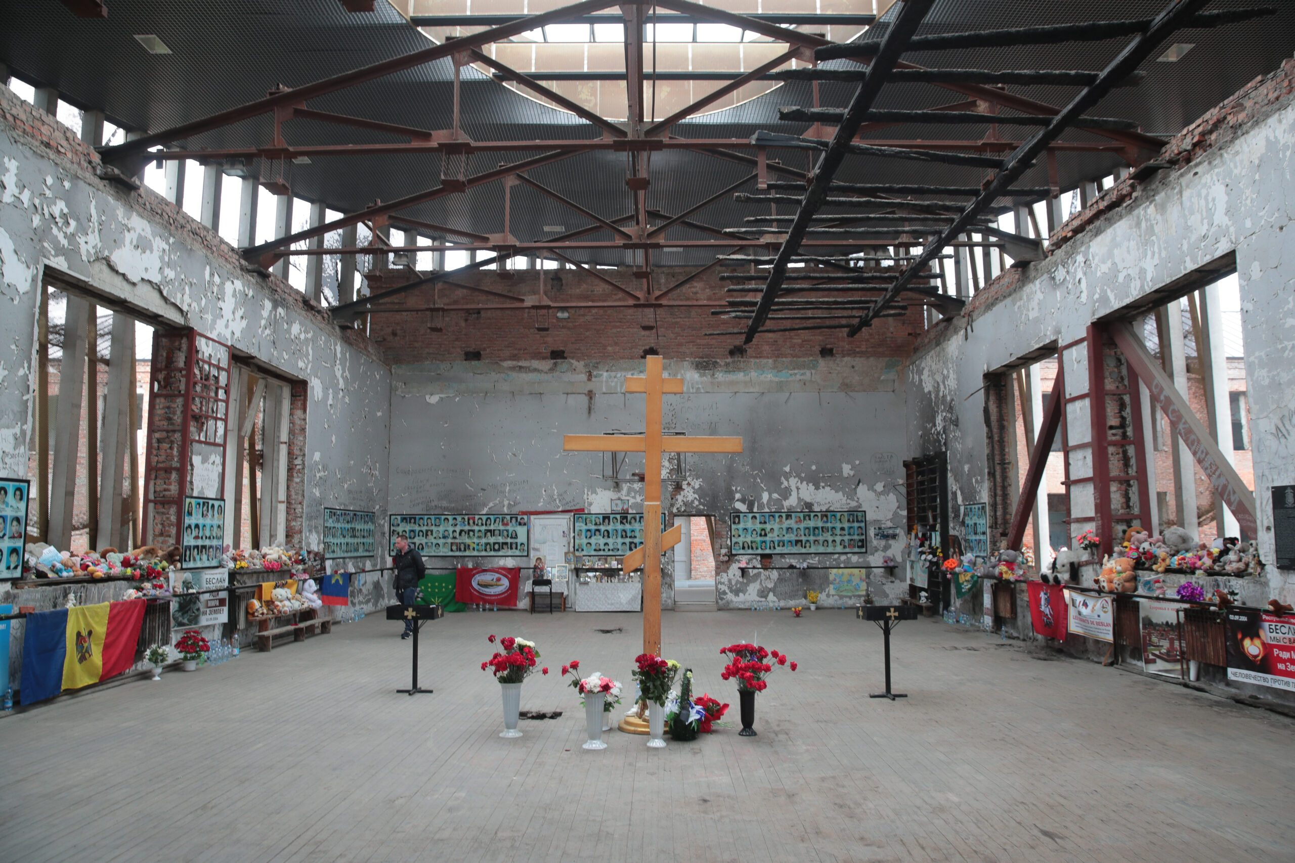
the 1 September 2004 North Ossetia Beslan

Slide 24
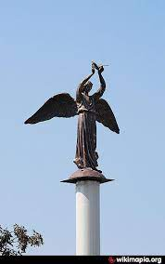
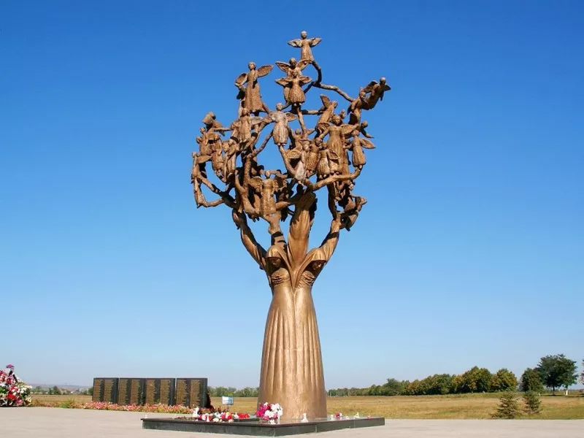
City of Angels

