Slide 1
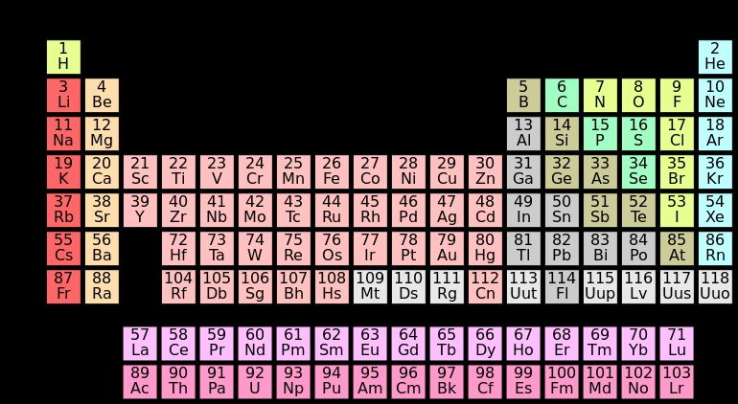

Slide 2
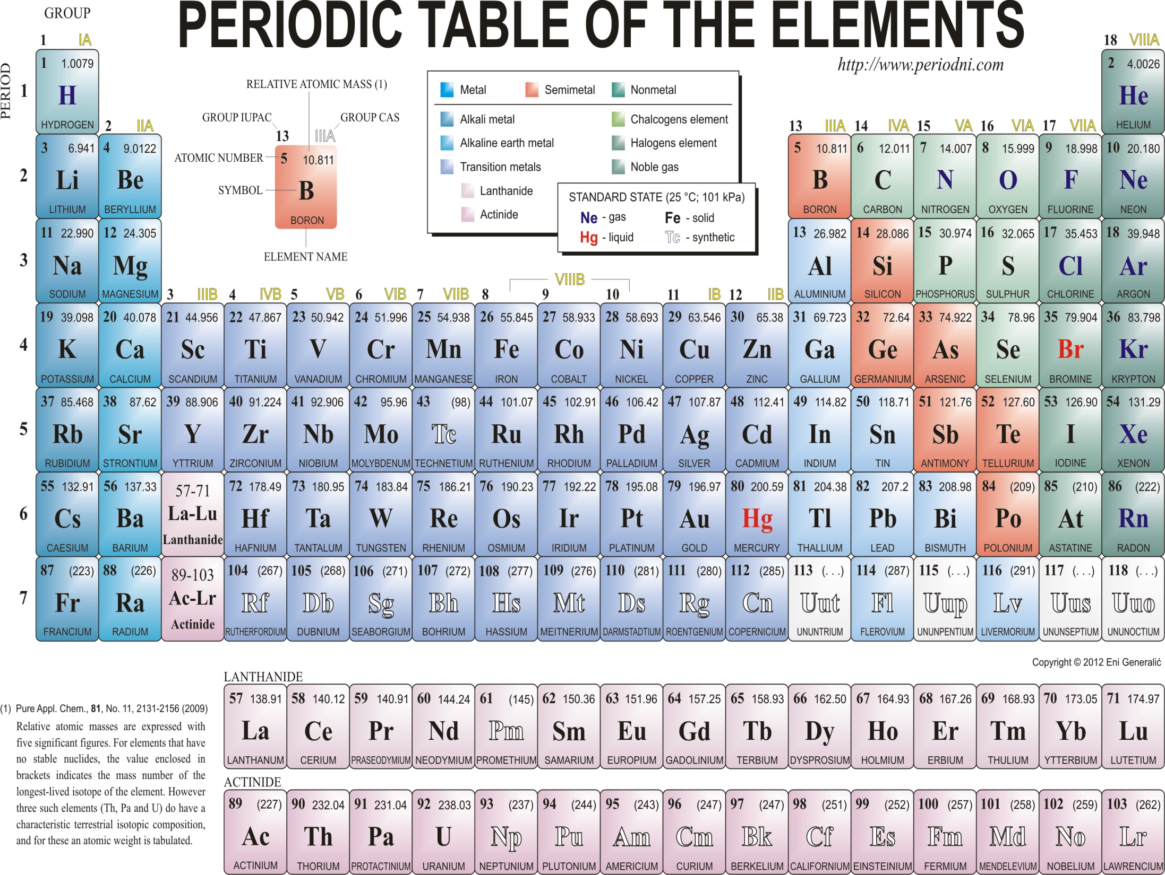

Slide 3
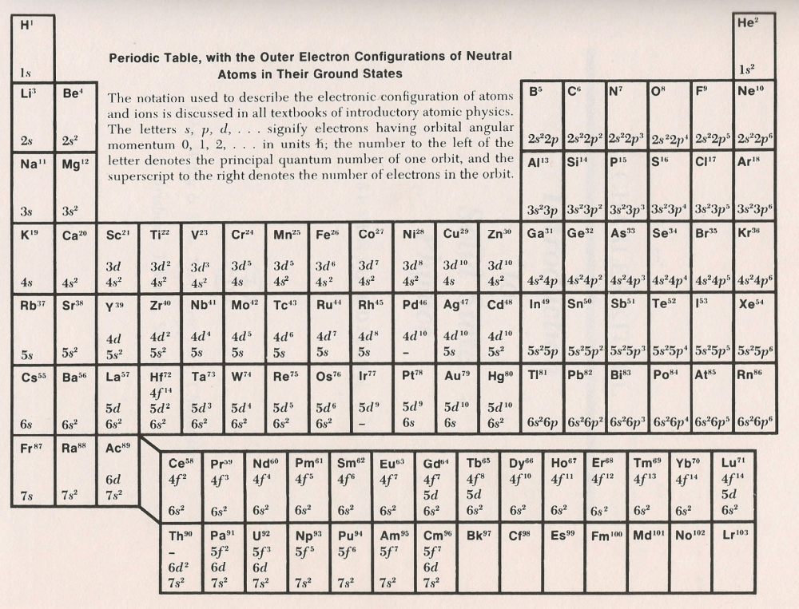

Slide 4
With relation to previous slide:
Group I – alkali metals, partially filled bands
Group II – alkaline earths
Group IV – semiconductors, insulators, filled bands + transition metals, noble metals

Slide 5
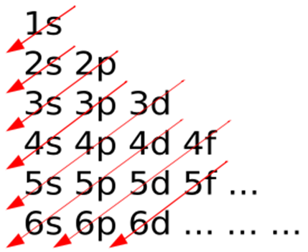
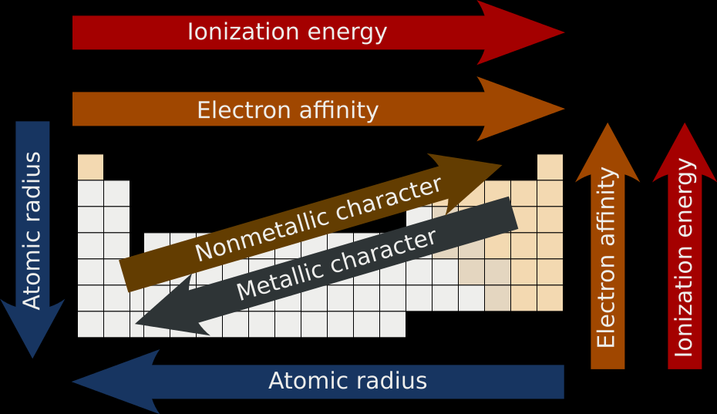
Electron configuration
Approximate order in which shells and subshells are arranged by increasing energy according to the Madelung rule

Slide 6
The electrons occupy a series of electron shells (numbered shell 1, shell 2, and so on). Each shell consists of one or more subshells (named s, p, d, f and g).
As atomic number increases, electrons progressively fill these shells and subshells more or less according to the Madelung rule or energy ordering rule, as shown in the diagram. The electron configuration for neon, for example, is 1s² 2s² 2p⁶.
With an atomic number of ten, neon has two electrons in the first shell, and eight electrons in the second shell – two in the s subshell and six in the p subshell. In periodic table terms, the first time an electron occupies a new shell corresponds to the start of each new period, these positions being occupied by hydrogen and the alkali metals.

Slide 7

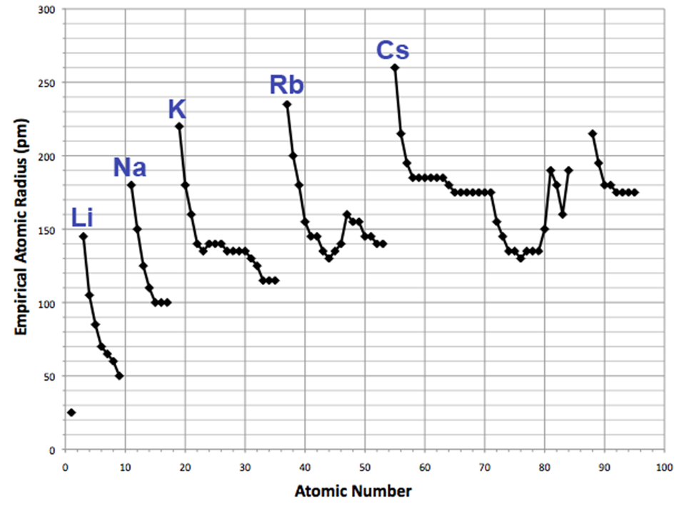
Atomic radii vary in a predictable and explainable manner across the periodic table.

Slide 8
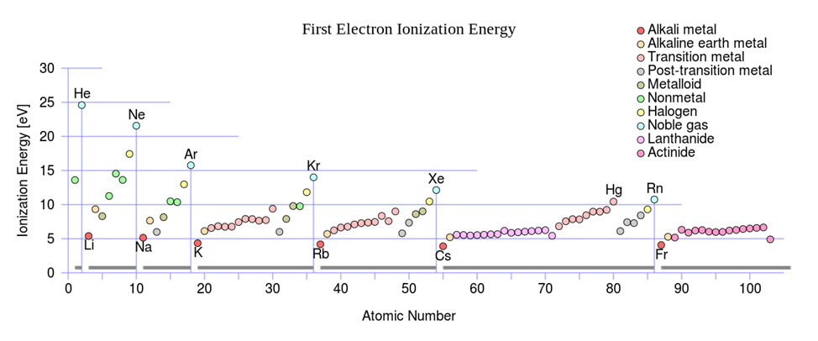
Ionization energy
The first ionization energy is the energy it takes to remove one electron from an atom, the second ionization energy is the energy it takes to remove a second electron from the atom, and so on. For a given atom, successive ionization energies increase with the degree of ionization.

Slide 9
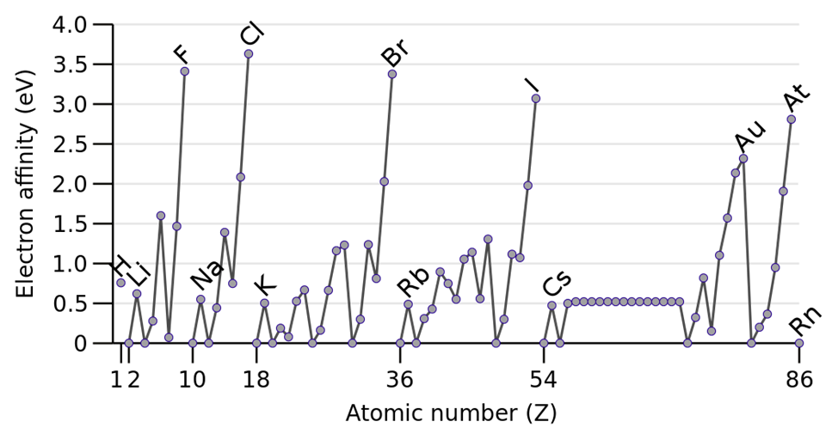
Electron affinity
The electron affinity of an atom is the amount of energy released when an electron is added to a neutral atom to form a negative ion.
Electron affinity generally increases across a period. This is caused by the filling of the valence shell of the atom; a group 17 atom releases more energy than a group 1 atom on gaining an electron because it obtains a filled valence shell and is therefore more stable.

