Slide 1
Separation techniques

Slide 2
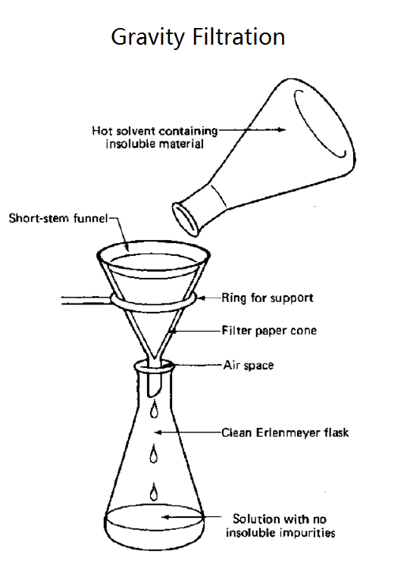
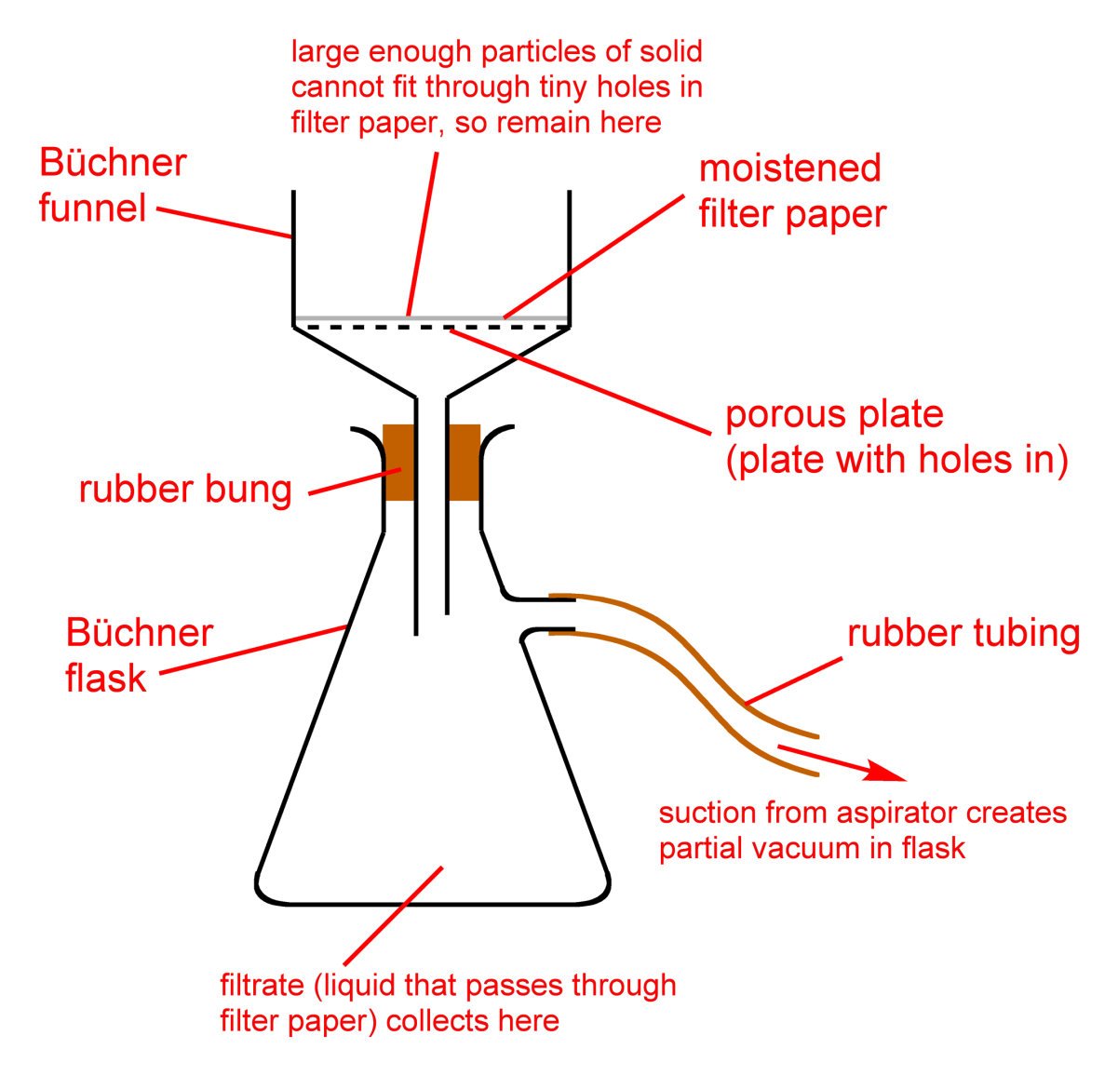
Filtration
Vacuum filtration
Precipitate,
crystals
Filtrate
(mother liquor)
Notes:
https://www.youtube.com/watch?v=17xy5-g22hI

Slide 3
Filtration
When we use gravity filtration?
What is the desired product in gravity filtration?
What equipment do you need to conduct gravity filtration?
How many methods of paper filter folding do you know?
How to properly pour suspension into a filter during gravity filtration?
In what case we use vacuum filtration?
What is the advantage of vacuum filtration?
What does a vacuum filtration setup include?
Notes:
https://www.youtube.com/watch?v=17xy5-g22hI

Slide 4
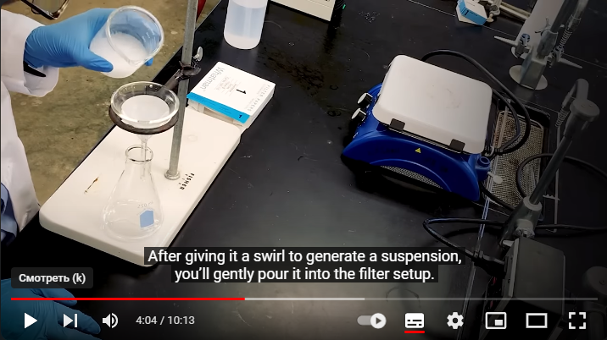

Slide 5
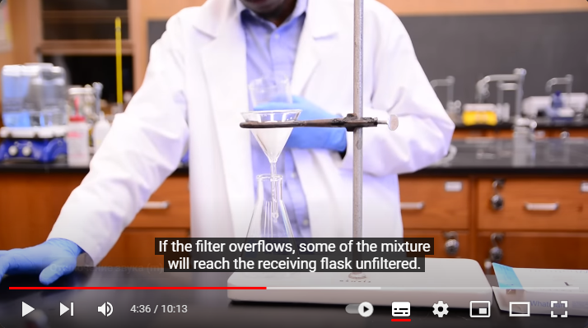

Slide 6
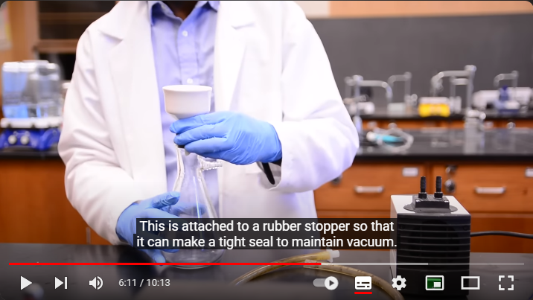

Slide 7
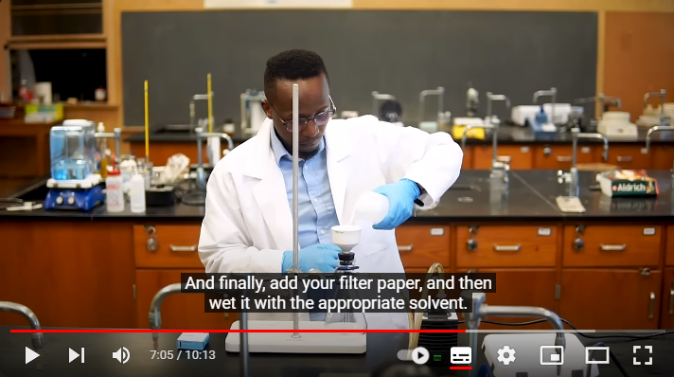

Slide 8
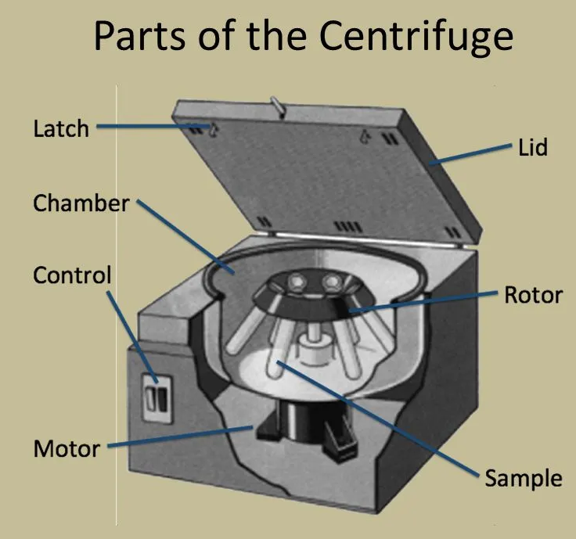
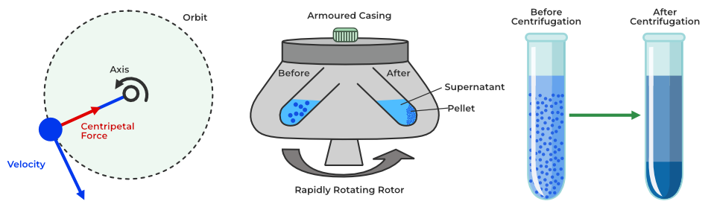
Centrifugation
Centrifugation is a mechanical process which involves the use of the centrifugal force to separate particles from a solution according to their size, shape, density, medium viscosity and rotor speed.
Chemists and biologists may increase the effective gravitational force of the test tube so that the precipitate (pellet) will travel quickly and fully to the bottom of the tube. The remaining liquid that lies above the precipitate is called a supernatant or supernate.

Slide 9
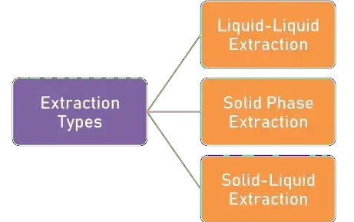
Extraction
Extraction is the method of removing active constituents from a solid or liquid by means of liquid solvent.
In this extraction the components of the liquid mixture are separated by contacting them with a suitable insoluble solvent which preferentially dissolves one or more components.
Solid phase extraction involves contacting of aqueous samples with a solid phase or sorbent, where the component under consideration is adsorbed on the surface of the solid phase prior to elution.
Solid-liquid extraction means the removal of constituents from a mixture of solids by bringing the solid material into contact with a liquid solvent that dissolves these particular constituents.

Slide 10
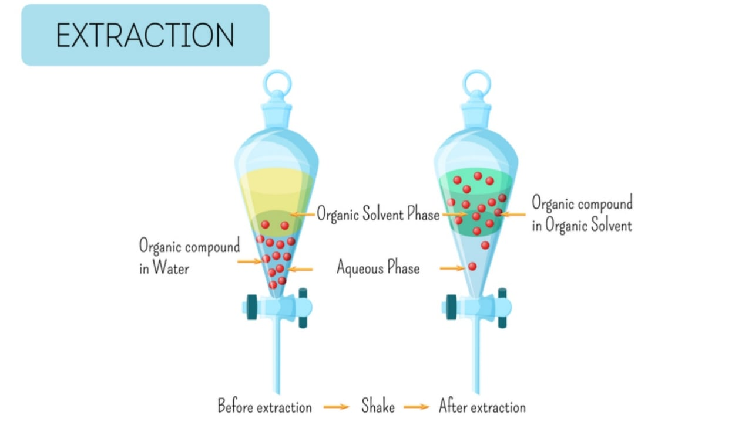
Extraction
Notes:
https://www.youtube.com/watch?v=TL0ZsNHGhsc

