Slide 1
Purification methods

Slide 2
Methods of purification of organic compound
Recrystallization
Sublimation
Distillation
Fractional distillation
Steam distillation
Column chromatography
Centrifugation
Solvent extraction

Slide 3
Recrystallization
Recrystallization is a method employed to purify solid compounds
It involves dissolving the impure solid in a heated solvent until the solution reaches saturation, followed by gradual cooling.
As the solution cools, pure crystals form while impurities are left behind.
Notes:
https://www.google.com/search?q=recrystallization&source=lmns&tbm=vid&bih=607&biw=1366&hl=ru&sa=X&ved=2ahUKEwiz67ygjL6CAxXkIRAIHYkEBOAQ_AUoAnoECAEQAg#fpstate=ive&vld=cid:d93d777a,vid:04HWovMzkAk,st:0

Slide 4
Sublimation
Sublimation is the direct change of
➔ a solid to vapour on heating, or
➔ a vapour to solid on cooling
➔ without going through the liquid state

Slide 5
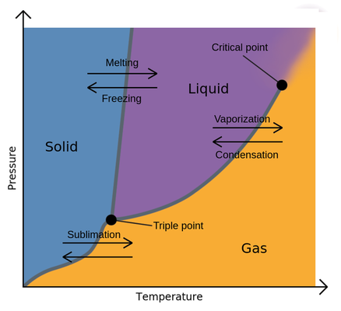
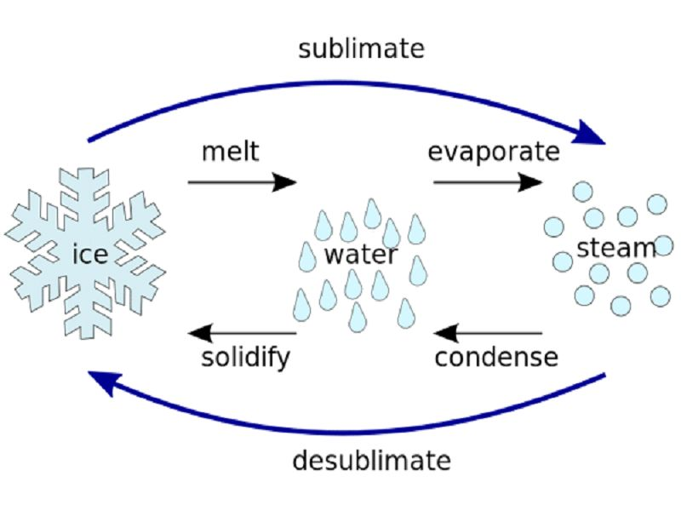
Sublimation
Phase transitions of matter
 | Solid | Liquid | Gas | Plasma
Solid |  | Melting | Sublimation
Liquid | Freezing |  | Vaporization
Gas | Deposition | Condensation |  | Ionization
Plasma |  |  | Recombination
Sublimation technique

Slide 6
Sublimation
A mixture of two compounds is heated in an evaporating dish
One compound changes from solid to vapour directly
➔ The vapour changes back to solid on a cold surface
The other compound is not affected by heating and remains in the evaporating dish

Slide 7
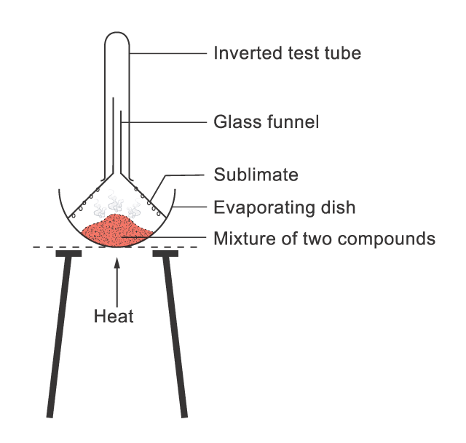
Sublimation
A mixture of two compounds can be separated by sublimation

Slide 8
Distillation
Aim
To separate a solution of a solid in a liquid and for separating a solution of two liquids whose boiling points are different.
Principle
Distillation involves the conversion of a liquid into its vapors upon heating and then cooling the vapors back into the liquid. Depending on the difference in boiling points of liquids.
Types of distillation
Simple Distillation
Fractional Distillation
Distillation Under Reduced Pressure or Vacuum Distillation
Steam Distillation

Slide 9
Simple distillation
A method used to separate a solvent from a solution containing non-volatile solutes or to separate a mixture of two or more miscible liquids having boiling points differing by 40-50 degrees.
When a solution is boiled,
➔ the liquid having the lower boiling point distills over first, and the other liquid component is left behind.
➔ the hot vapour formed condenses to liquid again on a cold surface
The liquid collected is the distillate

Slide 10
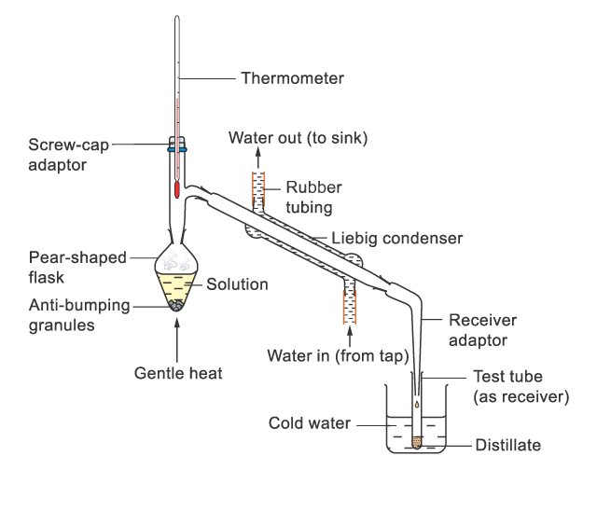
Simple distillation
The laboratory set-up of distillation

Slide 11
Simple distillation
Before the solution is heated,
➔ several pieces of anti-bumping granules are added into the flask
➔ prevent vigorous movement of the liquid called bumping to occur during heating
➔ make boiling smooth
If bumping occurs during distillation, some solution (not yet vaporized) may spurt out into the collecting vessel

Slide 12
Fractional Distillation
It is used for separating two liquids in any mixture, which have boiling points within a narrow range of temperatures.
In such cases, simple distillation does not give complete separation and a modified version called fractional distillation is employed.
A fractionating column is attached vertically between the flask and the condenser
➔ a column packed with glass beads
➔ provide a large surface area for the repeated condensation and vaporization of the mixture to occur

Slide 13
Fractional Distillation
The temperature of the escaping vapour is measured using a thermometer
When the temperature reading becomes steady,
➔ the vapour with the lowest boiling point firstly comes out from the top of the column
When all of that liquid has distilled off,
➔ the temperature reading rises and becomes steady later on another liquid with a higher boiling point distils out
Fractions with different boiling points can be collected separately

Slide 14
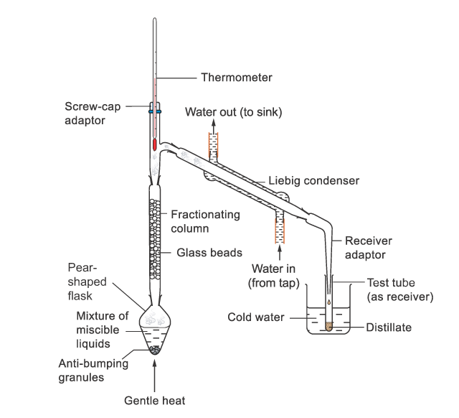
Fractional Distillation
The laboratory set-up of fractional distillation
Notes:
https://www.youtube.com/watch?v=Z6OyNB8V7Hc&ab_channel=ChemSurvival

Slide 15
Steam Distillation
This technique is used for separating/purifying liquids, which are immiscible with water, volatile in steam, & have high vapor pressure at the boiling temperature of water.
Steam distillation can be used when the boiling point of the substance to be extracted is higher than that of water, and the starting material cannot be heated to that temperature because of decomposition or other unwanted reactions.
It may also be useful when the amount of the desired substance is small compared to that of the non-volatile residues.

Slide 16
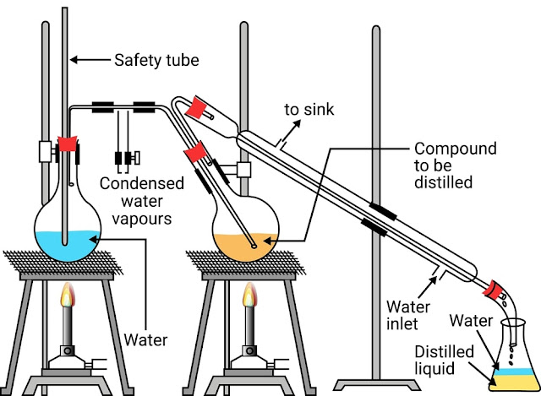
Steam Distillation

Slide 17
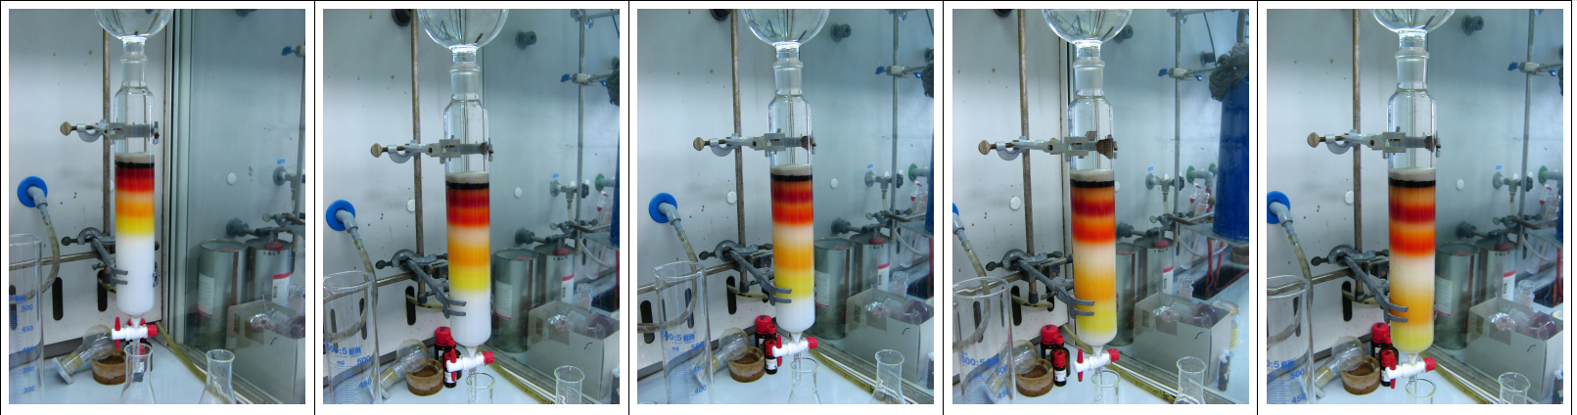
Column chromatography
Chromatography is able to separate substances based on differential adsorption of compounds to the adsorbent; compounds move through the column at different rates, allowing them to be separated into fractions.
Column chromatography video
Notes:
https://www.youtube.com/watch?v=Jr_ylwvxcQg&ab_channel=ProfessorDaveExplains

