Slide 1
Physical properties

Slide 2
Physical properties
A physical property is a characteristic of matter that is not associated with a change in its chemical composition. Familiar examples of physical properties include density, color, hardness, melting and boiling points, and electrical conductivity.
Other physical properties, such as the melting temperature of iron or the freezing temperature of water, can only be observed as matter undergoes a physical change. A physical change is a change in the state or properties of matter without any accompanying change in the chemical identities of the substances contained in the matter. Physical changes are observed when wax melts, when sugar dissolves in coffee, and when steam condenses into liquid water.

Slide 3
Absorption
boiling point
color
concentration
density
electrical conductivity
flash point
form
hardness
luminescence
melting point
purity
refraction index
solubility
thermal conductivity (and resistance)
vapor pressure
viscosity

Slide 4
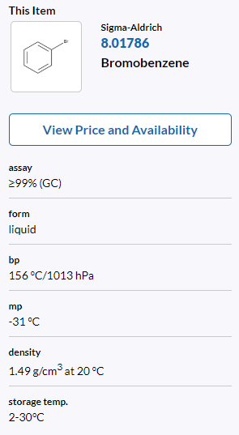
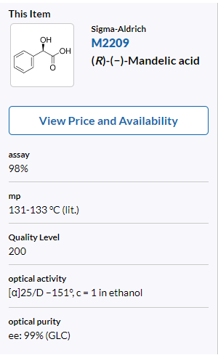
General properties
analysis
solid
gas
amorphous
crystals
Boiling point
Melting point
Notes:
http://www.chemspider.com/Chemical-Structure.2157.html?rid=d9aba2f6-6446-4524-bc41-12900cc423bf#suppInfoTab
http://www.chemspider.com/Chemical-Structure.971.html?rid=d76439a2-ddcb-4e2a-93ef-96132cc9201d

Slide 5
Appearance
Colorless to yellowish liquid with an ammonia-like odor.
Odorless, colorless to white, crystal-line powder.
Colorless to light-yellow liquid with an aromatic odor.
Colorless to light-pink with sharp, medicinal, sweet, tarry odor
Brownish-red liquid at room temperature with a bleach-like odor, dissolves in water.
a. Aspirin
b. Benzene
c. Bromine
d. Ethanol
e. Phenol
f. Triethylamine

Slide 6
Solubility
Designation of solubility of pharmaceutical substances and additive substances
Term | Approximate amount of solvent (mL) required for dissolution of 1 g of substance
Very easily soluble | up to 1 inclusive
Easily soluble | from 1 to 10 inclusive
Soluble | from 10 to 30 inclusive
Moderately soluble | from 30 to 100 inclusive
Slightly soluble | from 100 to 1,000 inclusive
Very slightly soluble | from 1,000 to 10,000 inclusive g
Practically insoluble | over 10,000

Slide 7
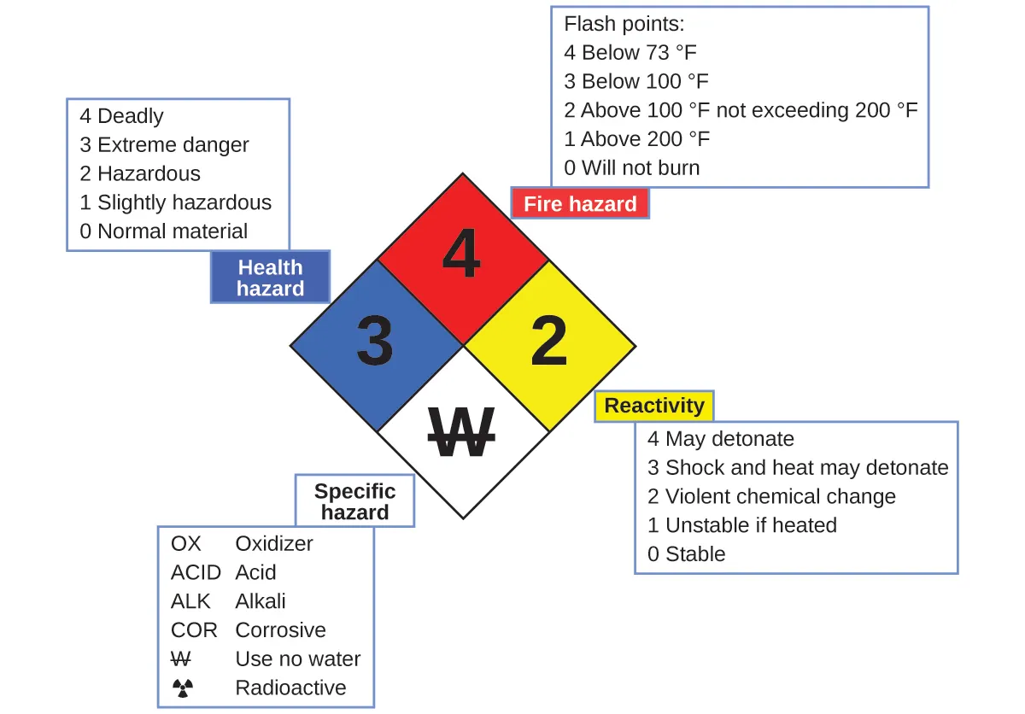
Hazard diamond
The National Fire Protection Agency (NFPA)

Slide 8
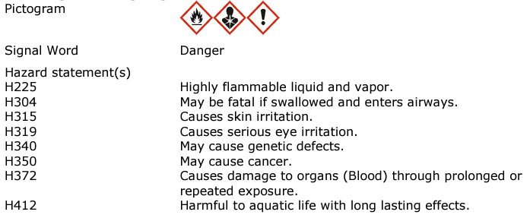
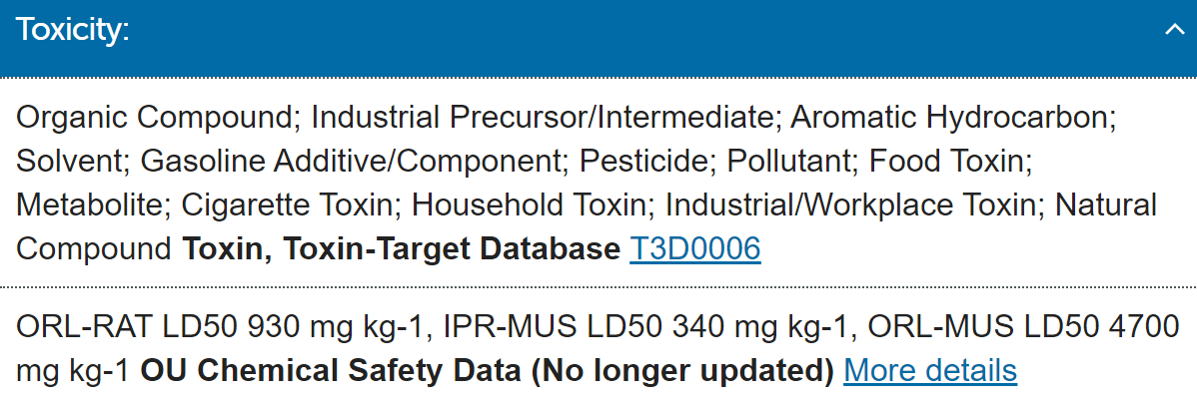
Toxicity
(Benzene)

