Slide 1
Lab equipment

Slide 2
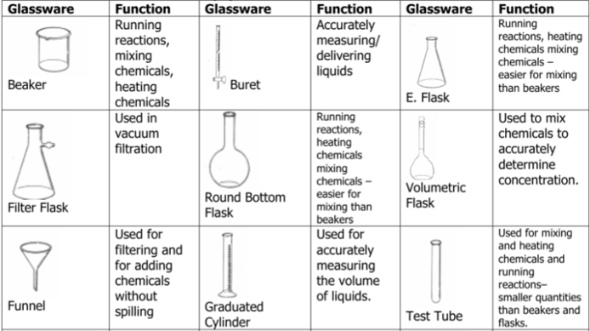
Laboratory glassware

Slide 3
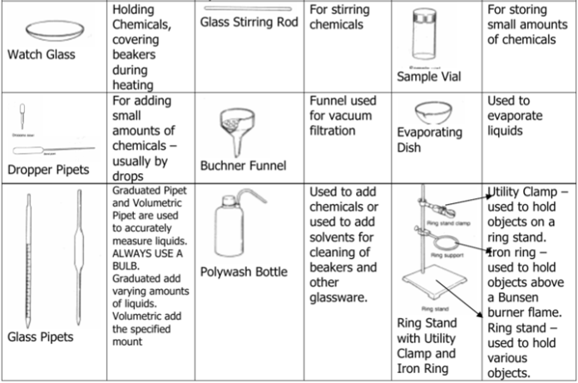
Laboratory glassware

Slide 4
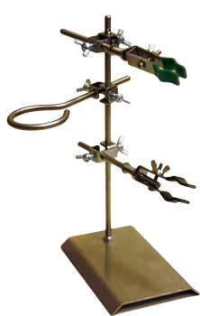
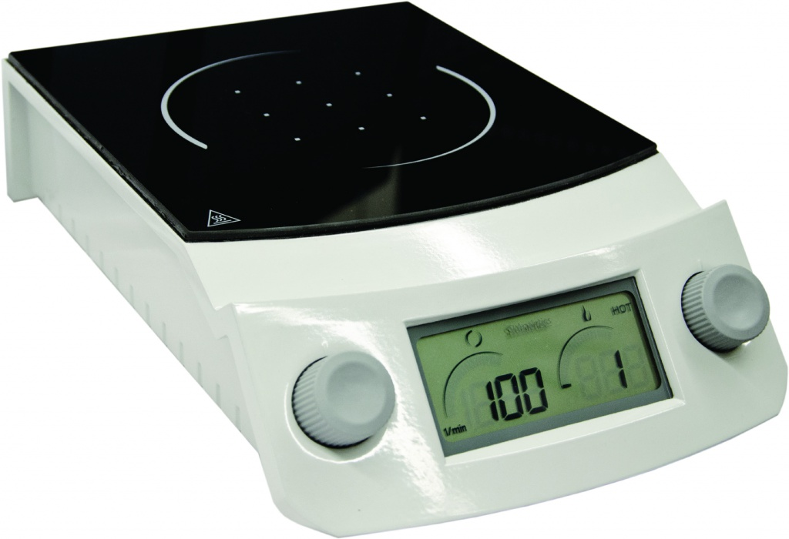
electric heater/ electric stove – электрическая плитка
stand – лабораторный штатив, состоит из:
Hot plate
  rod вертикальная стойка, стержень
  holder – держатель (лапка)
base основание, металлическая плита
Magnetic stirrer

Slide 5
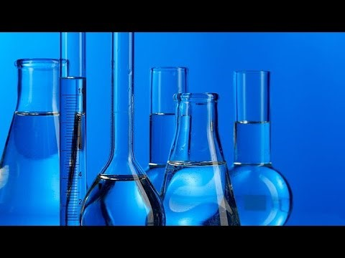
Common Scientific Glassware
Notes:
https://www.youtube.com/watch?v=RwBUgVDeRqw

Slide 6
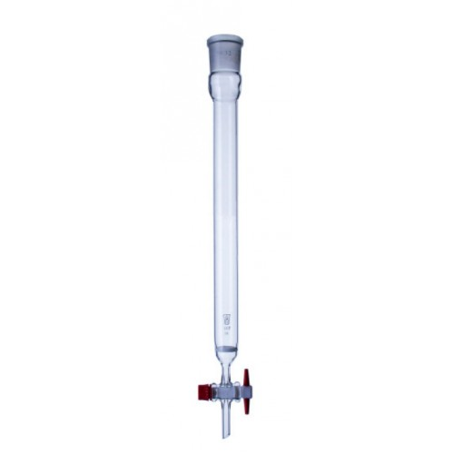
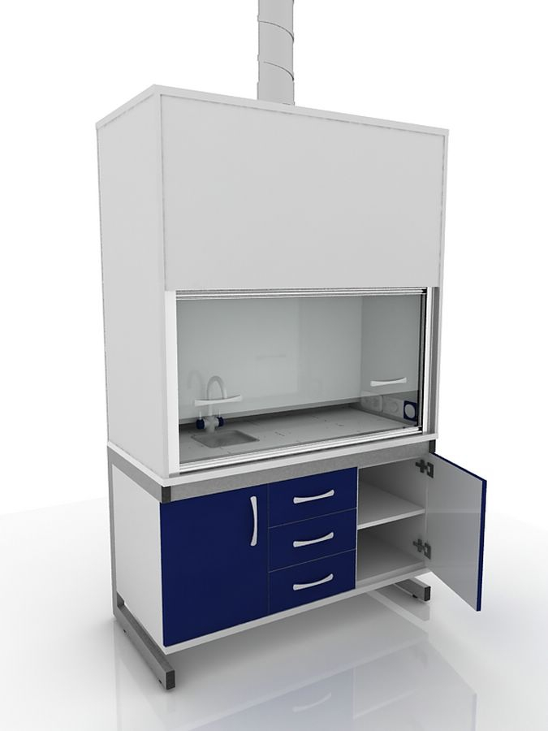
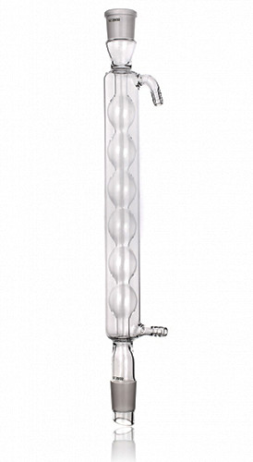
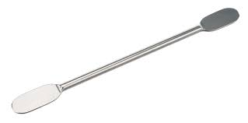
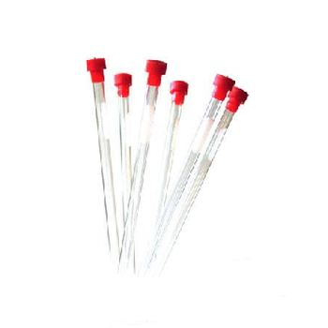
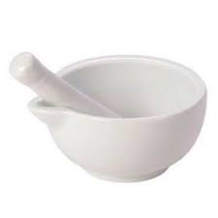
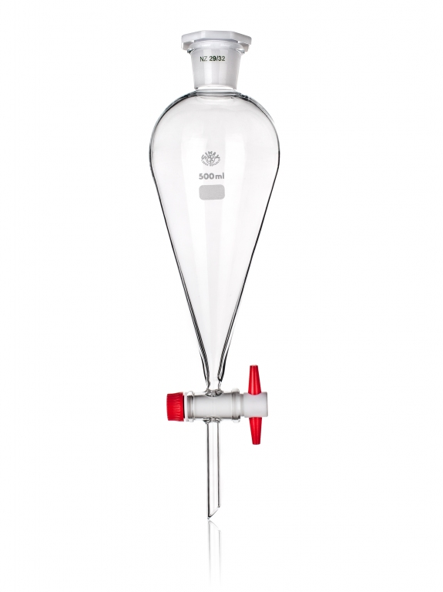
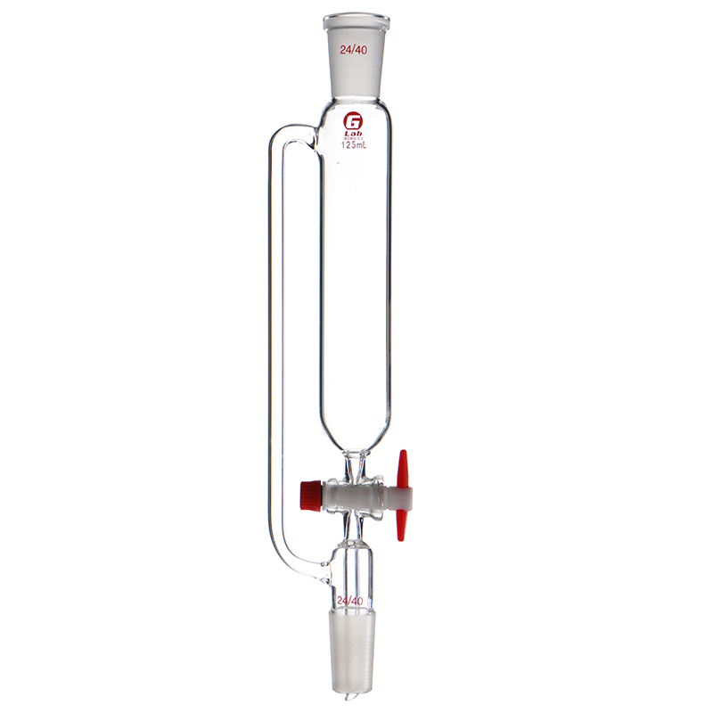
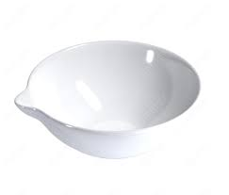
Chromatography column
Fume hood /
laboratory hood
Reflux condenser
Spatula
NMR tube
Mortar and pestle
Dropping funnel
Evaporating dish
Separatory funnel

Slide 7
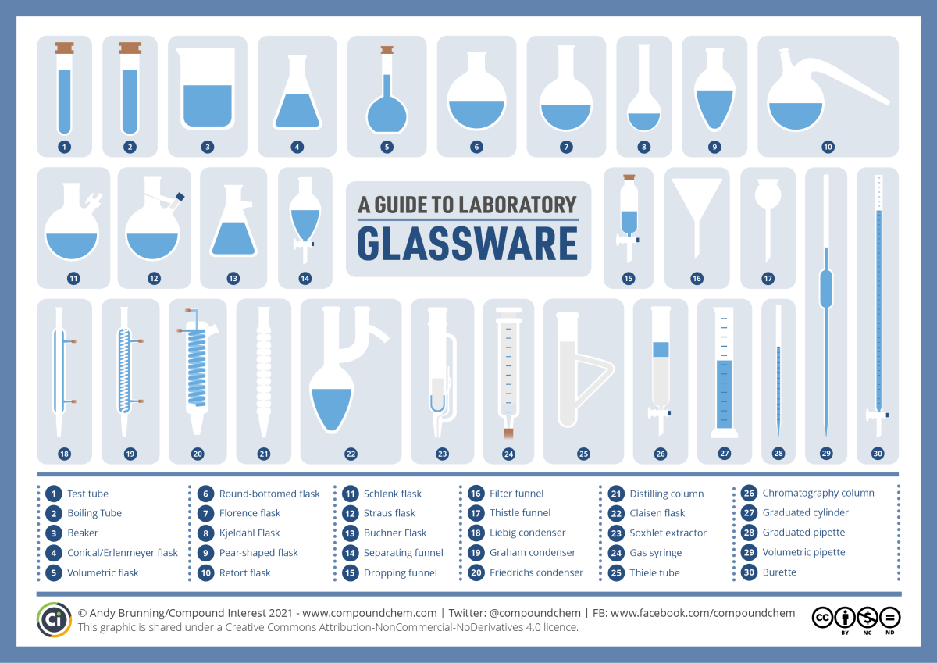

Slide 8
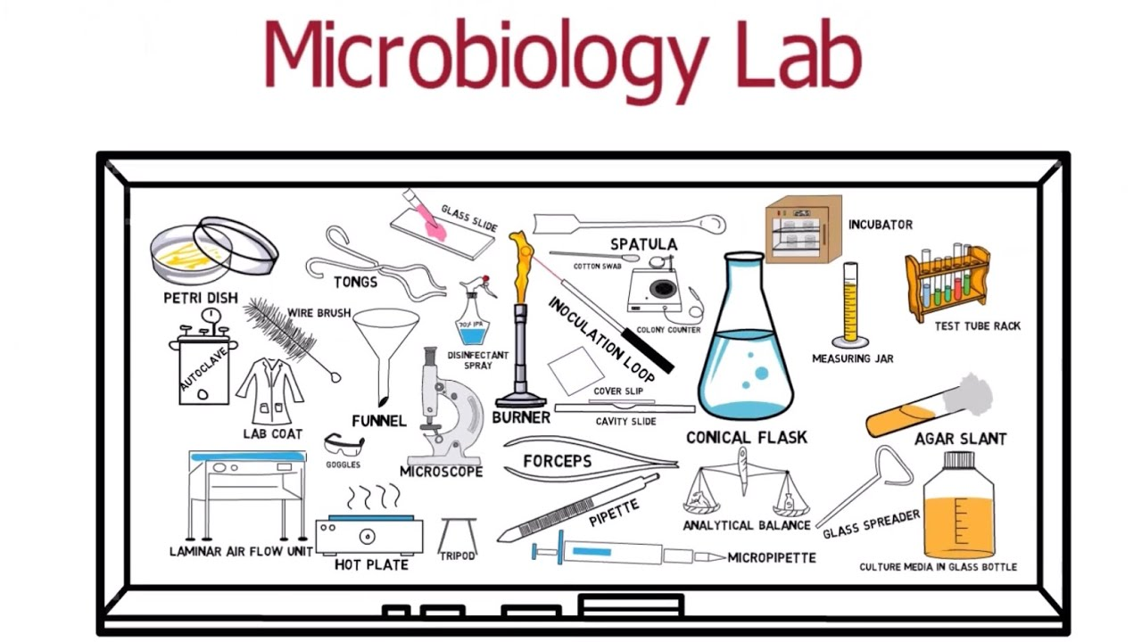

Slide 9
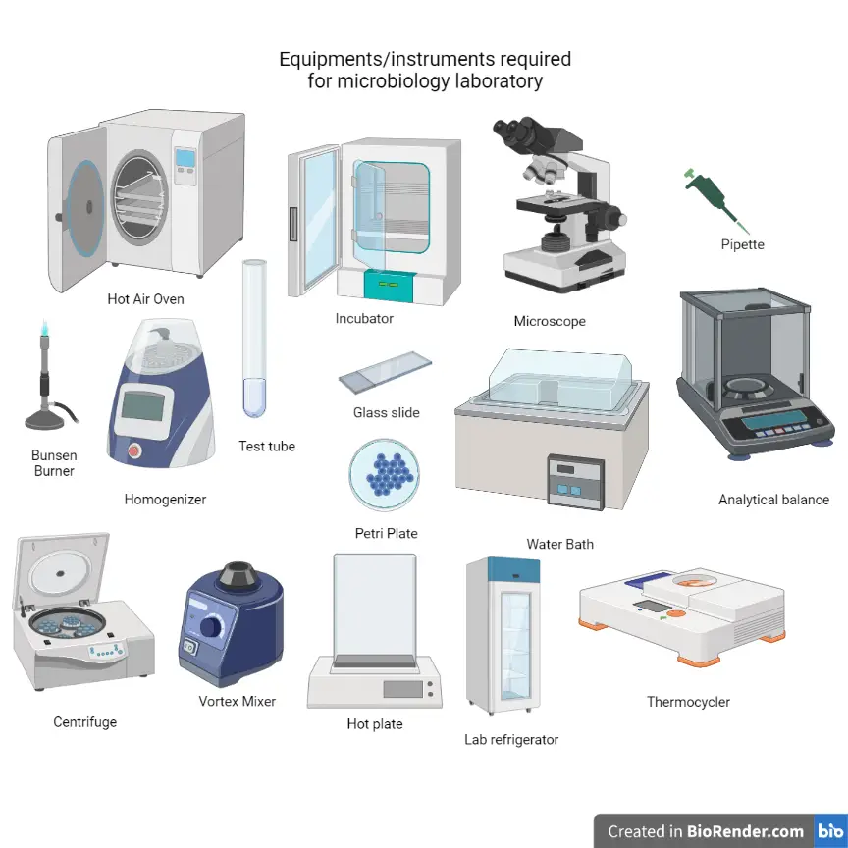

Slide 10
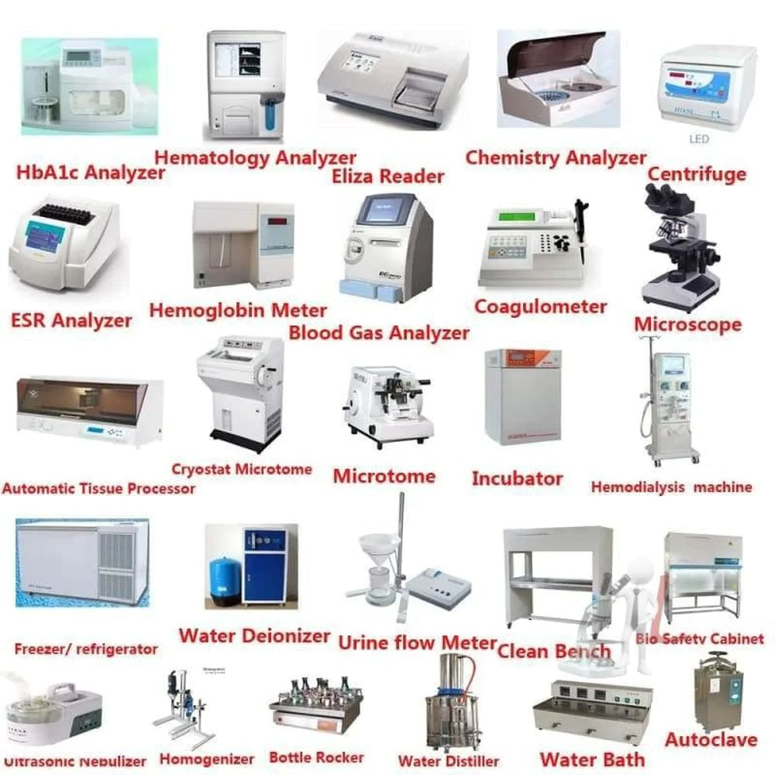

Slide 11
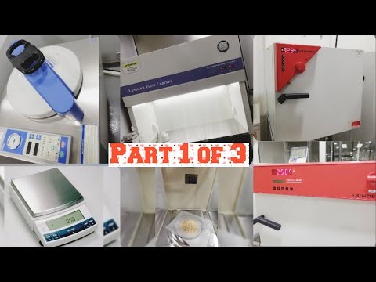
Microbiology lab equipment
Notes:
https://www.google.com/search?q=microbiology+lab+equipment&source=lmns&tbm=vid&bih=568&biw=1349&rlz=1C1GGRV_enRU751RU751&hl=ru&sa=X&ved=2ahUKEwjOjr2Ap7P9AhVIxioKHb-UBwIQ_AUoAnoECAEQAg#fpstate=ive&vld=cid:1632e22c,vid:X8dhl28JfkI

