Slide 1
Periodic Law and Periodic Table

Slide 2
Periodic Law Definition
The Periodic Law states that the physical and chemical properties of the elements recur in a systematic and predictable way when the elements are arranged in order of increasing atomic number.
Many of the properties recur at intervals. When the elements are arranged correctly, the trends in element properties become apparent and can be used to make predictions about unknown or unfamiliar elements, simply based on their placement on the table.

Slide 3
Discovery of Periodic Law
Periodic Law was formulated based on observations made by scientists in the 19th century. In particular, contributions made by Lothar Meyer and Dmitri Mendeleev made trends in element properties apparent. They independently proposed Periodic Law in 1869.
The periodic table arranged the elements to reflect Periodic Law, even though scientists at the time had no explanation for why properties followed a trend.
Once the electronic structure of atoms was discovered and understood, it became apparent the reason characteristics occurred in intervals was because of the behavior of electron shells.

Slide 4
Properties Affected by Periodic Law
The key properties that follow trends according to Periodic Law are atomic radius, ionic radius, ionization energy, electronegativity, and electron affinity.
Atomic and ionic radius are a measure of the size of a single atom or ion. While atomic and ionic radius are different from each other, they follow the same general trend. The radius increases moving down an element group and generally decreases moving left to right across a period or row.
Ionization energy is a measure of how easy it is to remove an electron from an atom or ion. This value decreases moving down a group and increases moving left to right across a period.

Slide 5
Properties Affected by Periodic Law
Electron affinity is how easily an atom accepts an electron. Using Periodic Law, it becomes apparent the alkaline earth elements have a low electron affinity. In contrast, the halogens readily accept electrons to fill their electron subshells and have high electron affinities. The noble gas elements have practically zero electron affinity because they have full valence electron subshells.
Electronegativity is related to electron affinity. It reflects how easily an atom of an element attracts electrons to form a chemical bond. Both electron affinity and electronegativity tend to decrease moving down a group and increase moving across a period. Electropositivity is another trend governed by Periodic Law. Electropositive elements have low electronegativities (e.g., cesium, francium).
In addition to these properties, there are other characteristics associated with Periodic Law, which may be considered properties of element groups. For example, all of the elements in group I (alkali metals) are shiny, carry a +1 oxidation state, react with water, and occur in compounds rather than as free elements.

Slide 6
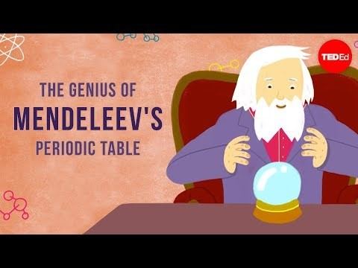
Periodic Table
Notes:
https://www.youtube.com/watch?v=fPnwBITSmgU

Slide 7
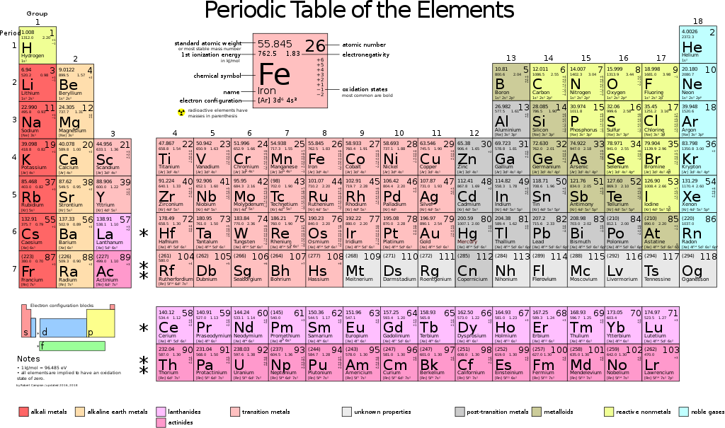

Slide 8
Chemical elements
1 | H | Водород | Hydrogen | [ ˈhaɪdrədʒən ]
2 | He | Гелий | Helium | [ ˈhiːlɪəm ]
3 | Li | Литий | Lithium | [ ˈlɪθiəm ]
4 | Be | Бериллий | Beryllium | [ bəˈrɪliəm ]
5 | B | Бор | Boron | [ ˈbɔːrɒn ]
6 | C | Углерод | Carbon | [ ˈkɑːbən ]
7 | N | Азот | Nitrogen | [ ˈnaɪtrədʒən ]
8 | O | Кислород | Oxygen | [ ˈɒksɪdʒən ]
9 | F | Фтор | Fluorine | [ ˈflʊəriːn ]
10 | Ne | Неон | Neon | [ ˈniːɒn ]
11 | Na | Натрий | Sodium | [ ˈsəʊdɪəm ]
12 | Mg | Магний | Magnesium | [ mæɡˈniːzɪəm ]
13 | Al | Алюминий | Aluminum | [ əˈluːmɪnəm ]
14 | Si | Кремний | Silicon | [ ˈsɪlɪkən ]
15 | P | Фосфор | Phosphorus | [ ˈfɒsfərəs ]
16 | S | Сера | Sulfur | [ ˈsəlfə ]
17 | Cl | Хлор | Chlorine | [ ˈklɔːriːn ]
18 | Ar | Аргон | Argon | [ ˈɑːɡɒn ]
19 | K | Калий | Potassium | [ pəˈtæsɪəm ]
20 | Ca | Кальций | Calcium | [ ˈkælsɪəm ]
21 | Sc | Скандий | Scandium | [ ˈskændɪəm ]
22 | Ti | Титан | Titanium | [ t(a)ɪ'teɪnɪəm ]
23 | V | Ванадий | Vanadium | [ vəˈneɪdiəm ]
24 | Cr | Хром | Chromium | [ ˈkrəʊmɪəm ]
25 | Mn | Марганец | Manganese | [ ˈmæŋɡəniːz ]
26 | Fe | Железо | Iron | [ ˈaɪən ]
27 | Co | Кобальт | Cobalt | [ ˈkəʊbɔːlt ]
28 | Ni | Никель | Nickel | [ ˈnɪkəl ]
29 | Cu | Медь | Copper | [ ˈkɒpə ]
30 | Zn | Цинк | Zinc | [ zɪŋk ]
31 | Ga | Галлий | Gallium | [ ˈɡæliəm ]
32 | Ge | Германий | Germanium | [ dʒɜːˈmeɪniəm ]
33 | As | Мышьяк | Arsenic | [ ˈɑːsnɪk ]
34 | Se | Селен | Selenium | [ sɪˈliːnɪəm ]
35 | Br | Бром | Bromine | [ ˈbrəʊmiːn ]
36 | Kr | Криптон | Krypton | [ ˈkrɪptɒn ]
37 | Rb | Рубидий | Rubidium | [ rʊˈbɪdiəm ]
38 | Sr | Стронций | Strontium | [ ˈstrɒntɪəm ]
39 | Y | Иттрий | Yttrium | [ ˈɪtriəm ]
40 | Zr | Цирконий | Zirconium | [ zɜːˈkəʊniəm ]
Notes:
https://study-english.info/vocabulary-elements.php

Slide 9
Chemical elements
41 | Nb | Ниобий | Niobium | [ naɪ'əubɪəm ]
42 | Mo | Молибден | Molybdenum | [ məˈlɪbdənəm ]
43 | Tc | Технеций | Technetium | [ tek'niːʃɪəm ]
44 | Ru | Рутений | Ruthenium | [ ruːˈθiːnjəm ]
45 | Rh | Родий | Rhodium | [ ˈrəʊdiəm ]
46 | Pd | Палладий | Palladium | [ pəˈleɪdiəm ]
47 | Ag | Серебро | Silver | [ ˈsɪlvə ]
48 | Cd | Кадмий | Cadmium | [ ˈkædmɪəm ]
49 | In | Индий | Indium | [ ˈɪndiəm ]
50 | Sn | Олово | Tin | [ ˈtɪn ]
51 | Sb | Сурьма | Antimony | [ ˈæntɪməni ]
52 | Te | Теллур | Tellurium | [ teˈlʊriəm ]
53 | I | Иод | Iodine | [ ˈaɪədiːn ]
54 | Xe | Ксенон | Xenon | [ ˈzenɒn ] [ˈziːnɒn ]
55 | Cs | Цезий | Cesium | [ ˈsiːziəm ]
56 | Ba | Барий | Barium | [ ˈbeəriəm ]
57 | La | Лантан | Lanthanum | [ ˈlænθənəm ]
58 | Ce | Церий | Cerium | [ ˈsɪərɪəm ]
59 | Pr | Празеодим | Praseodymium | [ˌpreɪziːəʊˈdɪmɪəm]
60 | Nd | Неодим | Neodymium | [ ˌniːəu'dɪmɪəm ]
61 | Pm | Прометий | Promethium | [ prəˈmiːθiəm ]
62 | Sm | Самарий | Samarium | [ səˈmeɪrɪəm ]
63 | Eu | Европий | Europium | [ jʊˈropiəm ]
64 | Gd | Гадолиний | Gadolinium | [ ˌɡædɒˈlɪnɪəm ]
65 | Tb | Тербий | Terbium | [ ˈtɜːbɪəm ]
66 | Dy | Диспрозий | Dysprosium | [ dɪsˈprəʊʃɪəm ]
67 | Ho | Гольмий | Holmium | [ ˈholmiəm ]
68 | Er | Эрбий | Erbium | [ ˈɜːbiəm ]
69 | Tm | Тулий | Thulium | [ ˈθjuːlɪəm ]
70 | Yb | Иттербий | Ytterbium | [ ɪˈtɜːbjəm ]
71 | Lu | Лютеций | Lutetium | [ lu:ʹti:ʃjəm ]
72 | Hf | Гафний | Hafnium | [ ˈhæfniəm ]
73 | Ta | Тантал | Tantalum | [ ˈtæntələm ]
74 | W | Вольфрам | Tungsten | [ ˈtʌŋstən ]
75 | Re | Рений | Rhenium | [ ˈriːniəm ]
76 | Os | Осмий | Osmium | [ ˈɒzmiəm ]
77 | Ir | Иридий | Iridium | [ ɪˈrɪdɪəm ]
78 | Pt | Платина | Platinum | [ ˈplætɪnəm ]
79 | Au | Золото | Gold | [ ɡəʊld ]
80 | Hg | Ртуть | Mercury | [ ˈmɜːkjʊri ]

Slide 10
Chemical elements
81 | Tl | Таллий | Thallium | [ ˈθæliəm ]
82 | Pb | Свинец | Lead | [ led ]
83 | Bi | Висмут | Bismuth | [ ˈbɪzməθ ]
84 | Po | Полоний | Polonium | [ pəˈləʊniəm ]
85 | At | Астат | Astatine | [ 'æstətiːn ]
86 | Rn | Радон | Radon | [ ˈreɪdɒn ]
87 | Fr | Франций | Francium | [ 'frænsɪəm ]
88 | Ra | Радий | Radium | [ ˈreɪdɪəm ]
89 | Ac | Актиний | Actinium | [ ækˈtɪnɪəm ]
90 | Th | Торий | Thorium | [ ˈθɔːriəm ]
91 | Pa | Протактиний | Protactinium | [ ˌprəʊtækˈtɪniəm ]
92 | U | Уран | Uranium | [ jʊˈreɪnɪəm ]
93 | Np | Нептуний | Neptunium | [ nepˈtjuːniəm ]
94 | Pu | Плутоний | Plutonium | [ pluːˈtəʊnɪəm ]
95 | Am | Америций | Americium | [ ˌæməˈrɪsiəm ]
96 | Cm | Кюрий | Curium | [ ˈkjʊərɪəm ]
97 | Bk | Берклий | Berkelium | [ bɜː'kiːlɪəm ]
98 | Cf | Калифорний | Californium | [ ˌkælɪˈfɔːnjəm ]
99 | Es | Эйнштейний | Einsteinium | [ ˌaɪn'staɪnɪəm ]
100 | Fm | Фермий | Fermium | [ ˈfermiəm ]
101 | Md | Менделевий | Mendelevium | [ ˌmendəˈliːviəm ]
102 | No | Нобелий | Nobelium | [ noˈbeliəm ]
103 | Lr | Лоуренсий | Lawrencium | [ lɒˈrensiəm ]
104 | Rf | Резерфордий | Rutherfordium | [ ˌrʌðə'fɔːdɪəm ]
105 | Db | Дубний | Dubnium | [ 'dʌbnɪəm ]
106 | Sg | Сиборгий | Seaborgium | [ 'siːbɔːgɪəm ]
107 | Bh | Борий | Bohrium | [ 'bɔrɪəm ]
108 | Hs | Хассий | Hassium | [ 'hæsɪəm ]
109 | Mt | Мейтнерий | Meitnerium | [ ˌmaɪt'nɪərɪəm ]
110 | Ds | Дармштадтий | Darmstadtium
111 | Rg | Рентгений | Roentgenium
112 | Cn | Коперниций | Copernicium
113 | Nh | Нихонй | Nihonium
114 | Fl | Флеровий | Flerovium
115 | Mc | Московий | Moscovium
116 | Lv | Ливерморий | Livermorium
117 | Ts | Тенессин | Tennessine
118 | Og | Оганесон | Oganesson

Slide 11
Pronunciation
https://quizlet.com/124752264/chemical-elements-crossword-puzzle-flash-cards/

Slide 12
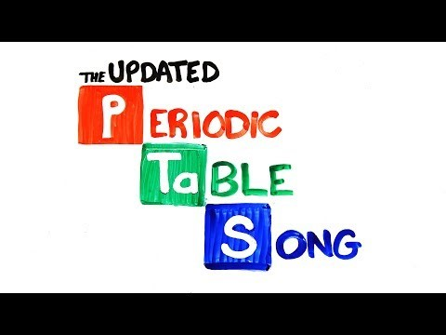
The Periodic Table Song
Notes:
https://www.youtube.com/watch?v=rz4Dd1I_fX0

