Slide 1
Bioactive compounds

Slide 2
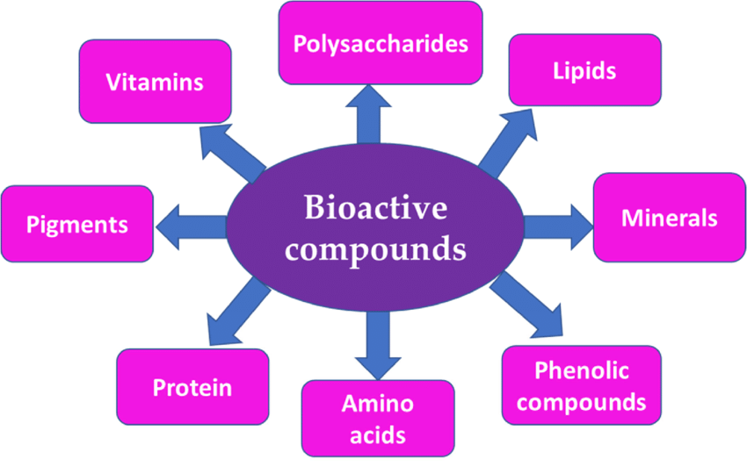

Slide 3
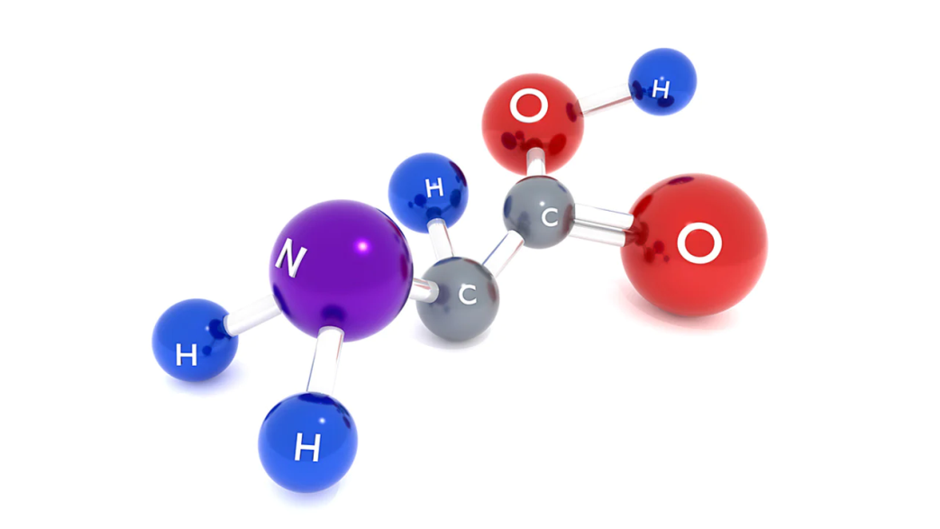
Amino acids
Amino acids are organic compounds that contain both amino and carboxylic acid functional groups. Although over 500 amino acids exist in nature, by far the most important are the 22 α-amino acids incorporated into proteins. Only these 22 appear in the genetic code of life.
arginine ['ɑːdʒɪni(:)n, ˈɑːdʒɪˌnaɪn]
alanine ['æləni:n]
asparagine [æs'pærədʒi(:)n]
aspartic acid [ə'spɑ:tɪk 'æsɪd]
glutamic acid [ɡluːˌtæmɪk 'æsɪd]
glutamine ['glu:təmi:n]
glycine ['glaisi:n]
histidine ['hɪstədi(:)n]
isoleucine [ˌaisəu'lju:si:n]
lysine ['laisin]
methionine [mɪ'θaɪən(a)ɪn]
phenylalanine [ˌfenəl'æləni:n]
proline ['prəʊli:n]
serine ['seri:n,'si(ə)-]
cysteine ['sɪstɪi:n]
tryptophan ['triptəfæn,(-fein)]
threonine ['θri:əˌni(:)n]
tyrosine ['taɪ(ə)rəsi:n]
valine ['væliːn]

Slide 4
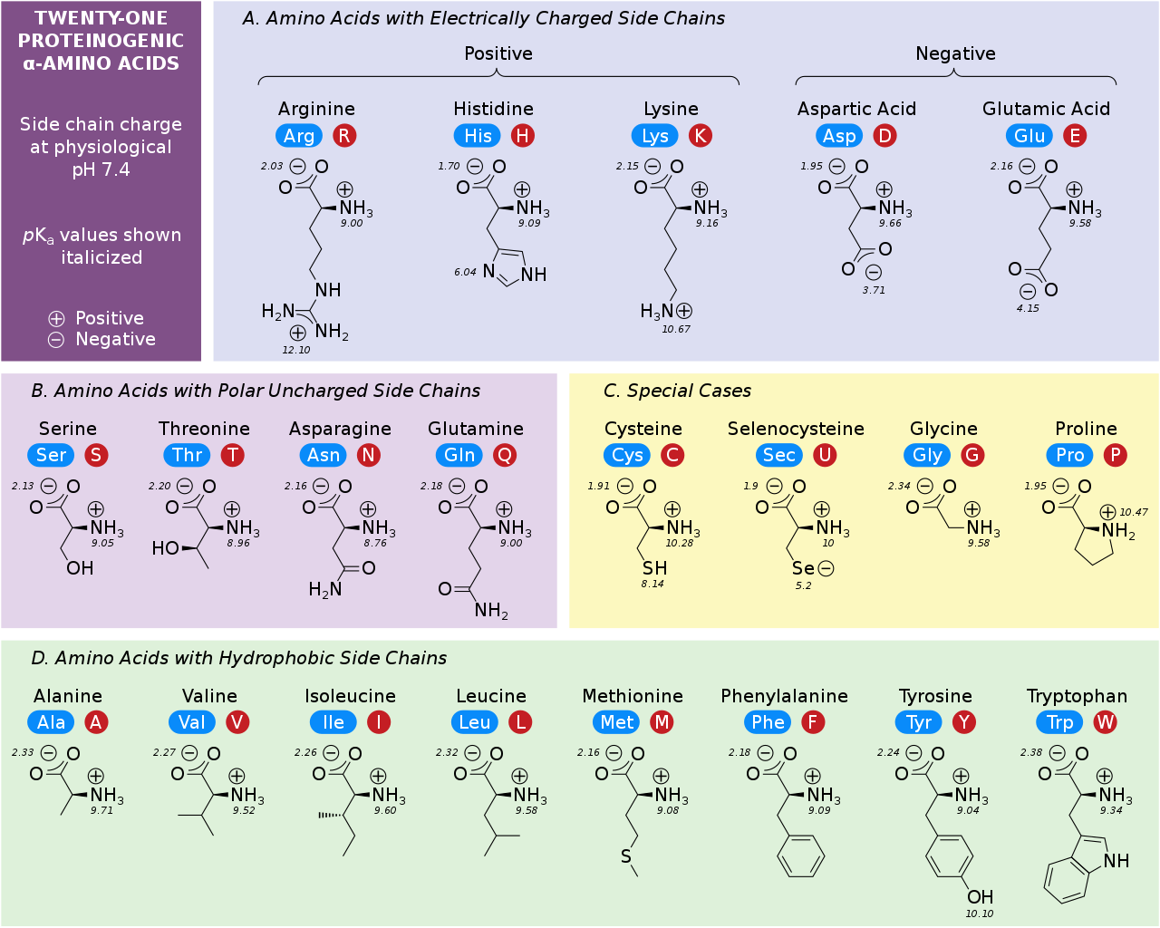

Slide 5
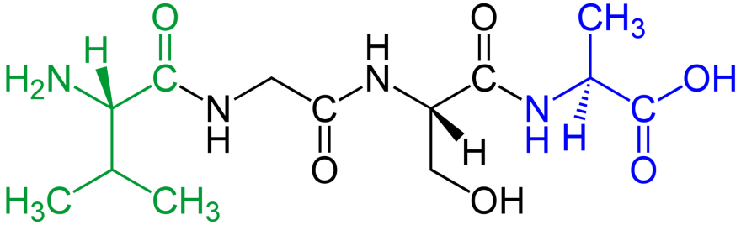
Peptides
Peptides are short chains of amino acids linked by peptide bonds.
Chains of fewer than twenty amino acids are called oligopeptides, and include dipeptides, tripeptides, and tetrapeptides.
A tetrapeptide Val-Gly-Ser-Ala
Amino acids that have been incorporated into peptides are termed residues.
Polypeptide is a longer, continuous, unbranched peptide chain.
Polypeptides which have a molecular mass of 10,000 Da or more are called proteins.
N-terminus
C-terminus
Notes:
Residue ['rezɪdju:] – остаток; осадок, оставшийся после выпаривания.

Slide 6
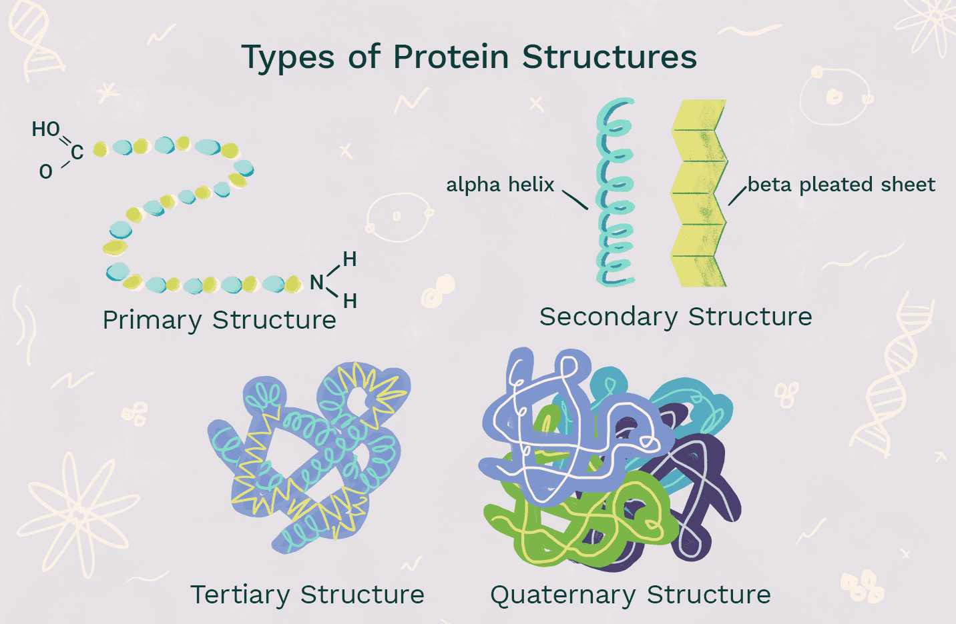
Proteins
Proteins are large biomolecules and macromolecules that comprise one or more long chains of amino acid residues. Proteins perform a vast array of functions within organisms, including catalysing metabolic reactions, DNA replication, responding to stimuli, providing structure to cells and organisms, and transporting molecules from one location to another.

Slide 7
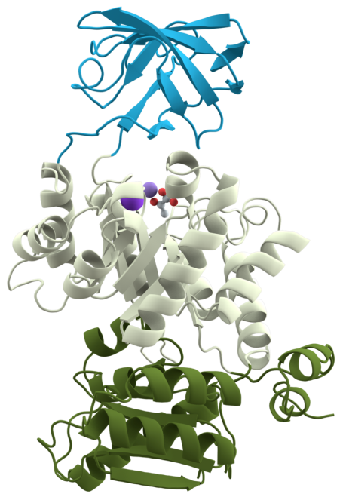
Protein domain is a region of a protein's polypeptide chain that is self-stabilizing and that folds independently from the rest.
The structural and sequence motifs refer to short segments of protein three-dimensional structure or amino acid sequence that were found in a large number of different proteins.
Protein fold refers to the general protein architecture, like a helix bundle, β-barrel, Rossmann fold or different "folds" provided in the Structural Classification of Proteins database
Three domains of the protein Pyruvate kinase
Notes:
Protein fold – укладка белка

Slide 8
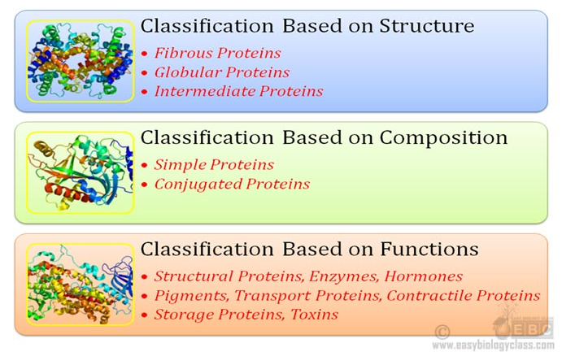
Classification of proteins

Slide 9
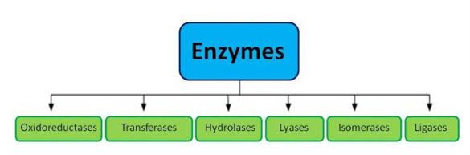
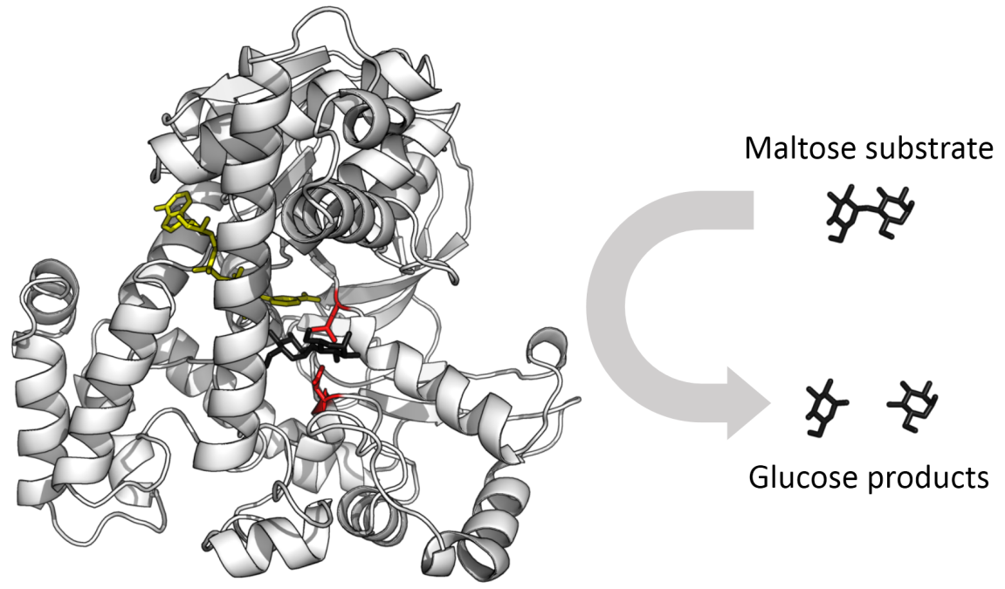
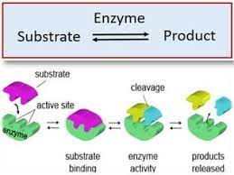
Enzymes
Enzymes are proteins that act as biological catalysts by accelerating chemical reactions. The molecules upon which enzymes may act are called substrates.
The enzyme glucosidase converts the sugar maltose into two glucose sugars. Active site residues in red, maltose substrate in black, and NAD cofactor in yellow.

Slide 10
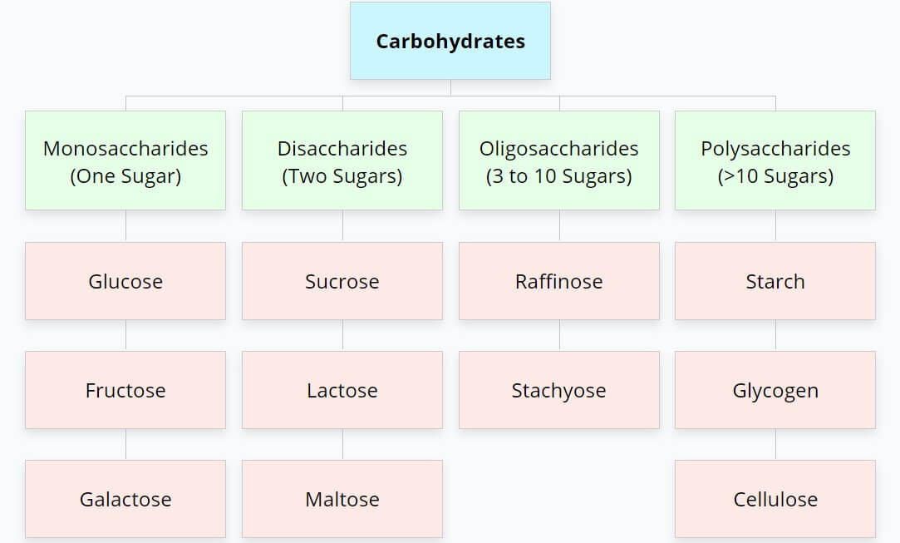
Carbohydrates (Sugars)

Slide 11
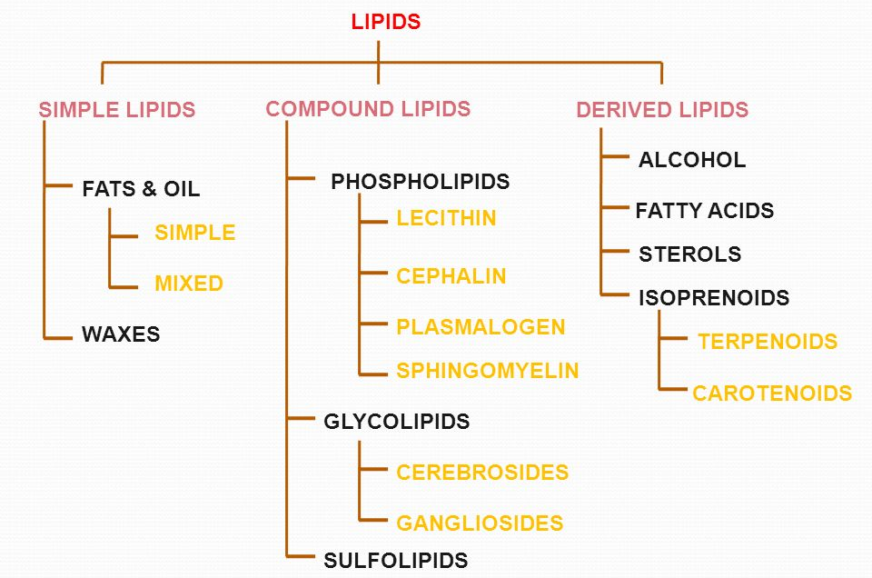
Lipids
Lipids are a broad group of organic compounds which include fats, waxes, sterols, fat-soluble vitamins, monoglycerides, diglycerides, phospholipids, and others.
The functions of lipids include storing energy, signaling, and acting as structural components of cell membranes
triglycerides

Slide 12
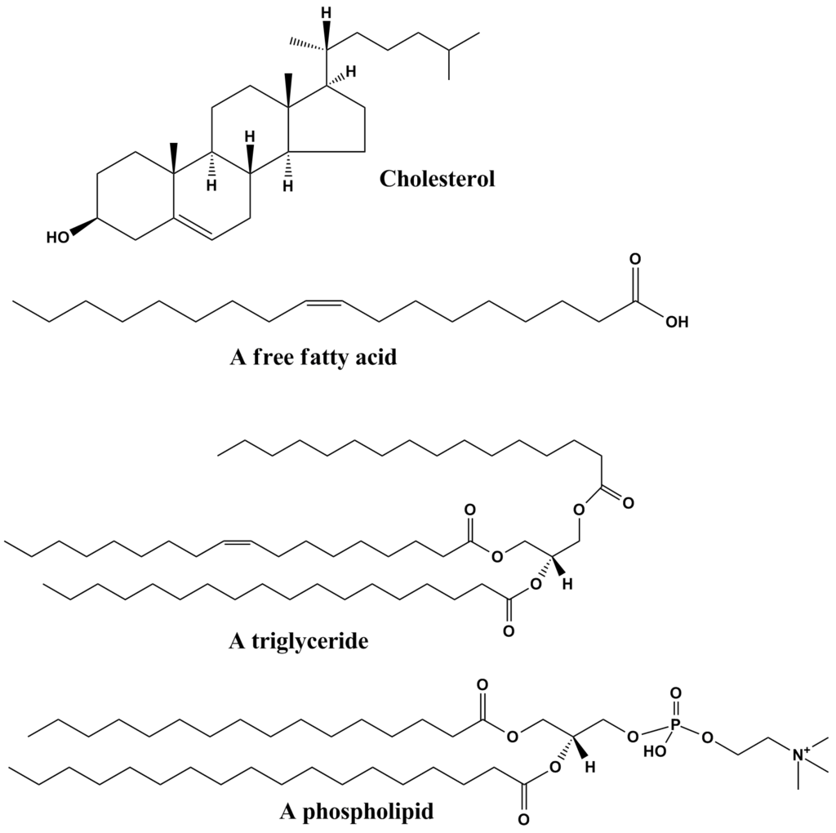
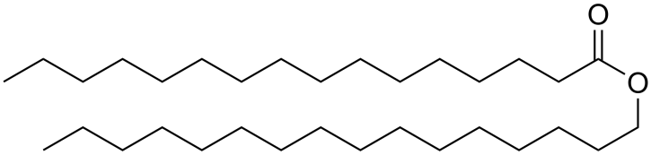
Lipids
wax [wæks]
triglyceride [traiˈglisəraid]
A wax

Slide 13
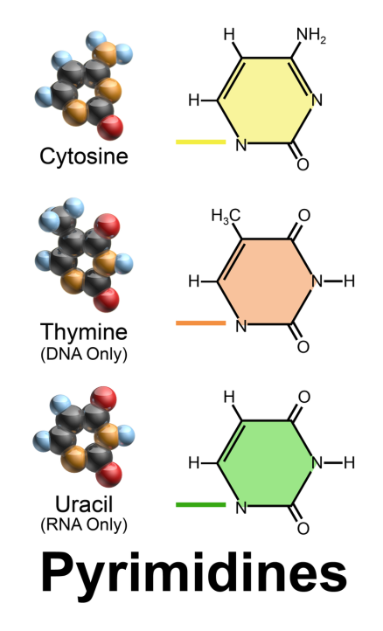
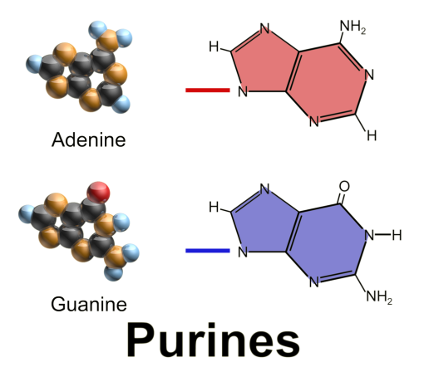
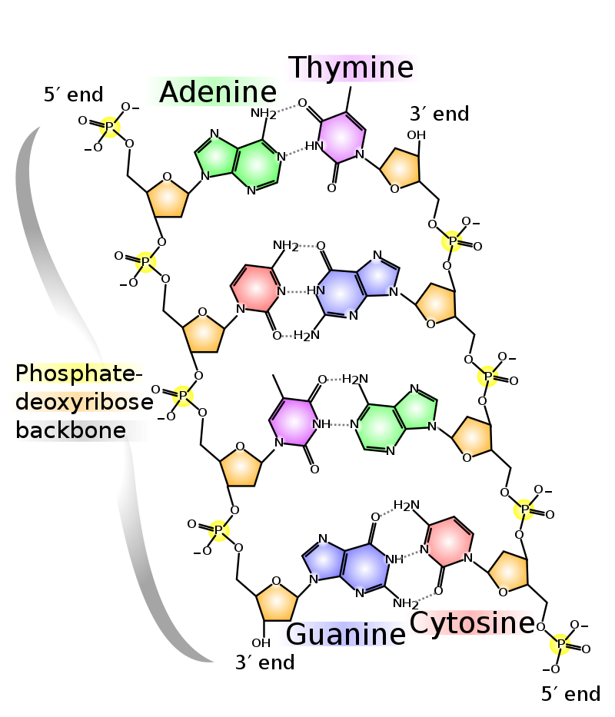
Nucleobases
Nucleobases (nitrogenous bases) are nitrogen-containing biological compounds that form nucleosides, which, in turn, are components of nucleotides, with all of these monomers constituting the basic building blocks of nucleic acids.
The ability of nucleobases to form base pairs and to stack one upon another leads directly to long-chain helical structures such as ribonucleic acid (RNA) and deoxyribonucleic acid (DNA).
['pjuəri:ns]
adenine ['ædəni(:)n]
guanine ['gwɑ:ni:n]
['pairimidi:ns]
cytosine ['saitəsi:n]
thymine ['θaimi:n]
uracil [ˈjurəsil]

Slide 14
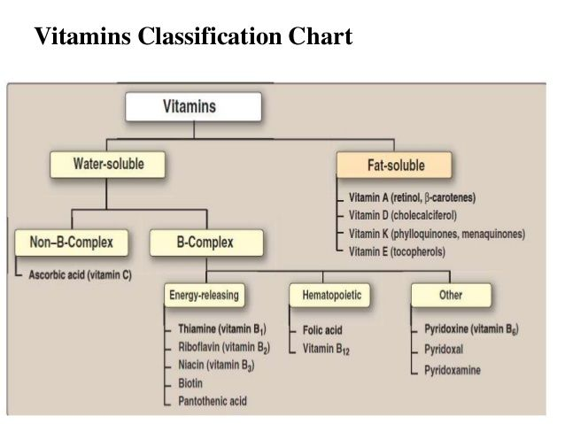
Vitamins

Slide 15
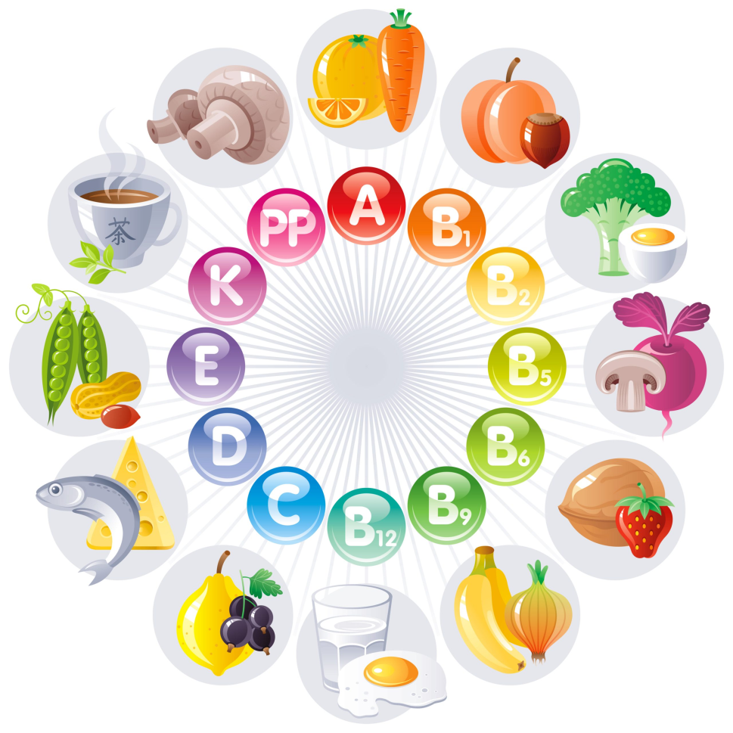
Vitamins
vitamin ['vıtəmin,'vaı-]
ascorbic acid [ə'skɔ:bɪk'æsɪd]
thiamine ['θaɪəmɪn]
riboflavin [raɪbəu'fleɪvɪn]
niacin ['naɪəsɪn]
biotin ['baiəutin]
pyridoxin [pairi'dɔksin,(-si:n)]
pyridoxal [ˌpiri'dɔksæl]
pyridoxamine [ˌpiəri'dɔksəmi(ː)n]
retinol ['retinɔl]
carotene ['kærəti:n]
cholecalciferol [ˌkəulikæl'sifərɔl]
phylloquinone [ˌfilə'kwinəun]
tocopherol [tɔ'kɔfərɔl]

Slide 16
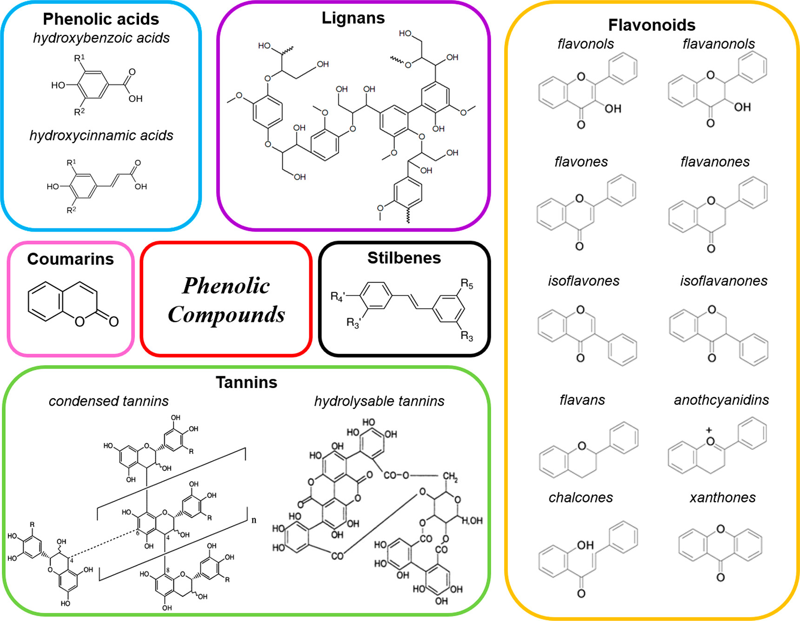

Slide 17
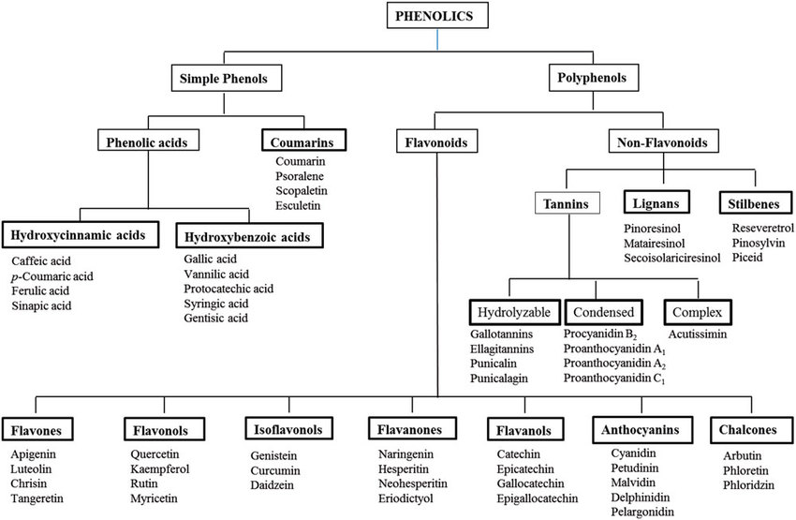

Slide 18
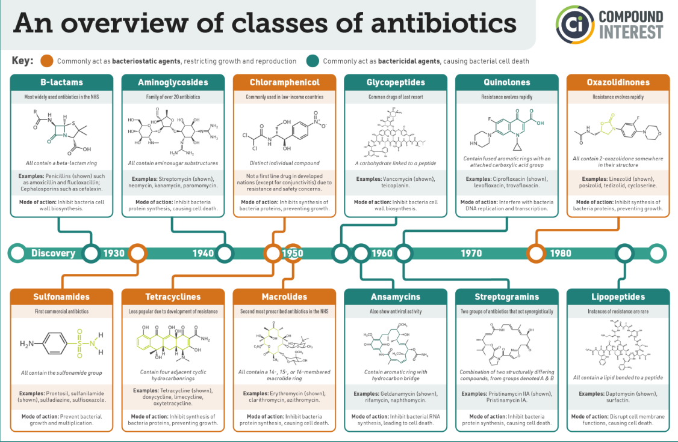

Slide 19
