Slide 1
Manufacturing flow chart

Slide 2
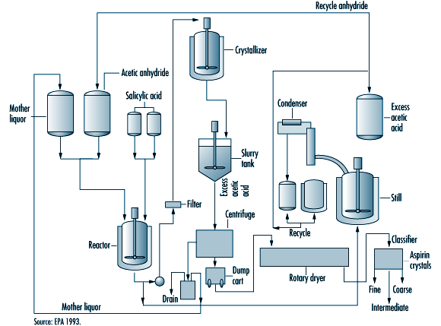

Slide 3
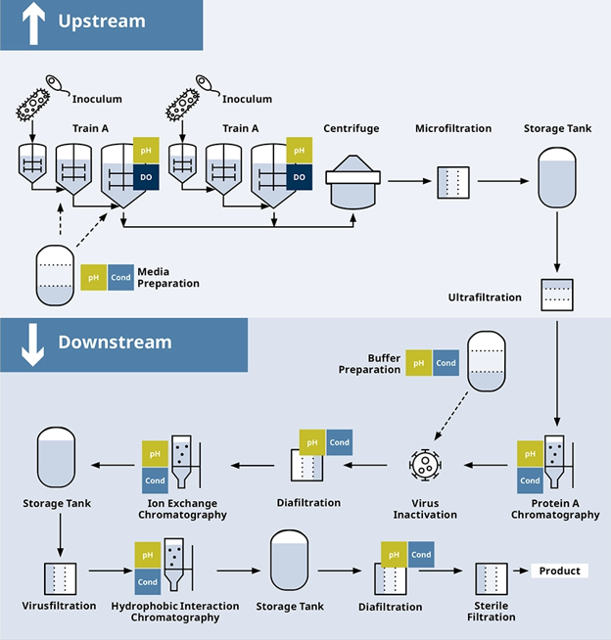

Slide 4
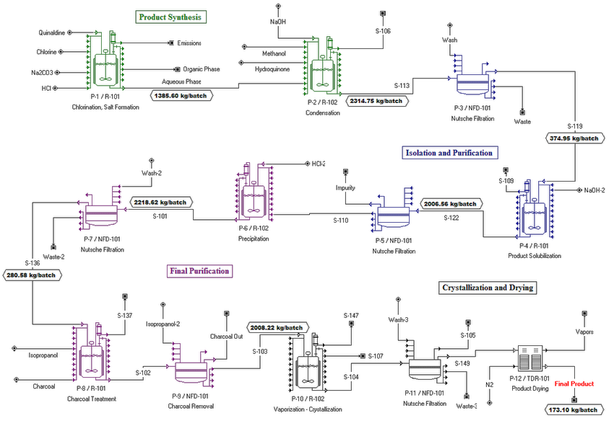

Slide 5
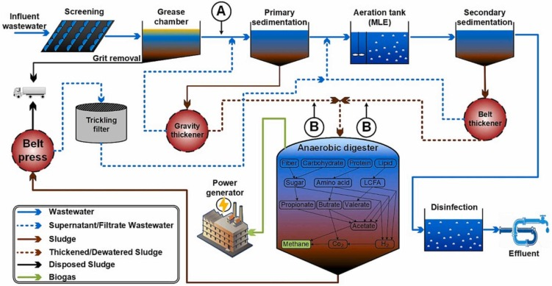

Slide 6
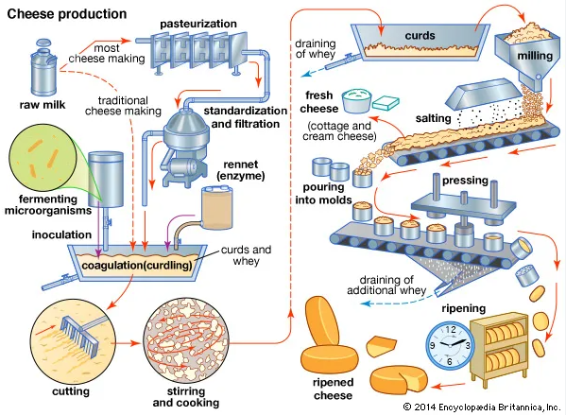

Slide 7
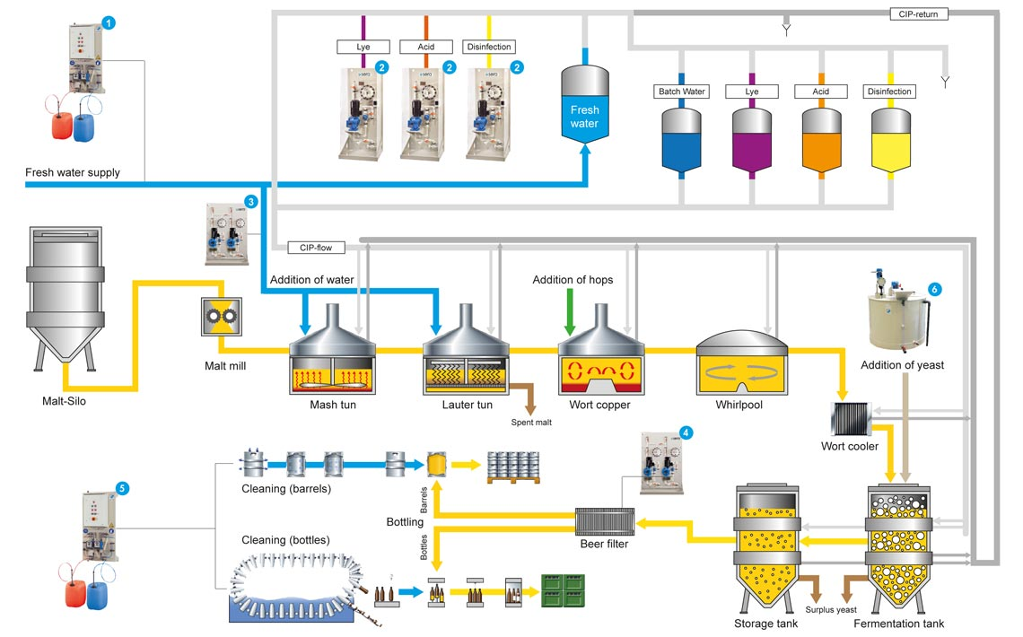

Slide 8
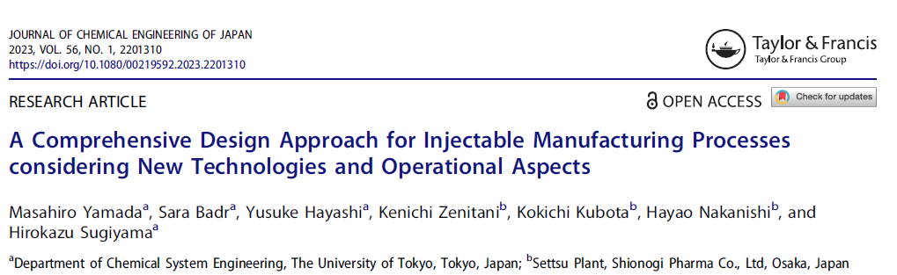
https://www.tandfonline.com/doi/full/10.1080/00219592.2023.2201310

Slide 9
Home Task
Choose a flow chart for some chemical/ pharmaceutical manufacture (or part of it) and describe in a few sentences, step by step, what materials and processes are employed for obtaining of the final product.

