Slide 1

Ecological issues

Slide 2
Ecological problems
Climate Change (Global Warming) – изменение климата (глобальное потепление)
Melting Ice Caps and Sea Level Rise – таяние ледников и повышение уровня моря
Loss of Biodiversity (species extinction) – потеря биоразнообразия (вымирание видов)
Air and water Pollution – загрязнение воздуха и воды
Plastic Pollution – загрязнение пластиком
Agricultural Pollution – сельскохозяйственное загрязнение
Deforestation – сокращение лесов
Ocean Acidification – повышение кислотности океанов
Soil Degradation – деградация почв
Food and Water Insecurity – небезопасность воды и еды
Food Waste – пищевые отходы (выбрасывание пищи)
Fast Fashion and Textile Waste – «быстрая мода» и текстильные отходы
Resource Depletion – истощение ресурсов
Notes:
https://earth.org/the-biggest-environmental-problems-of-our-lifetime/

Slide 3
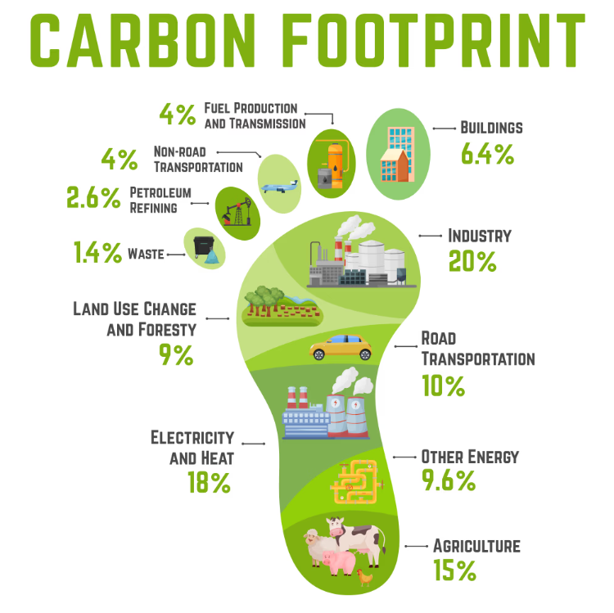
The impact of chemical manufacturing on the environment
1. Air pollution
Chemical manufacturing can contribute to air pollution through the release of various pollutants into the atmosphere. These pollutants can include volatile organic compounds (VOCs) and particulate matter (PM), which can contribute to the formation of smog and ground-level ozone, as well as particulate matter, nitrogen oxides, and sulfur dioxide, which can contribute to respiratory and cardiovascular problems.
Technological strategies:
using renewable energy sources.
using less harmful chemicals and optimizing manufacturing processes to reduce waste and emissions.
use of real-time monitoring systems.
Notes:
https://www.deskera.com/blog/impact-of-chemical-manufacturing-on-the-environment/#:~:text=Chemical%20manufacturing%20has%20a%20significant,health%2C%20wildlife%2C%20and%20ecosystems.

Slide 4
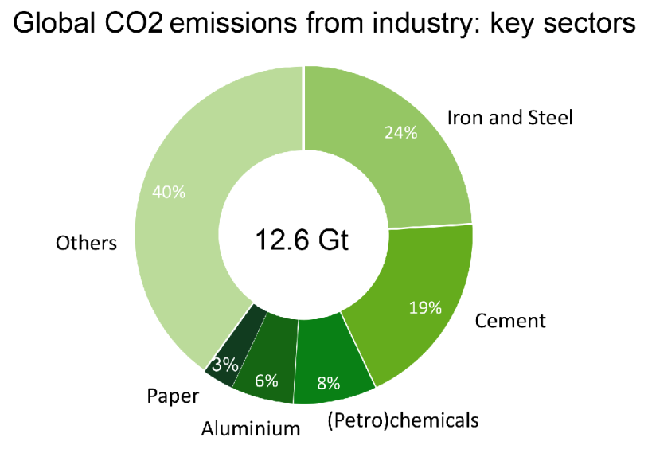
The impact of chemical manufacturing on the environment
2. Greenhouse gas emissions
Chemical manufacturing is also a significant contributor to greenhouse gas emissions, which contribute to climate change. Chemical manufacturing can produce greenhouse gases directly through the use of fossil fuels for energy and indirectly through the release of carbon dioxide during the production of chemicals.
Reducing the impact strategies:
Improving energy efficiency
Renewable energy
Renewable or recycled raw materials
Carbon capture and storage (CCS) technologies
designing products that have a longer lifespan or can be easily recycled
Sustainable transportation: electric vehicles or biofuels
The adoption of a circular economy model, where materials and products are reused and recycled
Notes:
https://www.deskera.com/blog/impact-of-chemical-manufacturing-on-the-environment/#:~:text=Chemical%20manufacturing%20has%20a%20significant,health%2C%20wildlife%2C%20and%20ecosystems.

Slide 5
The impact of chemical manufacturing on the environment
3. Water pollution
Chemical manufacturing can also contribute to water pollution through the release of pollutants into waterways. These pollutants can include toxic chemicals, heavy metals, and other contaminants that can harm aquatic ecosystems and human health.
Reducing the impact strategies:
Best management practices to minimize the risk of spills and leaks: regular maintenance and inspection of equipment, training for employees on safe handling practices, and emergency response plans in the event of a spill.
Wastewater treatment: activated carbon filtration, reverse osmosis, and other processes.
Chemical substitution: use of non-toxic solvents, safer surfactants, and other alternatives.
Regulatory controls: discharge permits, effluent limits, and other requirements.
Notes:
Spill – пролив
Leak – утечка

Slide 6
The impact of chemical manufacturing on the environment
4. Soil contamination
Chemical manufacturing can also contribute to soil contamination through the release of chemicals and other pollutants into the soil. These pollutants can harm soil quality and reduce soil productivity, which can have negative impacts on agriculture and other land uses.
Reducing the impact strategies:
Pollution prevention: proper handling and storage of chemicals, the use of less toxic chemicals
Remediation: excavation and removal of contaminated soil, in-situ treatment using chemical or biological methods, and the use of phytoremediation.
Regular soil quality monitoring.
Regulatory measures.
Sustainable manufacturing practices.

Slide 7
The impact of chemical manufacturing on the environment
5. Depletion of natural resources
Chemical manufacturing can contribute to the depletion of natural resources through the use of non-renewable resources, such as fossil fuels and minerals, in the production of chemicals. This can have negative impacts on the availability and quality of these resources for future generations.
Reducing the impact strategies:
Resource efficiency
use of bio-based feedstocks or recycled materials
Renewable energy
Circular economy

Slide 8
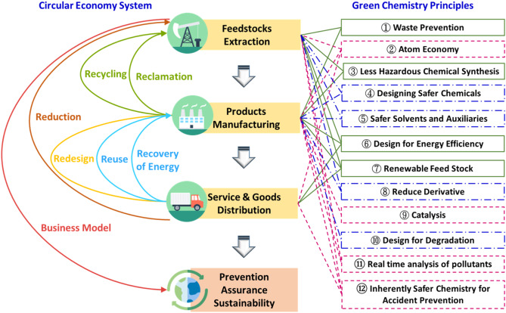
Circular economy
The circular economy is a model of production and consumption, which involves sharing, leasing, reusing, repairing, refurbishing and recycling existing materials and products as long as possible. In this way, the life cycle of products is extended.
Notes:
refurbishing - модернизация, ремонтно-восстановительные работы

Slide 9
Strategies for addressing the impact of chemical manufacturing on the environment
Cleaner production methods
Cleaner production methods involve the use of technologies and processes that minimize the generation of waste and the release of pollutants into the environment. This can include the use of closed-loop systems to minimize waste generation and the implementation of process optimization and energy efficiency measures to reduce the environmental impact of chemical manufacturing.
Safer chemicals
The development and use of safer chemicals can also help to reduce the impact of chemical manufacturing on the environment. This can include the use of green chemistry principles to design and produce chemicals that are less toxic and more environmentally friendly.
Notes:
addressing – направленный на решение, решающий проблему

Slide 10
Strategies for addressing the impact of chemical manufacturing on the environment
Pollution prevention and waste minimization
Pollution prevention and waste minimization programs can also help to reduce the impact of chemical manufacturing on the environment. These programs can include the implementation of best management practices to prevent spills and leaks, the use of advanced wastewater treatment technologies, and the implementation of waste reduction and recycling programs.
Renewable energy sources
The use of renewable energy sources, such as solar, wind, and hydropower, can also help to reduce the impact of chemical manufacturing on the environment by reducing the industry's reliance on fossil fuels.

Slide 11
Strategies for addressing the impact of chemical manufacturing on the environment
Sustainable resource management
The adoption of sustainable resource management practices, such as the use of sustainable forestry practices and the implementation of sustainable water management programs, can help to reduce the impact of chemical manufacturing on the environment by promoting the responsible use of natural resources.

Slide 12
Task
Read two articles about modern ecological problems:
https://earth.org/the-biggest-environmental-problems-of-our-lifetime/
https://www.edengreen.com/blog-collection/environmental-problems
Choose one topic and write short essay. In your work describe chosen problem, express your opinion on it, and think about possible ways to solve the problem.

Slide 13
