Slide 1
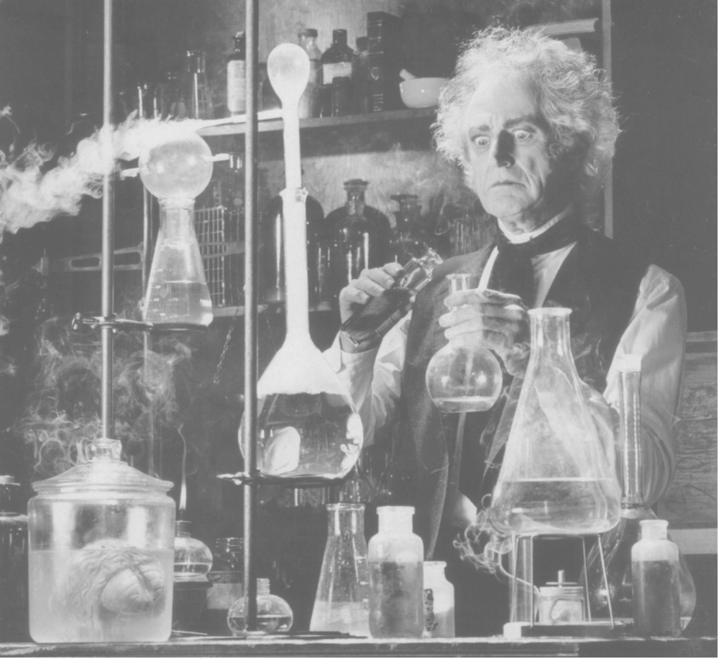
Methods of analysis of organic compounds

Slide 2
Methods of analysis
Melting / boiling point determination
Chromatography
  TLC
  HPLC
  Gas chromatography
UV-spectroscopy
IR-spectroscopy
NMR-spectroscopy
Mass-spectroscopy

Slide 3

Chromatography
Mobile phase
Stationary phase and mobile phase are two immiscible mediums. (Solid/liquid, liquid/gas, liquid/liquid, etc.)
The duty of the stationary phase is to keep and retain the substances. The duty of the mobile phase is to push and move the substances.
The working principle of chromatography is based on the interaction of substances with stationary phase and mobile phase.
sample
More interaction with stationary phase
Stationary phase
More interaction with mobile phase
Mobile phase

Slide 4
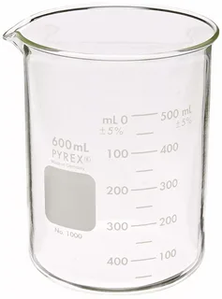
Mobile phase
If a substance has more interaction with mobile phase, it moves fast. It has a weak interaction with stationary phase.
If a substance has more interaction with stationary phase, it moves slowly. It has a weak interaction with mobile phase.
If a substance does not have any interaction with the mobile phase, it doesn’t move at all.
Each substance in the sample has a different ratio of interaction with mobile and stationary phases. That is why the speed rate of each substance is different.
In the end, they are located in different parts in the setup, and are separated from each other.
Stationary phase
Mobile phase

Slide 5
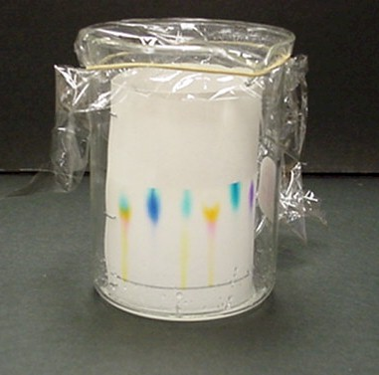
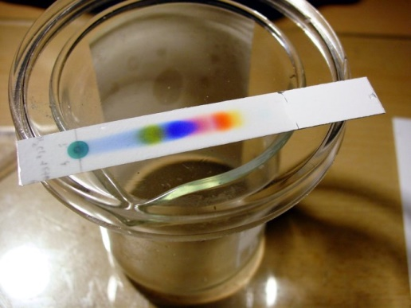
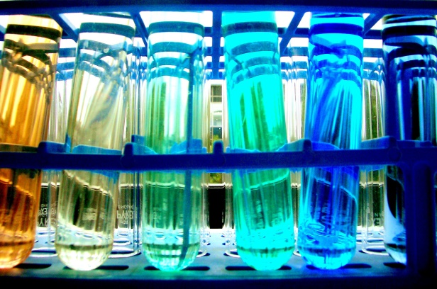
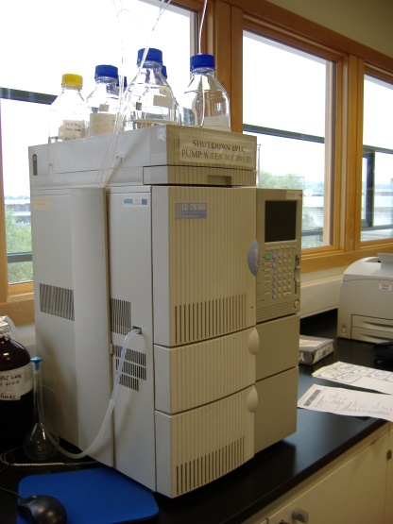
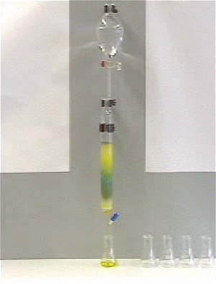
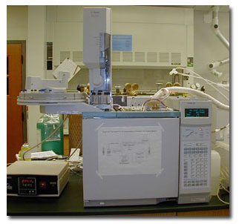
Types of Chromatography
Thin layer
Paper
HPLC
Column
Gas
Notes:
Most chromatography uses modern instrumentation and involves placing the sample to be analysed on a support (paper or silica) and transporting it along a mobile phase. The mobile phase can be a liquid (liquid chromatography) or a gas (gas chromatography).

Slide 6
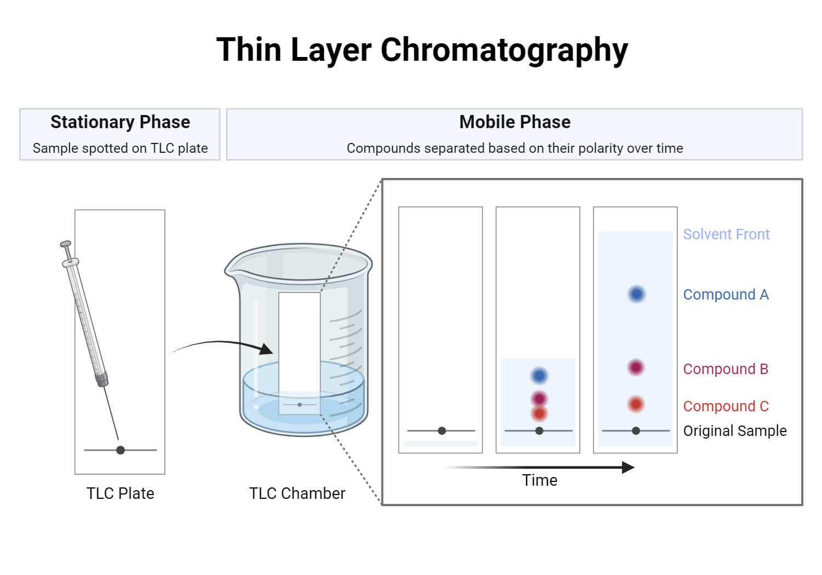
(TLC)

Slide 7
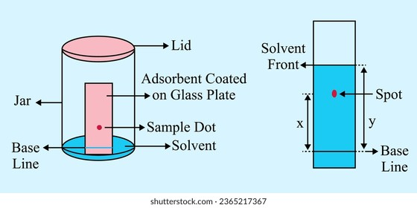
TLC retention factor (Rf)
Rf = x/y

Slide 8
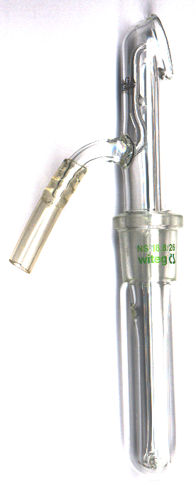
For Colorless Compounds:
Where is the spots ??
We do not know.
Solvent front
a
R_{f} = b/a
b
•
Base line
•
•
Iodine or sulphuric acid is used for most organic mixtures.
Ninhydrin is used for amino acids.
2,4-Dinitrophenylhydrazine is used for aldehydes and ketones

Slide 9
Gas Chromatography
Good for volatile samples (up to about 250 ºC)
0.1-1.0 microliter of liquid or 1-10 ml vapor
Can detect <1 ppm with certain detectors
Can be easily automated for injection and data analysis

Slide 10
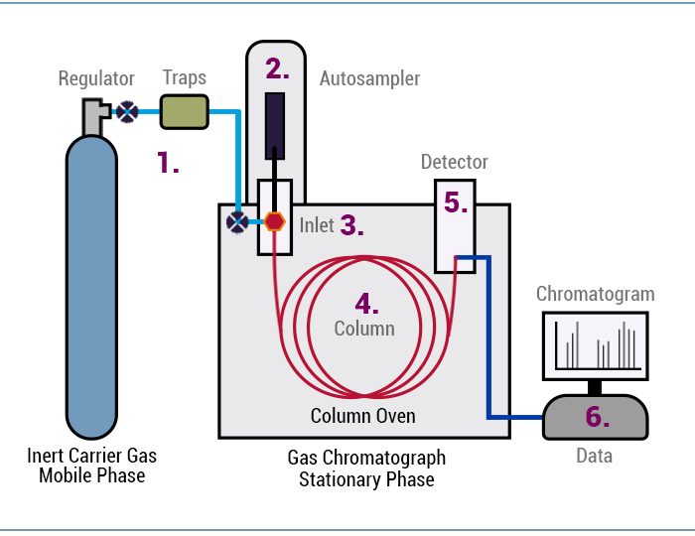
Scheme of Gas Chromatograph
Types of detector:
MS – mass spectrometry
TC - thermal conductivity
FID - flame ionization detector

Slide 11
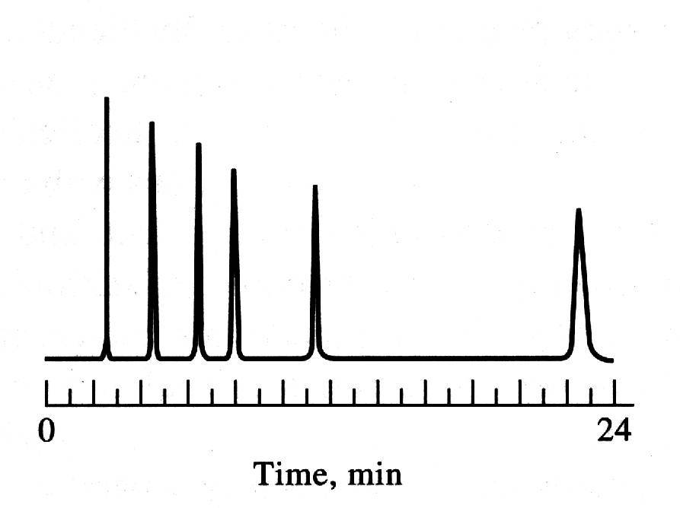
Applications of GC
Peaks correspond to
individual components
Qualitative Analysis
Separation of Mixture Components
Identification of Compounds
Retention time comparison
Authentic
Unknown

Slide 12
Quantitative Analysis
Calibration curve
External Standard Method
Peak area
Concentration
0
10
0
10
0
10
0
10
0
10
0
10
0
10
100 ng/mL
75 ng/mL
50 ng/mL
25 ng/mL
10 ng/mL
5 ng/mL
Unknown

Slide 13
High-performance liquid chromatography
HPLC formerly referred to as high-pressure liquid chromatography, is a technique in analytical chemistry used to separate, identify, and quantify specific components in mixtures.
It relies on high pressure pumps, which deliver mixtures of various solvents, called the mobile phase, which flows through the system, collecting the sample mixture on the way, delivering it into a column, filled with adsorbent material, called the stationary phase.

Slide 14
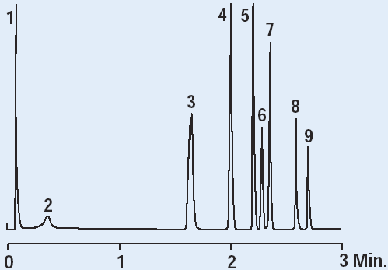
Instrumentation of HPLC
Sample injection valve
Solvent mixing
valve
Pump
Column
HPLC Chart
Detector
Recorder
Mobile phase
reservoir
Waste

Slide 15
HPLC Detector
Characteristics of Typical HPLC Detectors :
Type
Response
Sensitivity
(ng/mL)
Refractive index
Universal
1000
Conductimetric
Selective
100
UV/visible absorption
Selective
10
Mass-spectrometry
Selective
0.1
Fluorescence
Selective
0.001

Slide 16
Ultraviolet–visible spectroscopy
UV or UV-VIS-spectrophotometry refers to absorption spectroscopy or reflectance spectroscopy in part of the ultraviolet and the full visible regions of the electromagnetic spectrum.
UV-vis spectrophotometers work by passing a beam of light through the sample and measuring the amount of light that is absorbed at each wavelength. The amount of light absorbed is proportional to the concentration of the absorbing compound in the sample.
Most molecules and ions absorb energy in the ultraviolet or visible range, i.e., they are chromophores. The absorbed photon excites an electron in the chromophore to higher energy molecular orbitals, giving rise to an excited state.

Slide 17
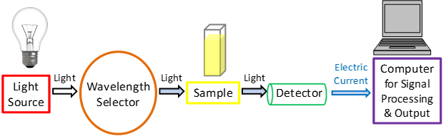
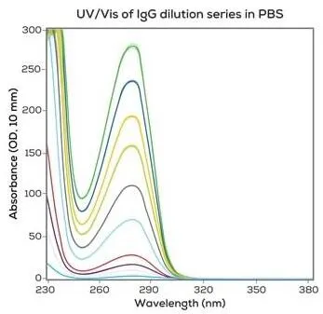
Principle of UV-spectrometer

Slide 18
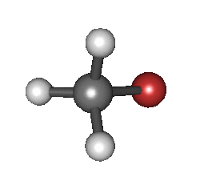
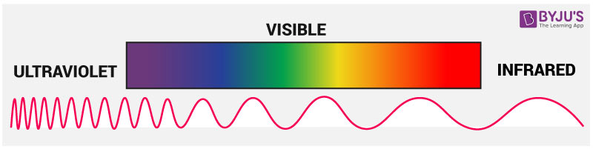
Infrared spectroscopy (IR)
Infrared spectroscopy exploits the fact that molecules absorb frequencies that are characteristic of their structure.
These absorptions occur at resonant frequencies, i.e. the frequency of the absorbed radiation matches the vibrational frequency.
The frequency of the vibrations are associated with a particular normal mode of motion and a particular bond type.

Slide 19
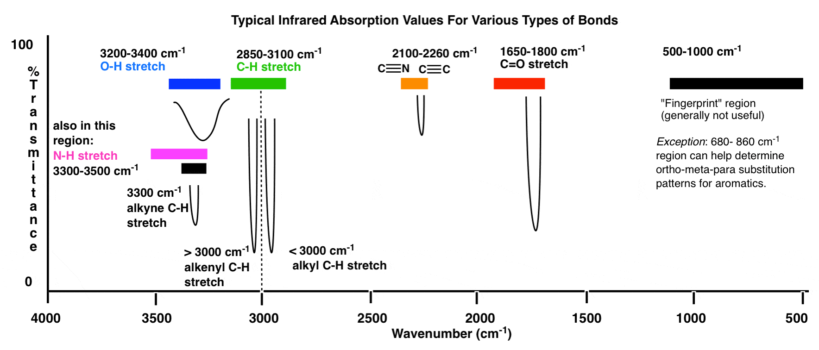
Infrared spectroscopy (IR)
The major use of infrared spectroscopy is to determine the functional groups of molecules.

Slide 20
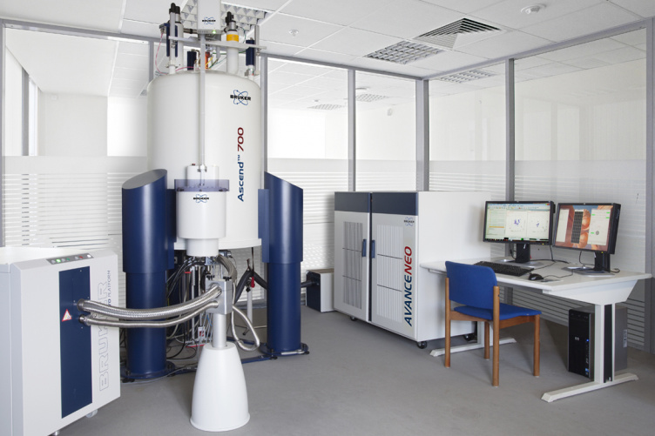
Nuclear magnetic resonance spectroscopy
NMR spectroscopy is a spectroscopic technique to observe local magnetic fields around atomic nuclei.
This spectroscopy is based on the measurement of absorption of electromagnetic radiations in the radio frequency region from roughly 4 to 900 MHz.

Slide 21
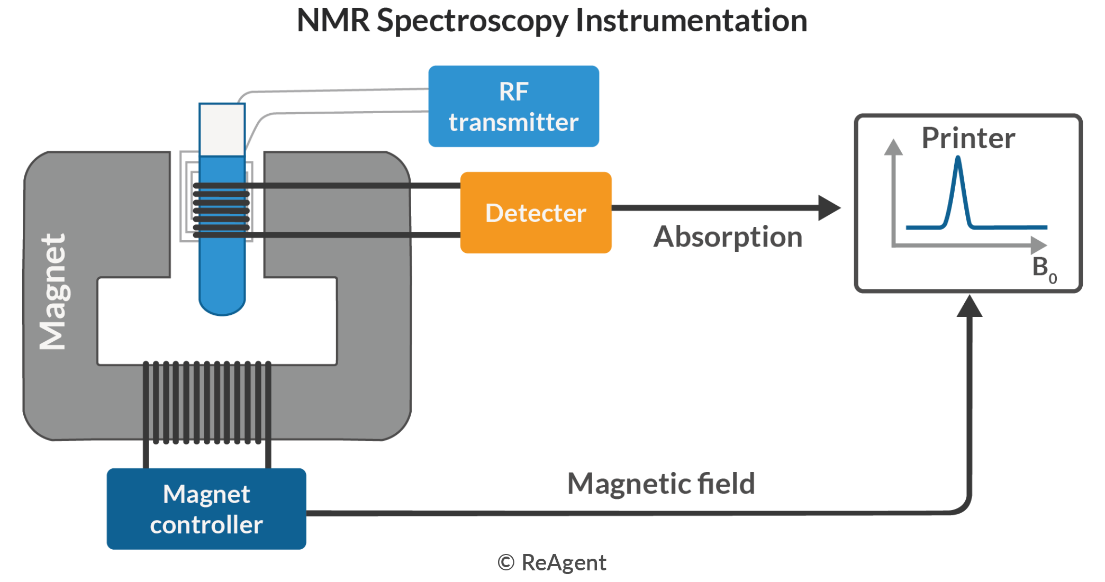
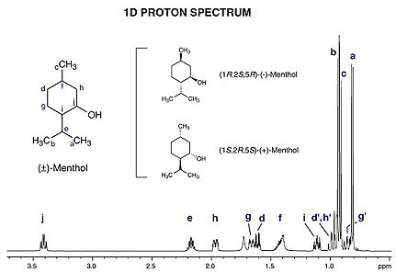
Nuclear magnetic resonance spectroscopy
NMR-spectroscopy helps to determine the
structure of molecules.
chemical shift

