Slide 1
Genetic engineering

Slide 2
What is genetic engineering?
Genetic engineering, the artificial manipulation, modification, and recombination of DNA or other nucleic acid molecules in order to modify an organism or population of organisms.
This may mean changing one base pair (A-T or C-G), deleting a whole region of DNA, or introducing an additional copy of a gene.
It may also mean extracting DNA from another organism’s genome and combining it with the DNA of that individual.
Genetic engineering can be applied to any organism, from a virus to a sheep.
For example, genetic engineering can be used to produce plants that have a higher nutritional value or can tolerate exposure to herbicides.
Notes:
altering - изменение

Slide 3
What is genetic engineering?
The term genetic engineering is generally used to refer to methods of recombinant DNA technology, which emerged from basic research in microbial genetics.
The techniques employed in genetic engineering have led to the production of medically important products, including human insulin, human growth hormone, and hepatitis B vaccine, as well as to the development of genetically modified organisms such as disease-resistant plants.

Slide 4
Historical developments
The possibility for recombinant DNA technology emerged with the discovery of restriction enzymes in 1968 by Swiss microbiologist Werner Arber. The following year American microbiologist Hamilton O. Smith purified so-called type II restriction enzymes, which were found to be essential to genetic engineering for their ability to cleave a specific site within the DNA (as opposed to type I restriction enzymes, which cleave DNA at random sites).
Drawing on Smith’s work, American molecular biologist Daniel Nathans helped advance the technique of DNA recombination in 1970–71 and demonstrated that type II enzymes could be useful in genetic studies.
In 1972, Paul Berg created the first recombinant DNA molecules by combining DNA from the monkey virus SV40 with that of the lambda virus.
In 1973 Herbert Boyer and Stanley Cohen created the first transgenic organism by inserting antibiotic resistance genes into the plasmid of an Escherichia coli bacterium. A year later Rudolf Jaenisch created a transgenic mouse by introducing foreign DNA into its embryo, making it the world's first transgenic animal.

Slide 5
Historical developments
In 1976 Genentech, the first genetic engineering company, was founded by Herbert Boyer and Robert Swanson and a year later the company produced a human protein (somatostatin) in E. coli.
The insulin produced by bacteria was approved for release by the Food and Drug Administration (FDA) in 1982.
The first field trials of genetically engineered plants occurred in France and the US in 1986, tobacco plants were engineered to be resistant to herbicides.
In 1994 American company Calgene attained approval to commercially release the first genetically modified food, the Flavr Savr, a tomato engineered to have a longer shelf life.
In 2009 11 transgenic crops were grown commercially in 25 countries, the largest of which by area grown were the US, Brazil, Argentina, India, Canada, China, Paraguay and South Africa.
In 2010, scientists at the J. Craig Venter Institute created the first synthetic genome and inserted it into an empty bacterial cell.
In 2012, Jennifer Doudna and Emmanuelle Charpentier collaborated to develop the CRISPR/Cas9 system, a technique which can be used to easily and specifically alter the genome of almost any organism.

Slide 6
Process and techniques
Most recombinant DNA technology involves the insertion of foreign genes into the plasmids of common laboratory strains of bacteria.
Plasmids are small rings of DNA; they are not part of the bacterium’s chromosome (the main repository of the organism’s genetic information). Nonetheless, they are capable of directing protein synthesis, and, like chromosomal DNA, they are reproduced and passed on to the bacterium’s progeny.
Thus, by incorporating foreign DNA (for example, a mammalian gene) into a bacterium, researchers can obtain an almost limitless number of copies of the inserted gene. Furthermore, if the inserted gene is operative (i.e., if it directs protein synthesis), the modified bacterium will produce the protein specified by the foreign DNA.
Notes:
Progeny - потомство

Slide 7
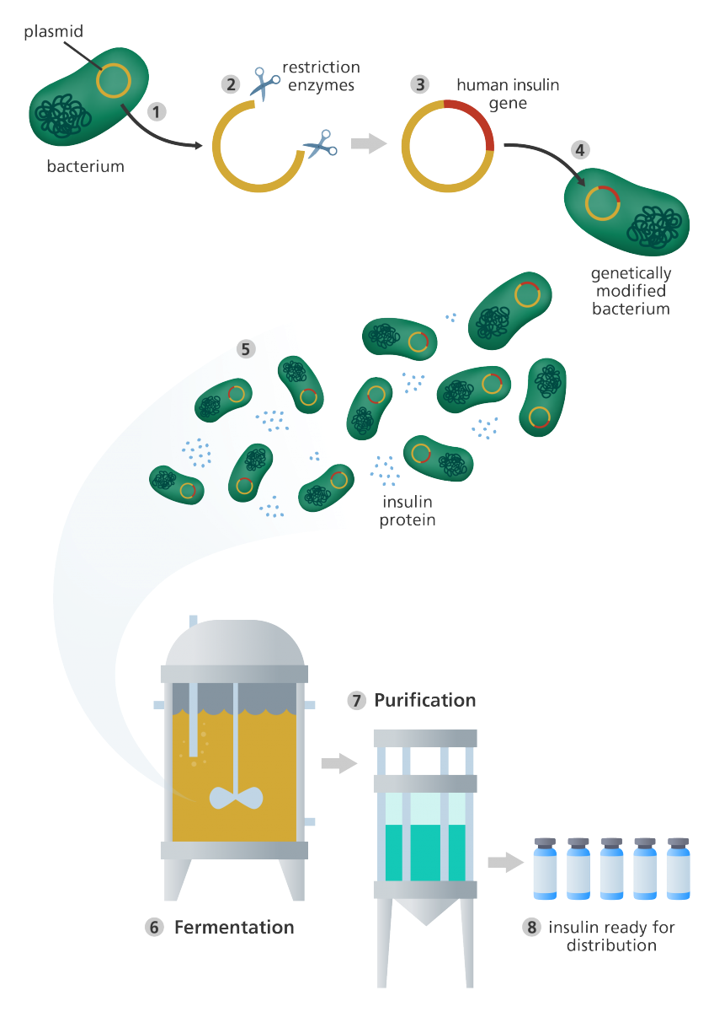
Insulin manufacturing
The genetic engineering process:
1. A small piece of circular DNA called a plasmid is extracted from the bacteria or yeast cell.
2. A small section is then cut out of the circular plasmid by restriction enzymes, ‘molecular scissors’.
3. The gene for human insulin is inserted into the gap in the plasmid. This plasmid is now genetically modified.
4. The genetically modified plasmid is introduced into a new bacteria or yeast cell.
5. This cell then divides rapidly and starts making insulin.

Slide 8
Insulin manufacturing
6. To create large amounts of the cells, the genetically modified bacteria or yeast are grown in large fermentation vessels that contain all the nutrients they need. The more the cells divide, the more insulin is produced.
7. When fermentation is complete, the mixture is filtered to release the insulin.
8. The insulin is then purified and packaged into bottles and insulin pens for distribution to patients with diabetes.

Slide 9
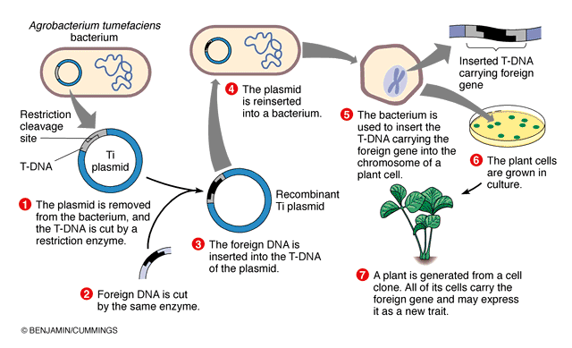
Agrobacterium is bacteria that uses a Horizontal gene transfer (HGT). HGT is the transfer of DNA between different genomes. HGT can occur in bacteria through three ways:
Transformation: The uptake and incorporation of external DNA into the cell thereby resulting in the alteration of the genome
Conjugation: The exchange of genetic material through cell-to-cell contact of two bacterial cells. A strand of plasmid DNA is transferred to the recipient cell and the donor cell then synthesis DNA to replace the strand that was transferred to the recipient cell.
Transduction: A segment of bacterial DNA is carried from one bacterial cell to another by a bacteriophage. The bacteriophage infects a bacterial cell and takes up bacterial DNA. When this phage infects another cell, it transfers the bacterial DNA to the new cell. The bacteria can then become a part of the new host cell.
However, it is also possible for HGT to occur between eukaryotes and bacteria though the mechanism for this transfer is not well understood.
Agrobacterium has the ability to transfer DNA between itself and plants and is therefore commonly used in genetic engineering.
Notes:
https://sphweb.bumc.bu.edu/otlt/MPH-Modules/PH/GMOs/GMOs3.html

Slide 10
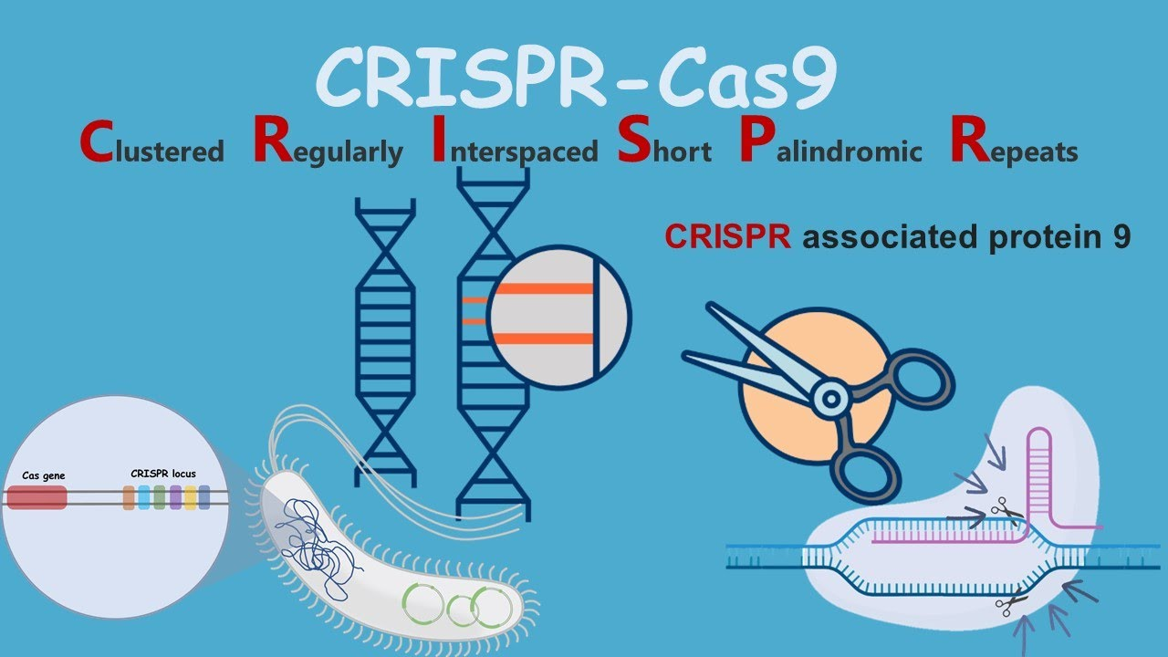
A subsequent generation of genetic engineering techniques that emerged in the early 21st century centered on gene editing. Gene editing, based on a technology known as CRISPR-Cas9, allows researchers to customize a living organism’s genetic sequence by making very specific changes to its DNA. Gene editing has a wide array of applications, being used for the genetic modification of crop plants and livestock and of laboratory model organisms (e.g., mice).
Video
Notes:
https://www.youtube.com/watch?v=qc6xgb4VXl0
CRISPR (короткие палиндромные повторы, регулярно расположенные группами)

Slide 11
How does CRISPR-Cas9 work?
The CRISPR-Cas9 system consists of two key molecules that introduce a change (mutation) into the DNA. These are:
an enzyme called Cas9. This acts as a pair of ‘molecular scissors’ that can cut the two strands of DNA at a specific location in the genome so that bits of DNA can then be added or removed.
a piece of RNA called guide RNA (gRNA). This consists of a small piece of pre-designed RNA sequence (about 20 bases long) located within a longer RNA scaffold. The scaffold part binds to DNA and the pre-designed sequence ‘guides’ Cas9 to the right part of the genome. This makes sure that the Cas9 enzyme cuts at the right point in the genome.

Slide 12
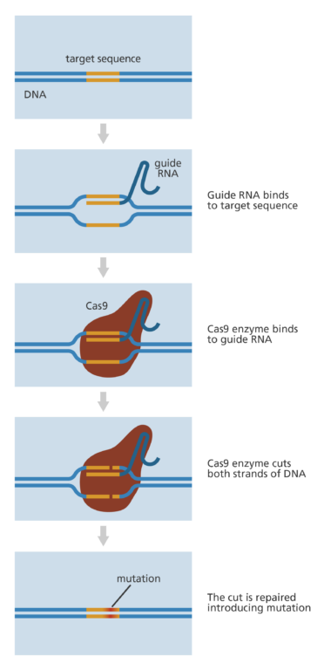
The guide RNA is designed to find and bind to a specific sequence in the DNA. The guide RNA has RNA bases that are complementary to those of the target DNA sequence in the genome. This means that, at least in theory, the guide RNA will only bind to the target sequence and no other regions of the genome.
The Cas9 follows the guide RNA to the same location in the DNA sequence and makes a cut across both strands of the DNA.
At this stage the cell recognizes that the DNA is damaged and tries to repair it.
Scientists can use the DNA repair machinery to introduce changes to one or more genes in the genome of a cell of interest.

Slide 13
Applications of CRISPR technology
CRISPR gene-editing technology has a wide array of research and medical applications. For example, in the laboratory, CRISPR systems can be used to modify genes in bacteria and in animal and plant models, enabling researchers to gain new understanding of the effects of genetic modification. Although preexisting genetic engineering technologies have allowed researchers to investigate various types of genetic modifications and alterations for decades, CRISPR is less costly, more efficient, and more reliable.
In addition, different CRISPR-based therapies are being explored in clinical trials for the treatment of certain human diseases. Some examples include novel treatments for diabetes; for sickle cell disease; for cancers of blood-forming tissues, such as multiple myeloma, leukemia, and lymphoma; for chronic infectious diseases, such as AIDS; and for a form of inherited impairment in vision known as Leber congenital amaurosis. Investigations of CRISPR-based therapies in humans are helping to shed light on how DNA alterations induced by CRISPR enzymes affect cells, on how the human immune system responds to CRISPR-derived interventions, and on risks associated with unwanted off-target alterations in DNA.

Slide 14
Applications of CRISPR technology
The correction of genetic errors associated with disease in animals suggests that gene editing has potential applications in gene therapy for humans. Gene therapy is the introduction of a normal gene into an individual’s genome in order to repair a mutation that causes a genetic disease. When a normal gene is inserted into a mutant nucleus, it most likely will integrate into a chromosomal site different from the defective allele; although this may repair the mutation, a new mutation may result if the normal gene integrates into another functional gene. If the normal gene replaces the mutant allele, there is a chance that the transformed cells will proliferate and produce enough normal gene product for the entire body to be restored to the undiseased phenotype.

Slide 15
Better targeting of CRISPR-Cas9
In most cases the guide RNA consists of a specific sequence of 20 bases. These are complementary to the target sequence in the gene to be edited. However, not all 20 bases need to match for the guide RNA to be able to bind.
The problem with this is that a sequence with, for example, 19 of the 20 complementary bases may exist somewhere completely different in the genome. This means there is potential for the guide RNA to bind there instead of or as well as at the target sequence.
The Cas9 enzyme will then cut at the wrong site and end up introducing a mutation in the wrong location. While this mutation may not matter at all to the individual, it could affect a crucial gene or another important part of the genome.
Scientists are keen to find a way to ensure that the CRISPR-Cas9 binds and cuts accurately. Two ways this may be achieved are through:
the design of better, more specific guide RNAs using our knowledge of the DNA sequence of the genome and the ‘off-target’ behaviour of different versions of the Cas9-gRNA complex.
the use of a Cas9 enzyme that will only cut a single strand of the target DNA rather than the double strand. This means that two Cas9 enzymes and two guide RNAs have to be in the same place for the cut to be made. This reduces the probability of the cut being made in the wrong place.

