Slide 1
Industrial fermentation technology

Slide 2
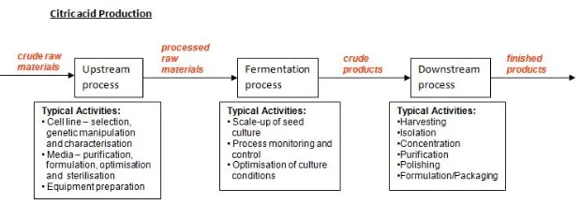
Industrial fermentation processes require three most important stages to complete product fermentation. These are:
up-stream processing (abbreviated as USP)
the fermentation process
down-stream processing (DSP).

Slide 3
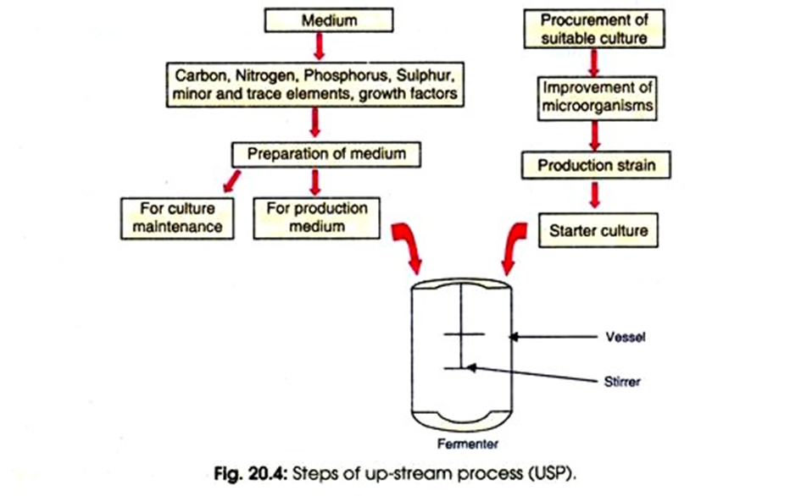
Stage # 1. Up-Stream Process
USP includes formulation of the fermentation medium, sterilization of air, fermentation medium and the fermenter, inoculum preparation and inoculation of the medium.
This process comprises of obtaining a desired microorganism, and its improvement so as to enhance the productivity and yield. It also includes the maintenance of strain purity, preparation of inocula and further efforts to improve the economic efficiency of the process.
There are two distinct processes involved in USP but both the processes run simultaneously. The medium is prepared for the culture (inoculum) preparation as well as for the production of desired product.
Notes:
https://www.biologydiscussion.com/industrial-microbiology-2/fermentation-industrial-microbiology-2/3-main-stages-involved-in-fermentation-microbiology/66007
https://www.biologydiscussion.com/biotechnology/bioprocess-technology/types-and-stages-of-fermentation-process-explained/10117
https://www.biotechnologyforums.com/thread-2336.html

Slide 4
Steps of up-stream processes: formulation of the fermentation medium
The fermentation medium should contain an energy source, a carbon source, a nitrogen source and micronutrients required for the growth of the microorganism along with water and oxygen, if necessary.
A medium which is used for a large scale fermentation, in order to ensure the sustainability of the operation, should have the following characteristics;
  1. It should be cheap and easily available
  2. It should maximise the growth of the microorganism, productivity and the rate of formation of the desired product
  3. It should minimise the formation of undesired products
Usually, waste products from other industrial processes, such as molasses, lignocellulosic wastes, cheese whey and corn steep liquor, after modifying with the incorporation of additional nutrients, are used as the substrate for many industrial fermentations.

Slide 5
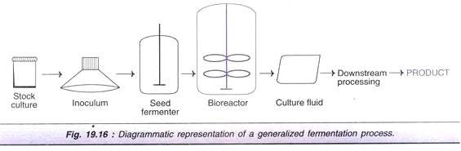
Steps of up-stream processes: inoculum preparation
Inoculum build up is the preparation of the seed culture in amounts sufficient to be used in the large fermenter vessel. This involves growing the microorganisms obtained from the pure stock culture in several consecutive fermenters. This process cuts down the time required for the growth of microorganisms in the fermenter, thereby increasing the rate of productivity. Then the seed culture obtained through this process is used to inoculate the fermentation medium.
USP

Slide 6
Steps of up-stream processes:
Sterilization
Sterilization is essential for preventing the contamination with any undesired microorganisms.
Air is sterilized by membrane filtration while the medium is usually heat sterilized.
Any nutrient component which is heat labile is filter-sterilized and later added to the sterilized medium.
The fermenter may be sterilized together with the medium or separately.

Slide 7
Stage # 2. Fermentation Process
The fermentation process involves the propagation of the microorganism and production of the desired product. The fermentation process can be categorized depending on various parameters.
It can be either aerobic fermentation, carried out in the presence of oxygen or anaerobic fermentation, carried out in the absence of oxygen. Many industrial fermentation are carried out under aerobic conditions where a few processes such as ethanol production by yeast require strictly anaerobic environments.

Slide 8
Modes of operation
The fermentation process can also be divided into three basic systems, namely batch, continuous or fed-batch, depending on the feeding strategy of the culture and the medium into the fermenter.
In a batch operation, the medium and the culture are initially fed into the vessel and it is then closed. After that, no components are added apart from oxygen (in an aerobic process) and acid or alkali for the pH adjustment. The fermentation is allowed to run for a predetermined period of time and the product is harvested at the end.
In a continuous process, fresh medium is continuously added and the products, along with the culture is removed at the same rate, thus maintaining constant concentrations of nutrients and cells are maintained throughout the process.
A fed-batch system is a combination of these two systems where additional nutrients are added to the fermenter as the fermentation is in progress. This extends the time of operation but the products are harvested at the end of the production cycle as in a batch fermenter.

Slide 9
The process can also be categorised as solid state fermentation (SSF) or submerged fermentation (SmF), depending on the amount of free water in the medium. In a solid state fermentation, the medium contains no free flowing water. The organisms are grown in a solid substrate which is moistened. This is used in certain industrial process such as ‘koji’ fermentation from soybeans, production of amylase and protease by Aspergillus oryzae on roasted soybeans and wheat, bioremediation, detoxification of agro-industrial wastes, etc. Submerged fermentation is in which microorganisms grow submerged in a liquid medium where free water is abundant. This is the method of choice for many industrial operations over SSF although SSF is also rapidly gaining interest in the present.

Slide 10
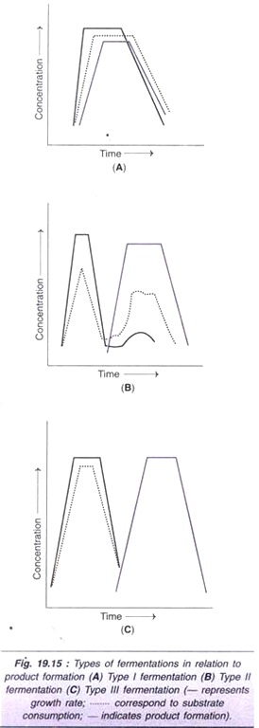

Slide 11
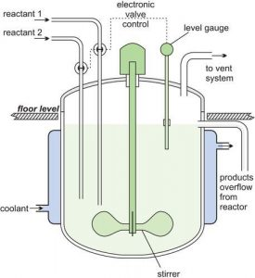
Types of fermenters:
Continuous Stirred-Tank Fermentor
The continuous stirred-tank reactor (CSTR) is composed of a vessel with pipes, pumps, valves, agitator, motor, shaft, and impeller(s). The shaft is situated at the bottom of the tank, and the number of impellers depends on the size of the bioreactor.
In this type of fermentor, a structure called sparger is found that keeps adding air to the culture medium. It is a ring-like structure with many holes. The sparger, along with the impellers, distribute gas in the entire vessel. The impellers break down the bubbles into smaller ones that are homogeneously distributed in the bioreactor.

Slide 12
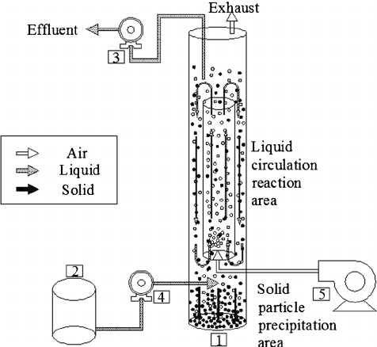
Types of fermenters:
Airlift Fermentor
The airlift bioreactors contain a baffle or a draft tube in the middle through which air is pumped into the vessel. There are two types of airlift fermentors:
Internal loop airlift bioreactor: It has a single central draft tube that provides inner circulation channels.
External loop airlift bioreactor: It contains external loops that separate the liquids flowing into independent channels.
Notes:
https://biologyease.com/types-of-fermentors/

Slide 13
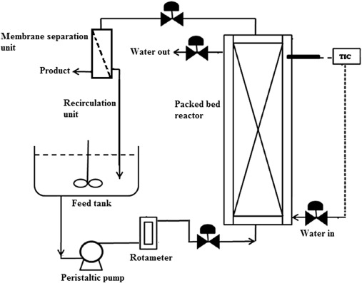
Types of fermenters:
Packed Bed Fermentor
In a packed bed fermentor, a hollow tube or pipe is packed with a biocatalyst. The bed is immobile in nature. The culture medium flows through the biocatalyst, which produces the metabolites continuously in the broth. These bioreactors are easy to operate but are often blocked due to poor oxygen circulation.
Fluidised Bed Fermentor
In this type of reactor, a solid granular bed that is usually made up of a biocatalyst is present. The fluid, that is, liquid or gas, is passed through the solid bed at high speeds, such that the suspended solid behaves like a fluid. This type of fermentor is used for microbial flocs, immobilised cells, and enzymes.

Slide 14
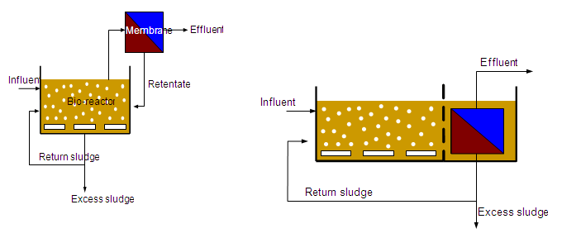
Membrane Fermentor
Membrane bioreactors work in conjugation with ultrafiltration and microfiltration. This type of fermentor is used for the biological treatment of wastewater. There are two types of membrane bioreactors:
Submerged membrane bioreactor: In this type of fermentor, the membrane is found inside the vessel submerged in the wastewater.
Side-stream membrane bioreactor: In this type of fermentor, the membrane is found outside the reactor and filtration by the membrane is an additional step in the whole process.

Slide 15
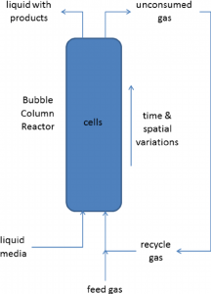
Bubble Column Fermentor
A bubble column fermentor is equipped with a cylindrical column that is filled with liquid, and gas is inserted into it from the bottom. It is vertically arranged, such that the introduction of gas from the bottom creates a turbulent stream and allows optimum gas exchange. The sparger mixes the contents of the vessel. The liquid flows either in a parallel direction or in a counter-current direction.

Slide 16
Stage # 3. Down-Stream Process:
Further processing is carried out depending upon whether the product is intracellular or present inside the cell or membrane bound or release outside the cell or extracellular in nature. This leads to recovery of the product in pure form.
The presence of undesirable products (by products), impurities in media, antifoam agents, etc. affect the DSP steps. Therefore, each step is required thorough check up in both USP as well as in DSP. For example, a cheap carbon and energy source may increase DSP cost.
At commercial level use of existing equipment’s, ancillaries, etc. are more advantageous than that of creating new facilities because the later step requires more investment which may lead to escalation of cost of the product and processes.

Slide 17
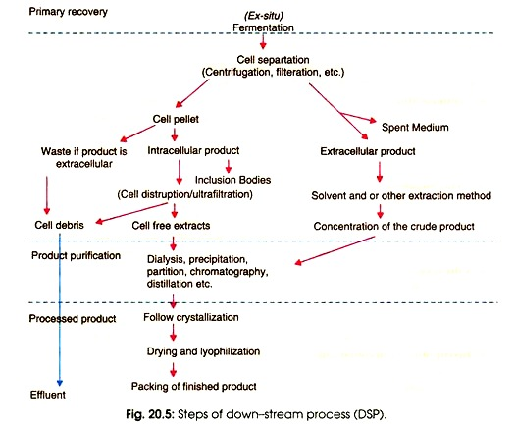
The DSP consists of series of distinct unity or processes which are connected to each other for getting the final product as shown in Fig 20.5.

Slide 18
Cell Harvesting:
Since, microbial cells are in liquid medium or broth, solid-liquid separation method is influenced by the size and morphology of the microorganisms (single cells, aggregates or mycelia).
Further, the process also depends upon the location of product whether it is intracellular or extracellular it has been secreted into the medium. Besides, other factors such as specific gravity, viscosity, and rheology of the medium also influence cell harvesting method.

Slide 19
Broth Conditioning Technique:
This technique allows separation of cells from large volume of liquid medium. In this case, cells are allowed to form floccules or precipitate by using chemical, physical and biological treatments.
Coagulating materials such as simple electrolytes, acids, bases, salts, multivalent ions etc. are added to form small floes from dispersed colloids or suspended materials. Certain floes precipitation methods are also used at the end of many traditional beer and wine fermentation processes for the precipitation of yeast cells.

Slide 20
Sedimentation:
This process is widely used for yeast separation during alcohol production and in waste-water treatment. The rate of particle sedimentation is a function of both size and density. If, larger the size, greater its density, and the faster rate of sedimentation. Therefore, for quick separation, the difference in density between the particle and the medium must be large with low viscosity.

Slide 21
Centrifugation:
This process allows small particles or cells to separate from liquid. It is also suitable for some liquid-liquid separations. Similar to sedimentation, its effectiveness also depends upon cell size, density difference between the cells and the medium, and its viscosity.
Higher speed of centrifugation requires for the separation of smaller microorganisms, such as bacteria. In case of yeast cells present in beer, relatively, low centrifugation effectively recovers residual yeast cells.

Slide 22
Filtration:
There are certain filters such as clothes, glass wool or cellulose that retain the solids and pass on the liquid. The solids accumulate above the filter. Such technique is useful in case of fungal mycelia separation.
There are two types of filters used in industrial process: plate and frame filters or filter press, and rotatory vacuum filter, which help in harvesting the fungal mycelia during antibiotic manufacture, bakers yeast production and in dewatering of sewage sludge.

Slide 23
Disruption of Microbial Cells:
When the product is intracellular, it is necessary to disrupt the cells/cell membrane so as to release the product. Cell disruption can be achieved by mechanical and non-mechanical methods. Some of the methods used are ultra-sonication and application of lysozyme. The ‘French-press’ is often used in laboratories, while Manton and Gaulin homogenizer (high pressure homogenizer) is employed for pilot scale cell disruption.
These are used for disruption of bacterial, yeast cells and fungal mycelia. The non-mechanical cell disruption is carried out by cell permeabilization. This can be accompanied by autolysis, osmotic shock, ruptures by ice crystal or heat shock treatment. Some organic solvents such as acetone, butanol, chloroform and methanol have been used to release enzymes from microorganisms.
Simple treatment with sodium dodecyl sulfate (SDS) or Triton X-100 is also found effective. Lysozyme is useful for Gram-positive organisms but addition of EDTA improves the effectiveness of lysozyme of Gram-negative bacteria. Some antibiotics namely penicillin and cycloserine may also be used to lyse the actively growing bacterial cells. Chitosan is effective for yeast cells.

