Slide 1
History of chemistry

Slide 2

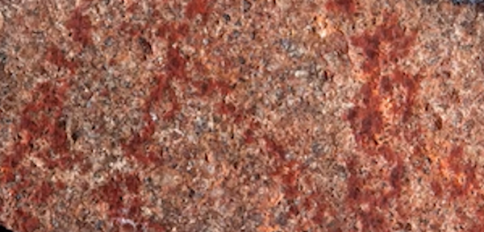
Ancient history
A 100,000-year-old ochre-processing workshop was found at Blombos Cave in South Africa. It indicates that early humans had an elementary knowledge of chemistry. Paintings drawn by early humans consisting of early humans mixing animal blood with other liquids found on cave walls also indicate a small knowledge of chemistry.
Blombos Cave
Claimed "Oldest known drawing by human hands", discovered in Blombos Cave. Estimated to be 73,000 years old.

Slide 3
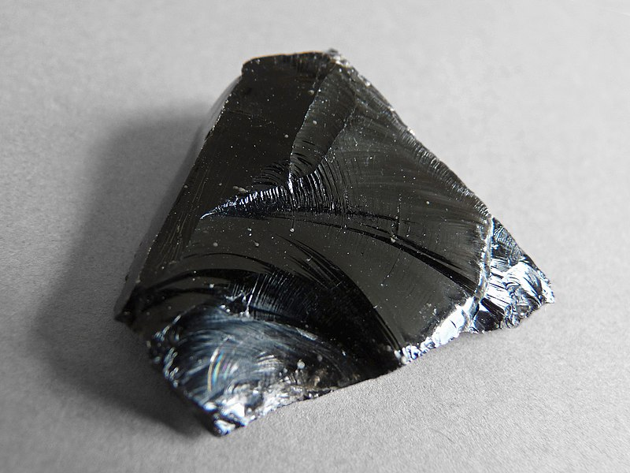
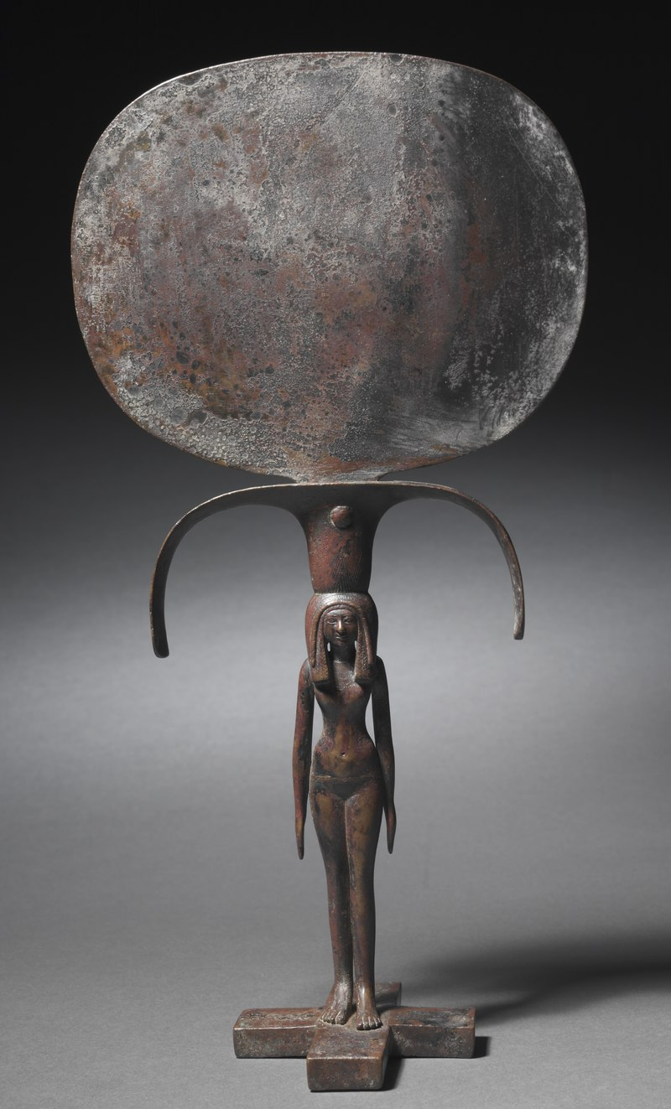
Early metallurgy
The earliest recorded metal employed by humans seems to be gold, which can be found free or "native". Small amounts of natural gold have been found in Spanish caves used during the late Paleolithic period, around 40,000 BC.
Silver, copper, tin and meteoric iron can also be found native, allowing a limited amount of metalworking in ancient cultures.
Arguably the first chemical reaction used in a controlled manner was fire. Fire led to the discovery of glass and the purification of metals; this was followed by the rise of metallurgy.
Certain metals can be recovered from their ores by simply heating the rocks in a fire: notably tin, lead and (at a higher temperature) copper. The first evidence of this extractive metallurgy, known as smelting, dates from the 6th and 5th millennia BC.
By combining copper and tin, a superior metal could be made, an alloy called bronze. This was a major technological shift that began the Bronze Age about 3500 BC.
Iron working appears to have been invented by the Hittites in about 1200 BC, beginning the Iron Age.
A piece of volcanic obsidian glass
Bronze mirror, Eighteenth dynasty of Egypt (1540–1296 BC)

Slide 4
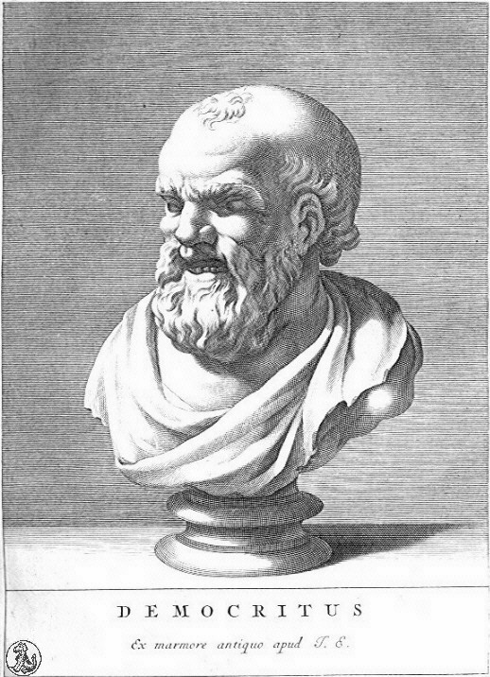
Classical antiquity and atomism
It was not until the era of the ancient Greeks that we have any record of how people tried to explain the chemical changes they observed and used. At that time, natural objects were thought to consist of only four basic elements: earth, air, fire, and water. Then, in the fourth century BC, two Greek philosophers, Democritus and Leucippus, suggested that matter was not infinitely divisible into smaller particles but instead consisted of fundamental, indivisible particles called atoms. Unfortunately, these early philosophers did not have the technology to test their hypothesis.
Democritus,
Greek philosopher and ancient atomist.

Slide 5
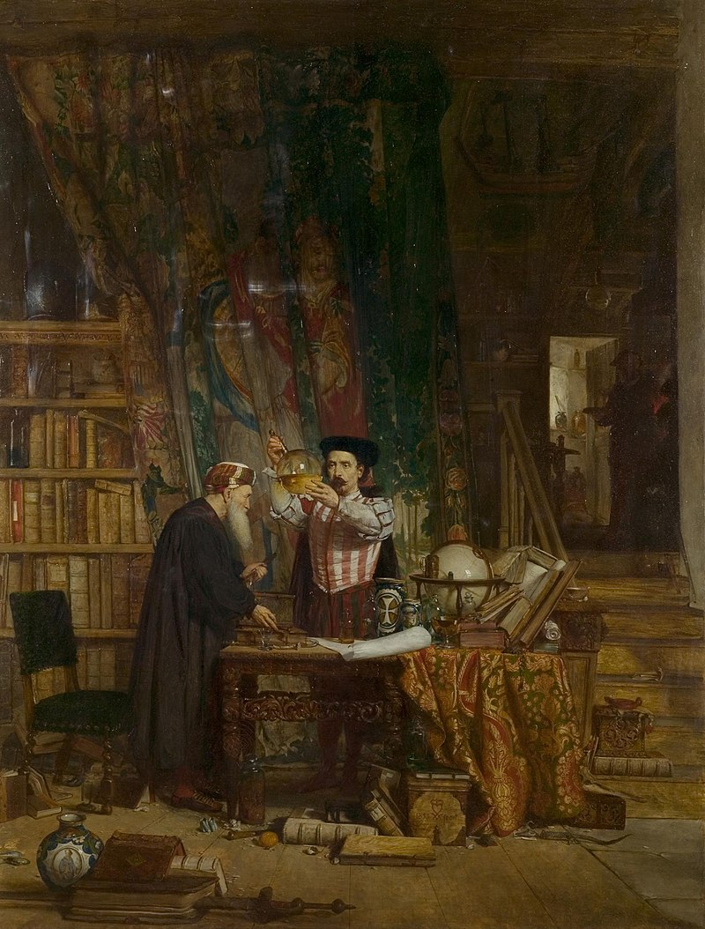
Medieval alchemy
Over the next two millennia, alchemists, who engaged in a form of chemistry and speculative philosophy during the Middle Ages and Renaissance, achieved many advances in chemistry. Their major goal was to convert certain elements into others by a process they called transmutation. In particular, alchemists wanted to find a way to transform cheaper metals into gold. Although most alchemists did not approach chemistry systematically and many appear to have been outright frauds, alchemists in China, the Arab kingdoms, and medieval Europe made major contributions, including the discovery of elements such as quicksilver (mercury) and the preparation of several strong acids.
"The Alchemist", by Sir William Douglas, 1855

Slide 6
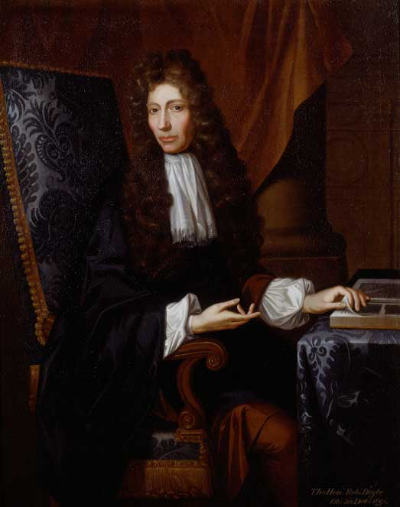
Modern Chemistry
The 16th and 17th centuries saw the beginnings of what we now recognize as modern chemistry. During this period, great advances were made in metallurgy, the extraction of metals from ores, and the first systematic quantitative experiments were carried out.
In 1661, the Englishman Robert Boyle defined an element as a substance that cannot be broken down into two or more simpler substances by chemical means. This led to the identification of a large number of elements, many of which were metals. Ironically, Boyle himself never thought that metals were elements.
Robert Boyle (1627–1691)

Slide 7
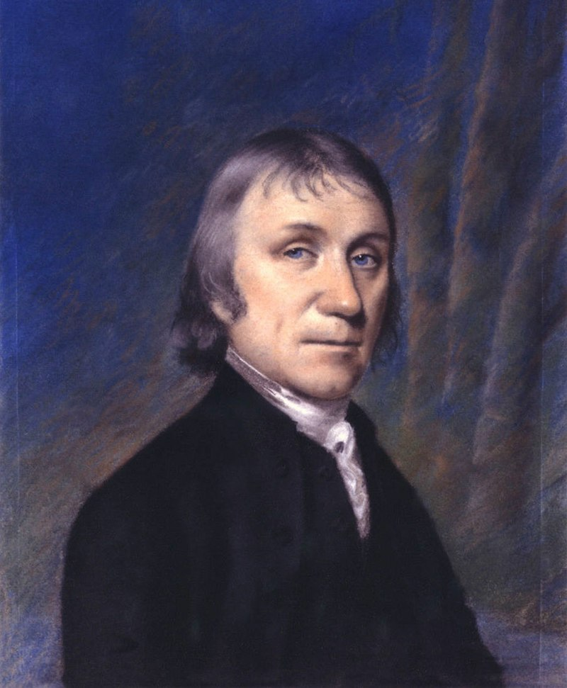
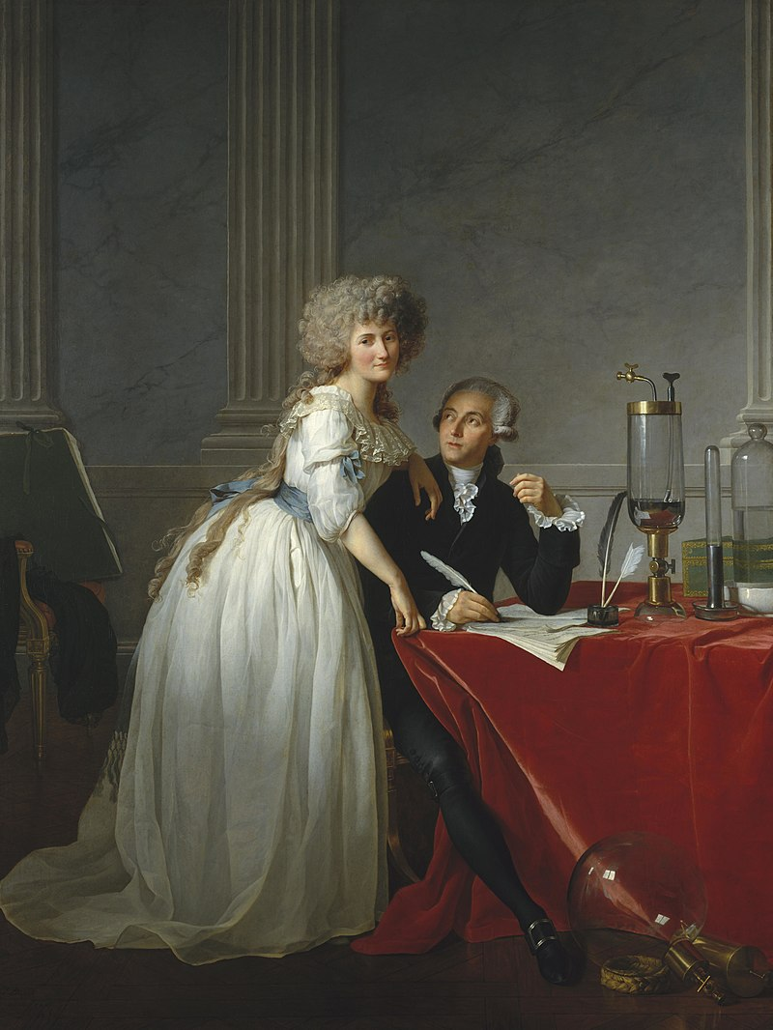
In the 18th century, the English clergyman Joseph Priestley discovered oxygen gas and found that many carbon-containing materials burn vigorously in an oxygen atmosphere, a process called combustion. Priestley also discovered that the gas produced by fermenting beer, which we now know to be carbon dioxide, is the same as one of the gaseous products of combustion.
In the late 18th century, however, the French scientist Antoine Lavoisier (1743–94) showed that combustion is the reaction of a carbon-containing substance with oxygen to form carbon dioxide and water and that life depends on a similar reaction, which today we call respiration. Lavoisier also wrote the first modern chemistry text and is widely regarded as the father of modern chemistry. His most important contribution was the law of conservation of mass, which states that in any chemical reaction, the mass of the substances that react equals the mass of the products that are formed. That is, in a chemical reaction, mass is neither lost nor destroyed.
Joseph Priestley
(1733–1804)
Portrait of Monsieur Lavoisier and his wife

Slide 8
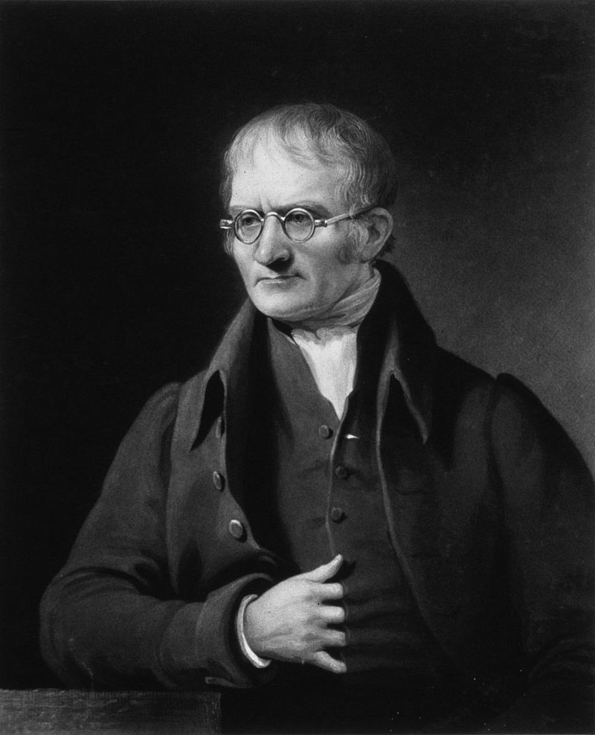
The Atomic Theory of Matter
In 1803, the English schoolteacher John Dalton expanded Proust’s development of the law of definite proportions and Lavoisier’s findings on the conservation of mass in chemical reactions to propose that elements consist of indivisible particles that he called atoms. Dalton’s atomic theory of matter contains four fundamental hypotheses:
All matter is composed of tiny indivisible particles called atoms.
All atoms of an element are identical in mass and chemical properties, whereas atoms of different elements differ in mass and fundamental chemical properties.
A chemical compound is a substance that always contains the same atoms in the same ratio.
In chemical reactions, atoms from one or more compounds or elements redistribute or rearrange in relation to other atoms to form one or more new compounds. Atoms themselves do not undergo a change of identity in chemical reactions.
John Dalton
(1766–1844)

Slide 9
Following the invention of the battery by Alessandro Volta (1745-1827), the field of electrochemistry (both theory and application) developed through major contributions by Humphry Davy (1778-1829) and Michael Faraday (1791-1867). Other areas of the discipline also progressed rapidly.
A Swedish chemist and disciple of Dalton, Jöns Jacob Berzelius embarked on a systematic program to try to make accurate and precise quantitative measurements and to ensure the purity of chemicals. In 1808 he introduced the classical system of chemical symbols and notation in which elements are abbreviated to one or two letters to make a distinct symbol from their Latin name.
In 1808 Gay-Lussac announced what was probably his single greatest achievement: from his own and others' experiments he deduced that gases at constant temperature and pressure combine in simple numerical proportions by volume, and the resulting product or products—if gases—also bear a simple proportion by volume to the volumes of the reactants. In other words, gases under equal conditions of temperature and pressure react with one another in volume ratios of small whole numbers. This conclusion subsequently became known as "Gay-Lussac's law" or the "Law of Combining Volumes“.
In 1811 Italian physicist Amedeo Avogadro (1776–1856) hypothesized that equal volumes of gases at the same temperature and pressure contain equal numbers of molecules, from which it followed that relative molecular weights of any two gases are the same as the ratio of the densities of the two gases under the same conditions of temperature and pressure.

Slide 10

urea
In 1825, Friedrich Wöhler and Justus von Liebig performed the first confirmed discovery and explanation of isomers, earlier named by Berzelius. Working with cyanic acid and fulminic acid, they correctly deduced that isomerism was caused by differing arrangements of atoms within a molecular structure. In 1827, William Prout classified biomolecules into their modern groupings: carbohydrates, proteins and lipids. After the nature of combustion was settled, a dispute about vitalism and the essential distinction between organic and inorganic substances began. The vitalism question was revolutionized in 1828 when Friedrich Wöhler synthesized urea, thereby establishing that organic compounds could be produced from inorganic starting materials and disproving the theory of vitalism.
This opened a new research field in chemistry, and by the end of the 19th century, scientists were able to synthesize hundreds of organic compounds.

Slide 11
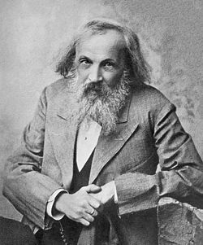
Mendeleev's periodic table
An important breakthrough in making sense of the list of known chemical elements (as well as in understanding the internal structure of atoms) was Dmitri Mendeleev's development of the first modern periodic table, or the periodic classification of the elements.
Mendeleev found that, when all the known chemical elements were arranged in order of increasing atomic weight, the resulting table displayed a recurring pattern, or periodicity, of properties within groups of elements. Mendeleev's law allowed him to build up a systematic periodic table of all the 66 elements then known based on atomic mass, which he published in Principles of Chemistry in 1869. His first Periodic Table was compiled on the basis of arranging the elements in ascending order of atomic weight and grouping them by similarity of properties.

Slide 12

The history of chemistry in 15 minutes

Slide 13
What is the most important discovery in chemistry on your opinion?

