Slide 1
Synthetic procedure writing

Slide 2
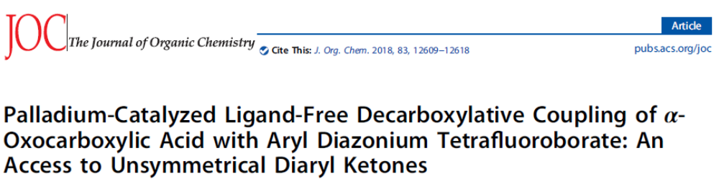

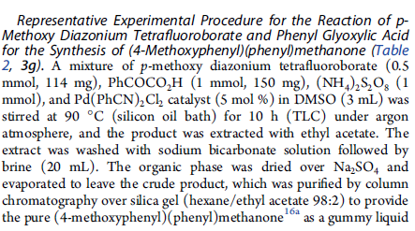
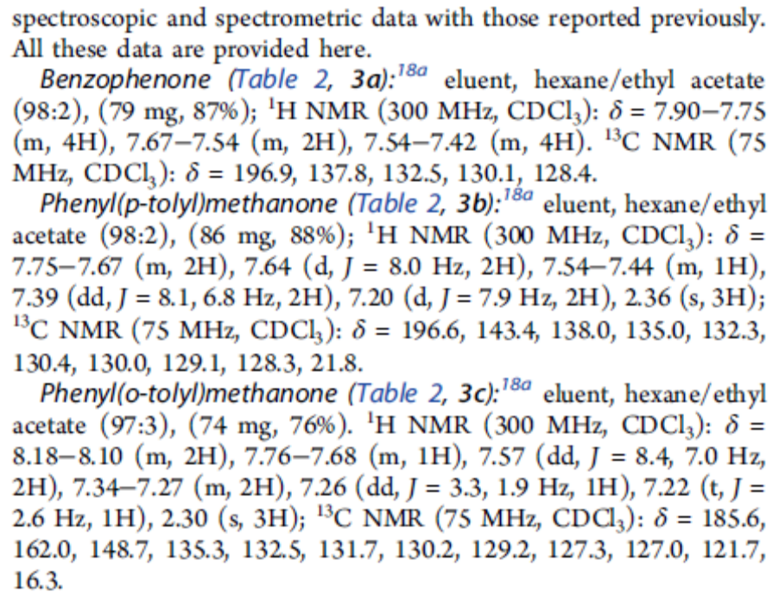
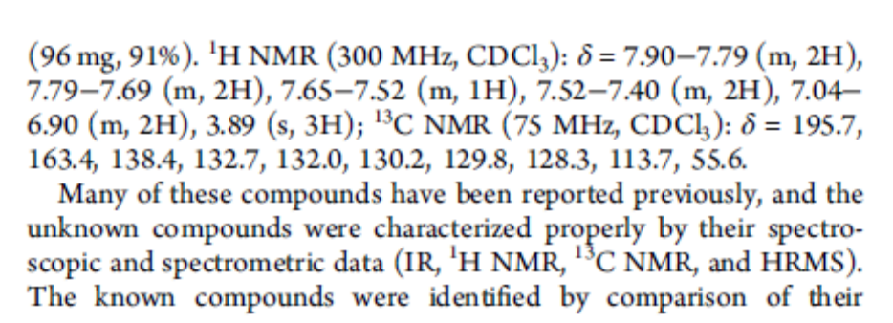
`
Title
Loading
Conditions, monitoring
Separation
Purification
Appearance, properties, spectral data

Slide 3
Use prepositions correctly!
at 50 ºC / high temperature / reflux
for 1 hour / 5 minutes / 2 days
under inert atmosphere / reduced pressure
to remove in vacuo
to dissolve in water
to wash / to extract / to treat with solvent
to dry over Na₂SO₄
to crystallize / to precipitate from solvent
to purify by column chromatography

Slide 4
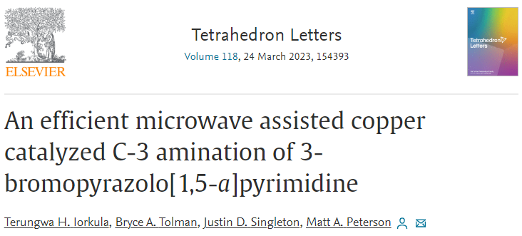
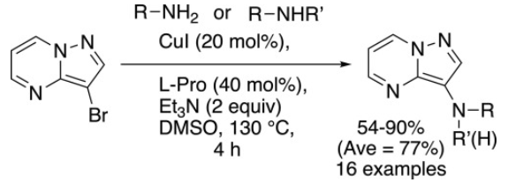
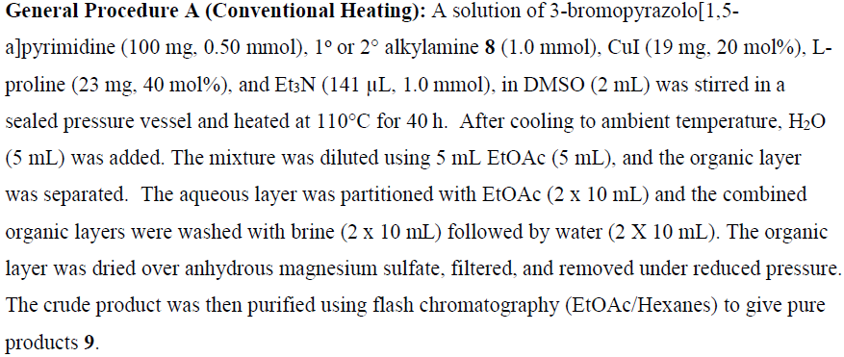
ambient temperature – температура окружающей среды brine – солевой раствор
to dilute – разбавлять aqueous layer – водный слой
to partition – разделять
crude product – технический продукт

Slide 5

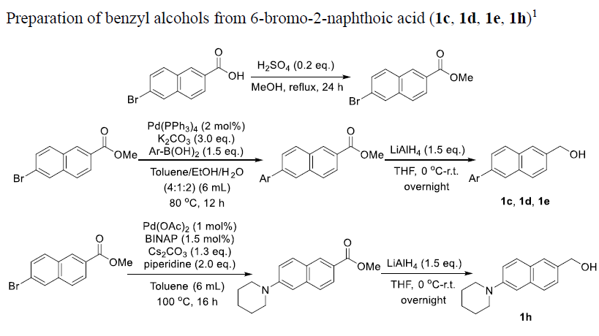
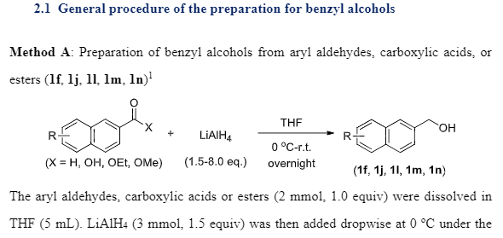
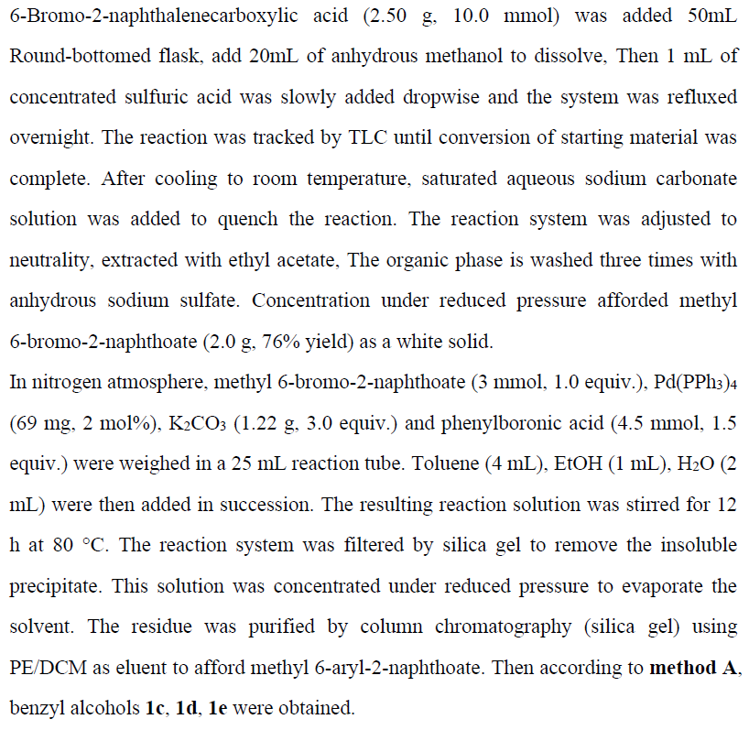
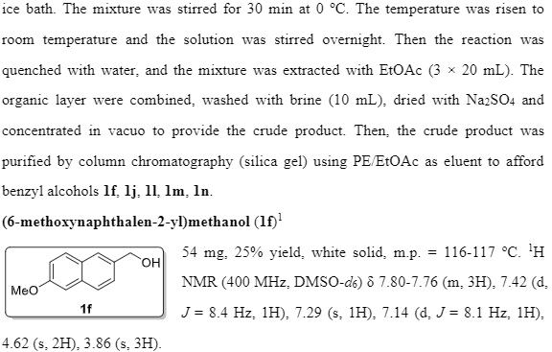
`

Slide 6

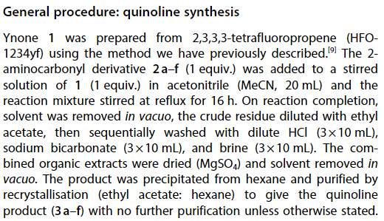

Slide 7

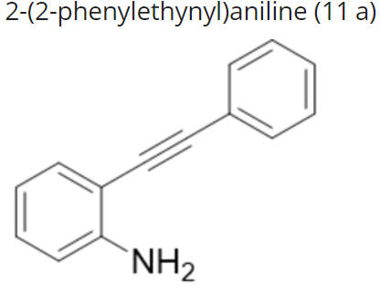
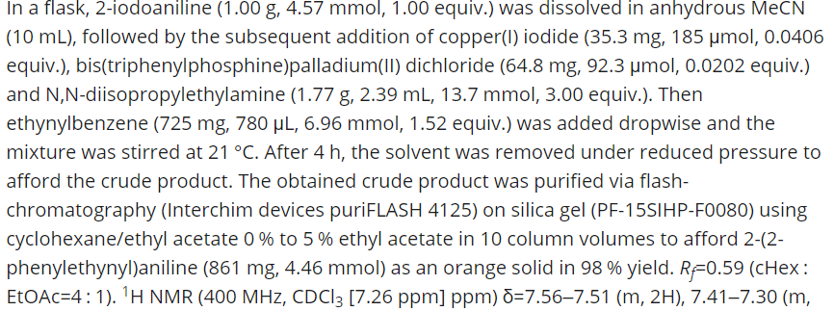

Slide 8
