Slide 1

National Research TPU
Institute of Power Engineering
The Everyday Classroom Routines
(классно-обиходная лексика для тех, кто читает лекции на английском языке)
Tazina K.A
Ph. D. in Pedagogy
Senior Teacher

Slide 2
Content
1) Beginning of the Lesson
2) Running the lesson
3) Sequencing actions
4) Ending of the lesson
5) Getting Students to Join in
6) Using the classroom creatively
7) Classroom Etiquette
8) Managing the classroom
9) Coping with problems
10) Using the textbook
11) Managing Exercises
12) Using technology
13) Developing Skills
14) Translation

Slide 3
Introduction
The everyday classroom phrases are of great importance for students and lecturers (readers).

Slide 4
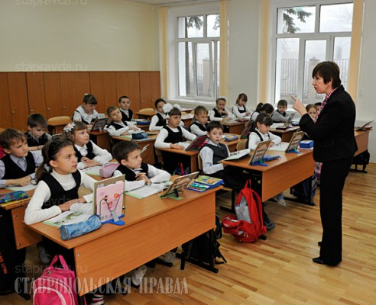
1)Beginning of the Lesson
It’s time to start… .
Put your things away.
Let’s see if everyone’s here.

Slide 5
2) Running the lesson
Let’s move on.
Is everything clear?
3) Sequencing actions
First, have a look at the text.
Next, read through the new words.
Last, try do ex.3.
4) Ending of the lesson
We have 5 more minutes.
Carry on with your work.
Go out quietly.
I’ll speak a bit louder.
Is that better?

Slide 6
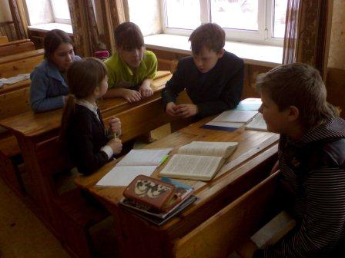
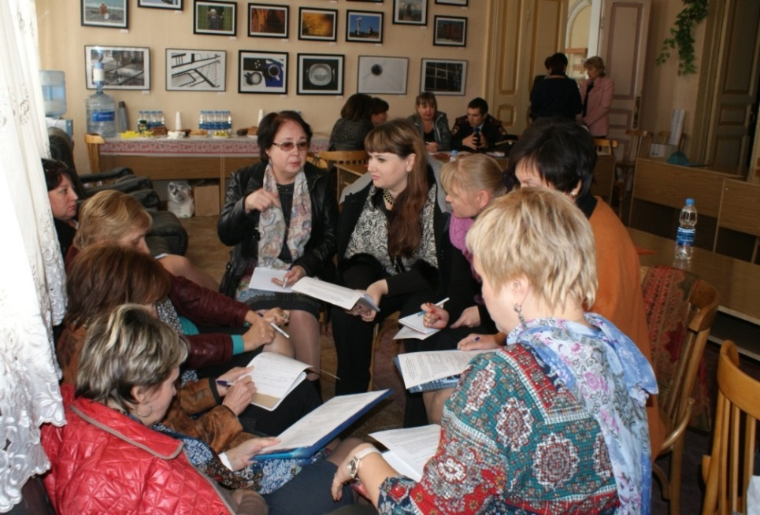
5) Getting Students to Join in
In turn. Your turn.
Who’s going to start? Who’s next?
Who hasn’t had a turn? Not you again.
Let’s give someone else a chance.
Are there any volunteers?
Which group do you want to join?
Could you join this group?
Work on your own.
Find yourself a partner.
6) Using the classroom creatively
Get into two teams.
One point for this team.
Sing along with recording.
There are too many in this group.
If you can’t hear come a bit closer.

Slide 7
7) Classroom Etiquette
Have a good holiday. The same to you.
Bless you. Good luck.
Thanks for your help.
I’d be grateful if you could help me.
That’s all right.
I’m sorry to hear that.
Excuse me, could I get past?
Can you repeat what you said?
Well done. Have another try.
Keep it up. You can do better than this.

Slide 8
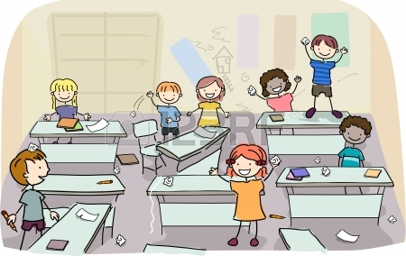
8) Managing the classroom
What a mess!
Put any rubbish in the bin please.
We need to make some space.
We need a big space.
Managing the learning environment.
Quiet, please.
There’s too much noise.
Don’t disturb the others, please.
Behave yourselves!
There will be trouble.
I’m waiting for absolute silence.

Slide 9


9) Coping with problems
That’s enough of that.
Don’t play the fool.
Stop clowning around.
How many times do I have to tell you?
That’s my final warning.

Slide 10

10) Using the textbook
One between two.
Has everybody got a copy?
Turn over the page 52.
Turn to page 57.
Collect the books.
Let’s read the passage aloud.
Go on reading.
Let’s talk about that chapter.
Let’s look at text in more details.
Managing exercises.
Copy this exercise down in your notebooks.
Rewrite it.

Slide 11
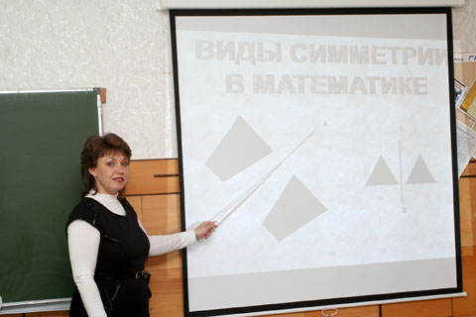
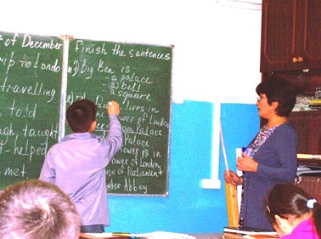
11) Managing Exercises
Let’s go through that exercise.
Let’s have a look on it together.
That’s also possible.
That wasn’t quite right.
Did anyone notice the mistake?

Slide 12
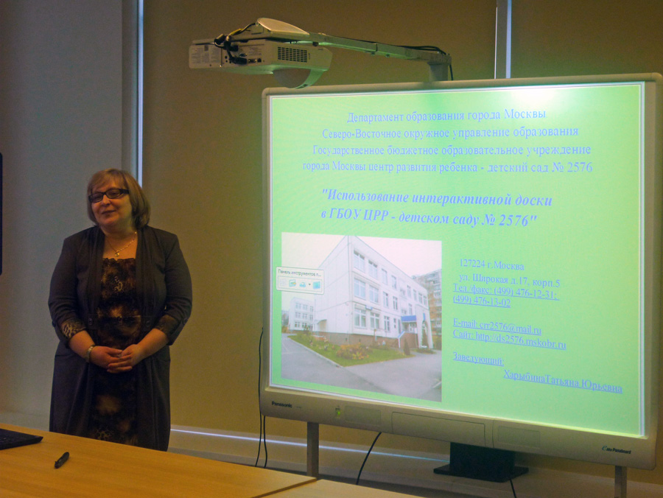
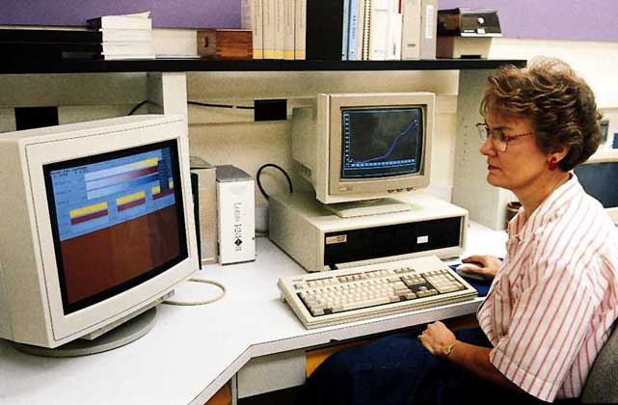
12) Using technology
*Using the board
Is sentence on the board right?
It’s in the top left hand corner.
You need a white board marker.
*Presenting with projected visuals
There will be a short presentation.
*Discussing visuals
I have a poster here.
*Working in language laboratory
*Working independently
*Using the computer
I may have pressed the wrong button.
Turn your computer on.
Wait for the computer to boot up.
Enter your username and password.
Click Ok.
Set the spellchecker.
Remember to save your work.
You can check your email first.
We’ll be using the internet today.
Enter a search engine address into address box.
Type an appropriate address into the address box.
Let’s ask the technician.

Slide 13
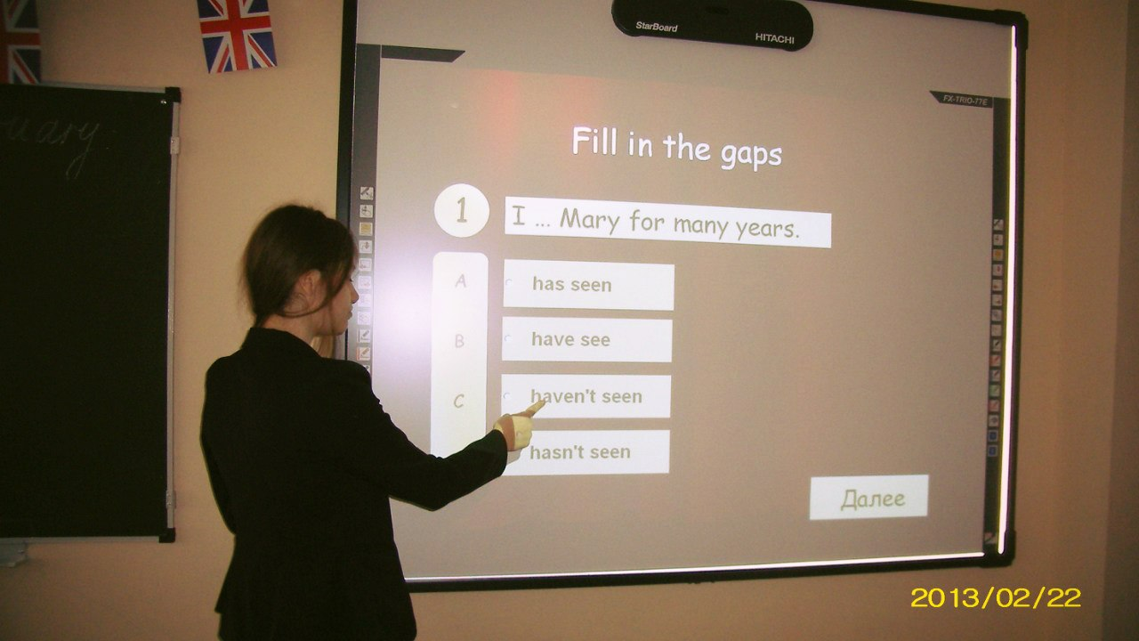
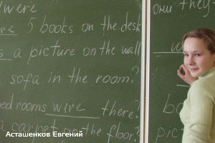
13) Developing skills
Skills in Listening and Writing
Skills in Reading and Speaking
Now we’ll do a listening exercise.
How is this word pronounced?
Let’s check your pronunciation.
Can you explain how it works?
Summarize the text for your partner.
This is not exactly the same.

Slide 14
Translation
1)Beginning of the Lesson Начало урока
It’s time to start… . Время начать… .
Put your things away. Уберите ваши вещи.
Let’s see if everyone’s here. Посмотрим, все ли здесь.
2) Running the lesson Ход урока
Let’s move on. Пойдем дальше.
Is everything clear? Все понятно?
3) Sequencing actions Последовательность действий
First, have a look at the text. Сначала просмотрите текст.
Next, read through the new words. Дальше бегло прочтите новые слова.
Last, try do ex.3. В конце попытайтесь сделать упражнение3
4) Ending of the lesson Конец урока
We have 5 more minutes. У нас есть ещё 5 минут.
Carry on with your work. Продолжайте работать.
Go out quietly. Выходите тихо.
I’ll speak a bit louder. Я буду говорить чуть громче.
Is that better? Так лучше?

Slide 15
5) Getting Students to Join in Вовлечение студентов в работу
In turn. Your turn. По очереди, ваша очередь
Who’s going to start? Who’s next? Кто начнет? Кто следующий?
Who hasn’t had a turn? Кто не делал?
Not you again. Не вы снова
Let’s give someone else a chance. Давайте дадим другим шанс
Are there any volunteers? Есть желающие?
Which group do you want to join? К какой группе вы хотите присоединиться?
Could you join this group? Можете присоединиться в эту группу?
Work on your own. Работайте сами.
Find yourself a partner. Найдите партнера.
6) Using the classroom creatively Творческая работа
Get into two teams. Разбейтесь на 2 группы.
One point for this team. 1 очко этой команде.
Sing along with recording. Пойте вместе с записью.
There are too many in this group. Слишком много в этой группе.
If you can’t hear come a bit closer. Если не слышите, подойдите ближе.

Slide 16
7) Classroom Etiquette Этикет
Have a good holiday. The same to you. Хороших каникул. Вам того же.
Bless you. Good luck. Будьте здоровы! Удачи!
Thanks for your help. Спасибо за помощь.
I’d be grateful if you could help me. Я был бы благодарен, если бы вы мне помогли
That’s all right. Все хорошо.
I’m sorry to hear that. Мне жаль это слышать.
Excuse me, could I get past? Извините, могу ли я пройти?
Can you repeat what you said? Можете ли вы повторить, что вы сказали?
Well done. Have another try. Хорошая работа. Сделайте другую попытку.
Keep it up. You can do better than this. Продолжайте. Вы можете лучше.
8) Managing the classroom Управление классом
What a mess! Какой беспорядок!
Put any rubbish in the bin please. Положите мусор в корзину.
We need a big space. Нам нужно много места
Quiet, please. Тише, пожалуйста.

Slide 17
There’s too much noise. Слишком шумно.
Don’t disturb the others, please. Не отвлекайте остальных.
Behave yourselves! Ведите себя хорошо.
There will be trouble. Будут проблемы.
I’m waiting for absolute silence. Я жду полной тишины.
9) Coping with problems Решение проблем
That’s enough of that. Достаточно.
Don’t play the fool. Не валяй дурака.
Stop clowning around. Хватит быть клоуном.
How many times do I have to tell you? Сколько раз я должен повторять?
That’s my final warning Это мое последнее предупреждение
10) Using the textbook Использование книги
One between two. Один на двоих.
Has everybody got a copy? У всех ли есть копия?
Turn over the page. Переверните страницу.
Turn to page 57. Перелистните на страницу 57.
Collect the books. Соберите книги.
Let’s read the passage aloud. Давайте прочитаем абзац вслух.

Slide 18
Conclusion
Thus, we can choose any phrases and expressions according to our needs.

Slide 19
Referenses
Glyn Hughes, Josephine Moade with Tina Raatikainen. - Practical Classroom English. - Oxford University Press, 2011.

Slide 20

For your attention.

