Slide 1
Управление данными
ЛК 8
Оптимизация запросов в реляционных БД

Slide 2
Оптимизация и выполнение запроса
Алгоритмы выполнения соединений
Этапы жизненного цикла запроса
План выполнения и выполнение запроса
Кеширование планов выполнения

Slide 3
Join algorithms
Nested loop join
  Inner join
    for each row R1 in outer table
    for each row R2 in inner table //or index lookup!
    if R1 joins with R2
    return join (R1, R2)
  Outer join
    for each row R1 in outer table
    for each row R2 in inner table //or index lookup!
    if R1 joins with R2
    return join (R1, R2)
    else
    return join (R1, NULL)

Slide 4
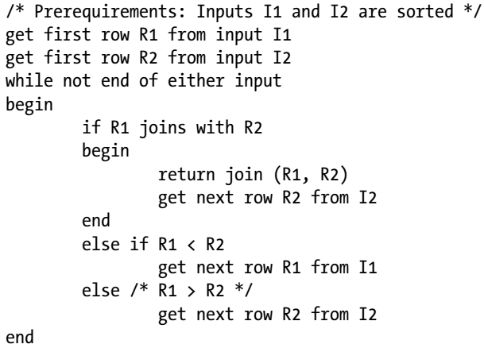
Join algorithms
Merge join

Slide 5
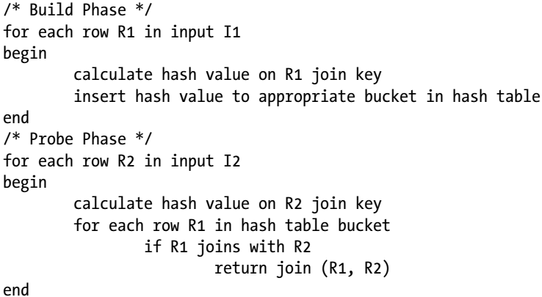
Join algorithms
Hash join

Slide 6
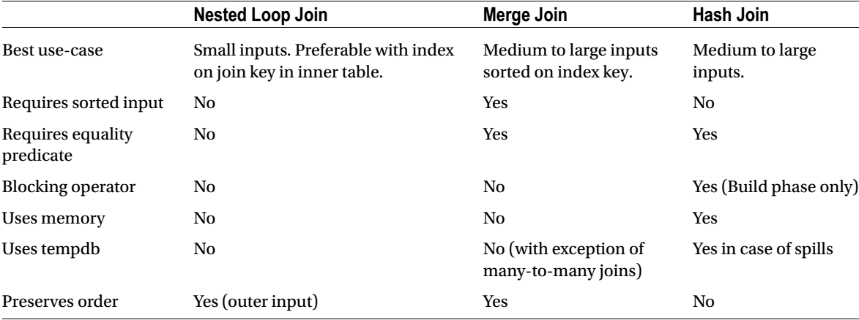
Join algorithms

Slide 7
Query optimization and execution
Query Life Cycle
Step | Description | Result
Parse | Syntax validation and initial transformation | Logical query tree
Bind | Binding to objects. Loading metadata properties | Bound tree
Optimize | Execution plan generation | Execution plan
Execute | Query execution | Result

Slide 8
Query optimization and execution
Optimization
  Goal – to find a good enough execution plan, quickly enough
Phases
  Simplification
  Trivial plan search
  Statistics update
  Cost-based optimization (several stages here)
  Execution plan generation

Slide 9
Query optimization and execution
Посмотреть план выполнения:
Можно в Management Studio, включив опцию “Show execution plan”
В текстовом/табличном/xml виде, предварительно выполнив запрос SET SHOWPLAN_TEXT ON или SET SHOWPLAN_ALL ON или SET SHOWPLAN_XML ON
Использовать системную функцию sys.dm_exec_query_stats. В этом случае не нужно отдельно запускать запрос, план будет показан из кеша

Slide 10
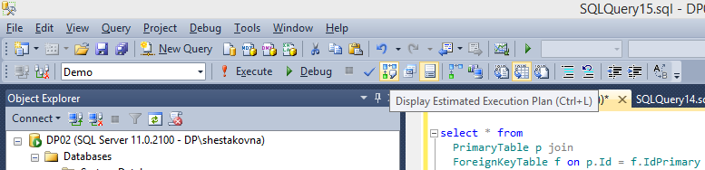
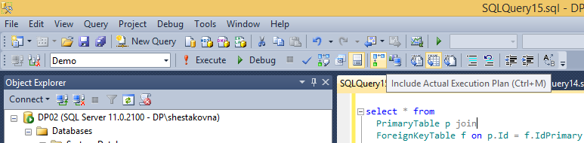
План выполнения
Estimated execution plan
Actual execution plan

Slide 11

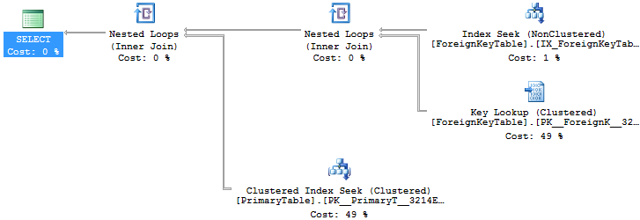
План выполнения
Actual execution plan показывает не только оцениваемые показатели, но и реальные

Slide 12
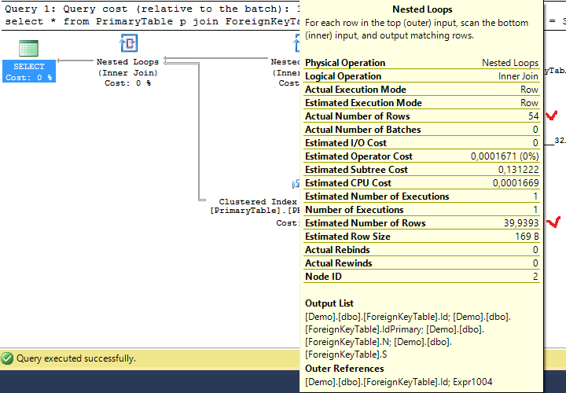
План выполнения

Slide 13
План выполнения
Планы можно выводить в виде:
Графический
XML
Табличный (через SET STATISTICS PROFILE ON)
Текстовый

Slide 14

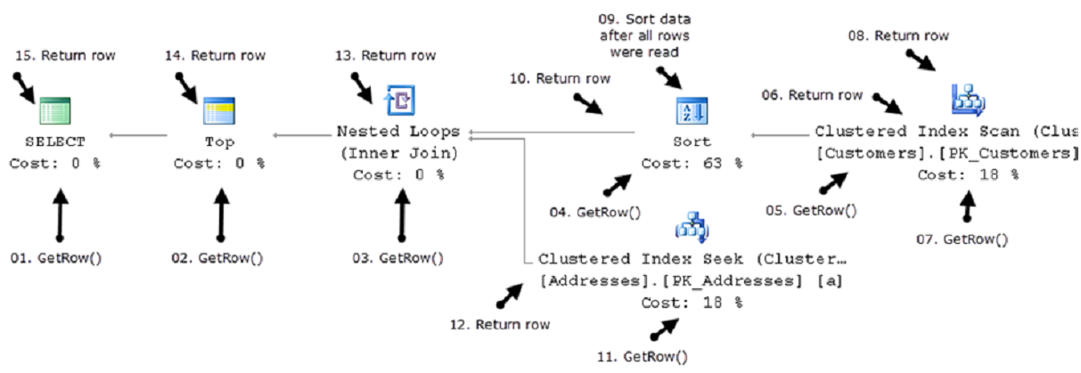
Query optimization and execution
Query execution

Slide 15
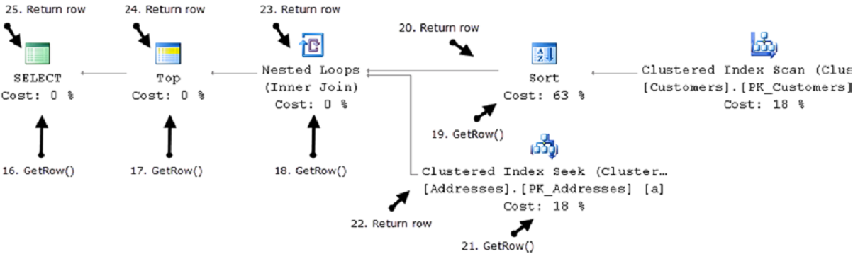
Query optimization and execution
Query execution

Slide 16
Статистики
/*
drop table ForeignKeyTable
drop table PrimaryTable
*/
create table PrimaryTable (Id int identity primary key, N int, S char(150))
go
create table ForeignKeyTable (Id int identity primary key, IdPrimary int references PrimaryTable, N int, S char(150))
go
insert into PrimaryTable (N, S) values (CAST(RAND() * 10000 as int), CAST(NEWID() as char(150)))
go 100000
insert into ForeignKeyTable (IdPrimary, N, S) values (CAST(RAND() * 100000 as int), CAST(RAND() * 1000 as int), CAST(NEWID() as char(150)))
go 200000
insert into ForeignKeyTable (IdPrimary, N, S) values (CAST(RAND() * 100000 as int), CAST(RAND() * 1000 + 1000 as int), CAST(NEWID() as char(150)))
go 100000
insert into ForeignKeyTable (IdPrimary, N, S) values (CAST(RAND() * 100000 as int), CAST(RAND() * 1000 + 2000 as int), CAST(NEWID() as char(150)))
go 150000
create nonclustered index IX_ForeignKeyTable ON dbo.ForeignKeyTable(N)
go
select * from
PrimaryTable p join
ForeignKeyTable f on p.Id = f.IdPrimary
where
f.N = 1234 -- change selectivity here and see how execution plan is changing
DBCC SHOW_STATISTICS ("dbo.ForeignKeyTable", "IX_ForeignKeyTable")

Slide 17
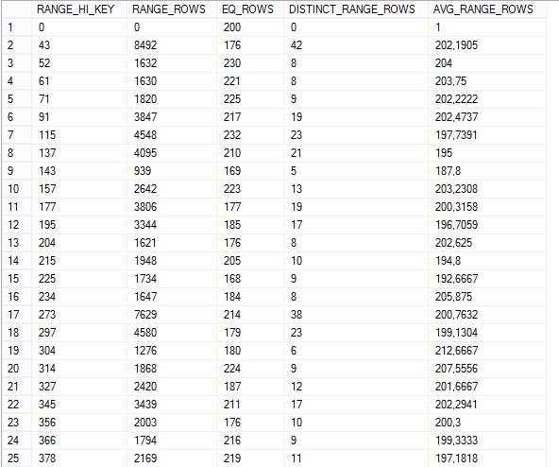
Статистики

Slide 18
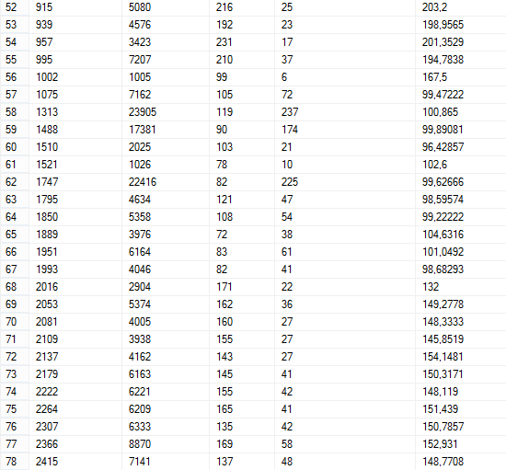
Статистики

Slide 19
Статистики
RANGE_HI_KEY | This is the top value of the step represented by this row within the histogram.
RANGE_ROWS | This number shows the number of rows within the step that are greater than the previous top value and the current top value, but not equal to either.
EQ_ROWS | This number shows the number of rows within the step that are greater than the previous top value and the current top value, but not equal to either.
DISTINCT_RANGE_ROWS | These are the distinct count of rows within a step. If all the rows are unique, then the RANGE_ROWS and the DISTINCT_RANGE_ROWS will be equal.
AVG_RANGE_ROWS | This represents the average number of rows equal to a key value within the step.

