Slide 1
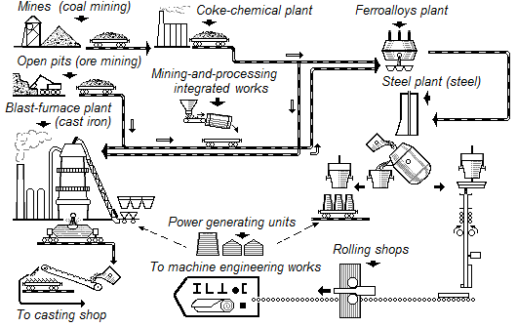
Fundamentals of Metallurgy
The scheme of ferrous metallurgy

Slide 2
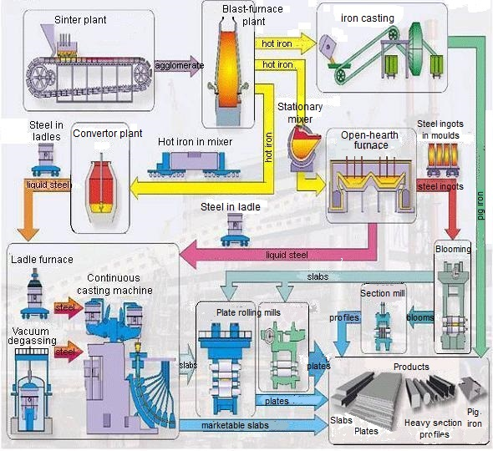
Fundamentals of Metallurgy
The scheme of ferrous metallurgy: equipment and products

Slide 3
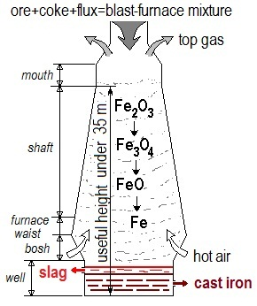
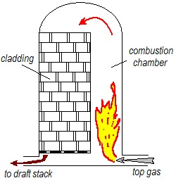
Fundamentals of Metallurgy
The blast furnace scheme Blast-furnace stove heating the brick cladding

Slide 4
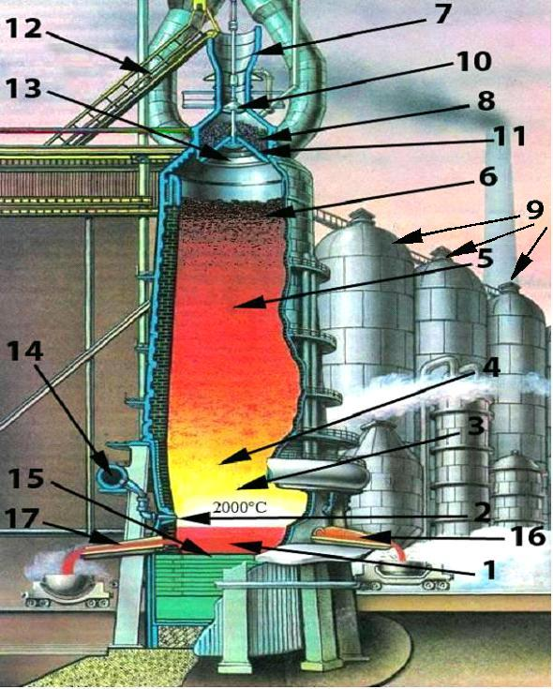
Fundamentals of Metallurgy
Blast furnace design:
1 –well,
2 – tuyeres,
3 – bosh,
4 – waist,
5 – mine,
6 – mouth,
7 - receiving bowl,
8 – charging gear,
9 – stoves,
10 – small cone,
11 – bowl,
12 – inclined bridge,
13 - big cone,
14 - tuyere belt,
15 – bottom,
16 – slag notch,
17 – metal notch

