Slide 1


CONTEMPORARY HISTORY OF RUSSIA
Lecture with elements of seminar:
Russian Revolution and Civil War
Vera Valentinovna Ageeva
Tomsk Polytechnic University
Institute of Humanities, Social Sciences & Technologies
Department of History and Regional Studies
iforya@tpu.ru

Slide 2


Lecture 2: Russia at the turn of the 19th and 20th centuries
Plan
1. The State Duma, Coup of June 1907 and evolution of the multi-party political system in Russia in 1905-1917.
2. February revolution: Causes, objectives and results
3. ”From the February to the October”
4. October Revolution

Slide 3
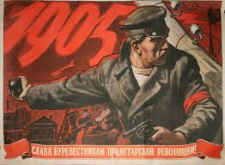
Revolution of 1905-1907
Causes of the revolution
1. Confronting the autocracy and society, lack of political freedom and the Parliament
2. Unsolved agrarian question (the preservation of the landlords landownership, preservation of peasant communities, land hunger of the peasants)
3. The labor question
4. "National Question" (The crisis of the imperial system of relations between the center and the provinces, national suburbs; infringement of minority rights associated with Russification, "the Jewish question")
5. Russia's defeat in the war with Japan

Slide 4
Political parties
Black Hundreds, monarchists
Union of October 17
Constitutional Democratic Party
Socialist Revolutionary Party
Mensheviks (Russian Social Democratic Labour Party)
Bolsheviks (Russian Social Democratic Labour Party)

Slide 5
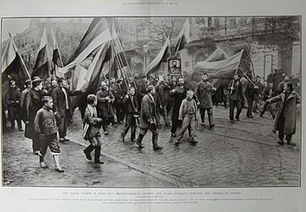
Black Hundreds, monarchists
Organizations and Parties:
Union of the Russian People
Union of the Russians
Russian Monarchist Party
Ideology: Nationalism (Russian),
Monarchism,
Antisemitism
Social composition and social base:
under-privileged people (peasants),
landlords, officials
Leaders:
A.I. Dubrovin
V. M. Purishkevich
Political position: Far-right
Objectives: the protection of national,
orthodox, monarchical values

Slide 6
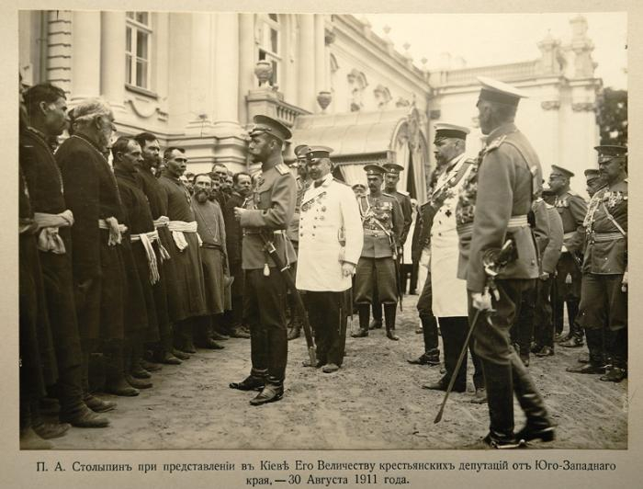
Black Hundreds, monarchists
Political system: Autocratic monarchy
The agrarian question:
the inviolability of landlords’ private property,
the transfer of public land to the peasants,
intensification of migration policy
The labor question:
improving working conditions,
insurance
The National Question:
preferential rights for the Russian population,
anti-Semitism
Tactics:
the creation of fighting squads,
pogroms (riots aimed at persecution or massacre of a particular ethnic or religious group, usually Jews)

Slide 7
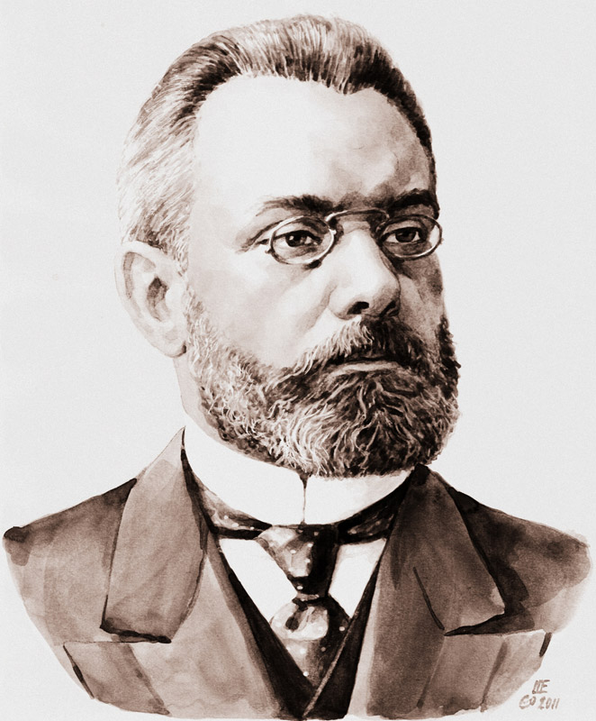
Union of October 17
(Octyabrists)
Founded: 1905
Dissolved: 1917
Ideology: Monarchism, Conservatism
Counter-revolutionary
Social composition and social base:
landlords with liberal political views,
commercial, industrial and financial
bourgeoisie
President: Alexander Guchkov
Political position: Right-wing

Slide 8
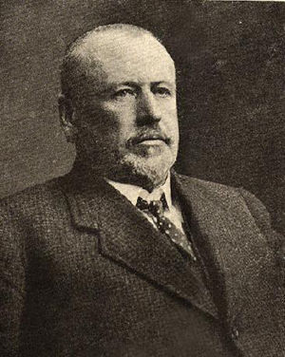
Union of October 17
(Octyabrists)
Objectives: contribute to the development of Russia on the liberal way through governmental reforms. The introduction of basic civil rights and freedoms.
Political system: a constitutional monarchy with a bicameral parliament, popular representation
The agrarian question:
the inviolability of landlords’ private property, alienation of the landlords' land at a fair price
the transfer of public land to the peasants,
intensification of migration policy
The labor question:
improving working conditions, insurance
the right to economic strikes
The National Question:
united and indivisible Russia,
cultural-national autonomy for the small nations
Tactics: promotion of ideas through the press;
assistance to the Government in the suppression of the revolution, active participation in elections
Mikhail Rodzianko

Slide 9
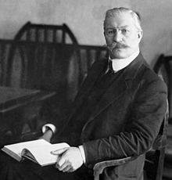
Constitutional Democratic Party
Founded: 1905
Dissolved: 1917
Ideology: Liberalism, Constitutional monarchy
Social composition and social base:
landlords with liberal political views,
Intelligentsia,
broad sections of the urban population,
President: Pavel Miliukov
Political position: Centre-right
«The ability to work for the benefit of the Motherland»

Slide 10
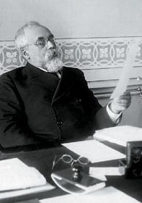
Constitutional Democratic Party
Objectives: contribute to the capitalistic development of Russia. They did not exclude the possibility of political revolution.
Political system: a constitutional monarchy with the separation of powers and responsibility of the Government to the State Duma
The agrarian question:
partial forced alienation of the landlords' land at a fair price
the development of small private peasant landownership
The labor question:
the right to economic strikes
freedom of trade unions
8 hour working day
The National Question:
united and indivisible Russia,
cultural-national autonomy for the small nations
Tactics: promotion of ideas through the press; active participation in elections; criticism of the government;
passive resistance to the government
S. A. Muromtsev

Slide 11
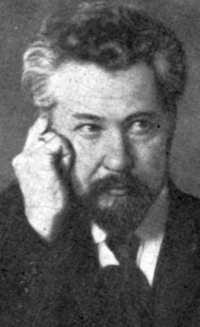
Socialist Revolutionary Party
Founded: 1902
Dissolved: 1940
Ideology: Agrarian socialism, Neo-Narodnichestvo
Social composition and social base:
Peasantry + intelligentsia + proletariat
= the working class
General Secretary: Viktor Chernov
Political position: Left-wing
"Through struggle you will attain your rights!"

Slide 12
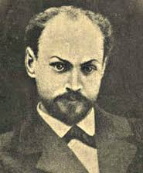
Socialist Revolutionary Party
Objectives: the conquest of political and civil liberties, which will facilitate the movement to socialism
Political system: democracy, the Constituent Assembly, in the future - the socialist system
The agrarian question: land socialization
The labor question:
the right to strikes
freedom of trade unions
8 hour working day
The National Question:
the right of nations to self-determination
Tactics:
promotion of ideas through the press;
individual terror
participation in armed uprisings
Gregory A. Gershuni

Slide 13
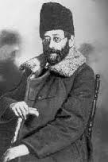
The Mensheviks (Russian Social Democratic Labour Party)
Founded: 1903
Dissolved: 1921
Ideology: Socialism
Social composition and social base:
Peasantry + intelligentsia + proletariat
= the working class
Leader: Yuliy Osipovich Martov
Political position: Left-wing

Slide 14
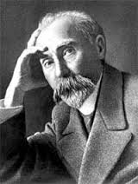
The Mensheviks (Russian Social Democratic Labour Party)
Objectives: the transition from capitalism to socialism by the proletarian revolution
Political system: democracy, republic
The agrarian question: land municipalization
The labor question:
the right to strikes
freedom of trade unions
8 hour working day
The National Question:
the right of nations to self-determination
Tactics:
promotion of ideas through the press;
united democratic front (= alliance with the liberals)
participation in armed uprisings
Georgy Plekhanov

Slide 15
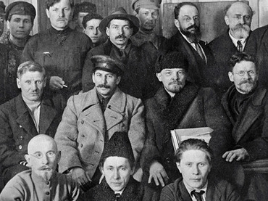
The Bolsheviks (Russian Social Democratic Labour Party)
Founded: 1903
Dissolved: 1991
Ideology: Socialism
Social composition and social base:
Peasantry + intelligentsia + proletariat
= the working class
Political position: Left-wing

Slide 16
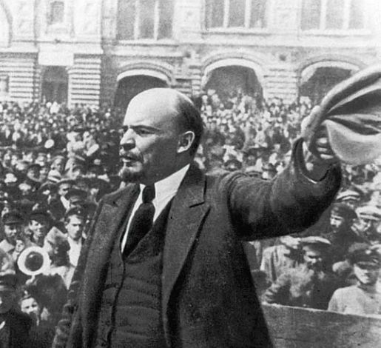
The Bolsheviks (Russian Social Democratic Labour Party)
Objectives: the transition from capitalism to socialism by the proletarian revolution
Political system: Socialistic republic
The agrarian question: land nationalization
The labor question:
the right to strikes
freedom of trade unions
8 hour working day
The National Question:
the right of nations to self-determination
Tactics:
promotion of ideas through the press;
participation in armed uprisings
Vladimir Lenin

Slide 17
25-28 October 1905
The uprising in Kronstadt
II
17 October 1905
October Manifesto
Moscow Uprising of December 1905
I
April 1906 The basic State laws of the Russian Empire
III
All-Russian October Political strike
April 1906
I State Duma
May 1905 the first labor Soviet
in Ivanovo
February 1907
II State Duma
9 January 1905
The «Bloody Sunday»
Coup of 3 June 1907
The First Russian Revolution (1905-1907)

Slide 18
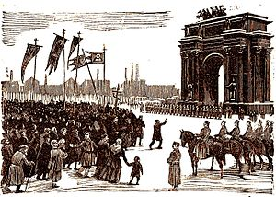
Results of the Revolution
Revolutionaries defeated
Nicholas II retains the throne
October Manifesto
Constitution enacted
Establishment of the State Duma

Slide 19
The First State Duma
(March, 1906 – January, 1907)
Parties and coalitions | Seats
Constitutional Democratic Party (Kadets) | 179
Trudoviks (moderate labor) | 97
Russian Social Democratic Labour Party | 18
Octobrist Party (conservative-liberal) | 16
National minorities | 63
Independents* | 105 (including 34 SRs)
Total: | 478

Slide 20
The Second State Duma
(20 February 1907 to 3 June 1907)
Parties and coalitions | Seats
Constitutional Democratic Party (Kadets) | 92
Trudoviks (moderate labor) | 104
Russian Social Democratic Labour Party | 65
Octobrist Party (conservative-liberal) | 42
SRs | 37
Right groups | 12
Total: | 352

Slide 21
Coup of June 1907
The Coup of June 1907, sometimes known as Stolypin's Coup, is the name commonly given to the dissolution of the Second State Duma of the Russian Empire, the arrest of some its members and a fundamental change in the Russian electoral law by Tsar Nicholas II on 3 June [O.S.] 1907.
This act is considered by many historians to mark the end of the Russian Revolution of 1905, and was the subject of intense subsequent debate as to its legality.
It also created a fundamental shift in the makeup of future Dumas in the Russian Empire: whereas previous laws had given peasants and other lower-class people a larger proportion of electors to the Duma, the new law transferred this to the propertied classes, in an effort to avoid election of the large number of liberal and revolutionary deputies who had dominated the First and Second Dumas.
Although it largely succeeded in this objective, it ultimately failed to preserve the Imperial system, which ceased to exist during the Russian Revolution of 1917.

Slide 22
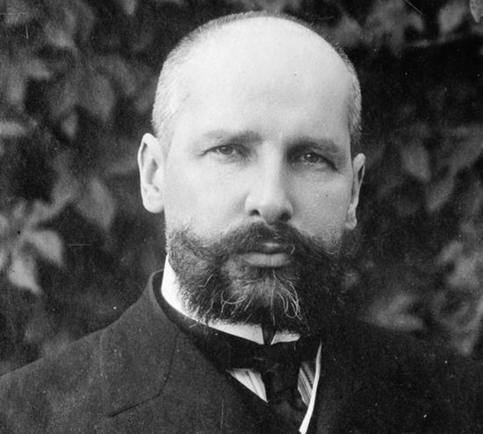
Pyotr Stolypin
Military courts
Agrarian reform
The Coup of June 1907
“They need great upheavals, we need a great Russia!”
«First calm, then - the reform»

Slide 23
What were the reasons for the February Revolution?

Slide 24
3 Mar - The abdication of Michael Romanov
28th Feb - Petrograd Soviet
27th Feb - Victory of the Revolution in Petrograd
2 Mar - The abdication of Nicholas II Romanov
28th of Feb - The dissolution of the State Duma. Creation of a Temporary Committee of the State Duma
23th Feb 1917 Demonstrations of Petrograd’s workers against hunger, war and tsarism.
February Revolution
of 1917

Slide 25
The Russian Provisional Government
The Russian Provisional Government was a provisional government of the Russian Republic established immediately following the abdication of Tsar Nicholas II (March 15, 1917).
The government replaced the institution of the Council of Ministers of Russia, members of which after the February Revolution presided in the Chief Office of Admiralty.
The intention of the provisional government was the organization of elections to the Russian Constituent Assembly and its convention.
The government was initially composed of the Kadet coalition led by Prince Georgy Lvov, which was replaced by the Socialist coalition led by Alexander Kerensky.

Slide 26
The Petrograd Soviet of Workers' and Soldiers' Deputies
The Petrograd Soviet was a city council of Petrograd (Saint Petersburg), the capital of the Russian Empire. During the revolutionary days the council tried to extend its jurisdiction nationwide as a rival power center to the Provisional Government creating. Its committees were key components during the Russian Revolution and some of them led the armed revolt of October Revolution.
The soviet was established in March 1917 after the February Revolution as a representative body of the city's workers and soldiers.

Slide 27
Dual power in 1917
Dual power was a term first used by Lenin, which described a situation in the wake of the February Revolution in which two powers, the workers councils (or Soviets, particularly the Petrograd Soviet) and the official state apparatus of the Provisional Government coexisted with each other and competed for legitimacy.
Lenin argued that this essentially unstable situation constituted a unique opportunity for the Soviets to seize power by smashing the Provisional Government and establishing themselves as the basis of a new form of state power.

Slide 28
1917 - From the February to the October
Bolsheviks
Mensheviks
Socialist
Revolutionary
Party
Constitutional
Democratic
Party
Union of
October 17
Monarchists
Feb Mar Apr May Jun Jul Aug Sep Oct Nov Dec

Slide 29
Directed by the Military Revolutionary Committee, the Bolsheviks occupied the strategic objects of Petrograd
Formation of the First Soviet government
Attack of the Winter Palace
The first Bolsheviks’ decrees
24 Oct 25 Oct 26 Oct

Slide 30
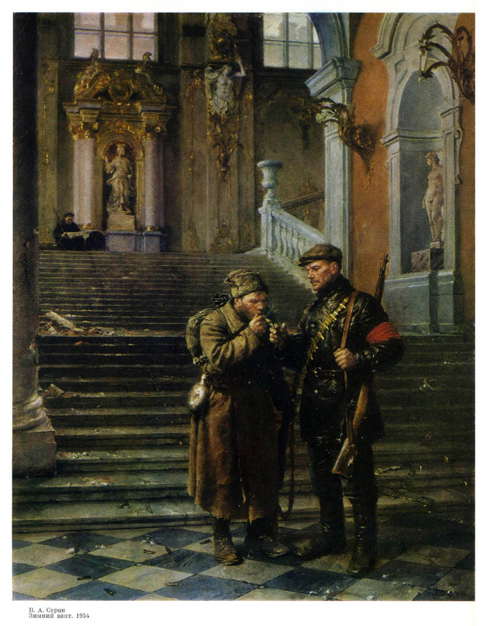
«The city lived a normal life»
«20 October, 1917, Lenin arrived illegally from Vyborg in Petrograd. 24 October, 1917 (6 November in New Style) after 6 pm, Lenin left the conspirative apartment, leaving a note to flat's owner: "I went to where you do not want me to leave. Bye, Ilyich“. Lenin reaches the Botkin street by tram, in the road he was twice detained by the Junkers and finally he comes to the Smolny. Arriving in Smolny he proceeds to leading the uprising».
«The Winter Palace is occupied»
(A.V. Serov, 1954)

Slide 31

THANK
FOR YOUR
ATTENTION!
Vera V. Ageeva
Department of History and Regional Studies
iforya@tpu.ru
+7 (382)2 563549

