Slide 1


CONTEMPORARY HISTORY OF RUSSIA
Lecture with elements of seminar:
Soviet Russia in 1953-1964: The Khrushchev Thaw
Vera Valentinovna Ageeva
Tomsk Polytechnic University
Institute of Humanities, Social Sciences & Technologies
Department of History and Regional Studies
iforya@tpu.ru

Slide 2


Lecture 11
Plan
Soviet Russia in 1953-1964.
2. Social and economic development: transformation of the command-administrative system and contradictions of planned economy.
3. Political development of the USSR after Khrushchev’s speech at the 20th Party Congress (1956).

Slide 3
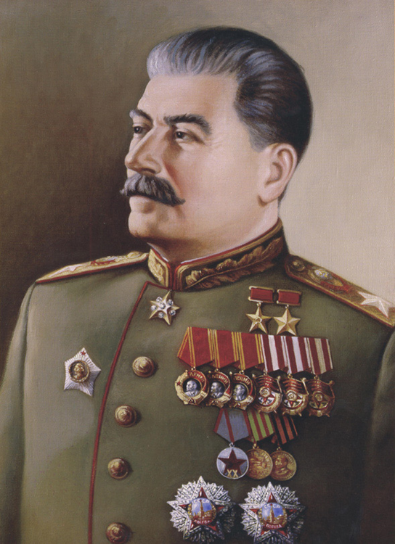
Stalinism Apogee
Eliminating famous commanders
Demonstrative litigations (condemnation of "adulation to the West")
Fighting “freethinking and cosmopolitanism”

Slide 4
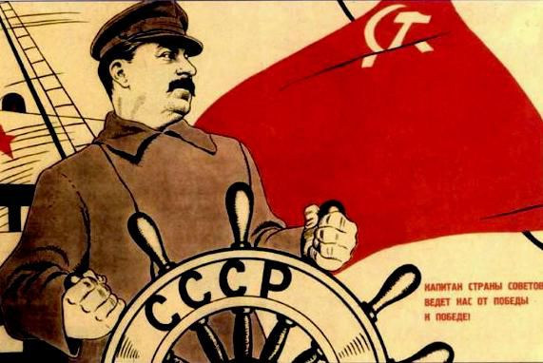
1945-1953: time of contradictions in the Soviet Union
Socio-political situation was characterized by duality in the Soviet Union in the postwar decade.
On the one hand, “the people-winner” deservedly expected significant political changes and liberalization, on the other hand, there was the final consolidation of Stalinism (“Stalinism apogee”).
There was a return to the pre-war model of centralization in the planning and management of the economy.
The growth of the administrative-bureaucratic system, focus on the extensive way of economic development, a return to the methods of pre-war repression and international isolation have affected the life

Slide 5

Soviet Planned Economy
no material incentive mechanisms
complete lack of market regulators of industrial production
Non-financial recognition of industrial production (state awards, honorary degrees, promotions)
Over-exploitation
of cheap or free labor,
forced labor,
repressive mechanisms

Slide 6
Soviet Planned Economy
Planning not only macro- but also micro-economic indicators
Full state planning and control of the production and realization cycle
volume of production
the volume of sales of products
regions of realization
production technology
product nomenclature
wage
upgrades schedule
price of a commodity
Soviet
industrial
enterprise

Slide 7
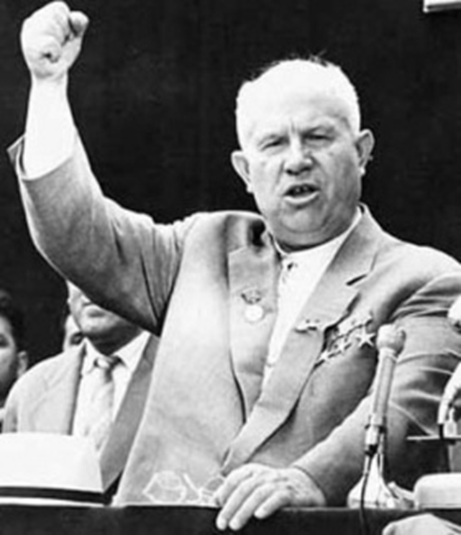
N.S. Khrushchev (1953 – 1964)
Changes in the political life (The Thaw)
2. Socio-economic development (reforming the planned economy)
3. Creating socially oriented state
4. Scientific and cultural achievements

Slide 8
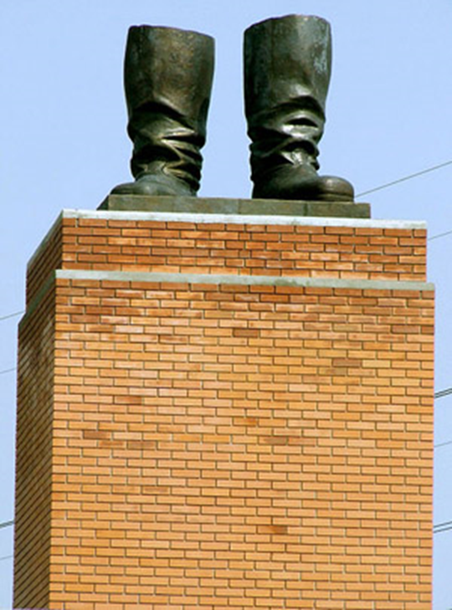
The Khrushchev Thaw
The Khrushchev Thaw refers to the period from the early 1950s to the early 1960s when repression and censorship in the Soviet Union were relaxed, and millions of Soviet political prisoners were released from Gulag labor camps due to Nikita Khrushchev's policies of de-Stalinization and peaceful coexistence with other nations.
Monument to Stalin's boots in Budapest. It was central sculptural work of the
capital of Hungary until 1956. It was established in December 1951 as a gift from the
Hungarian people to Joseph Stalin's seventieth birthday (21 December 1949).
The monument destroyed 24 October 1956 by the crowd during the Hungarian
Revolution of 1956.

Slide 9
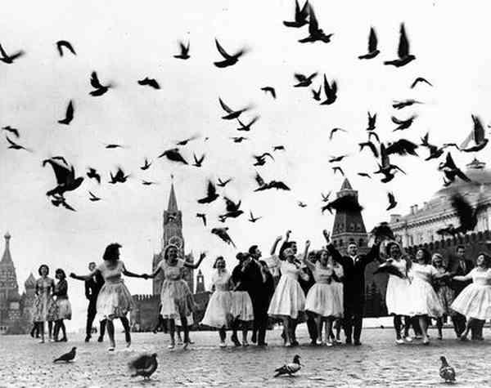
Changes in the political life
Rehabilitation of repressed
"On the Personality Cult and its Consequences"
De-Stalinization
The reorganization of public authorities
Change in the Art. 58 of the Criminal Code of the RSFSR

Slide 10
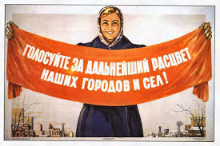
Socio-economic development
Basic concepts and slogans:
“The current generation of Soviet people will live under communism”
Sovnarkhoz (советы народного хозяйства)
“virgin soil”
“Catch up and overtake America ...”
“Queen of fields – Corn”.
Construction of affordable housing
Pensions – to kolkhozniks

Slide 11

Agriculture development

Slide 12
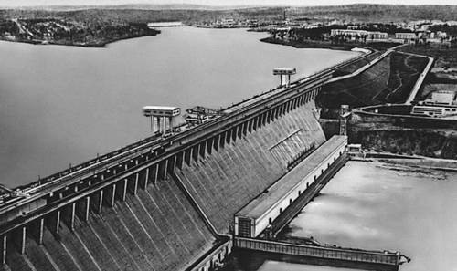
Industrial development
Dam of the Bratsk hydropower plant

Slide 13
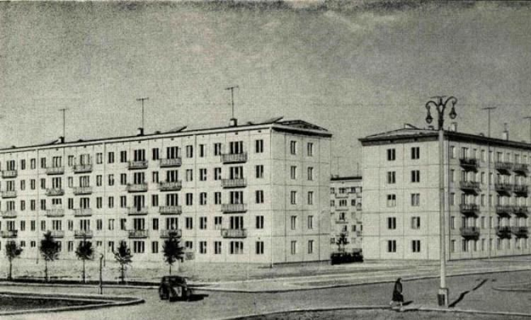
Mass housing construction
"Khrushchevka" - panel or brick two five-storey apartment blocks, massively constructed in the Soviet Union during Nikita Khrushchev’s period and received his name among soviet people.

Slide 14
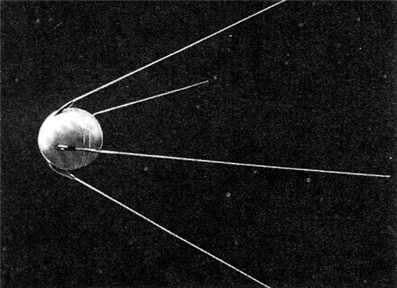
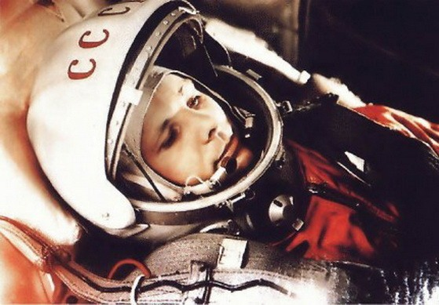
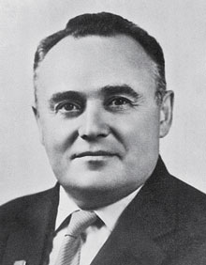
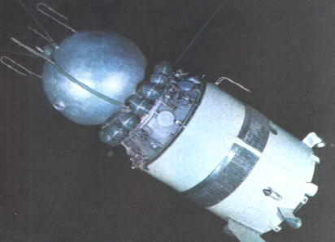
“Conquering space”

Slide 15
The Thaw
The Thaw initiated irreversible transformation of the entire Soviet society by opening up for some economic reforms and international trade, educational and cultural contacts, festivals, books by foreign authors, foreign movies, art shows, popular music, dances and new fashions, and massive involvement in international sport competitions. Although the power struggle between liberals and pro-Stalinists never stopped, it eventually weakened the Soviet Communist Party.
Khrushchev's Thaw allowed some freedom of information in the media, arts, and culture; international festivals; foreign films; uncensored books; and new forms of entertainment on the emerging national TV, ranging from massive parades and celebrations to popular music and variety shows, satire and comedies. Such political and cultural updates all together helped liberate the minds of millions and changed public consciousness of several generations of people in the Soviet Union.

Slide 16
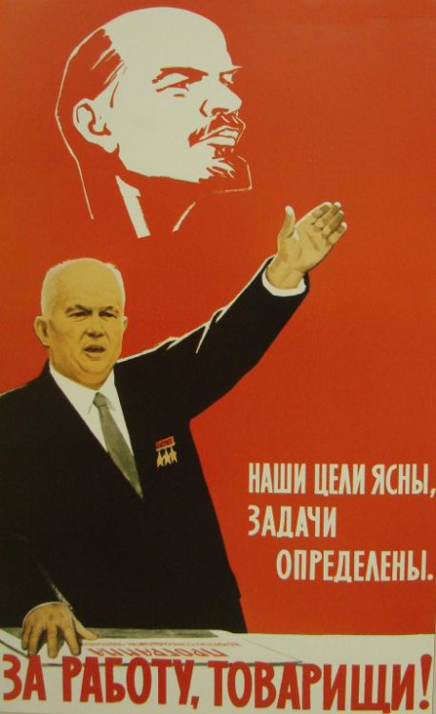
The results of the Khrushchev’s era
Advantages:
Softening domestic and foreign regime
Raising living standards
Scientific and cultural achievements
Disadvantages:
Inconsistency
Incoherence
Populism

Slide 17

THANK
FOR YOUR
ATTENTION!
Vera V. Ageeva
Department of History and Regional Studies
iforya@tpu.ru
+7 (382)2 563549

