Slide 1


ECONOMY OF RUSSIAN REGIONS
Vera Valentinovna Ageeva
Tomsk Polytechnic University
Institute of Humanities, Social Sciences & Technologies
Department of History and Regional Studies
iforya@tpu.ru

Slide 2
Plan of lectures for December
Central and Northwestern economic region economic regions (December 2, 2015)
North Caucasus economic region, Central Black Earth economic region, Crimea region (December 4, 2015)
Volga economic region, Urals economic region (December 9, 2015)
West Siberian economic region, East Siberian economic region, Far Eastern economic region (December 16, 2015)
Non-observed economy and economic security in Russia (December 18, 2015)
Ecological security of the national economy in Russia (December 23, 2015)
Final assessment (December 30, 2015)

Slide 3
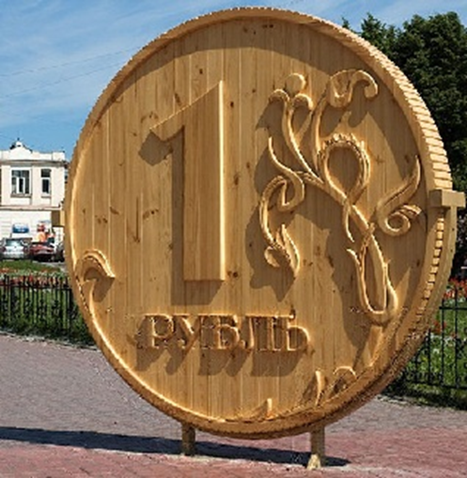
Monument to Russian Ruble
Monument to the Russian ruble in Tomsk - a wooden ruble weight of 250 pounds and a height of over two meters. Made in a realistic manner on a scale of 100:1. It is made of pine wood and the top is covered with a special solution that protects it from moisture. Now placed in a clear plastic box.
Monument wooden ruble was set in 2008. The initiator of the monument became the Administration of Tomsk. It is the largest wooden ruble in the world.

Slide 4
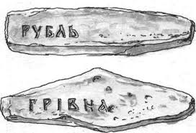
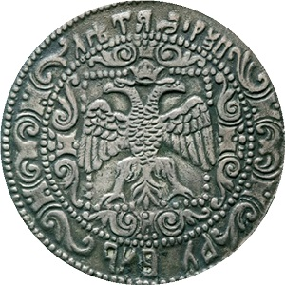
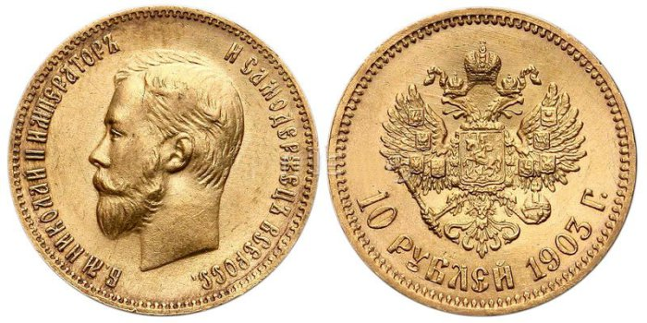
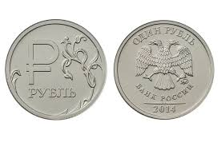
Ruble and its history
Russian ruble is the currency used by the Russian Federation and Belarus. This has been the unit of currency for almost 500 years. The name ruble originally meant a piece of chopped gold or silver.
In the 17th century, the amount of ruble depended on what it is composed of. A ruble plated with gold or platinum has a higher value than a usual ruble coin which is made of 28 grams of silver. As years went by, the amount of silver and the amount of gold that was be put in coins was standardized by the Government so that it will have an exact value for denomination purposes.
Russian ruble is equivalent to 100 kopek or 100 Russian coins. Russian coins since 1724 are minted in Moscow and at the Saint Petersburg Mint while paper money is printed in Goznak in Moscow since 1919 up to the present.

Slide 5
What are the differences between the terms “exchange inflation” (inflationary pressures) and “devaluation” (depreciation of currency) ?

Slide 6
Inflation is a sustained increase in the general price level of goods and services in an economy over a period of time. When the price level rises, each unit of currency buys fewer goods and services. Consequently, inflation reflects a reduction in the purchasing power per unit of money – a loss of real value in the medium of exchange and unit of account within the economy.
Devaluation is a reduction in the value of a currency with respect to those goods, services or other monetary units with which that currency can be exchanged.
The reverse process is denomination (revaluation of currency).

Slide 7

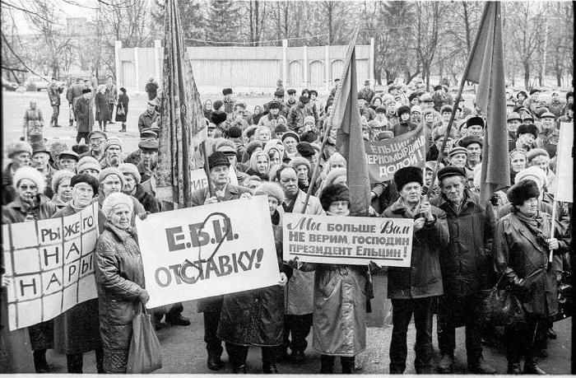
Ruble denominations
There have been seven different incarnations of the rouble, due to various drastic changes in the currency’s value, with the most recent being released in 1998.
The FIRST rouble was in place for over 200 years up to 1921 when it fell dramatically in value.
The SECOND rouble was the first in the series of redenominations, swapping one ‘new’ rouble for 10,000 ‘old’ roubles. These were introduced in 1922.
A quick redenomination took place the year after, valuing the new rouble at 1 to 100 of the former roubles. This was the THIRD rouble.
In 1924, the FOURTH rouble, known as the ‘gold rouble’, was introduced and lasted until 1947. This one was valued at 50,000 of the previous issue of the rouble.

Slide 8
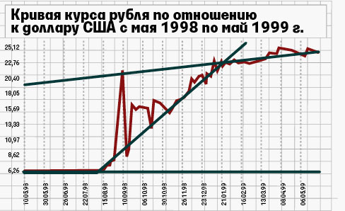
Ruble denominations
After the Second World War the government attempted to reduce the amount of money in circulation by imposing a confiscatory redenomination on paper money, which valued the new rouble at one tenth the value of the fourth rouble.
From 1961 to 1997, the SIXTH rouble was in circulation and the redenomination was based on the same terms as the 1947 redenomination. After the fall of the Soviet Union in 1991, the rouble remained the currency of the Russian Federation. During the early 1990s there was a period of hyper-inflation which meant the currency fell significantly in value.
In January 1998 the seventh rouble was introduced. It was valued at 1,000 of the previous roubles in what was simply a psychological step. Later in the same year, the rouble lost 70% of its value against the US dollar in just six months following the Russian financial crisis of 1998.

Slide 9
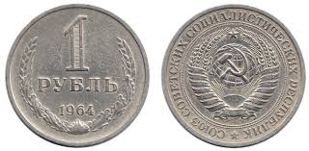
Ruble Coins
In the 18th century, the lower value roubles, such as half a kopek or a single kopec were made from copper, while five kopecs up to 50 kopecs and one rouble coins were made from silver. Five rouble coins were originally made from gold.
After the Russian civil war, silver was used for lower value coins with gold chervonets minted in 1923. In 1961 new materials such as aluminium bronze were introduced, along with cupro-nickel-zinc.
In 1991 more modern techniques were used, combining several types of metal to form new, bimetallic coins in denominations including ten roubles. New coins were again released after the fall of the Soviet Union in 1991.

Slide 10
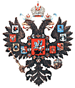
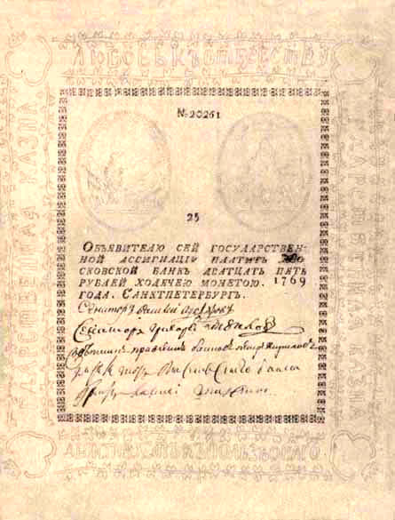
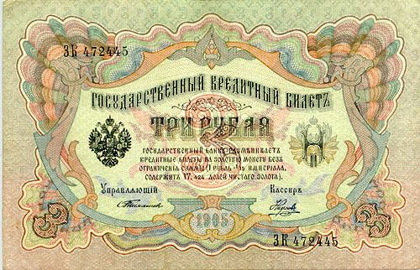
Russian Paper Money — Imperial period
The first Russian paper money were printed in 1769 during the reign of Ekaterina II. It was forced by the imperfectness of the monetary system, in which coins were the only payment method.
The banknotes were printed on white paper and had watermarks. From 1786 the banknotes were printed on color paper, but were still very simple, which cause massive fraud. In the beginning of the 19th century the paper money changed the outlook to a classicism style one. Architectural images and portraits began appearing on the banknotes in the 50s and 60s, along with imperial monograms.
By the beginning of the 20th century many famous painters, like Reichel, Zauerveir and Lundin, took part in banknote design. The 1912 500 ruble banknote is often named as one of the most beautiful ones in history. All the banknotes of the Imperial period were printed in Russia, with one exception of a emission printed in the USA not long before the revolution of 1917.

Slide 11
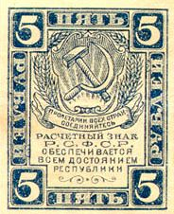
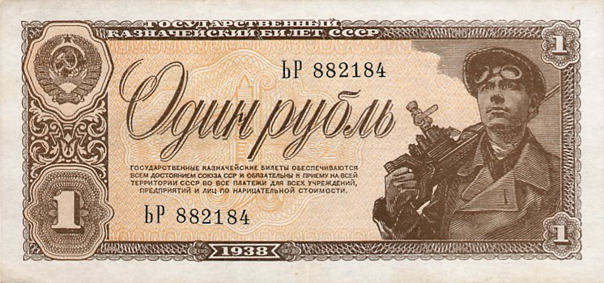
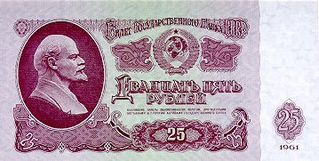
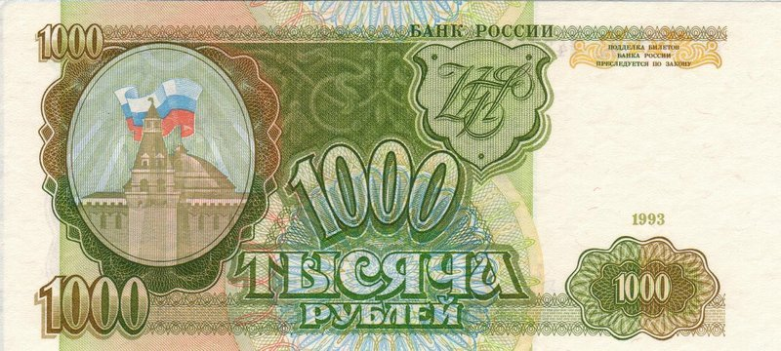
Russian Paper Money — USSR period
The paper money of the USSR period underwent many emissions and changed its outlook very much. Most of it was printed on white paper and had watermarks, but the format and style of different series varies very much.
For example, the 1918-1922 series are quite simplistic, while the 1923 one continues the traditions of the Imperial period. From 1925, the banknotes contained, in addition to the state symbols, pictures of people and their life (the worker and the farmer reading Karl Marx, a seeder, scenes of harvest, etc.).
In 1937 for the first time Lenin himself appeared on the notes, and stayed there until 1992.

Slide 12
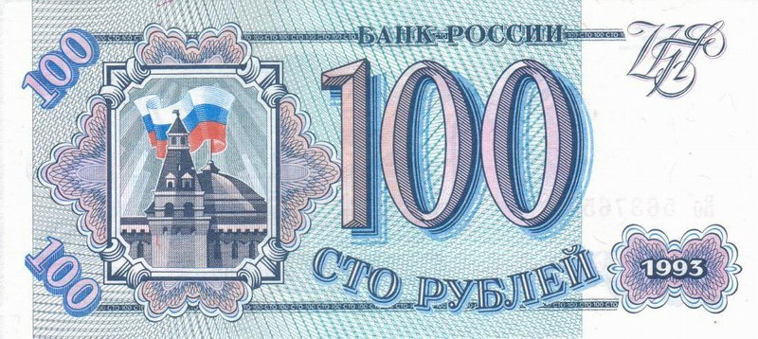
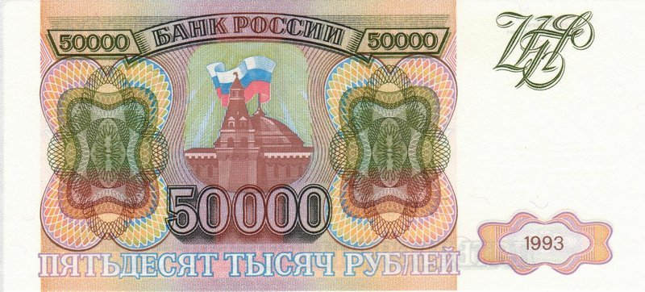
Russian Paper Money — Contemporary Period
Russian money of the new epoque (after 1992) differ from the previous series by the disappearance of the Lenin portraits (which lasted 55 years).
In 1992 another revolution happened in Russia, the single-party system was replaced by a democratic system. The money started baring pictures of cities. Until 1993 it was Moscow, and starting with 1995 more (Saint-Petersburg, Vladivostok, Novgorod, Krasnoyarsk, Yaroslavl and Archangelsk).
During the devalvation of 1998 the value of the notes lost three zeros, but the note design remained the same.

Slide 13
In the 18th, 19th and 20th centuries, several coins had individual names:
1⁄4 kopek – polushka
1⁄2 kopek – denga or dénezhka
2 kopek – semishnik (mostly disappeared by 20th century), dvúshka (20th century) or grosh
3 kopek – altyn (not in use anymore by the 1960s)
5 kopek – pyaták
10 kopek – grívennik
15 kopek – pyatialtýnny (5 altyn; the usage lived longer than altyn)
20 kopek – dvugrívenny (2 grivenniks)
25 kopek – polupoltínnik (half poltínnik) or chetverták (from the Russian for ¼)
50 kopek – poltína or poltínnik

Slide 14
In modern Russian slang only these names are used:
1 ruble – tselkóvy (целко́вый), meaning "entire" or "whole" (це́лый)
5 rubles – pyatyórka (пятёрка), pyaták (пята́к), pyatachyók (пятачо́к)
10 rubles – chírik (чи́рик), chervónets (черво́нец) or desyátka (деся́тка)
50 rubles – poltínnik (полти́нник) with some variants like poltishók (полтишо́к), pyótr (Пётр) from picture of monument to the Peter I shown on a bill
100 rubles – stólnik (сто́льник), sótka (сотка)
500 rubles – pyatikhátka (пятиха́тка), originally pyatikátka (пятика́тка)
1,000 rubles – kosár (коса́рь), shtúka (шту́ка) or a hybrid shtukár (штукарь), tónna (то́нна), ruble (mostly in St. Petersburg)
1,000,000 rubles – limón (лимо́н), lyam (лям)
1,000,000,000 rubles – lyard (лярд).

Slide 15
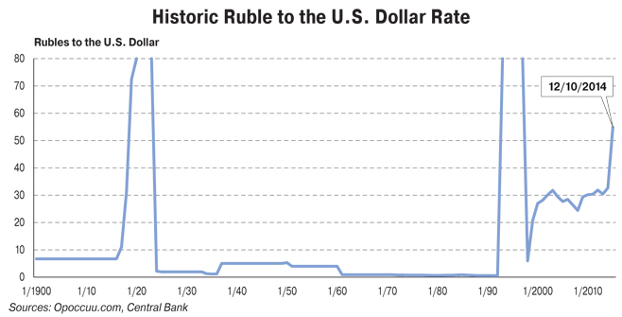

Slide 16
Russian Economic Regions
Russia is divided into 12 economic regions - groups of federal subjects sharing the following characteristics:
Common economic and social goals and participation in development programs;
Relatively similar economic conditions and potential;
Similar climatic, ecological, and geological conditions;
Similar methods of technical inspection of new construction;
Similar methods of conducting customs oversight;
Overall similar living conditions of the population.

Slide 17
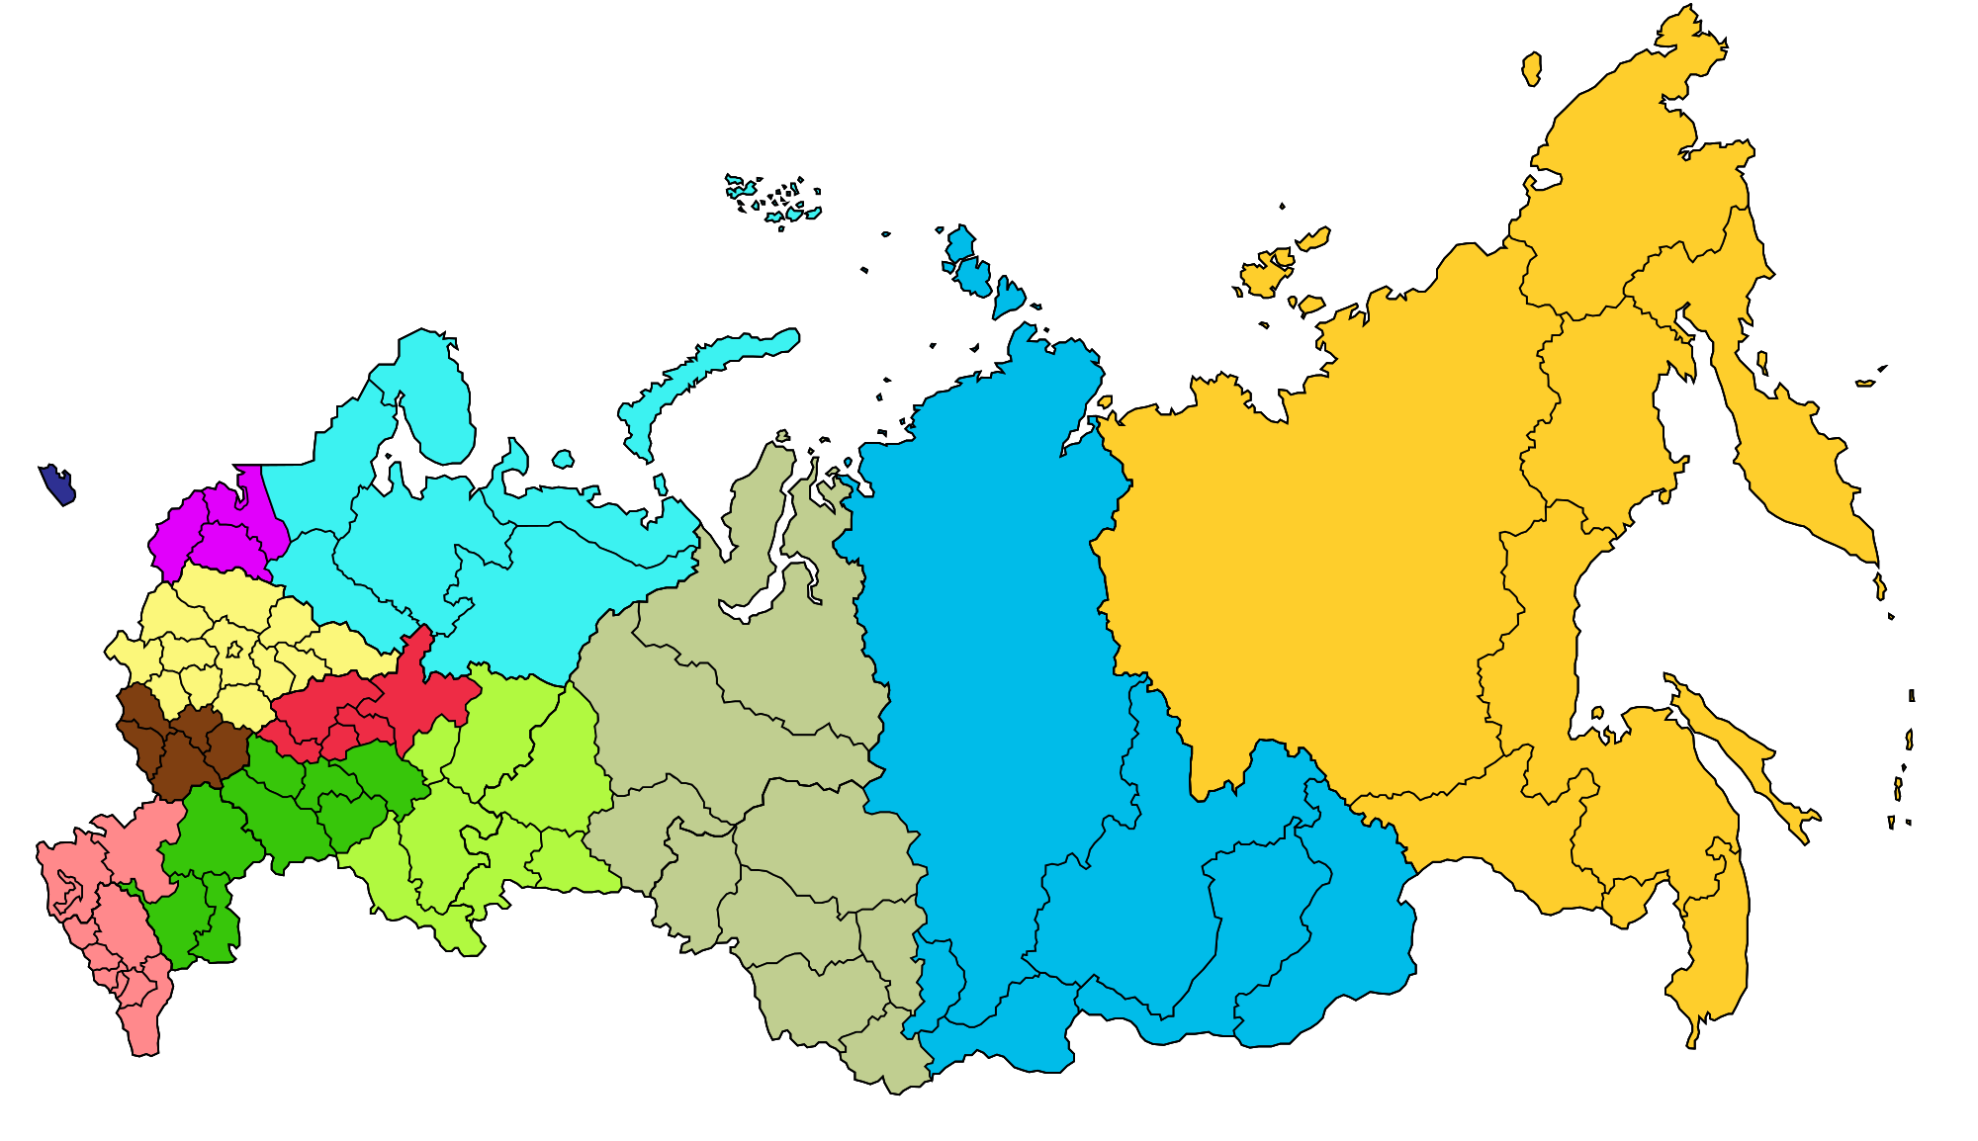
Match the name of economic regions with their position on the map

Slide 18
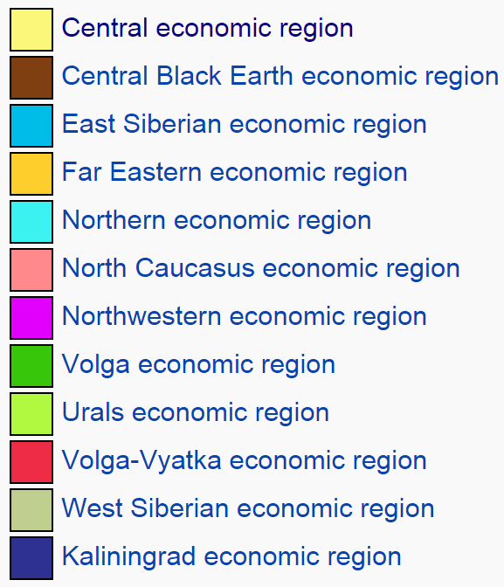


Slide 19
Compare division into economic regions, the Federal District and time zones in Russia. Which division, in your opinion, was the primary? What came later than the other division? Why are not the same economic regions and federal districts?

Slide 20
Considerations
1. interregional integration in Russia
2. an approximately equal distribution of gross domestic product by Federal Districts
3. specialized approaches to managing territories
(establishing the Ministries of the Far East, the North Caucasus, the Crimea)
4. simplification of operational management of territories

Slide 21
Russian Regional Economic Inequality
“Tyumen is like the United States, Stavropol is like Sri Lanka”
The level of development of Russian regions is decisively impacted by their Soviet inheritance or by mother nature. With a few exceptions, regions were not able to seriously improve their welfare in the absence of favorable starting conditions.
The divergence in living standards of different regions has sharply increased. The coefficient of differentiation has grown from 10 in 1998 to 22 in 2009. “From 1999-2009 the average per-capita GDP grew by 1.83 times while, simultaneously, the differentiation of regional GDPs more than doubled”

Slide 22
Central Economic Region
Central Economic Region is one of twelve economic regions of Russia.
Area: 484,000 km²; population: 30.5 million (2002 Census). Average population density—63/km². Over 80% of the population is urban.
Central Economic Region is located in the central portion of the European part of Russia. A great number of automobile and railroads intersect on the territory of this region.
This flat, rolling country, with Moscow as its center, forms a major industrial region. Besides Moscow, major cities include Smolensk, Yaroslavl, Vladimir, Tula, Dzerzhinsk, and Rybinsk. Trucks, ships, railway rolling stock, machine tools, electronic equipment, cotton and woolen textiles, and chemicals are the principal industrial products. The Volga and Oka Rivers are the major water routes, and the Moscow–Volga and Don–Volga canals link Moscow with the Caspian and Baltic Seas. Many rail lines serve the area.

Slide 23
Northwestern economic region
With its Baltic port and proximity to Finland, this region and its chief city St. Petersburg have always been a Russian window on the west. Its history is very different from that of Moscow and other parts of the Russian Federation. This is reflected in the positive outlook of many residents. The evaluation of the current economy is unusually high by Russian standards, and so to is the expectation of life improving. The region is also a magnet for student seeking higher education.
While nominal income is well below the national average, to a significant extent this is compensated by the fact that the likelihood being paid is well above the national average. Moreover, those finding life bearable are also well above the national average.

