Slide 1


ECONOMY OF RUSSIA
Lecture 7: Innovative Economy
/advanced knowledge-intensive technologies
Vera Valentinovna Ageeva
Tomsk Polytechnic University
Institute of Humanities, Social Sciences & Technologies
Department of History and Regional Studies
iforya@tpu.ru

Slide 2
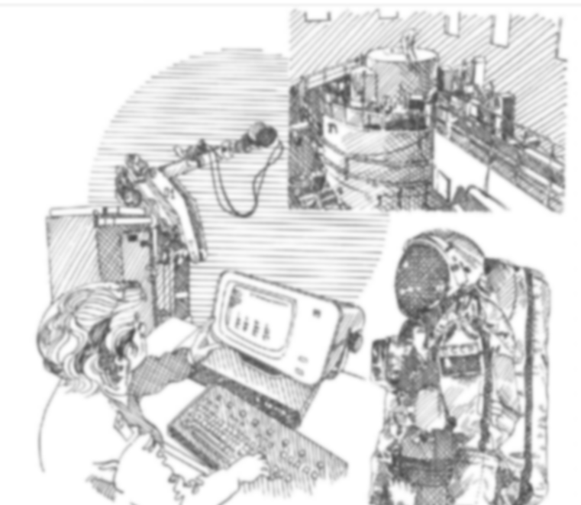
Plan
Historical considerations: Soviet Science and Technology
Russian Special Economic Zones (RUSSEZ project, innovation zones)
Skolkovo: prospects and criticism
Rusnano
Discussion questions

Slide 3
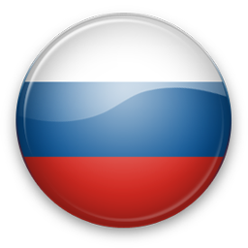

Special Economic Zones
of the Russian Federation
Industrial Production SEZ
Technology Innovative SEZ
Tourism and Recreational SEZ
Port SEZ

Slide 4
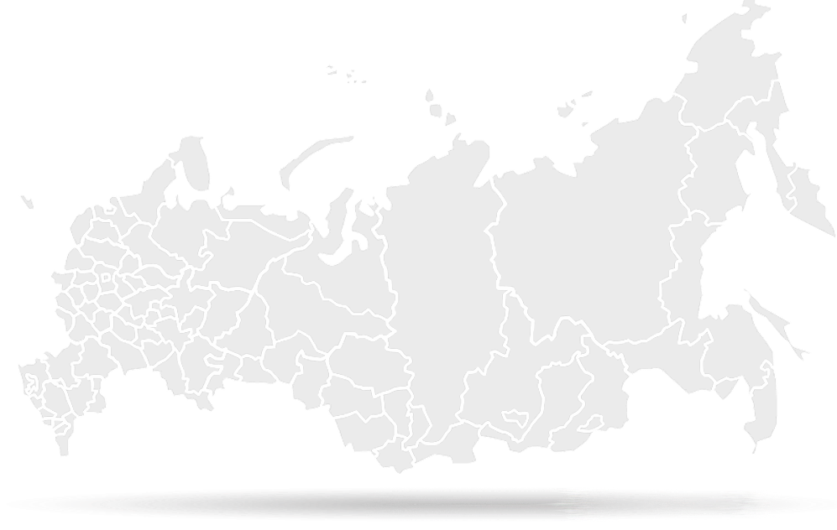
Why Russia?
(Ministry for economic development of the Russian Federation Department of special economic zones, regional and mono-cities development projects)
Advantageous position between Europe and Asia – location of distribution channels;
Rich natural resources ( > 20% of the world resources);
Russia is the 6th largest economy in the world by the GDP ($2,5 bln, purchasing power parity). According to IMF in 2017, the nominal size Russia’s GDP will reach $3,3 trillion;
Russia has 9th largest domestic market in the world (consumer spendings account for 70-75% of income);
Balanced labor cost and workforce skills, high level of education, strong labor market (unemployment rate is 5,5%);
Growth of Russian stock market capitalization by 22 times;
Developed infrastructure;
Policy to reduce bureaucracy and corruption;
Economy diversification, reducing dependence on oil and gas sector.

Slide 5
Location of 29 special economic zones
7
Industrial and production zones
14
Tourist and recreational zones
5
3
Technology and innovation zones
Port zones
St.Peterburg
Murmansk Region
Samara Region
Republic of Tatarstan
Republic of Tatarstan
Sverdlovsk Region
Pskov Region
Moscow Region
Dubna
Moscow
Zelenograd
Khabarovsk Region
Kaluga Region
Lipetsk Region
Ulyanovsk Region
Vladivostok
Tourist claster
Stavropol Region | The Republic of Ingushetia | The Republic of Kabardino-Balkaria
The Republic of Adygeya | The Republic of Karachaeva-Cherkessia | The Republic of Osetiya
Krasnodar Region | The Chechen Republic | The Republic of Dagestan
Tomsk Region
Altai Region
Russkiy island
Republic of Altai
Irkutsk Region
Republic of Buryatia
5
Notes:
5

Slide 6
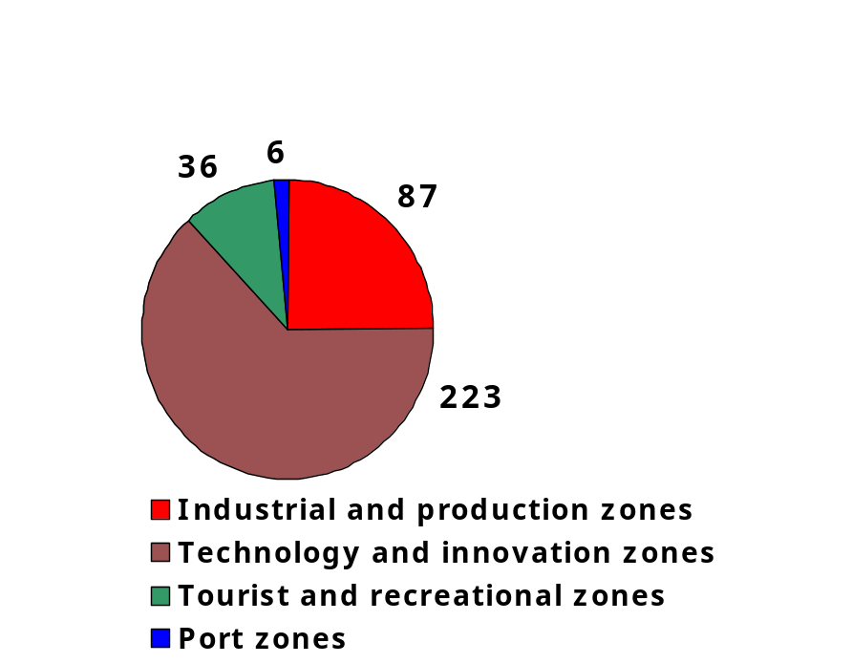

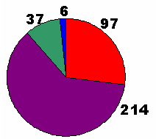
The key figures of SEZ’s efficiency
More than 73 bln. rub invested in infrastructure
About 460 bln. rub investors planned total investments
More than 350 residents in SEZ
3.10.14

Slide 7





























The largest SEZ investors

Slide 8
Preferences
Special administrative regime
  Decrease in administrative barriers
Transparent legislative and management
  Authorities involved: Ministry of economic development, professional management company
Access to qualified human resources
  Science and education centers
Free customs mode
  No import duty, refundable VAT
All the necessary infrastructure at lower prices
  Office facilities, gas, water, energy etc.
State guarantees and stability
  Investment agreement with the Government, SEZs are created for 49 years
Special tax treatment
  Income tax decrease, property, transport tax exemption for 10 years

Slide 9
Preferences
Preferences/taxes | Federal SEZ |  |  |  | Territory of the Russian Federation
 | Industrial and production zones | Technology and innovation zones | Port zones | Tourist and recreational zones
Profit tax Federal budget Regional budget | 2% 0-13,5% | 0% for 5 years 0-13,5% | 2% 0-13,5% | 0% for 10 years (for cluster residents) 0-13,5% | 2% 18%
Property tax | 0% for 10 years | 0% for 10 years | 0% for 10 years | 0% for 10 years | 2,2%
Land tax | 0% for 5 years | 0% for 5 years | 0% for 5 years | 0% for 5 years | 1,5%
Transport tax (rub/1 hp) | 0 for 10 years | 0 for 10 years | 0 for 10 years | 0 for 10 years | 10-150
Insurance fee payment | 14% till 2017 for residents involved in R&D activities | 14% till 2017 | - | 14% till 2017 for residents of tourist cluster | 34%
Free customs regime | + | + | + | - | -
Ready-to-use infrastructure | + | + | + | + | -

Slide 10
Obtaining the resident status
4) sign an agreement with the Ministry and the management company
2) forming request to the Ministry
STEP 1
STEP 2
STEP 3
STEP 4
1) register the company;
forming business plan
3) expert committee consideration

Slide 11
Management authorities of SEZ
Single centralized management system of SEZ
Government of constituent entity of Russia
Ministry of Economic Development of Russia
Management company
Main functions:
provides expert examination of project documentation and engineering survey
Main functions:
elaboration of the unified state policy in sphere of SEZ establishment and functioning;
SEZ management;
legal entities and individual entrepreneurs registration as SEZ residents;
maintenance of SEZ residents register;
issue of extracts from the SEZ residents register;
annual SEZ efficiency estimation;
control of operation agreement implementation by SEZ resident;
decision making on land buy-out by renters;
other functions.
Main functions:
provides establishment and operation of SEZ infrastructure;
attracts residents and other investors in SEZ;
development of SEZ zoning project;
acts as a state customer for SEZ territory zoning and infrastructure creation at the expense of budget funds;
obtains technical conditions for SEZ facilities and surrounding territory connection to the engineering and technical networks; transferring them to legal entities and individual entrepreneurs carrying out the construction;
manages and disposes SEZ land and other SEZ real estate;
publication of information of free land.
Supervisory board
Main functions:
coordination of activities on SEZ development;
control of the agreement on SEZ establishment implementation;
analysis, approval and control of SEZ development plans implementation;
assistance in SEZ residents and other investors project implementation

Slide 12
Located in major centres of science and education with long-standing scientific traditions and recognised research schools, the Innovation Zones offer great opportunities for innovative businesses to manufacturescience-intensive products and sell them on the domestic and international markets.
A set of customs and tax privileges and access to professional personnel resources combined with growing demand for new technologies and modernisation of various sectors of Russian economy make the Innovation Zones attractive for venture funds and developers/manufacturers of technology-intensive products.
The four existing Innovation Zones are situated in Tomsk, St. Petersburg, Moscow, and Dubna, Moscow Region.

Slide 13
The innovation Zones priority sectors are:
Nano and biotechnologies
Medical technology
Electronic and telecom equipment
Information technology
Precise and analytical instruments
Nuclear physics

Slide 14
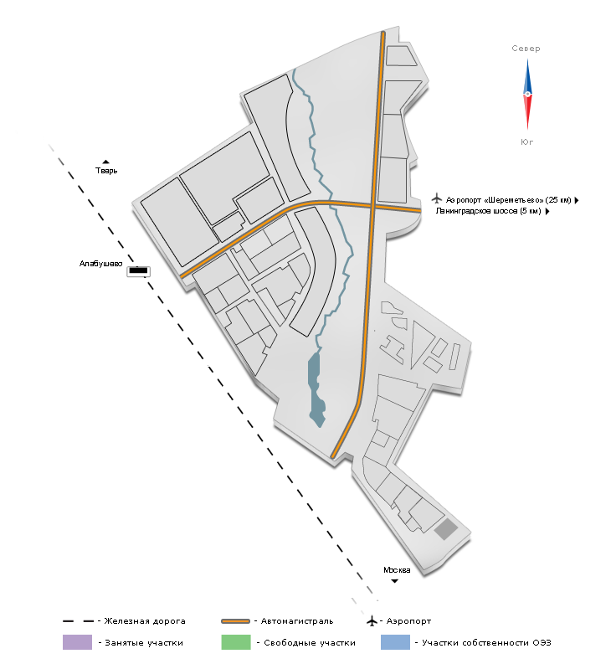
Zelenograd Innovation Zone
The Zelenograd Innovation Zone was created in Zelenograd Borough, Moscow
The zone occupies 146,27 hectares
Objectives:
Development innovative infrastructure
Create breakthrough technologies and products able to compete in the domestic and international markets
Promote domestic and foreign investment in Zelenograd’s science and technology-intensive industries
Upgrade Zelenograd’s manufacturing sector
Commercialise innovative products developed by Zelenograd’s companies

Slide 15
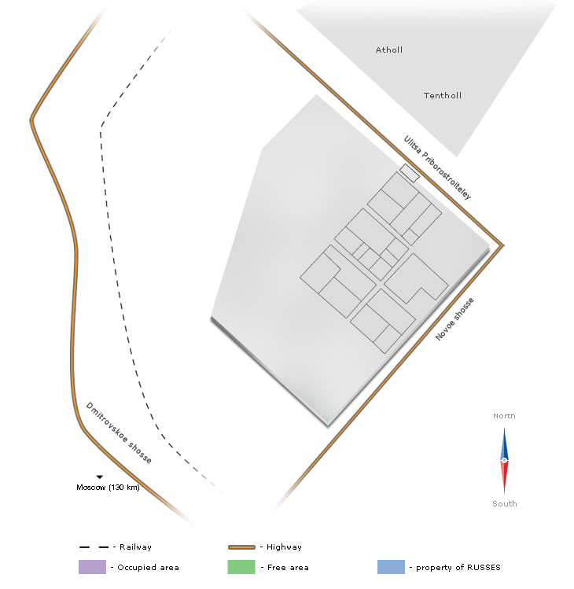
Dubna
Innovation Zone
The parties involved in implementation of the Dubna project are the Russian Government, the Government of Moscow Region, and the Dubna municipality.
The Dubna Innovation Zone is located 100 km off Moscow.
The Zone’s total area is 187,7 hectares

Slide 16


THANK
FOR YOUR
ATTENTION!
Vera V. Ageeva
Department of History and Regional Studies
iforya@tpu.ru
+7 (382)2 563549
14

