Slide 1


ECONOMY OF RUSSIA
Module 2: Sectors of Modern Russian Economy
Vera Valentinovna Ageeva
Tomsk Polytechnic University
Institute of Humanities, Social Sciences & Technologies
Department of History and Regional Studies
iforya@tpu.ru

Slide 2




Professional Background
Vera Valentinovna Ageeva
Associate professor, PhD in History
Cources
o History
o Political science
o Foreign Trade Goods Classification of the Customs Union
o Declaring, reporting, entry of goods
Research
o Historiography and methodology of history
o World Russian Studies
o Customs and Compliance Control
Advanced Professional Training
2013. Further training in the Russian Customs Academy in the distance-learning institute of retraining and professional development. Program “Topical issues of customs administration in the conditions of Russia's accession to the WTO” (102 hours).
2015. Educational Program “Blended Learning in Electronic Environment” in the University of Southampton

Slide 3
Module 2: Sectors of Modern Russian Economy
10 Classes:
1, 2 - Russian “Oil Economy”
3, 4 - Industry
5 - Agriculture
6 - Trade
7 - Infrastructure and Transportation
8 - Banking and Investment
9 - Fiscal Policy and Protectionism
10 – Review: Problems and Prospective
3

Slide 4
Russian Oil Economy: Statistics
GDP | $1.175 trillion (April 2015) (nominal)
 | $3.458 trillion (April 2015) (PPP)
GDP growth | -4.6% (Q2 2015, compared with a year earlier)
GDP by sector | Agriculture: 4%, Industry: 36.3%, Services: 59.7% (2014)
Inflation | 15.3% (June 2015)
Average gross salary | 35,930 rubles (June 2015)
Exports | $210.2 billion (Jan-Jul 2015)
Export goods | petroleum and petroleum products, natural gas, metals, wood and wood products, chemicals, and a wide variety of civilian and military manufactures
Import | $110.9 billion (Jan-Jul 2015)
Import goods | consumer goods, machinery, vehicles, pharmaceutical products, plastic, semi-finished metal products, meat, fruits and nuts, optical and medical instruments, iron, steel
4

Slide 5
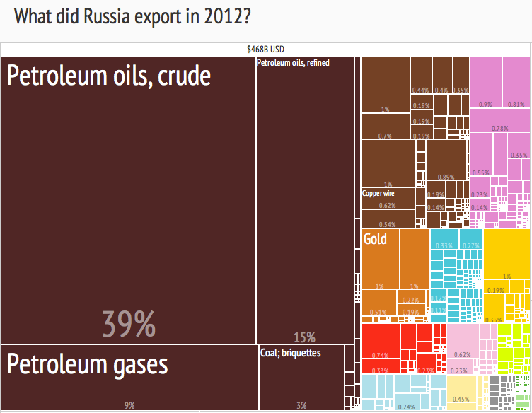
The Structure of Russian Export according to Harvard Atlas of Economic Complexity
5

Slide 6
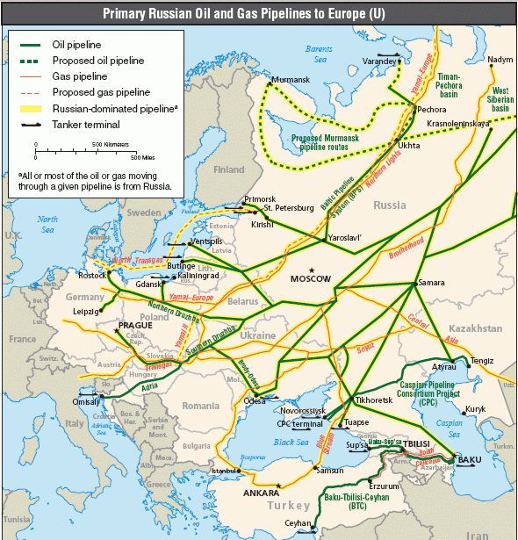
Oil and natural gas pipelines in Europe
6

Slide 7
In Pair Discussing the Following Question:
What were the historical reasons for the dependence of the Russian economy from natural resources, primarily oil and gas?
7

Slide 8
What were the historical reasons for the dependence of the Russian economy from natural resources, primarily oil and gas?
Forced industrialization and economic modernization in Russia and the Soviet Union during the 18th, 19th and 20th centuries; the need for “fast money”;
Use of oil trade as a tool to support the economy in times of crisis (in 1990s the oil industry has been virtually the only sector of the economy that gave a steady income);
The discovery of oil fields in Western Siberia (Tyumen) and the growth of Soviet oil production in the 1960s.
8

Slide 9
What were the historical reasons for the dependence of the Russian economy from natural resources, primarily oil and gas?
War between Egypt and Israel in 1972 and the oil embargo of the Arab countries, has become an incentive for the expansion of Soviet oil exports;
Radiophobia in Eastern Europe in the late 1980s after the accident at the Chernobyl nuclear power plant, which has led to increased use of natural gas.
9

Slide 10
In Pair Discussing the Following Question:
What the problems (environmental, social, economic, political) are a consequence of the oil of the Russian economy?
10

Slide 11
What the problems (environmental, social, economic, political) are a consequence of the oil of the Russian economy?
The dependence of the budget on the world prices for oil,
The monopolization of the leading sectors of the economy, corruption and big business oligarchization,
Unavoidable costs for the construction of pipelines,
The destruction of fertile soils,
Disturbance of ecosystems,
Loss and unsustainable use of natural resources, the loss of the cultural heritage of the indigenous population (resettlement with material compensation, the loss of traditional occupations - hunting, fishing, herding),
The lack of incentives for the modernization of other sectors of the economy.
11

Slide 12
In Pair Discussing the Following Question:
Imagine the possible ways to overcome the oil orientation of the economy taking into account the fact that proven oil reserves will last for 30 years.
12

Slide 13
Imagine the possible ways to overcome the oil orientation of the economy taking into account the fact that proven oil reserves will last for 30 years.
Economic diversification (development of other sectors of industry and services);
Deep processing of oil (polymers, pharmaceuticals);
Modernization of traditional industries (agriculture, engineering);
Development and implementation of innovative technologies (nanotechnology, electronics);
Development of services, including tourism and education;
Formation of an effective state reserve fund.
13

Slide 14

THANK
FOR YOUR
ATTENTION!
Vera V. Ageeva
Department of History and Regional Studies
iforya@tpu.ru
+7 (382)2 563549
14

