Slide 1
Contemporary History of Russia
Lecture 9: Perestroika

Slide 2
Issues:
Perestroika. Acceleration period
Perestroika. Publicity and Democratization
USSR Collapse

Slide 3
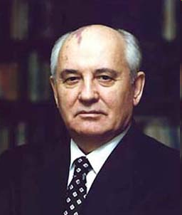
«Perestroika»
Stages:
1985-1987 "Acceleration"
An anti-alcohol company,
Combating unearned income, corruption
1987-1989 Publicity and Democratization
Gorbachev Mikhail Sergeevich, born 1931
General Secretary of the CPSU Central Committee 1985-1991.
USSR President 1990-1991

Slide 4
«Perestroika»
Most party and state elites did not have a clear idea of the causes and nature of the crisis of Soviet society
1987 rotation in party organs
1985-1988 economic reforms:
Brigade Contract Law 1986
Law on State Enterprise 1987
Law on Cooperation 1988
Law on Lease and Lease Relations 1989

Slide 5
Law on State Enterprise 1987
Central ministries define benchmarks and state orders.
Indicators had to decline
The products produced beyond the order could be sold at a market price
Lack of infrastructure
Labor collectives fought for the state order, Enterprises increased prices and reduced the production of cheap goods

Slide 6
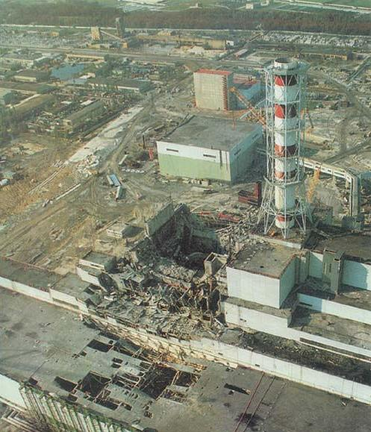
Chernobyl disaster
April 26 1986
First mention in Media in 36 hours
115 000 people evacuated

Slide 7
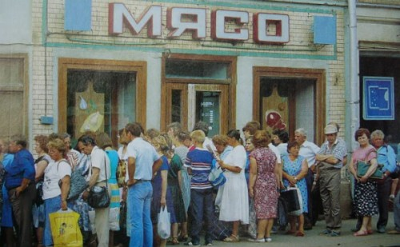
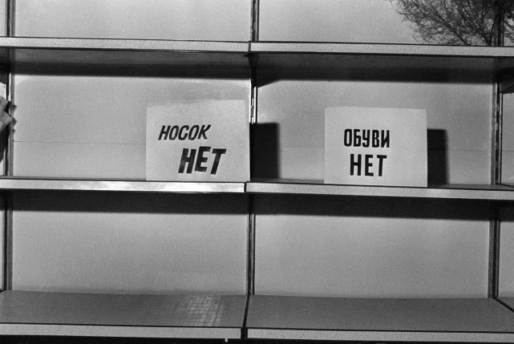
Economical crisis
1986-1989 Slight increase
1990 Fall in GDP -2 %
1991 Fall in GDP – 6-10%
From 1985 increase in money supply
1990 inflation was not less than 25%
End 1991 inflation was 10% in month

Slide 8
Political changes
Acceleration was said to be blocked with political system, constructed in 1930s
Democratization was said to be a mechanism to destroy administrative command system
Economical and political alternative
December 1, 1988 Law on Amendments and Additions to the Constitution of the USSR

Slide 9
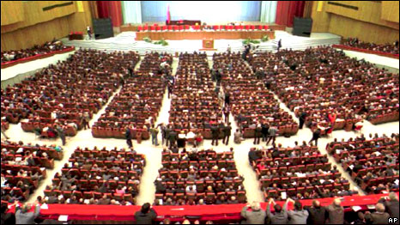
Political changes
Congress of People's Deputies – 2 250
2/3 – elected by citizens
1/3 – elected by enterprises
Elections 1989
Boris Yeltsin elected from the Moscow region

Slide 10
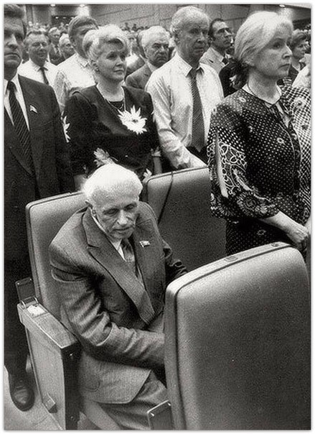
Political changes
Congress of People's Deputies
Criticism of the system
Inter-regional Deputies Group
March 1990Cancellation of the sixth article

Slide 11
«USSR Collapse»
Strengthening of interethnic problems
(1986 Yakutsk students’ squabble; December 1986 Kazakhstan squabble; 1987; Nagorno-Karabakh conflict 1987-1988; Tbilisi meeting dispersal 1989,)
Strengthening of economical problems
Federal structural problems
Reduction of trust to the central authorities
(War in Afghanistan; Chernobyl disaster)
Devaluation of the communist idea
Cold war and armaments drive

Slide 12
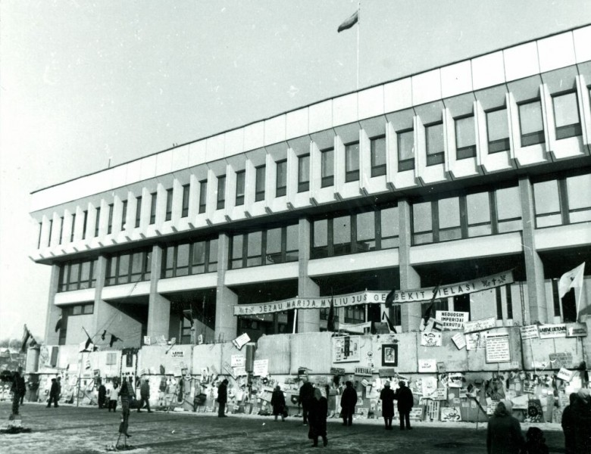
«USSR Collapse»
Elections lead opposition forces to the Supreme Soviets of the republics of the USSR
1990 "parade of sovereignties"
11 March 1990 Act of Independence of Lithuania
January 1991 - the entry of troops into Lithuania

Slide 13
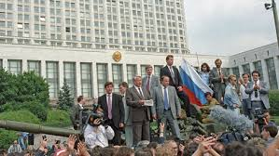
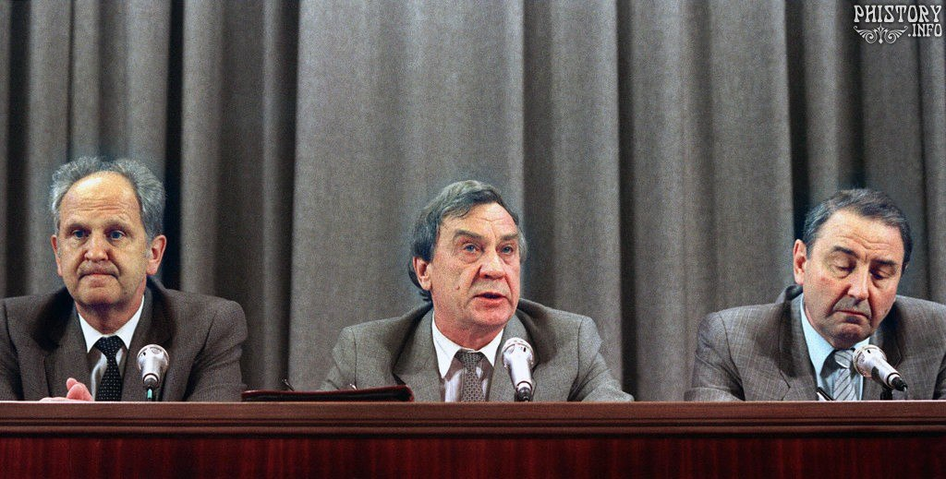
«USSR Collapse»
March 17, 1991. Referendum on the Preservation of the USSR (yes - 77%)
June 12, 1991 Yeltsin elected as a president of RSFSR
August 19-21, 1991 Attempt of a coup d'état

Slide 14
«USSR Collapse»
December 8, 1991 Belovezhsky agreements
December 29, 1991, the resignation of the president of the USSR, MS. Gorbachev

