Slide 1
Contemporary History of Russia
Lecture 7:

Slide 2
Issues
Restoration of the USSR after the war
De-Stalinization
Socio-economic transformations in 1953-1965
Development of the fuel and energy complex

Slide 3
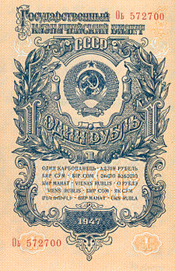
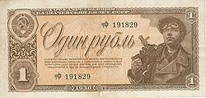
Economic recovery after the war
On June 23, 1945, the demobilization of the active army (8.5 million people)
September 4, 1945 abolition of emergency martial law, an 8-hour day was restored
Preservation of the military-industrial complex to ensure employment
1947 The abolition of the card system and the implementation of monetary reform - denomination with limited exchange

Slide 4
Policy
Strengthening the power of Stalin: a great philologist, a great agronomist, etc.
the Supreme Council had less sessions than the constitution said
Co-optation of party functionaries
Strengthening the power of the nomenklatura

Slide 5
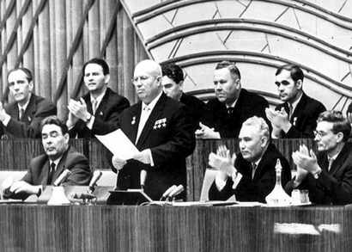
De-Stalinization
1953 Dismantling of the Gulag
1954 military prosecutor's office began rehabilitation of illegally convicted persons
February 25-26, 1956 Closed meeting of the 20th Congress of the CPSU: Khrushchev report on the cult of the personality of Stalin
Charges against the people are dropped: Chechens, Ingush, Balkars, Meskhetians, Kalmucks, Kurds, Germans, Crimean Tatars and Greeks
Renaming of cities since 1961 (Stalingrad-Volgograd, Stalinobad-Dushanbe, Stalino-Donetsk)

Slide 6
Socio-economic transformations in 1953-1965

Slide 7
Reduced subscription to loans
Reduction of the working day to 6-7 hours
5-day work week
Reduction of the working day on holidays and pre-holidays
Abolition of criminal prosecution for abortion (introduced in 1936) (1955)
Abolishing the tax on childlessness (introduced in 1941) (1958)

Slide 8
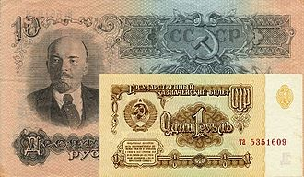
1954 elimination of separate education
1956 abolition of payment for secondary education
1958 Introduction of universal secondary education
1961 Monetary reform - denomination and devaluation
1964 introduction of pensions for collective farmers (kolkhoz workers)

Slide 9
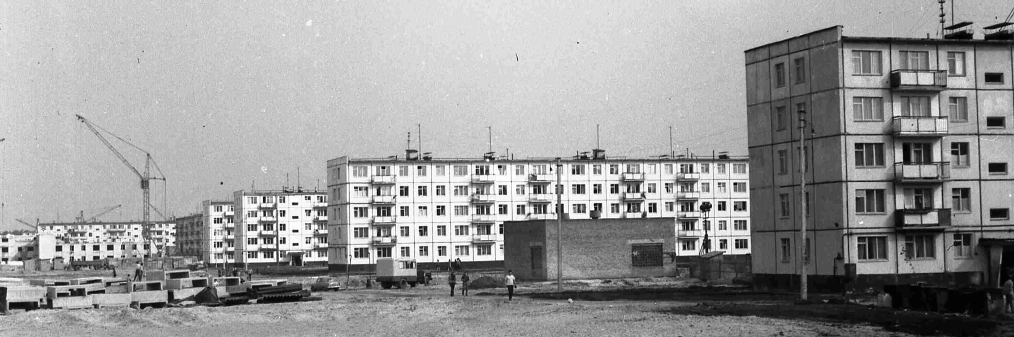
The economic recovery of the USSR in 1945-1953 was concentrated on heavy industry
Industrialization of housing construction
1958 family settling apart

Slide 10
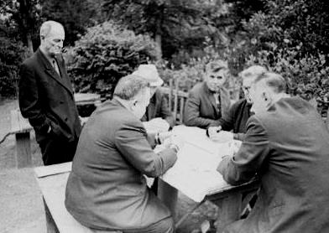
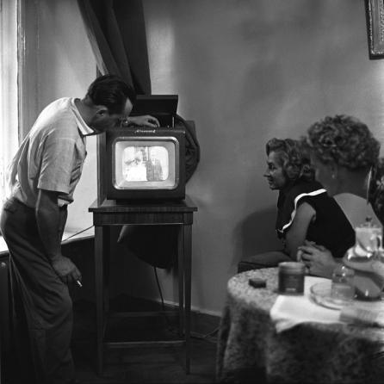

Forming a new everyday culture
Courts and Court life
Hobbies and travels
Nuclear family emergence
Change in the importance of higher education

Slide 11
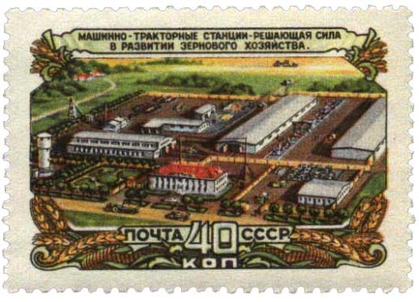
Falling of production in agriculture
1953 only 22% of the collective farms are electrified
Machine and tractor stations
1953 The CPSU Central Committee's Plenum defined the causes of the lag in agriculture:
Material disinterest
Contradiction of personal and public interests
Low level of mechanization of labor
Low level of management skills

Slide 12
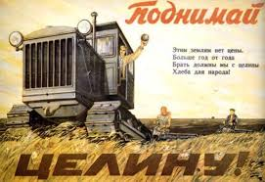
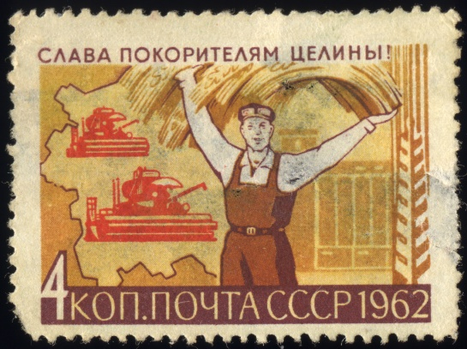
The development of virgin land
Resolution of the Plenum of the CPSU Central Committee 1954
Choosing an Extensive Way for the Development of Agriculture
Lack of infrastructure
Disregard for the ecology of the steppe zone
1961 The first grain purchase abroad

Slide 13
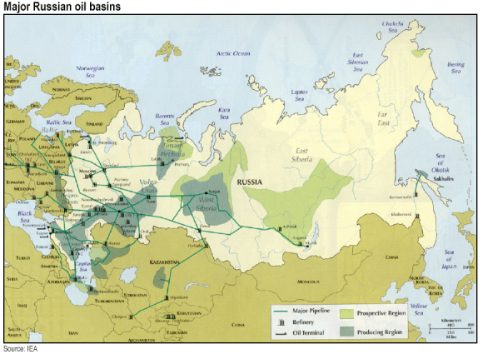
Development of the fuel and energy complex
1963 total oil and gas production exceeded the share of coal fuel
1964 Opening of the West Siberian Oil and Gas Field
1965 total production exceeded half of the Energy complex
Gasification of human settlements
Reorientation of production for chemical products

