Slide 1
Contemporary History of Russia
Lecture 6: Soviet foreign policy 1918-1945

Slide 2
Issues
Intervention during the Civil war
Recognition of the Soviet state
Anglo-Franco-Soviet negotiations before the Second World War
Soviet-German negotiations before the Second World War and the Molotov-Ribbentrop Pact
Japan's Warfare
Campaign of the Red Army to Poland
Soviet-Finnish campaign
Great Patriotic War1941-1945

Slide 3
Intervention
December 9, 1917. Conference in Paris - refusal of recognition of the Soviet government
Convention of December 23:
France - Ukraine, Bessarabia, Crimea
England - the Caucasus
January 1 1918 Japan introduced warships in Vladivostok
July 2, 1918 the Supreme Council of the Entente decides on the beginning of the intervention

Slide 4
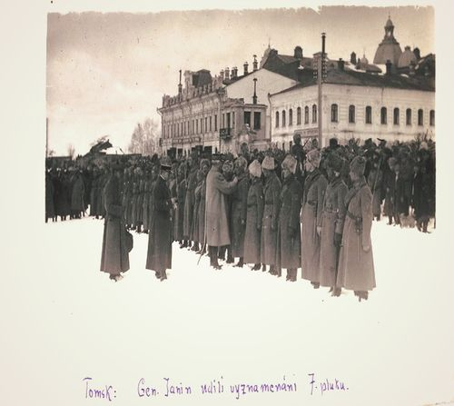
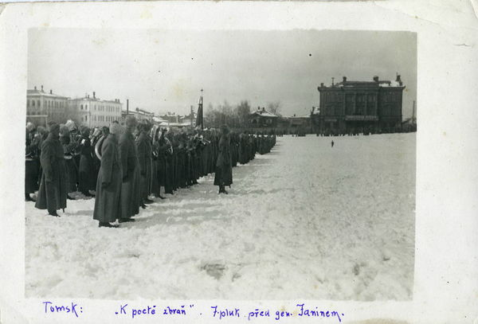
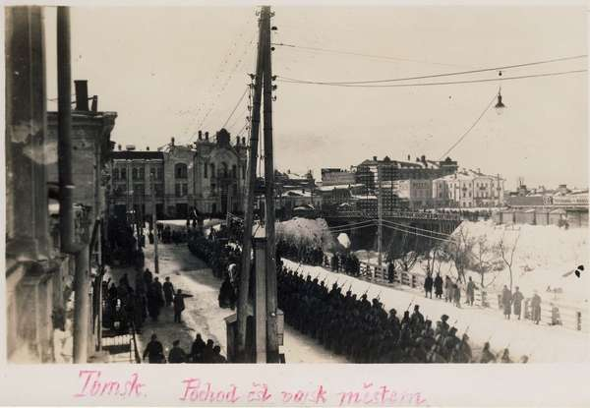
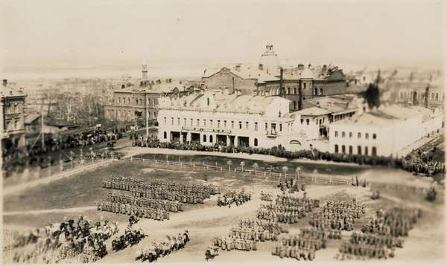

Slide 5
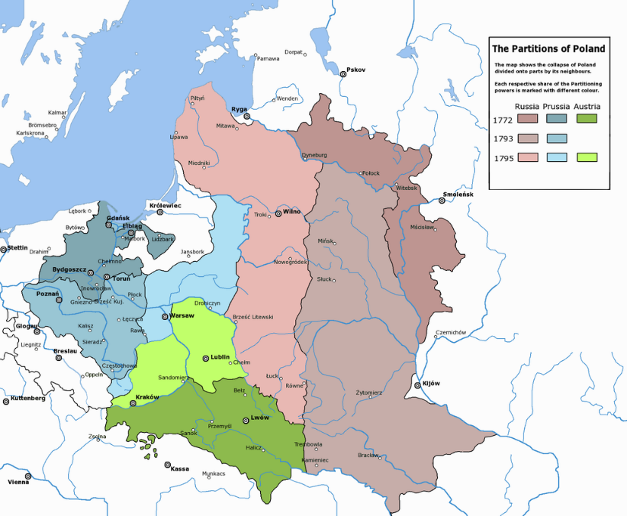
Polish–Soviet War
The leader of Poland, J. Piłsudski, declared plans for the restoration of Polish borders of 1772
April 25, 1920 - the attack of the Polish troops on Volhynia and Podolia
May 14, 1920 M.N. Tukhachevsky begins attack
July 4, 1920 the withdrawal of Soviet troops to ethnic Poland
August 12 1920 The Warsaw operation
August 16 counterattack of the Polish forces
March 18, 1921 peace treaty

Slide 6
Foreign policy of the Soviet government
The coming to power of the Bolsheviks was accompanied by an international boycott.
The Versailles treaty did not solve the Soviet question - Soviet Russia was not recognized

Slide 7
1923 defeat of the general strike in Hamburg lead to the rejection of an early world revolution, the need for pragmatic solutions (1926 support for strikes in the UK)
International Economic and Financial Conference in Gene April-May 1922
Expert conference in Hague June-July 1922
Lausanne Conference November-July 1923
September 18, 1934 the USSR was admitted to the League of Nations

Slide 8
Soviet-German relations
April 16, 1922 The bilateral treaty between Soviet Russia and Germany in Rapallo - renunciation of mutual postwar claims and the restoration of diplomatic relations
1924-1926 the creation of secret military centers of Reichswehr (Lipetsk, Kazan, Saratov)
October 12, 1925 Trade agreement with Germany
April 24, 1926 treaty of non-aggression and neutrality
1926 Long-term loan from Germany

Slide 9
Foreign policy of the Soviet government
1928-1933 - Allied relations with Germany, opposition to "democratic" countries, promotion to China and activation in Afghanistan and Iran
1933-1939 years. - rapprochement with Britain, France and the US on an anti-German and anti-Japanese basis, the desire to preserve spheres of influence in the East and avoid direct confrontation with Japan
1939-1941 - rapprochement with Germany and Japan

Slide 10
Foreign policy of the Soviet government
The position of the USSR on the events of 1935-1938. (Occupation of Ethiopia and Albania by Italy, Japan's actions in China, Anschluss of Austria, capture of the Czech Republic by Germany)
XVIII Congress of the Party in March 1939: to exercise caution and not allow to be dragged into war
Condemnation of the policy of neutrality of France and England

Slide 11
Anglo-Franco-Soviet negotiations in Moscow
June-August 1939 Anglo-Franco-Soviet negotiations in Moscow
Negotiations on the Tripartite military cooperation treaty
Question on the passage of Soviet troops through Poland
May 19, 1939 Franco-Polish secret treaty
August 25, 1939 Anglo-Polish agreement on cooperation

Slide 12
The Soviet-German negotiations
The treaty issue was first raised May 25, 1939
July 26, 1939 the German side declared its readiness to prove intention to make an agreement
August 23-24, 1939 Visit of Ribbentrop

Slide 13
The Molotov-Ribbentrop Pact
Soviet-German non-aggression pact for 10 years
Secret Additional Protocol
The Congress of People's Deputies of 1989 stressed that "the content of this treaty did not differ from the norms of international law and the treaty practice of states adopted for such a situation. However, both during the conclusion of the treaty and in the process of its ratification, the fact that simultaneously the treaty there was a "secret additional protocol" was hidden.

Slide 14
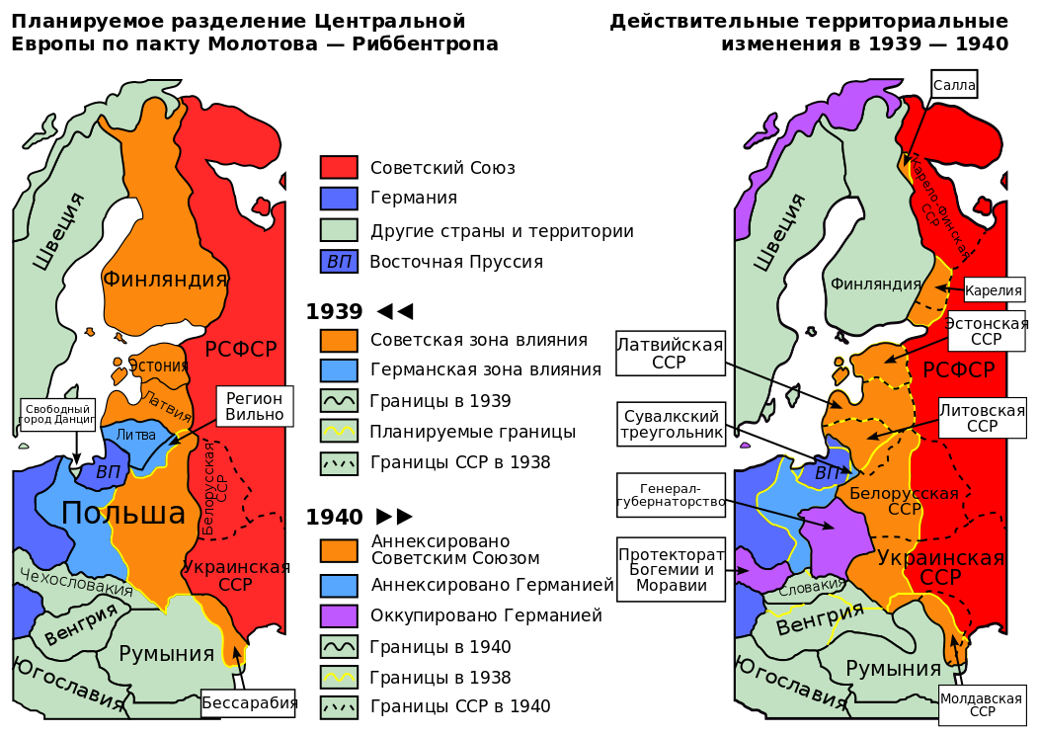
Secret Additional Protocol
Germany refuses from Ukraine, the Baltic states.
In cause of war with Poland, the border of spheres of influence must pass along the rivers Narew, Vistula and San.

Slide 16
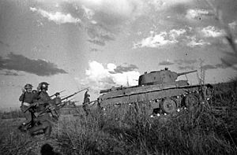
Japan's Warfare
July-August 1938 Hassan Lake
August 1939 the river Halkin-Gol

Slide 17
Campaign of the Red Army to Poland
On September 17, 1939, the German troops reached the line indicated in the secret protocols
The Soviet government notified the Polish ambassador that Poland, as a state, had virtually ceased to exist
The Soviet government intends to protect Ukrainians, Belarusians in Poland

Slide 18
Campaign of the Red Army to Poland
September 17 - 25, 1939, Soviet troops reach the indicated border
In general, the Polish population did not show resistance to Soviet troops
Polish officers were arrested by Red Army
September 28, 1939 Treaty of Friendship and the Borders of the USSR and Germany
On March 2, 1940, 21,857 Polish officers were killed (the Katyn case)

Slide 19
The Soviet-Finnish campaign
1935 Finland declared neutrality
October 14, 1939 the USSR proposed to Finland to lease out land for 30 years (port Hanko, several islands of the Gulf of Finland, part of the Karelian Isthmus), and in return to the USSR promise to transfer to Finland 5529 km of Eastern Karelia
On November 29, 1939, an incident near the village of Mainila

Slide 20
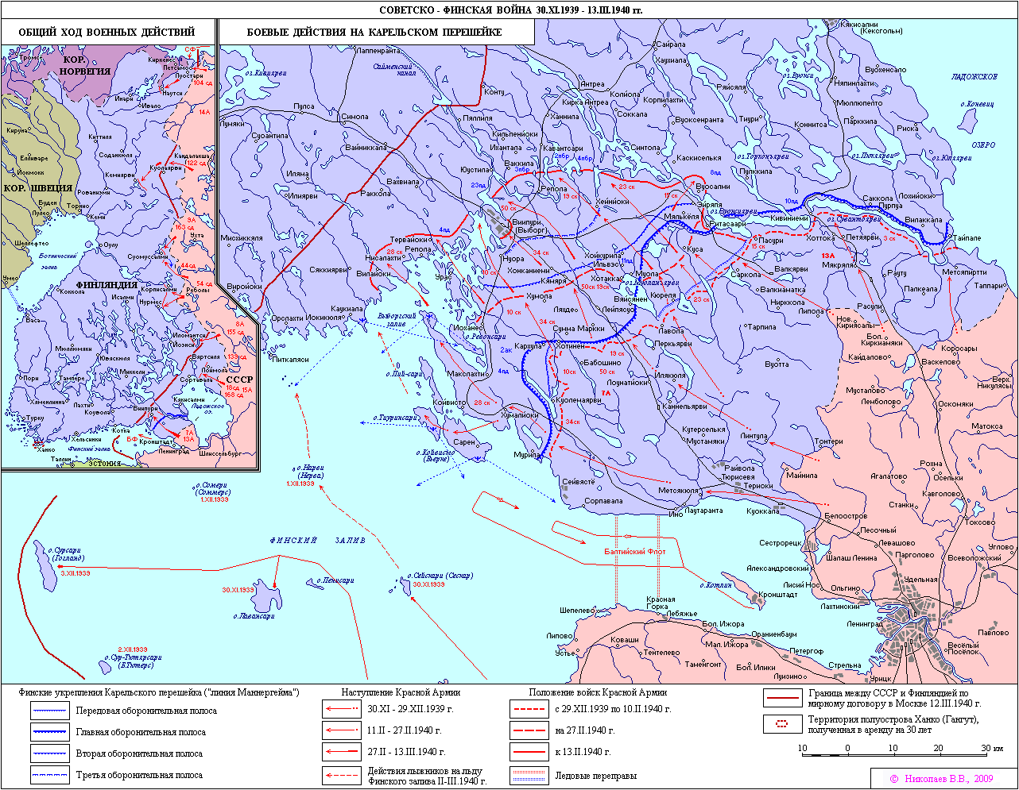

Slide 21
The Soviet-Finnish campaign
November 30, 1939 the beginning of the war
November 30, 1939 the government of the Finnish Democratic Republic of Terioki
November 30, 1939 - March 12, 1940
105 days of war 65 000 killed
200 000 wounded and frostbitten

Slide 22
The Great Patriotic War
1941-1945
Initial stage June 1941 - November 1942 (Battle of Moscow)
The radical change November 1942 (Stalingrad) - December 1943 (the Battle of Kursk in July-August 1943)
The closing period of 1944-September 1945

Slide 23
The Consequences of the War
Change in the economic map of the USSR
Identity Transformation
Changing attitudes with the church
Demographic consequences
New generation
New World Policy

