Slide 1
Contemporary History of Russia
Lecture 4: USSR in 1920-1930s

Slide 2
Issues:
Politics of "War Communism“ (Ideological background; measures; results;)
USSR formation (ideas, main events)
New Economic Policy
Totalitarism (Definition and approaches; Power concentration)

Slide 3
Politics of "War Communism" (1918-1921)
The term by A.A. Bogdanov (Malinovsky) before 1917
On December 2, 1917, Establishment of the Supreme Council of National Economy

Slide 4
Politics of "War Communism" (1918-1921)
Liquidation of private banks and confiscation of deposits (Decree of the All-Russian Central Executive Committee on December 14, 1917)
Nationalization of industry.
By the summer of the 1920s 50 chief directorates establishment
Monopoly of foreign trade (April 1918)
Compulsory labor service
Food dictatorship

Slide 5
Politics of "War Communism" (1918-1921)
The production of pig iron in 1920 compared with 1918 fell 4.5 times.
Steel - 2.5 times
Sale - 2 times
Increasing military production.=>
In 1920, 2-3 less machines and implements were supplied to agriculture than in 1919
Cutting of sown areas by 20%
The fall in the collection of agricultural products by 40-45% compared with 1913.

Slide 6
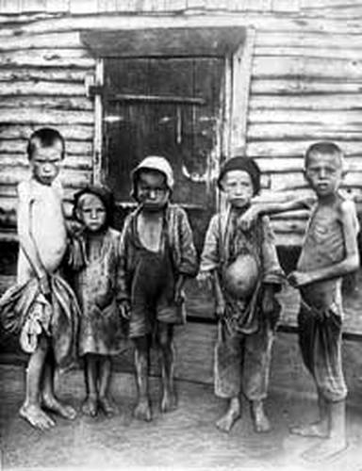
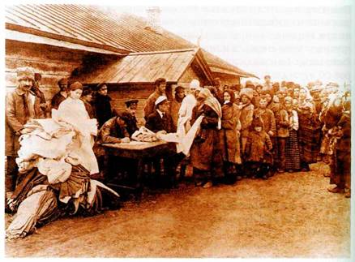
Politics of "War Communism" (1918-1921)
Drought
Famine griped up to 20% of the population
5 million people died

Slide 7
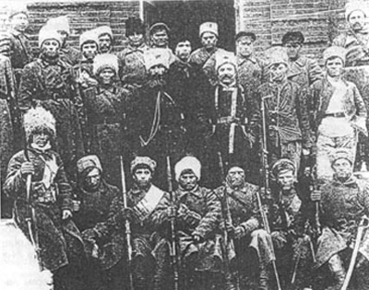
«Power to the Soviets, but not to parties!»
The Kronstadt Uprising (about 27 thousand people). March 1921
The uprising in Western Siberia (about 100 thousand people).
Uprising in Tambov province and in a number of districts of Voronezh, Saratov province (30 thousand people).
1920-1921

Slide 8
Formation of the USSR
Intraparty discussion
Lenin VI-federation
Stalin I.V. - "autonomization"
January 31, 1922 the constitution of the USSR

Slide 9
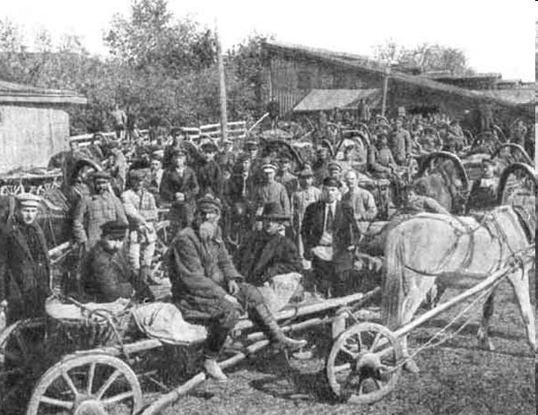
New Economic Policy (1921-1928)
March 15, 1921 Decision on the cessation of military communism and the transition to the NEP (X Congress of the RCP (b)).
1923-1924 гг. Prodnalog (food tax) with food late money
1924-1925 Transition to the monetary taxation of the village
Delivery of grain

Slide 10
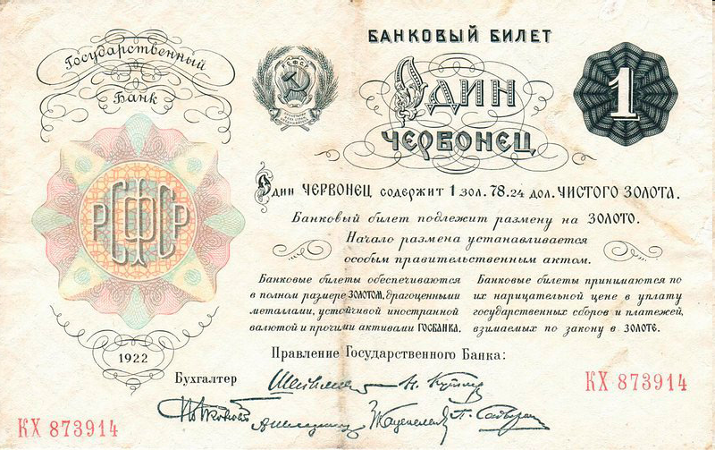

Slide 11
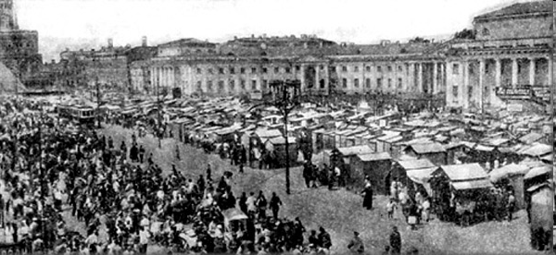
Bolshaya Sukharevskaya Square in Moscow during the NEP

Slide 12
Totalitarism
A political regime that characterizes the desire to control all spheres of society and human life.
Features:
Authoritarism
Etatism
Unified ideology
The device of compulsion
Nationalization or major state sector in economy
Hanna Arendt

Slide 13
The reasons for the formation of totalitarian regimes
Economic:
The immaturity of the country's capitalist development
Impact of the crisis of 1929-1933
Sociological:
"Generation of the century"
Increase the proportion of active social elements with the social bottoms
Social instability strengthens the "family model" of relationships
Psychological:
Authoritarianism

Slide 14
Totalitarianism. The formation of the totalitarian regime in the USSR
Spring 1921 X Congress of the RCP (b) - the prohibition of factional activities.
1922 I.V. Stalin was appointed Secretary General of the Central Committee of the RCP (B.):
Unification of the structure of party committees
At the head of party committees are secretaries approved from above

Slide 15
Totalitarianism. The formation of the totalitarian regime in the USSR
January 21, 1924, the death of VI. Lenin
Three groups:
L.D. Trotsky - Chairman of the Revolutionary Military Council, People's Commissar for Military and Naval Affairs
Kamenev L.V. (Member of the Politburo, chairman of the Moscow Soviet), G.E. Zinoviev (member of the Politburo, chairman of the Comintern), I.V. Stalin (member of the Politburo, Secretary General of the Central Committee of the CPSU (b)
N.I. Bukharin (member of the Politburo, responsible editor of Pravda), A.I. Rykov (member of the Politburo, chairman of the Council of People's Commissars)

Slide 16
Totalitarianism. The formation of the totalitarian regime in the USSR
New Economic Policy cut the party into fractions
1923 Statement of 46 members with an accuse in inconsistency
“New course” by Trotsky
1924 Triumvirate Stalin-Zinoviev-Kamenev

Slide 17
Totalitarianism. The formation of the totalitarian regime in the USSR
1925 Economic stabilization
"Building Socialism in One Country“ I. Stalin
XIV Party Congress Zinoviev and Kameniev vs Stalin and Bukharin
Industrialization issue cut the party into fractions

Slide 18
Totalitarianism. The formation of the totalitarian regime in the USSR
1927 All-Union Party Registry
October 13, 1927, the resolution of the Central Committee of the CPSU (b) "On regulating the growth of the party in connection with the results of the party list"
April plenum of 1927-course for the purification of the party

Slide 19
