Slide 1
Contemporary History of Russia
Lecture 2: Social and Economical situation ant the beginning of XX c.

Slide 2
Issues:
Demographic description (population growth; ethnical composition; Russification policy)
Social composition (Estates, aristocracy; bourgeoisie; intelligentsia; peasants; workers)
Economical situation (Review, Witte’s reforms; Agrarian reform 1906)

Slide 3
Socio-economic situation in Russia in the late XIX - XX centuries
Population growth
1858 – 68 millions
1897– 116 millions
1914 – 163 million
Urban population growth
1858 – 9,2%
1897 – 12,5%
1914 – 14,3%
Migration Processes

Slide 4
Age composition of the population
Children till 14 – 33%
14-30 years old – 32 %
Elder than 60 – 7%
(from 14 till 60 years old – 60%)
What did they dream?

Slide 5
Ethnical composition of the population
The meaning of the term «русский»/”Russian”
Great Russians – 47,8 %
Little Russian (Малороссы)/Ukrainians – 19%
White Russians – 6,1%
Turkic peoples - 7,7 millions
Jews – 3,3 % - deprivation of civil rights
Latvians, Estonians, Germans, Moldavians, Armenians, Mordvins
Russification from 1860s:
Forced baptism
Transformation national writings to Cyrillic
Poland and Finland destitution

Slide 6
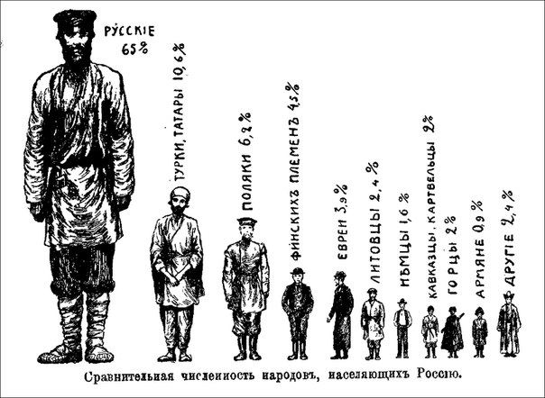

Slide 7
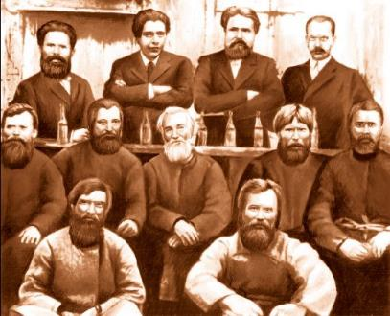


Multan affair 1892
Trial proceedings of an Udmurts peasants group from the village “Old Multan” accused of ritual murder - human sacrifice to the pagan gods

Slide 8



Slide 9
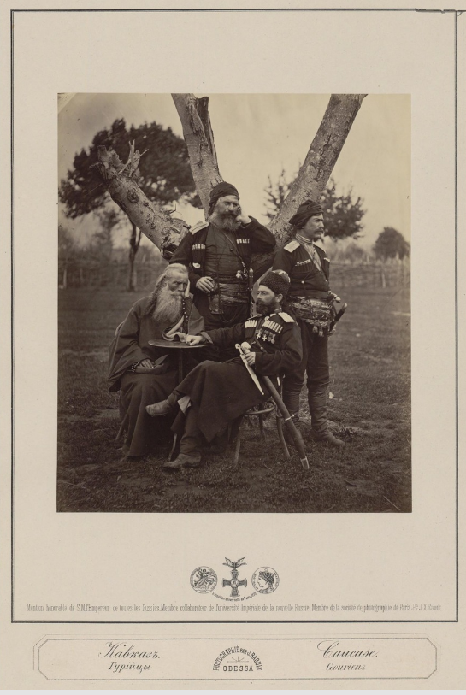
Notes:
Жан Ксавье Рауль. Кавказ. Гурийцы. Конец 1870-х
Подробности: https://regnum.ru/pictures/2090938/40.html Любое использование материалов допускается только при наличии гиперссылки на ИА REGNUM.

Slide 10
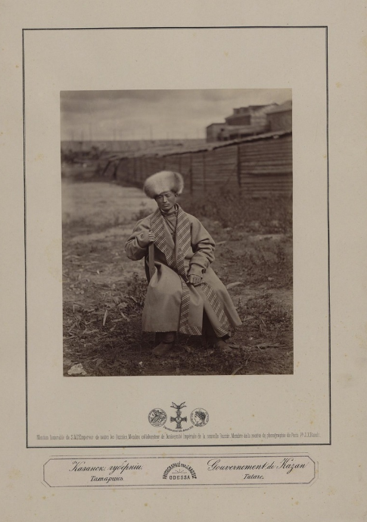
Notes:
Жан Ксавье Рауль. Казанская губерния. Татарин в лисьей шапке. 2-я пол. 1870-х
Подробности: https://regnum.ru/pictures/2090938/44.html Любое использование материалов допускается только при наличии гиперссылки на ИА REGNUM.

Slide 11
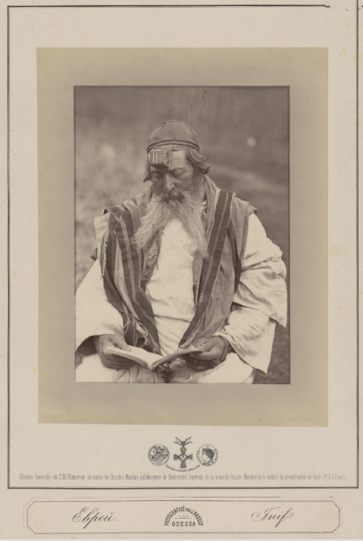
Notes:
Жан Ксавье Рауль. Еврей. Конец 1870-х
Подробности: https://regnum.ru/pictures/2090938/35.html Любое использование материалов допускается только при наличии гиперссылки на ИА REGNUM.

Slide 12
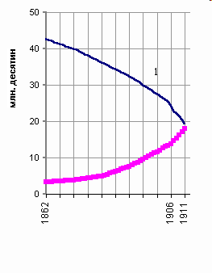
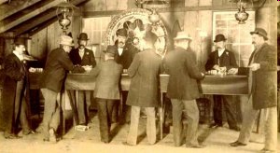
Social composition
Aristocracy - 1,5 %
Economic situation degradation
Bourgeoisie
Merchants – 0,5 %
townspeople – 10,6%
Intelligentsia
Notes:
Диаграмма из
Помещичье (дворянское) (1) и крестьянское (2) землевладение в Европейской России в 1862-1911 гг.
Кара-Мурза С.Г. Советская цивилизация Т. 1.

Slide 13
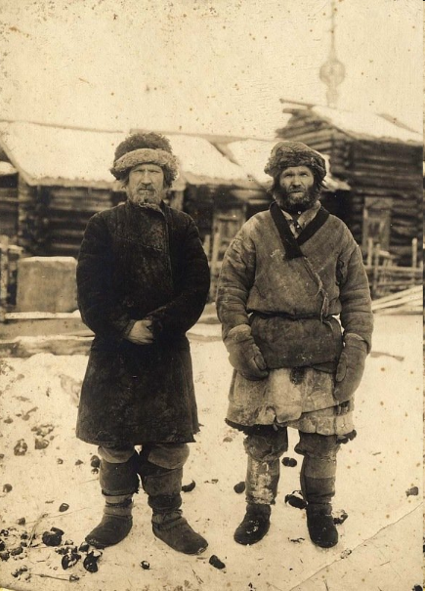
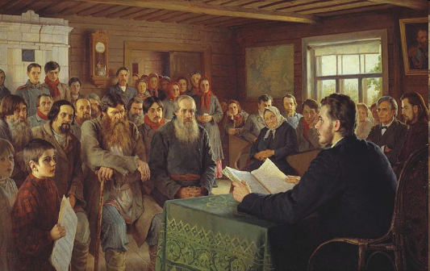
Old peasants. Krasnoyarsk region, 1911.
Peasants 77%-87%
Role of Community
Differentiation in economic position
Shortage of land
Migration
Low educational level
The ideal of a just monarch
Effect of party propaganda
From 1902 peasants uprising.
Since spring 1905 unrest intensified so much, that it covered about 20% of counties
Notes:
Богданов-Бельский, Николай Петрович «Воскресное чтение в сельской школе», 1895. Государственный Русский музей, Санкт-Петербург

Slide 14
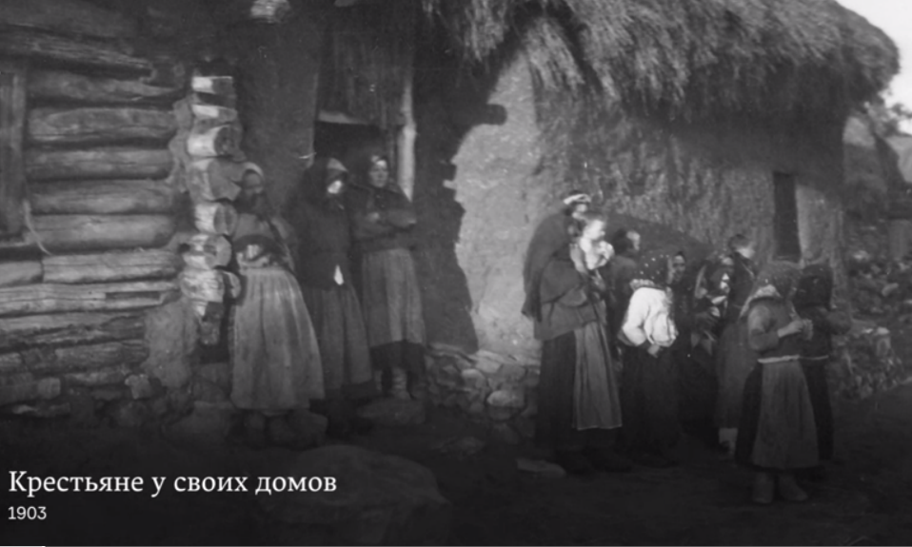

Slide 15
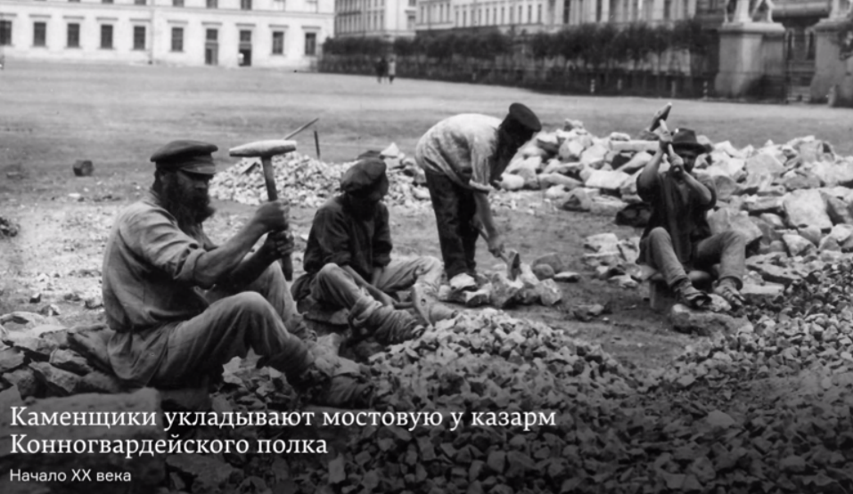

Slide 16
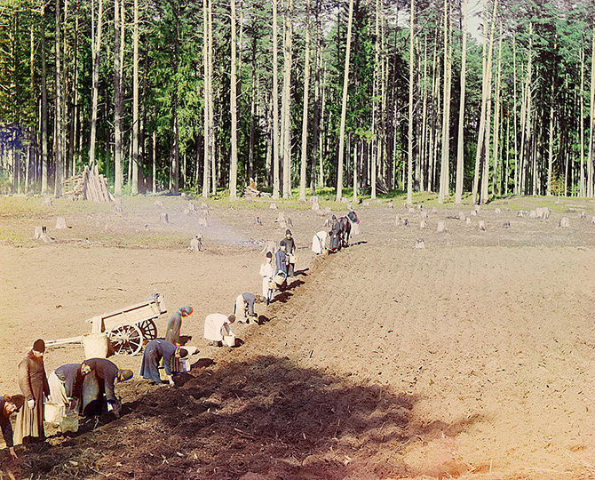

Slide 17
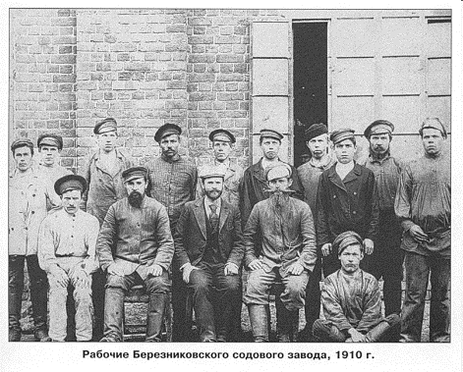
Workers
15 millions - 10%
1-3 generations (peasant mentality)

Slide 18
Economical situation
Rural economy domination till the 1890s
Internal market formation
Since 1840s. light industry appearance
Since 1890s heavy industry development
The industrial boom of 1893-1900s
Economic crisis 1901-1903s
Monopoly emergence

Slide 19
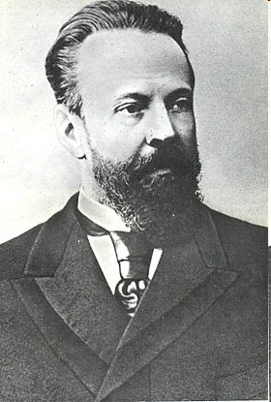
Sergey Julievich Witte
(1849-1915)
Witte served as Russian Director of Railway Affairs within the Finance Ministry from 1889–1891, then he was appointed as a Minister of Ways and Communications in 1892 and at August 1892, Witte was appointed to the post of Minister of Finance, a post which he held for the next 11 years.

Slide 20
Sergey Witte had for an object speeding up the development of Russians industry
Perusing this object he used traditional methods of government intervention in the economy:
Economic policy of protectionism was strengthened in 1894
Alcohol monopoly was introduced in 1896, which greatly increased government revenue
Foreign loans became one of the most important sources of finance for Witte’s economic policies
Increasing indirect taxation and the raising of the commerce tax.

Slide 21

5. One of the most important measures of Witte’s financial policy was the currency reform of 1897. Due to means collected as a result of higher taxes, increased gold mining and purchase of gold, foreign loans it become possible to issue gold coins instead of paper money, which helped to attract foreign capital to Russia and to strengthen the monetary system the country.

Slide 22
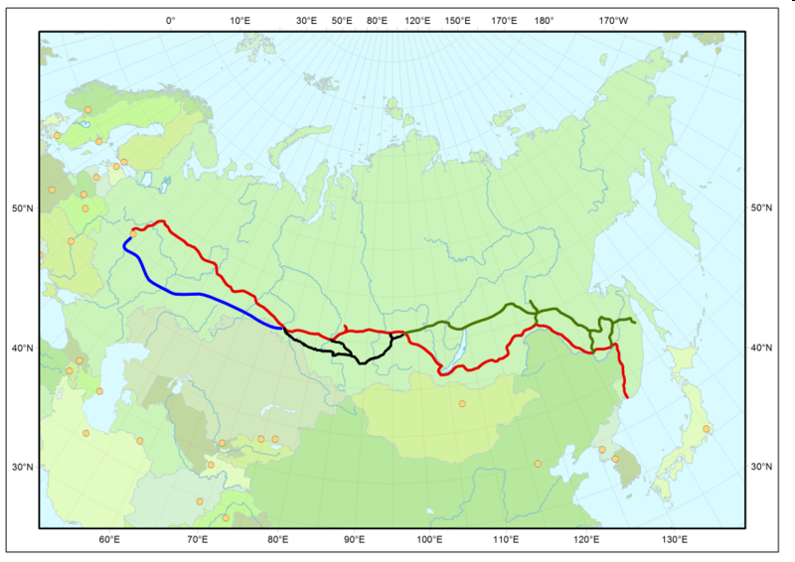
6. Sergey Jul. Witte significantly accelerated the construction of the Trans-Siberian Railway, which also had a positive impact on the economic situation in the country because of government investment in the economy.

Slide 23
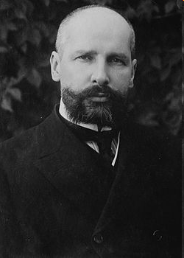
Peter Arkadievich Stolypin
(1862-1911)
Prime Minister 1906-1911
He aimed to create a moderately wealthy class of peasants, who would be supporters of societal order

Slide 24
Agrarian reform 1906
Idea:
Rapid peasants stratification
The rich ones buy out plots
Farmers emergence
Laborers emergence
Measures:
Redemption payments cancel (since 1870s)
Free withdrawal from the community
Migration policy
Results
10% of rural families withdrew from the community
Development of large-scale individual farming (khutors)
Since 1907 to 1914, officially registered more than 1 million returned from Siberia families
Upset the balance of agriculture and animal husbandry
The growth of commodity grain production

Slide 25
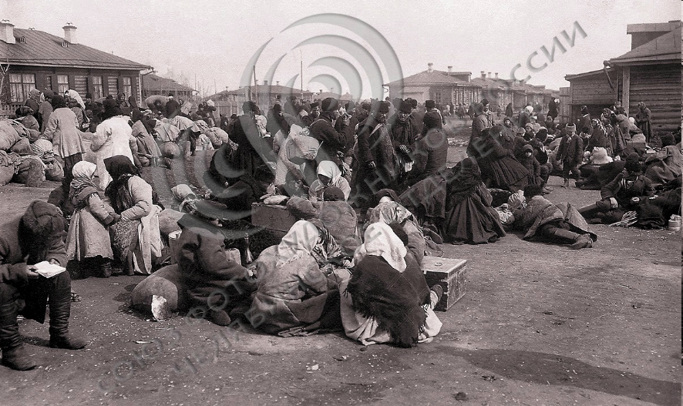
Settlers’ families
Notes:
http://www.fotosoyuz74.ru/images/photoarchive/1317294806161.jpg

Slide 26
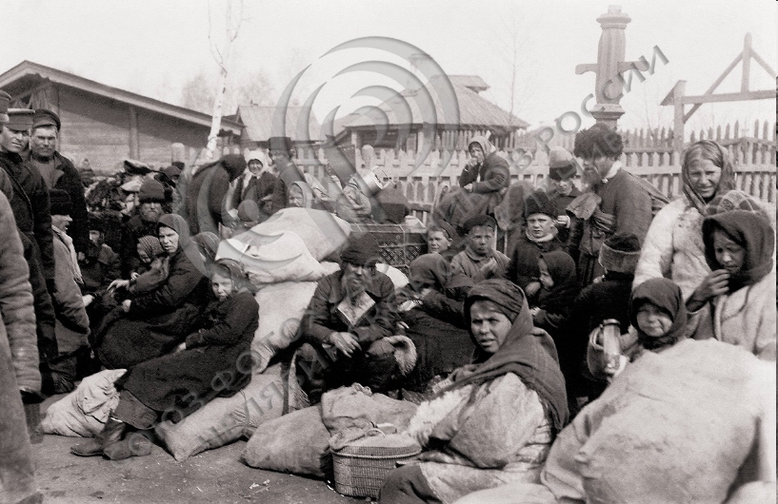
Settlers on a railroad station platform
Notes:
http://www.fotosoyuz74.ru/images/photoarchive/1317294806103.jpg

