Slide 1
Oriental Despotism
Karl August Wittfogel

Slide 2
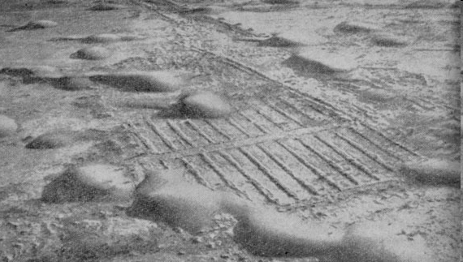
Hydraulic Hypothesis

Slide 3
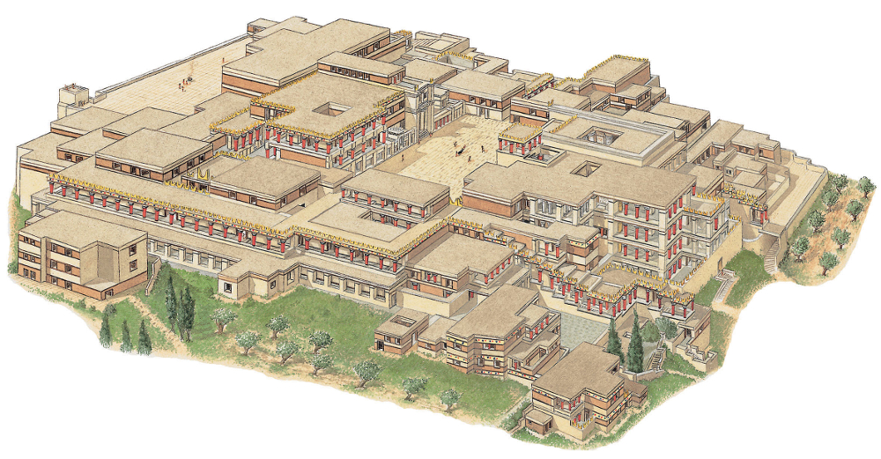

Slide 4
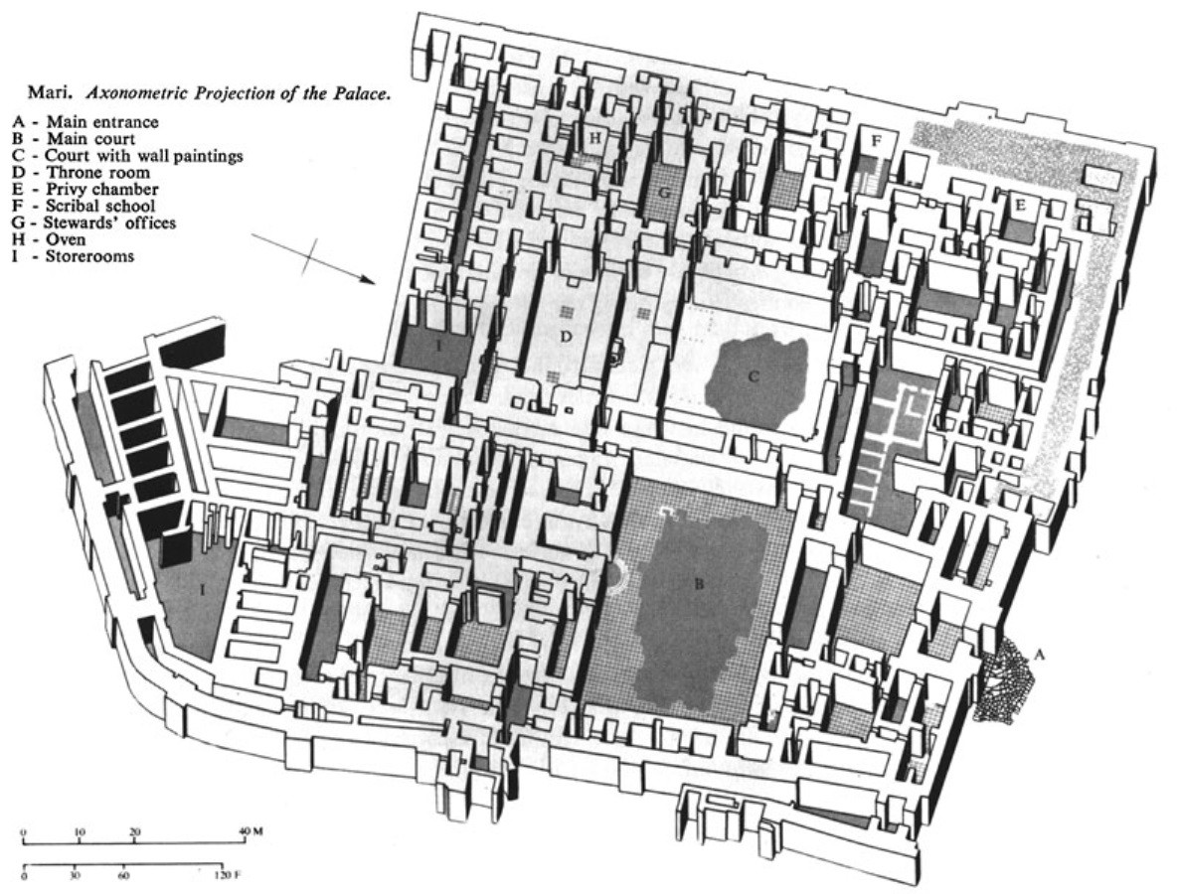
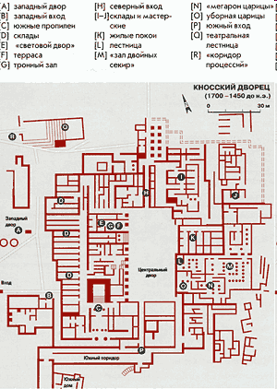
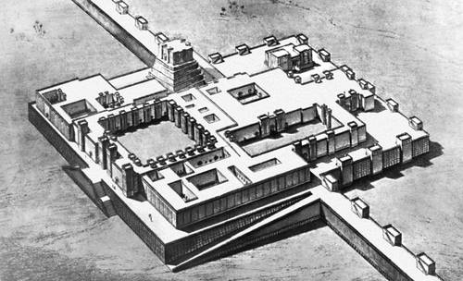
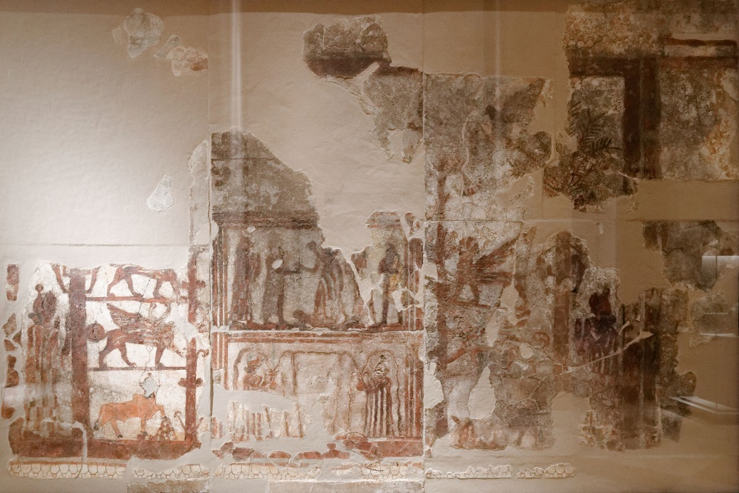
Дворец в Мари
XVIII век до н.э.

Slide 5
Hydraulic Hypothesis
The law of decreasing administrative returns by K. A. Wittfogel
Insignificant costs increase agricultural and state revenues
Administrative costs approach administrative income
Reduction of state revenues

