Slide 1

Biocompatible Materials
Lecturer: Arysheva Galina Vladislavovna

Slide 2
There have been enormous strides in the development of novel biomedical materials over the past three decades.
A biomedical material (also known as a biomaterial) is a polymer, metal, ceramic, or natural material that provides structure and/or function to an implantable medical device.
In one generation, a large number of biodegradable polymers, bioactive ceramics, and wear-resistant metal alloys have made their way from research laboratories into widely-used medical devices.

Slide 3
Lecture 1. Section 1.
General properties of materials and their compatibility with biological environments
Modern medicine can not develop without having the latest medical technology - hardware and equipment. Designers in collaboration with physicians continue to work on the improvement of medical technology, diagnostics and treatment to be more effective and machinery, tools, equipment - more reliable and convenient in practical application.
It is necessary to know not only the properties of starting materials and methods but also to change them in the desired direction.

Slide 4
Materials as feedstock for the medical devices must meet the following specific requirements:
- biological inertness and non-toxicity in relation to the body tissue and environments with which they come into contact;
- the possibility of aseptic processing without changing the properties and forms;
- corrosion resistance.

Slide 5
By mechanical properties of the material are strength, hardness, elasticity, toughness, ductility, fatigue.
The chemical properties determined by the chemical composition of the material, which affects its properties and the relation to various influences.
By understanding the physical properties of the behavior of materials under the influence of different types of energy, including heat, electricity, magnetism, light, sound, radiation (excluding chemical and mechanical energy).
Technological properties of materials due to the different methods of their processing into products, which are likely to significant changes in the properties.

Slide 6
Biological compatibility
The problem of biological compatibility covers both the effect of the biological environment on the material and the effect of the material on surrounding tissues.
Biologically compatible materials need to be designed at the molecular level.
Among the methods of laboratory and clinical studies there are:
1) Testing of materials:
• replantation;
• tissue culture;
• blood clotting;
2) Testing of extracts of materials:
• rapid intoxication;
• skin reactions;
• tests for pyrogenic substances;
• hemolysis tests.

Slide 7
Biological compatibility includes:
- Cellular reactions to foreign bodies
- Toxicity of materials
- Hemocompatibility
- Tumor formation

Slide 8
Stability of functional properties of materials
Living matter puts extremely harsh conditions for the material in contact with it, therefore it is necessary to foresee the most various degradation changes when it is introduced into the body.
Corrosion of metal
Destruction of polymers
Sterilization treatment (Thermal, chemical, radiation)

Slide 9
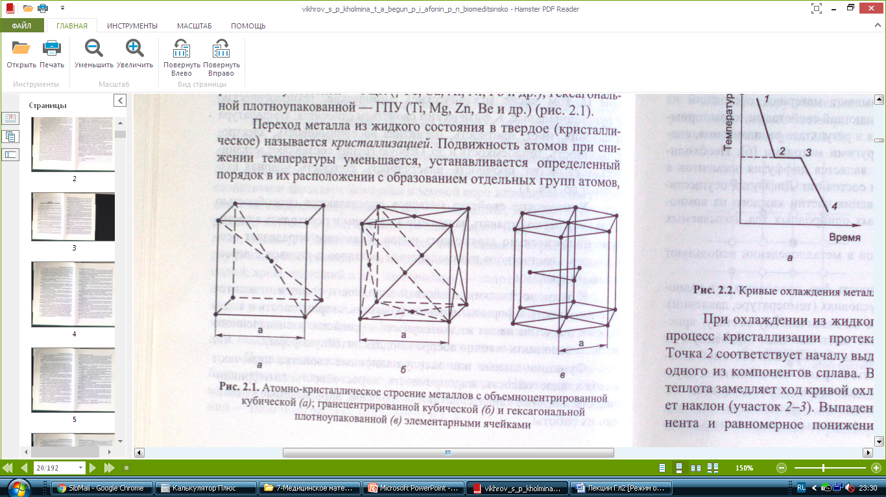
Lecture 2. Section 2. Metal materials and
their alloys in biomedical practice
For metals include substances having high heat conductivity and electrical conductivity, ductility, luster and other characteristic properties which are due to the presence of the crystalline lattice of a large number of free electrons.
The most widely used metals and alloys, formed one of the three types space lattices, defined by a single elementary cell:
a) body-centered cubic lattice – bcc (α-Fe, β-Fe, δ-Fe, Cr, W, Mo, V),
b) face-centered cubic lattice – fcc (Ɣ-Fe, Сu, Al, Ni, Pb),
c) hexagonal close-packed lattice – hcp (Ti, Mg, Zn, Be ).
a
c
b

Slide 10
Main types of alloys
Pure metals in most cases do not provide the necessary complex mechanical, technological and functional properties, and therefore rarely used. In technique in the most cases used only alloys.
Called metal alloy material consisting of two or more components and having properties characteristic of metals.
To describe the properties of the alloys used: system, phase, component.
The alloys which are in the solid state, the composition is divided into three groups: a solid solution, a chemical compound, a mechanical mixture of components.

Slide 11
The solid solution. The most liquid metal alloy is a homogeneous liquid, i. e. liquid solutions. In the transition to the solid state in many alloys such uniformity, and hence solubility are retained.
By the nature of the placement of atoms in the crystal lattice distinguish substitutional solid and interstitial solid solution.
Chemical compound. The elements forming the chemical compounds usually differ sharply on the size of the atom, electron shell structure and the parameters of the crystal lattices.
Mechanical mixture. Formation mechanical mixtures occurs when elements have limited solubility and the presence of the chemical compound.

Slide 12
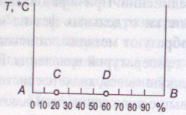
Status of binary alloys Diagrams
The state diagram is a graphical representation of the phase and state of critical points alloys depending on the temperature and concentration under equilibrium conditions. Equilibrium is an environment in which the processes occurring in the system are reversible.

Slide 13
Thermal and chemical-thermal processing
of steel
Heat treatment called processes associated with heating and cooling, causing changes in the internal structure of the alloy and the resulting changes in the physical, mechanical and other properties.
The process of heat treatment process involves three successive operations performed:
1) heating to a predetermined temperature;
2) holding at this temperature;
3) cooling at a predetermined rate.

Slide 14
Heat treatment called annealing process comprises heating to a definite temperature, subsequent exposure and usually slow cooling (in an oven) in order to obtain a steel equilibrium structure. After annealing eliminates internal stresses, crushed grain, improved ductility.
Types of annealing:
the first type (diffusion and recrystallizative)
the second type (full, partial, isothermal)

Slide 15
Tempering called hardened steel heating to a temperature below the critical point and held at this temperature followed by relatively slow cooling in air. Tempering is the final heat treatment operation began.
There are low- (50-250^{о}С), medium- (350-450^{о}С), high- temperature tempering (500-650^{о}С).

Slide 16
Chemical heat treatment of steel - a process which is a combination of thermal and chemical exposure for the purpose of changing the composition, structure and properties of the surface layer of steel.
For example:
- Cementation
- Nitriding
- Cyanidation
- Boration
- Diffusion metallization

Slide 17
Lecture 3. Electrical and thermal conductivity
of metals
The classical electron theory of metals is a solid conductor in the form of systems consisting of units of the crystal lattice ion, which is located inside of the itinerant electron gas of free valence electrons.
According to quantum mechanical representations reason for having an electrical resistance of solids it is not a clash of free electrons with the lattice atoms and scattering them on the lattice defects. The presence of structural defects leads to disruption of the periodicity of the potential, the scattering of carriers and non-zero value of the electrical resistance of the crystal.
Heat is transferred through the metal essentially the same free electrons which determine conductivity and metals; amount of metal per unit volume is great compared with dielectrics. Therefore, usually, the thermal conductivity of metal is much greater than that of dielectrics.

Slide 18
Application of solid conductive materials in biomedical practice
The most appropriate classification principle of conductive biomedical materials is classification by structure that separates all the materials of this group in the one-component (pure) and multicomponent (alloys). This division reflects the most important indicators of the material from a medical point of view: the chemical composition and structural perfection.

Slide 19
1 - Pure-metals
Biomedical materials which are pure metals belong to the group of biologically inert materials. They have the property of chemical inertia towards the biological medium, which is chemically highly: contains fats, organic acids and salts, in particular chlorides, are corrosion activators.
Group of pure metals that are used in medicine is small, because few metals satisfy all medical and technical requirements for biomaterials. This group includes the structural materials having high chemical resistance: tantalum, zirconium and titanium.

Slide 20
2 - Alloys and steel
In medicine various alloys and steels are used as biomaterials:
- Corrosion-resistant steel;
- High-speed steels;
- Precious metal alloys;
- Alloys of corrosion-resistant metals.
Alloys based on gold, silver and titanium are used for the manufacture of surgical implants and prostheses. For these alloys is characterized by a small amount of impurity in order to maintain the relative biological inertness and chemical homogeneity.

Slide 21
3 - Carbon
One solution to the problem of creating a chemically inert material with a surface having compatibility with living tissues is the use of carbon. It can be produced in large quantities and types of forms with minimal or no impurities. As one of the basic chemical elements that make up living tissue, carbon different inertia, lack of toxicity and carcinogenicity. The particles of carbon, without adversely affecting the surrounding living tissues, the lymphatic system and are displayed cumulated parenchymal organs.

Slide 22
In 90-ies of XX century scientists of the Ural Research Institute of composite materials, and Perm Medical Institute, developed and clinically tested carbon composite material "Uglekon-M". The material is a composite of woven carbon fibers associated with pyrolitic carbon (hard shiny product of carbohydrate decomposition on hot surfaces, which is a monolithic carbon body).
The chemical composition of the new material is almost pure carbon, the ash content is minimal and includes potassium - 0.0031% hydrogen - 0.028% sodium - 0.75%, calcium - 0.020%, sulfur - 0.006%, iron - 0.007%.

Slide 23
Lecture 4. Section 3.
Semiconductor materials
in biomedical practice
Semiconductor resistivity, at room temperature, is 10⁻⁶-10⁹Om•m. Semiconductors occupy an intermediate position between the conductors and dielectrics.
Unlike conductors, semiconductors conductivity increases with rising temperature. For semiconductors, this characteristic depends on the type and amount of impurities contained in them.

Slide 24
According to the chemical composition semiconductor materials are divided into simple substances (atomic, elemental semiconductors - germanium, silicon, tellurium, etc.) and various types of chemical compounds.
The main type of chemical bonds between atoms in elementary semiconductors is a covalent, in chemical compounds - a mixed ionic-covalent.
The most common types of crystal structure are diamond-type structure (fcc) - for simple substances; and sphalerite and wurtzite type - for chemical compounds.
According to the structure of the semiconductor material can be monocrystalline, polycrystalline and disordered (glassy (amorphous)).

Slide 25
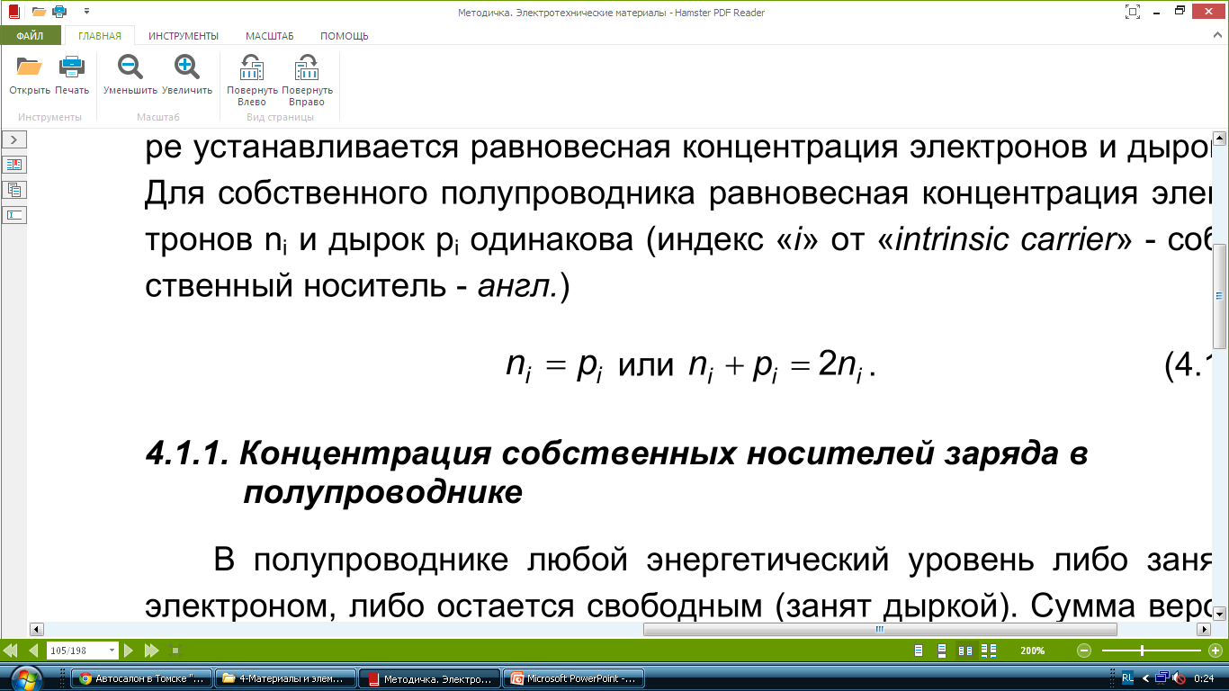
Intrinsic conduction of semiconductors
Semiconductors - is electronically conductive materials, electrical properties strongly depend on the content of impurities, defects of the structure and external factors (temperature, light, electromagnetic field, etc.). Related to semiconductors include materials with a band gap ∆Е <3 eV.
The conductivity due to electrons excited in the conduction band is called electron conductivity or n-conductivity type. The conductivity due to diffusion of holes in the valence band is called the p-type or p-type conductivity.

Slide 26
Impurity conductivity of semiconductors
Impurity conductivity provided by the charges of impurities. Impurities create small energy levels in the forbidden band of the semiconductor. Due to the small size of the impurity ionization energy (ΔEpr = 0.01 ... 0.1 eV), in a semiconductor can be subjected to strong currents at low energy impact. There are two types of impurities: donor (supplying electrons into the conduction band of the semiconductor) and acceptor (capture the valence electrons of the semiconductor).

Slide 27
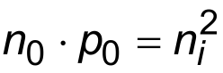
Basic and minority carriers. The impurity semiconductor n-type majority carriers are electrons, but there is a certain concentration of holes that are minority carriers. The p-type semiconductor hole - the majority charge carriers, and electrons - minority.
In the non-degenerate semiconductor at any temperature in the thermodynamic equilibrium product concentration of majority and minority carriers (n₀ and p₀ holes equilibrium electrons) is constant, independent of the content of impurities.

Slide 28
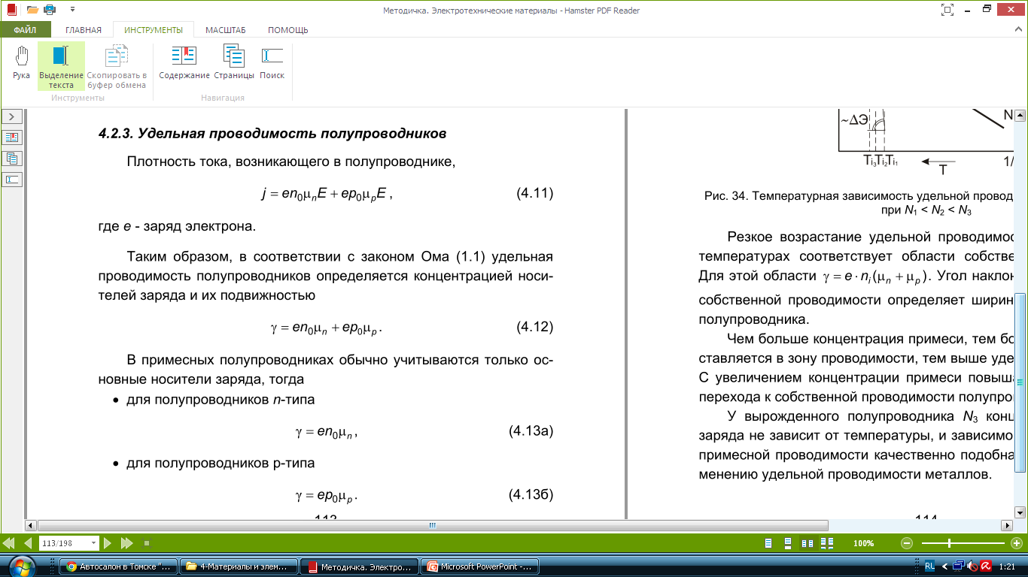
Specific conductivity of semiconductors
The current density in the semiconductor
Thus, in accordance with Ohm's law, it is determined by the conductivity of the semiconductor carrier concentration and its mobility
In impurity semiconductors are generally recorded only the basic charge carriers, then
- for n-type semiconductors
- for p-type semiconductors

Slide 29
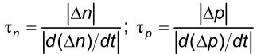
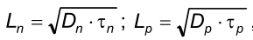
Main characteristics of the recombination process:
• lifetime of nonequilibrium charge carriers (is the ratio of the excess of the nonequilibrium charge carriers (Δn, Δp) to the rate of change of this concentration during the recombination),
• diffusion length (the distance that the nonequilibrium charge carriers to diffuse during the lifetime).

Slide 30
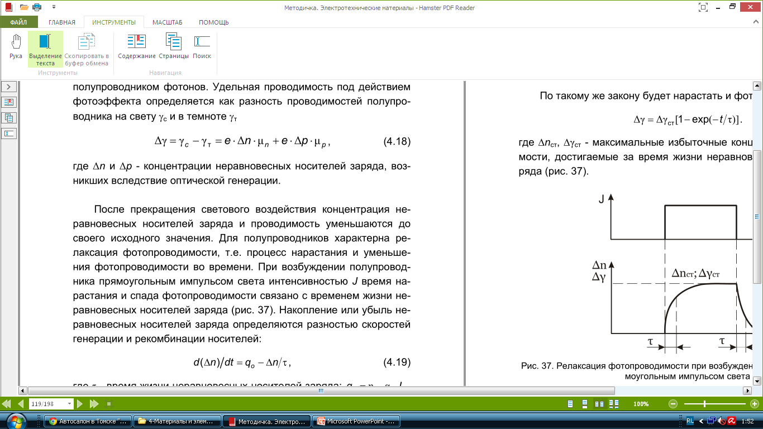
Photoconductivity (photoconductive effect) - a change in the electrical conductivity under the influence of electromagnetic radiation.
Photoconductivity can occur only when the semiconductor absorption of photons. Specific conductivity under the influence of the photoelectric effect is defined as the difference between the conductivity of semiconductors in the light Ɣ_{c} and in the dark Ɣ_{t}:

Slide 31
Thermoelectric phenomena
Seebeck effect (consists in the appearance of an electromotive force in an electrical circuit consisting of series-connected dissimilar materials, if the contact temperatures are different).
Peltier effect (consists in cooling or heating the contact of two materials when a direct current flows through it).
Thomson effect (consists in the release or absorption of heat, in addition to the Joule-Lenz heat, when a direct current flows through a homogeneous semiconductor in which there is a temperature gradient).
Hall effect (If a semiconductor (or conductor), along which an electric current flows, is placed in a magnetic field perpendicular to the direction of the current, then a transverse electric field perpendicular to the current and the magnetic field arises in the material).

Slide 32
Lecture 5. Section 4.
The use of dielectric materials in the biomedical practice
Select a number of basic groups of dielectric materials used in medical and biological practice:
• synthetic resins (plastics, polymers),
• elastomers,
• fibrous materials,
• laminated plastics,
• glass,
• ceramics.

Slide 33
Electrical conductivity of dielectrics
The main properties that determine the use of dielectrics in biotechnical equipment are their insulating qualities, as well as the ability to create an electric capacity due to the existence of an internal electric field, i.e. polarization.
To perform the function of electrical insulation, dialectic materials must prevent the passage of electric current by paths that are not desirable for the operation of the device. From this point of view, the main characteristic of dielectrics is the value of the specific conductivity or resistivity.

Slide 34
A feature of the electrical conductivity of solid dielectrics is that, because of their high specific resistance, the current through the volume of the dielectric Iv is comparable to the current over the surface Is, so the total insulation current is equal to
I = I_{v} + I_{S}.
The second characteristic feature of the electrical conductivity of dielectrics is a gradual decrease in the current with time after switching on the constant voltage. Over time, the current reaches a certain constant value, called the through-conductivity current (I_{thr}), whose magnitude is determined by the presence of free charge carriers in the dielectric. The part of the current that decreases with time is called the absorption current (I_{abs}) due to the presence of delayed polarization in the dielectric.

Slide 35
Polarization of dielectrics
The electric polarization under the action of the field is manifested in the limited elastic displacement of the bound charges, the orientation of the dipole molecules, as a result of which a certain volume or surface of the dielectric acquires an electric moment. After the removal of the electric field, the associated charges return to their original state.

Slide 36
Dielectrics are divided into two classes: polar and nonpolar. In molecules of nonpolar substances, the centers of gravity of the total positive and negative charges coincide. The molecules of polar materials have the form of electric dipoles, capable of orienting themselves in an electric field.
All types of polarization are divided into two groups: instantaneous and relaxation. Instantaneous polarization (electronic, ionic) occurs with virtually no loss of energy. Delayed polarization (electron, ion, dipole-relaxation, structural, spontaneous) is accompanied by losses of electrical energy.

Slide 37
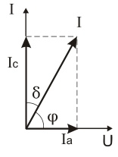
Dielectric losses
Dielectric losses are the power of an electric current that is dissipated in a dielectric in the form of heat. Numerically, the dielectric losses are characterized by the tangent of the dielectric loss angle tgδ, where δ is the angle complementing up to 90 ° the phase shift angle φ between the current and voltage vectors in the circuit with the capacitance (δ = 90° - φ).
Types of dielectric losses:
• losses from through conductivity (on electrical conductivity);
• relaxation;
• ionization;
• resonant.

Slide 38
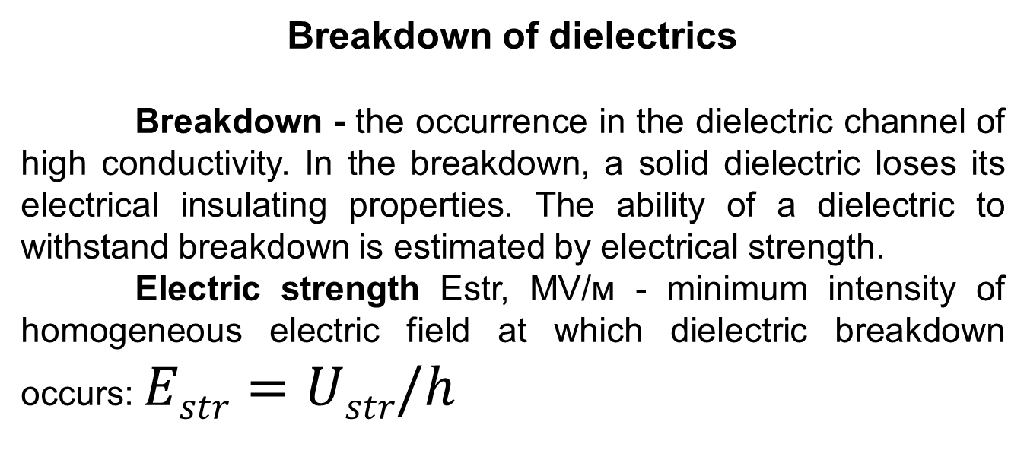
Breakdown of dielectrics
Breakdown - the occurrence in the dielectric channel of high conductivity. In the breakdown, a solid dielectric loses its electrical insulating properties. The ability of a dielectric to withstand breakdown is estimated by electrical strength.
Electric strength Еstr, МV/м - minimum intensity of homogeneous electric field at which dielectric breakdown occurs: $Estr=Ustr/h$

Slide 39
Types of breakdown of dielectrics:
• The electrical breakdown is due to the phenomena of shock ionization and photoionization.
• Thermal breakdown is caused by excessive heat generation due to large dielectric losses.
• Electrochemical breakdown is caused by the development in the dielectric of chemical processes leading to the formation of mobile ions.
Dielectric materials for different purposes
1 - Plastics
2 - Elastomers
3 - Fiber-based and laminated materials
4 - Glass and ceramics

Slide 40
Lecture 6. Section 5.
The properties of living tissues
A living organism is different from inanimate matter replication property (reproductive function), the presence of metabolism and complex hierarchical organization with strong reciprocal relationships between all internal components. So in the body as autonomous system, local changes, in varying degrees, affect, at first glance, not associated with the local exposure of organs or systems of the bodies.

Slide 41
Mechanical properties of biological tissues and fluids
Biological tissue is a system of cells and intercellular structures, united by a common function, structure, and origin. It is a complex compositional structure with anisotropic properties that are different from the properties of individual components and depend on the function of the fabric.
Organ — is the part of the body, which is formed evolutionarily complex tissues, united by a common function of structural organization and development.
One relatively basic subsystems in the hierarchy of systems that make up a living organism - cell. It consists of two main parts — the nucleus and cytoplasm surrounded by thin-walled membrane. The cell is capable of independent existence, self-renewal and development.

Slide 42
The basis of biological tissues is collagen, elastin and binder. Elastin is a protein, the typical elastic elastomer capable of strong tension (allow deformation up to 200-300%), has a pronounced nonlinear mechanical behavior of variable elasticity module of 1·10⁵ to 6·10⁵ PA. Pure collagen is a fibrous protein group — is stretched less elastin (limit deformation up to 10%) and also detects non-linear properties. Its modulus of elasticity reaches values from 1·10⁷ to 1·10⁸ PA. Collagen serves as a major component of tendons, ligaments and the dermis.
All parts and human bodies decayed, if were not bound by connective tissue.

Slide 43
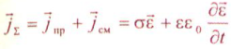
Classification of composite physical and chemical environments (living organisms) on
the nature of the electrical conductivity
Full current I∑ in the complex environment, consisting of conductors and dielectrics, calculates of current conduction (I_{con}) prospect and current bias I_{b}.

Slide 44
Thus, the conduction current density is a function of the absolute value of the tension of the electrical field and current density Ɛ offset is a function of the rate of change of the vector, i.e., the frequency of the field. Therefore, an object placed in a constant field, there are only current conduction, and the more, the more the field strength. The displacement current density in a constant field is zero.
If the complex physico-chemical environment affects a variable electromagnetic field, it will occur simultaneously and conduction current and displacement current. The frequency of an external field does not affect the amount of current conduction, but with increasing frequency increases current offset.

Slide 45
Conducting media includes media (objects) for which j_{con}/j_{b}>100, to dielectric - medium in which j_{con}/j_{b}<100. As the criterion for conducting properties of real media, the tangent of the dielectric loss angle is indicated: tgδ=σ/(ƐƐ_{o}ω)
It is important to bear in mind that one and the same substance (medium) placed in electromagnetic fields of different frequencies may possess the properties of either a conductor or a dielectric.
When exposed to electromagnetic radiation on the human body, the bias current begins to predominate over the conduction current at ultrasound frequencies exceeding 30 MHz. Therefore, when performing ultra-high frequency therapy (f=40.68 MHz), the therapeutic effect is mainly due to the effect of the bias current.

Slide 46
Lecture 7.
Features electrical conductivity of living tissue
Electrical conductivity of organs and tissues is connected with the presence in them of ions, which are free of charges, creating the current conduction in the organism under the influence of electromagnetic fields, as created by external sources, and generated by living cells.
Electrical conductivity of living tissue is determined primarily by the electrical properties of blood, lymph, interstitial fluid and the cytosol contains large amounts of water, as the electrical conductivity of the water is much higher than other parts of the body.

Slide 47
Mobility of ions in biological fluids has approximately the same amount as in the solutions of the corresponding salts, prepared on the basis of distilled water. DC is distributed in the body environment the path of least resistance: on intercellular spaces, blood and lymphatic vessels.
However, the electrical conductivity of the specific internal organs at 4-6 orders of magnitude below the electrical conductivity of liquids extracted from them. The reason specified are low-volume, present free electrolytes in organs and tissues of living organisms.

Slide 48
Living tissues are characterized by the dependence of electrical conductivity on the frequency of the electromagnetic field, i.e, the dispersion of electrical conductivity. Dispersion of any physical parameter is its frequency dependence. As the frequency increases, the electrical conductivity of the tissues increases. Dispersion of electrical conductivity is particularly pronounced in the low-frequency range.

Slide 49
Dielectric properties of live tissues
When the electric field interacts with the body tissues, biophysical changes take place in them: linear or pendular movement of ions, orientation of dipole molecules or their rotation around their axis, increase of conduction currents and mixing currents. There are losses of through conductivity and polarization losses. In the conductor tissues, the losses associated with the through conductivity predominate. In tissue-dielectrics, the losses associated with various types of polarization predominate. The loss of electrical energy in tissues depends on the dielectric properties and temperature, as well as on the frequency of the alternating current or electromagnetic field. The dielectric properties of living tissues are due to the presence of water (ε~​​81) and macromolecules dissolved in it, as well as the compartmentalization of cellular structures.

Slide 50
Magnetic properties of biological objects
The magnetic properties of biological objects are characterized by a fairly low value of the magnetic permeability μ close to unity. This is explained by the fact that the main components of biological media - proteins, carbohydrates, lipids, water, phosphorus, sulfur, carbon - belong to diamagnetics. However, in paramagnets (oxygen, alkali and alkaline earth elements, some other metals and oxides), the common magnetic moments of atoms and molecules are mutually compensated, since they are randomly oriented.

Slide 51
In living nature, there are unique representatives possessing ultrastructures with ferromagnetic properties. For example, one of the simplest organisms spirella is able to synthesize ferritin and accumulate it in specialized organelles - magnetosomes.
In humans, ferritin-containing inclusions in the adrenal glands and blood have also been found. The inhomogeneity of the magnetic susceptibility, together with the biocurrents (bioionts) that flow inside the organism during its vital activity, is the main source of biomagnetic fields.

Slide 52
Stability of functional properties of materials
The change in the mechanical, physical and chemical properties of materials under the influence of living body environments, on the one hand, is one of the important aspects of the problem of biocompatibility, on the other hand, the problems of reliable performance of the required functions.
The difficulty lies in the fact that most materials and devices were introduced into medical practice by trial and error. And at present there is no acceptable system of criteria that would make it possible to unequivocally decide on the suitability of a material for use. Little is known about the conditions in which the material is located inside a living organism.

Slide 53
Corrosion of metals
Most metals in an aggressive environment are more or less susceptible to corrosion. It is now very difficult to determine the reaction of fabrics to the material. It is even more difficult to identify the reaction to corrosion products, as well as the degree of damage to the material or device.
It has been histologically established that metals penetrate into tissues from the implant and are absorbed by the cells. On the other hand, the presence of metal in the tissues does not mean that it is an implant metal.
The material of some metal implants tends to dissolve in the body. Dangerous consequences for the body can often occur cracking corrosion of metals.

Slide 54
Lecture 8. Section 6.
Materials for interstitial prosthetics
Basic material requirements
The creation of endoprostheses is a new field both in the science of biomedical materials and in medicine. The purpose of man's artificial organs is by no means limited to the replacement of natural, living organs, that is, the sphere of radical therapy, but opens up a fundamentally new methodological area of ​​fundamental medicine based on imitation-analog modeling of body functions.
Special materials are applied to the materials used for interstitial prosthetics. The main of them can be divided into three groups: 1) biological, 2) physico-mechanical, 3) technological.
These requirements are interrelated and should be considered inseparable from each other.

Slide 55
Biological inertness of the material is an indispensable condition for its suitability for endoprosthetics. Implants should be biologically compatible with the contacting tissues and physiologically indifferent to the body as a whole.
The stability of the physico-mechanical characteristics of the material after a long stay in the medium of a living organism indicates its high resistance to bio-aging.
Surgical implants undergo significant bending, tensile, compressive, twisting and abrading loads. Endoprostheses can fail due to corrosion, deformation or fracture under the influence of mechanical loads; the implant may be rejected by a biological tissue.

Slide 56
Membranes for regulating the composition
of biological fluids
In artificial systems, the transfer of matter by diffusion is common: from a higher concentration to a lower concentration, from a high energy region to a low region. This process is called passive transfer. In living organisms quite often there is an opposite picture, i.e., a transfer, called active.
There are two types of membranes:
- Membranes for dialysis and hemolysis,
- Membranes for oxygenation.

Slide 57
Blood-substituting fluids, or blood substitutes, plasma substitutes, blood substitution solutions, plasma-substituting solutions, hemocorrectors are the means used for the necessary time for therapeutic purposes as blood substitutes or correctors. Blood-substituting fluids are used for transfusion therapy in various pathological conditions; they are administered intravenously, intraarterially, intraosseously, sometimes subcutaneously through the probe into the gastrointestinal tract.

Slide 58
The blood substitutes used are divided into six groups:
1) hemodynamic (anti-shock) - to treat shock of various origins and normalize hemodynamic disorders;
2) detoxification - for the treatment of intoxications;
3) preparations for parenteral nutrition - the introduction of substances into the body, bypassing the digestive tract;
4) regulators of water-salt and acid-alkaline equilibrium:
5) blood substitutes with oxygen transfer function;
6) multifunctional blood substitutes for complex action.

Slide 59
Biodestructive endoprostheses
Materials for biodegradable endoprostheses should be destroyed in the body at a given time, while retaining the ability to perform a specific function. To regulate the timing of destruction of polymers intended for the manufacture of implants, there are a number of methods:
1. Introduction into the main polymer chain of readily hydrolyzable groups.
2. Introduction into the main chain of fragments subjected to enzymatic cleavage. Such enzymes can be di- and tripeptides, which convert the polymer into a kind of substrate for certain enzymes.
3. Increasing the contact surface of the implant with tissues and body fluids (creating a fine-porous material) accelerates the process of hydrolysis and leads to an earlier manifestation of the cellular mechanism of biodegradation.

Slide 60
Concluding remarks
Materials science in the field of biomedical engineering is a relatively young branch of science. Its intensive development is conditioned by the development and study of the most functional and safe materials that contribute to the improvement of health and human life.
The further development of biomedical materials science will lead to a deeper understanding of existing scientific problems in this field, as well as to more substantiated use of various materials in biomedical engineering.

