Slide 1


RUSSIAN LAW
Lecture 1.
Lecture with elements of seminar:
Theory of law. Introduction to Russian Law
Ilya Alexandrovich Ageev
Tomsk Polytechnic University
School of Core Engineering Education
Division for Social Sciences and Humanities
agilalex@tpu.ru

Slide 2

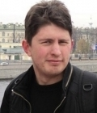

Professional Background
Ilya Alexandrovich Ageev
Associate professor, PhD in History
Courses
o Law
o Political science
Research
o Urban studies
o Transport history

Slide 3
Information about the course
“Russian law”
Study time allocation | 36 contact hours = 18 lectures with elements of seminars.
Credit points | 2 or 3
Semester | 2
Assessment method | Pass/fail exam
Mode of study | full-time attendance

Slide 4
RUSSIAN LAW
Course overview
The course is aimed at the formation of students' comprehensive understanding of the systemic foundations of Russian state and law, which allows feeling confident in the legal system of the Russian Federation and regulations governing the future professional activity of technical focus.
Keywords
law, state, legal regulations, constitutional system, civil rights.
Aims
to follow the legal regulations, to use the legal documents, to understand legal regulation of state secrets;
to use in-depth knowledge of legal and ethical norms during drafting and implementation of large-scale and socially significant projects, the evaluation of professional results;
to use legal documents in professional activities;
to develop and implement regulatory documents related to the conduction of professional activities.

Slide 5
RUSSIAN LAW
Knowledge and Understanding
Students will be able to demonstrate knowledge and understanding of:
Transferable and Generic
Students will be able to:
Subject Specific Practical
Take into account the current legal norms when designing optimal solutions
communicate effectively
Current legal norms and restrictions related to engineering activities
study and learn independently,
Students will be able to:
Use reference electronic resources to search for and determine current editions of legal norms

Slide 6
Information support of the course
Personal Web-Page in English and Russian
http://portal.tpu.ru/SHARED/a/AGILALEX/eng http://portal.tpu.ru/SHARED/a/AGILALEX

Slide 7
What are the main purposes of law studies?
question:

Slide 8
question:
What does it mean the term “legal system”?
What types of legal system do You know?

Slide 9
Legal systems in the World
Civil law (roman-german legal system)
English and American legal system
Religious legal systems
(Sharia, Halakha, Hindu law)
Socialist law (China, Vietnam)
Common (traditional ) law system

Slide 10
What type of legal system is a basis of Russian law?

Slide 11
…Roman-Germanic law system

Slide 12
The main law source in Roman-Germanic system is legislative act / legal authority

Slide 13
Sources of law:
Legislation (normative legal act )
Case (Precedent)
Customary law (custom)
Religious text
Contract

Slide 14
Match the sources and legal systems:
Civil law (roman-german legal system)
English and American legal system
Religious legal systems
(Sharia, Halakha, Hindu law)
Common (traditional ) law system
Legislation (Statements)
Case (Precedent)
Custom
Religious text
Contract

Slide 15
Is it possible to be a state without law system?
Is it possible to be law system without a state?

Slide 16
What are the key features of a state?

Slide 17
Key features of a state
Public power
Tax system
Territory
Law
Religion, culture, language
Protected borders

Slide 18
What forms of governance do you know?

Slide 19
What form of government does exist in modern Russia?

Slide 20
In Russia is established a mixed republic
The government is subject to both the parliament and the president
The president and the parliament restrain each other's power

Slide 21
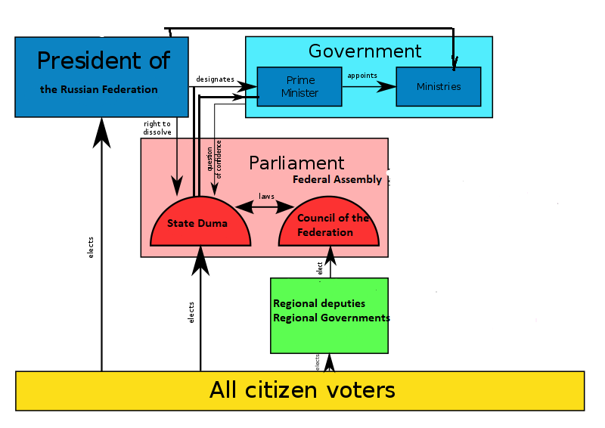

Slide 22
What is the term of office of the Russian president?

Slide 23
How many times can the president of Russia be re-elected?

Slide 24
What does it mean “the separation of powers”?

Slide 25
What branches of power do exist in modern Russia?

Slide 26
Theory of Law
Features of law
Principles of law
Branches of law

Slide 27

THANK
FOR YOUR
ATTENTION!
Ilya A. Ageev
Division for Social Sciences and Humanities
agilalex@tpu.ru

