Slide 1


National Research
Tomsk Polytechnic University
International Academic Summer School on Well-being
«UniverCiTerra» 2015
19.07. - 08.08. 2015
Institute of Humanities, Social Sciences & Technologies

Slide 2

Organizers:
Ministry of Education and Science of the Russian Federation
The Russian Government
National Research Tomsk Polytechnic University
Vienna University of Technology
Delft University of Technology
Tomsk State University of Architecture and Building
Siberian Resource Center of Tourism Industry
NPO “Tomsk Association of Tourism and Hospitality”

Slide 3
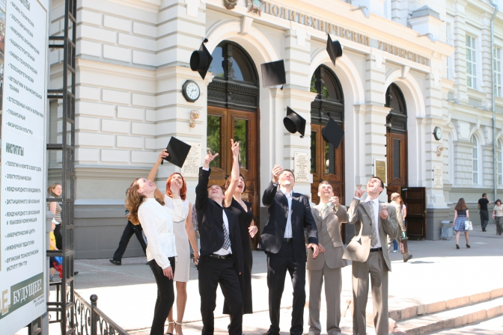
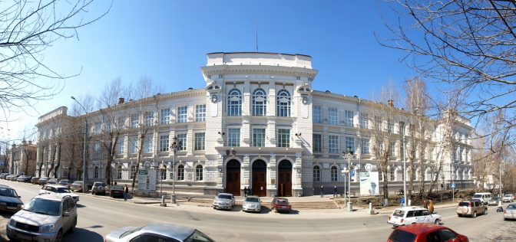
National Research Tomsk Polytechnic University

Slide 4
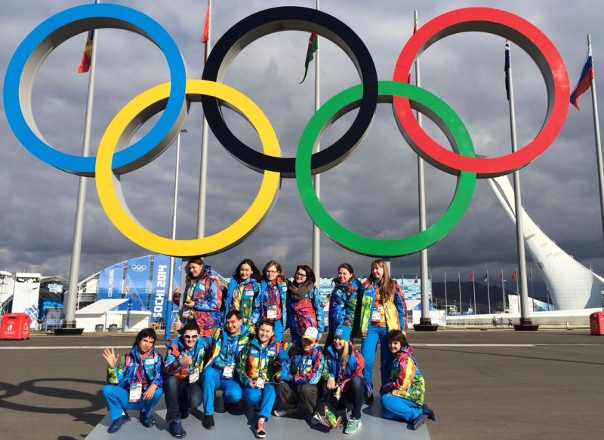
Institute of Humanities, Social Sciences and Technologies
11 departments
8 international laboratories and centers
Academic staff - Over 30 Professors
- Over 100 Associate Professors
- Over 100 PhD Students
Students - from Europe, Asia and Africa.

Slide 5
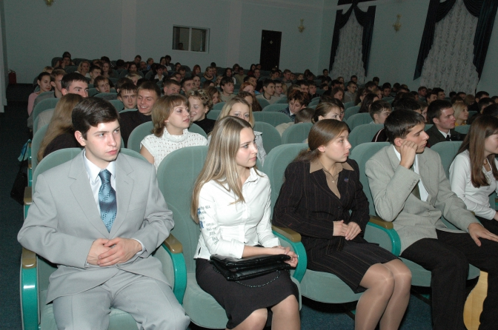
«UniverCiTerra» 2015: mission
To enable the opportunity to students from different countries to gain experience in dealing with complex challenges issued in modern society via intercultural dialogue

Slide 6
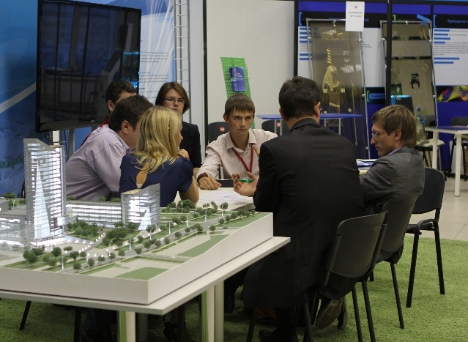
Aim - to define global risks of society wellbeing
Constructing strategies for sustainable urban development.
4. Designing wellbeing models
2. Constructing strategies for sustainability communication.
3. Designing friendly technologies

Slide 7
Modules:
Lifelong
Wellbeing
Rules, people, technologies
City Tourism: Smart and Sustainable
Rules, People, Technologies
Sustainability communication
Lifelong wellbeing.
Active aging. Sustainable development
City Tourism : Smart & Sustainable
Sustainability communication

Slide 8
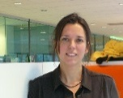
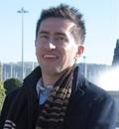
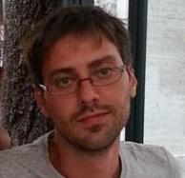

Lecturers:
1. Ellen van Bueren
Affiliations: Dr. E.M. van Bueren is Professor of Urban Development Management, the Delft University of Technology, the Netherlands
Research interests: Urban sustainability, policy design and evaluation, multi-actor decision-making, process management, gaming and simulation
2. Fabio Casati
Affiliations: Fabio Casati is professor of Computer Science at the University of Trento, Italy
Research interests: Engineering and computer information, social informatics (or informatics at the service of the community), web services and business process management
3. Daniele Didino
Affiliations: Post-doc, Tomsk Polytechnic University, Russia
Research interests: Subjective well-being, numerical cognition, numerosity processing, experimental psychology
4. Marcello M. Mariani
Affiliations: Marcello M. Mariani is Professor of Management and Marketing, the University of Bologna, Italy
Research interests: Destination marketing & management, digital marketing, public-private partnerships, cultural heritage, business models in creative industries

Slide 9

Participants
Students from world leading universities and research centers

Slide 10
Requirements for participants:
International students under the age of 35
2. Fluent English
3. A letter of reference from scientific supervisor or professor
4. A motivation essay
5. A valid passport at least six months beyond the dates of the trip

Slide 11
Summer School Grant
Every student has a chance to win a scholarship
2. This scholarship covers travel expenses and accommodation
3. The number of scholarships is limited - only 50
website: www.uct2015.tpu.ru

Slide 12
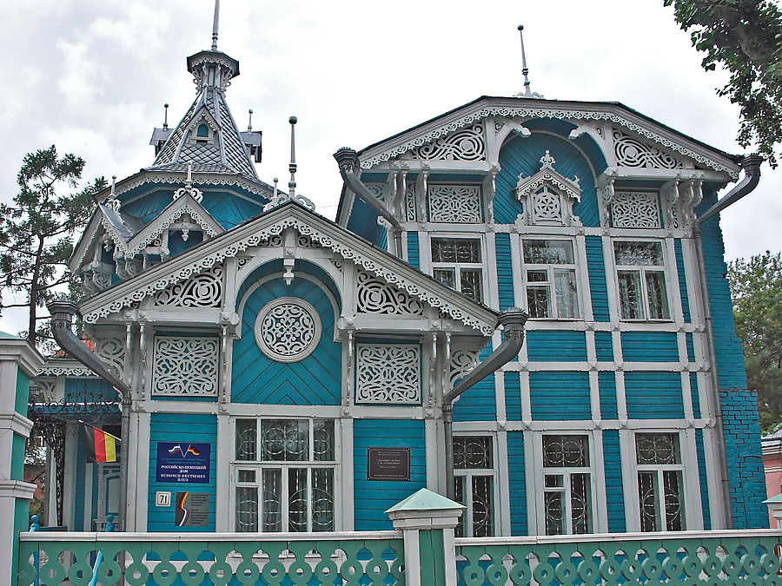
Wooden Architecture of Tomsk
During participation in the Summer School
you’ll receive 3 credits in total,
and can participate in sports events
and fantastic excursions!
Every student will get a participant’s
pack for studying.

Slide 13
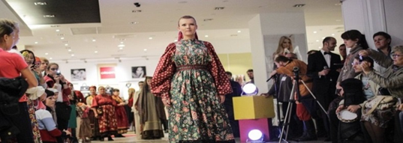
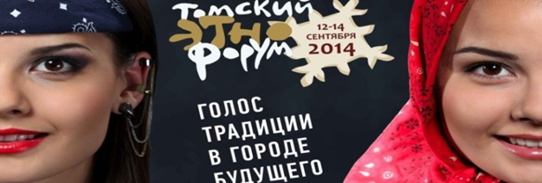

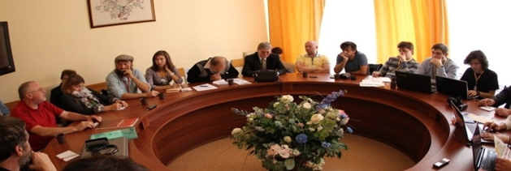
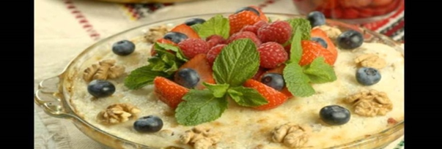
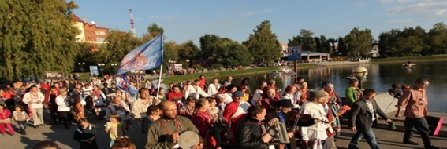
Cultural events

Slide 14


 | INSTITUTE of HUMANITIES SOCIAL SCIENCES & TECHNOLOGIES
www.uct2015.tpu.ru

