Slide 1
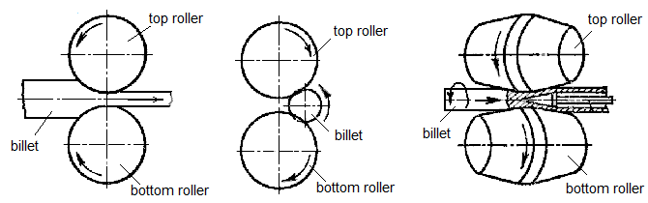
ROLLING
Rolling is a method of metal forming when a metal billet is plastically deformed between the rotating rollers. In this case friction forces between rollers and the billet pull the last into the roll space, and normal forces perpendicular to the roller surface produce deformation of the billet.
a b c
Schemes of rolling:
а – longitudinal; b – cross; c – helical

Slide 2
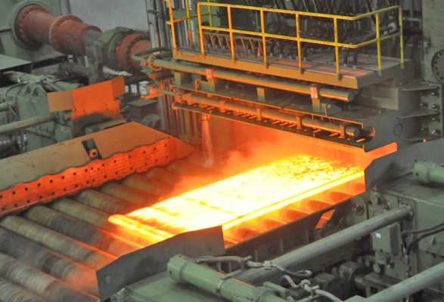
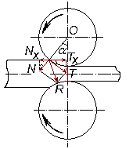
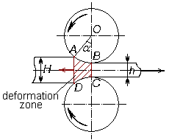
ROLLING
Sheet rolling mill
T∙cosα > N∙sinα;
friction force T = N∙k_{fr}, therefore
N∙k_{fr}∙cos α > N∙sin α;
k_{fr} > tg α.
Rolling deformation zone
Condition of roller bite of metal: the coefficient of friction between the rollers
and a billet should be higher than tangent of the angle of nip.

Slide 3
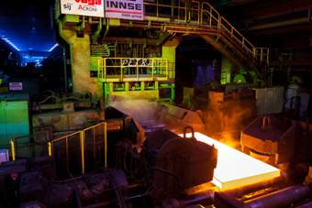
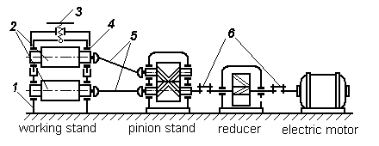
ROLLING
Slabbing is a primary rolling mill for making slabs – plates 2000×20 mm
Single-stand rolling mill:
1 – mill housing; 2 – rollers; 3 – screw-down structure; 4 – bearings;
5 – spindles; 6 – clutches

Slide 4

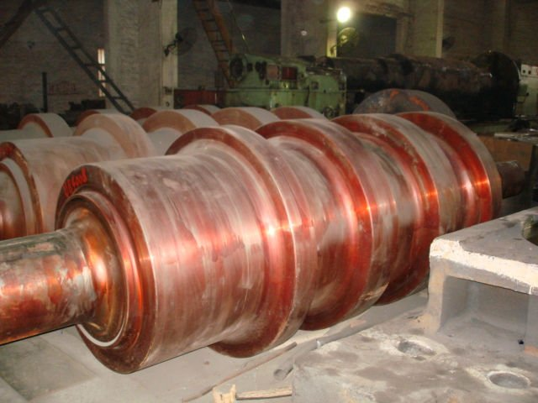
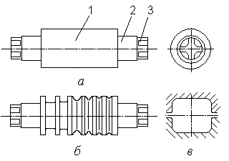
ROLLING
a b c d e f g h i j k
Sections of rolled metal – simple (а–f) and shaped (g–k):
а – circle; b – square; c – strip; d – hexagonal steel; e – oval; f – segmental steel; g – angle; h – channel; i – T-beam; j – I-beam; k – rail
b
b c
Rollers: flat (а) and grooved (b):
1 – body; 2 – roll neck; 3 – roll wobbler; c – pass

Slide 5
Methods of metal forming
Name | Place of deformation | Tool | Equipment | Billet | Heating | Deformation value | Products
Fabrication of shapes
Rolling | Roller opening | Rolls or rollers | Rolling mill | Ingot, bloom, slab, intermediate product | Hot deformation as a rule | µ ≤ 2 | Sections, sheets, pipes, special shapes
Drawing | Hole of drawing die | Drawing die | Drawing bench | Bar, pipe, hot-rolled wire | Cold deformation | µ ≤ 1,5 | Wire, gauged bars and pipes, shaped sections
Pressing | Matrix hole | Matrix, needle | Hydraulic press | Ingot, hot-rolled wire | Usually hot deformation | µ = 30÷50 | Simple and shaped sections, tools
Fabrication of billets and machine parts
Forging | Between heads | Heads, laid under tools | Hammers and presses | Ingot, bloom, sections of simple shape | Hot deformation | FR ≤ 20 | Wide range of forged pieces not over 300 t
Die forging | Die cavity | Die (stamp) | Hammers and presses, crank stamping press, upsetting machine | Sections of simple shape | Hot deformation more often | FR ≤ 2÷3 | Stamped pieces of series manufacture not over 3 t
Cold sheet-metal stamping | Gap between punch and matrix | Punch and matrix | Crank stamping press, hydraulic press | Sheet, strip, tipe | Cold deformation | - | Flat and volume parts having small mass and high strength

