Slide 1

Signal analysis
Lecture-7
Additional chapters of mathematics
Dmitriy Sergeevich Nikitin
Assistant
Tomsk Polytechnic University
email: NikitinDmSr@yandex.ru

Slide 2
Signal
In communication systems, signal processing, and electrical and information engineering, a signal is a function that conveys information about the behavior or attributes of some phenomenon. A signal may also be defined as an observable change in a quantifiable entity.
In the physical world, any quantity exhibiting variation in time or variation in space (such as an image) is potentially a signal that might provide information on the status of a physical system, or convey a message between observers, among other possibilities

Slide 3
Signal
In an electrical system, the physical variables of interest might be a voltage, current, amount of charge, etc. In a mechanical system, the variables of interest might be the position, velocity, mass, volume, etc. of various objects. Financial examples might include the price of a stock, commodity, or option, an interest rate, or an exchange rate.
In performing its tasks, the system may need to manipulate or combine various signals, extract information, or otherwise process the signals. These actions are called signal processing or signal analysis.

Slide 4
Signal as a function
A convenient abstraction is to model the value of a physical variable of interest by a number. We are usually interested in the physical variable not at just a single time, but rather at a set of times. In this case, the signal is a function of time, say f(t). For example, f(t) might denote a voltage level, or the velocity of an object, or the price of a stock at time t.
In some cases, we might be interested in measuring the quantity as a function of some variable other than time. For example, suppose we are interested in measuring the water temperature in the ocean as a function of depth. In this case, the signal is a function of a spatial variable, with f(x) denoting temperature at depth x.

Slide 5
Signal as a function
A signal need not be a function of just a single variable. To continue the example above, suppose we are interested in the temperature at particular points in the ocean, not simply as a function of depth. In this case, we might let f(x, y, z) denote the temperature at the point (x, y, z), so the signal is a function of three variables. Now, if we are also interested in how the temperature evolves in time, the signal f(x, y, z, t) would be a function of four variables.

Slide 6
Classification of signals
Continuous time – Discrete time
Analog – Digital (numerical)
Periodic – Aperiodic
Energy – Power
Deterministic – Random (probabilistic)
Note:
Such classes are not disjoint, so there are digital signals that are periodic of power type and others that are aperiodic of power type etc.
Any combination of single features from the different classes is possible.

Slide 7
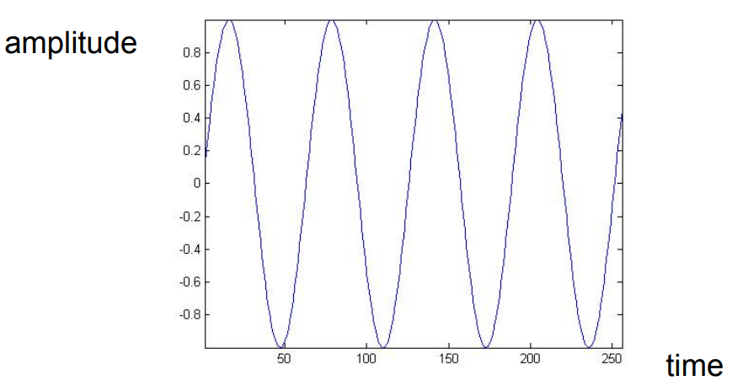
Continuous time signal
Continuous time signal is a signal that is specified for every real value of the independent variable.
– The independent variable is continuous, that is it takes any value on the real axis.
– The domain of the function representing the signal has the cardinality of real numbers:
Signal ↔ f = f(t)
Independent variable ↔ time (t), position (x)
For continuous-time signals: t ∈ R

Slide 8
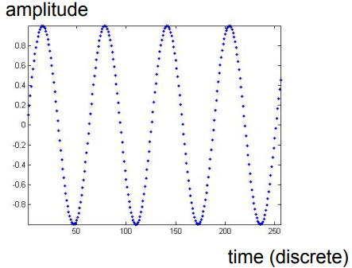
Discrete time signal
Discrete time signal: a signal that is specified only for discrete values of the independent variable.
– It is usually generated by sampling so it will only have values at equally spaced intervals along the time axis
– The domain of the function representing the signal has the cardinality of integer numbers
Signal ↔ f = f[n], also called “sequence”
Independent variable ↔ n
For discrete-time functions: t ∈ Z

Slide 9
Analog – Digital
Often the domain and the range of a signal f(x) are modeled as continuous. That is, the time (or spatial) coordinate x is allowed to take on arbitrary values (perhaps within some interval) and the value of the signal itself is allowed to take on arbitrary values (again within some interval). Such signals are called analog signals. A continuous model is convenient for some situations, but in other situations it is more convenient to work with digital signals – i.e., signals that have a discrete (often finite) domain and range.

Slide 10
Analog signal
Analog signal is a signal whose amplitude can take on any value in a continuous range. The amplitude of the function f(t) (or f(x)) has the cardinality of real numbers.
The difference between analog and digital is similar to the difference between continuous-time and discrete-time. In this case, however, the difference is with respect to the value of the function (y-axis). Analog corresponds to a continuous y-axis, while digital corresponds to a discrete y-axis.
An analog signal can be both continuous time and discrete time.

Slide 11
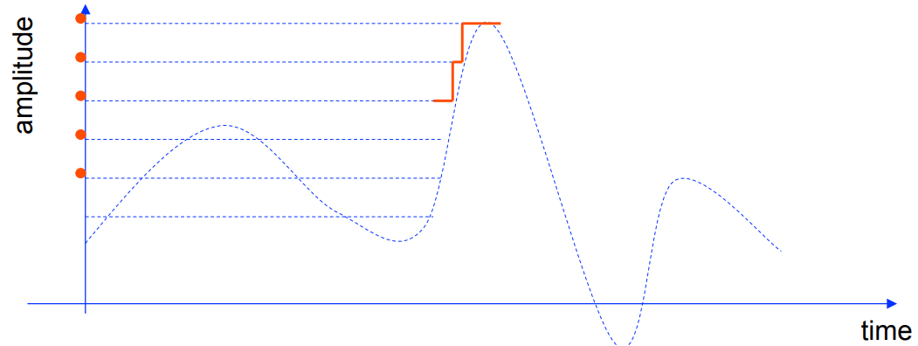
Digital signal
Digital signal is a signal is one whose amplitude can take on only a finite number of values (thus it is quantized). The amplitude of the function f(t) can take only a finite number of values. A digital signal whose amplitude can take only M different values is said to be M-ary.
Binary signals are a special case for M=2.

Slide 12
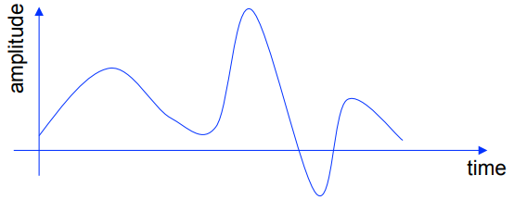
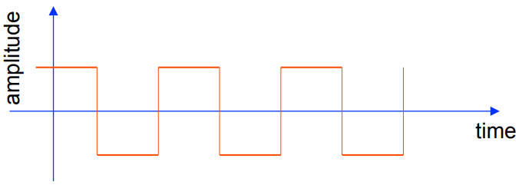
Examples
Continuous time analog
Continuous time digital (or quantized). Binary sequence, where the values of the function can only be one or zero.

Slide 13
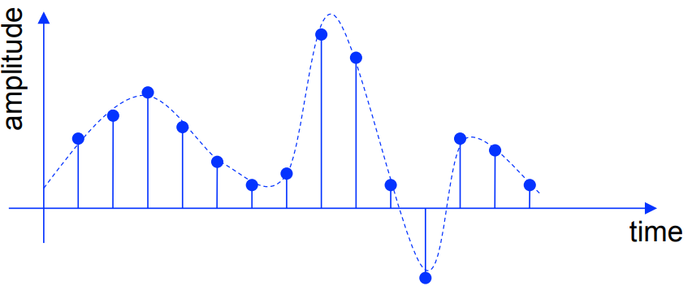
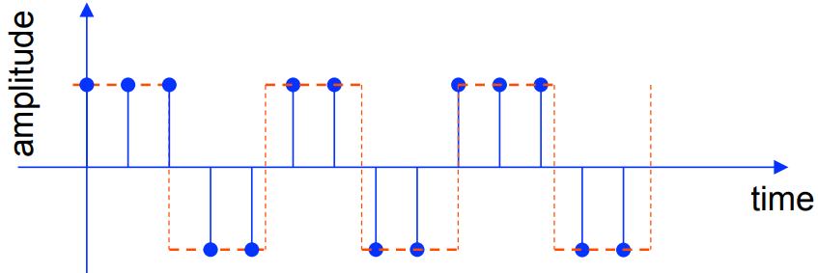
Examples
Discrete time analog
Discrete time digital. Binary sequence, where the values of the function can only be one or zero.

Slide 14
Sampling and quantization
Sometimes a signal that starts out as an analog signal needs to be digitized (i.e., converted to a digital signal). The process of digitizing the domain is called sampling. The process of digitizing the range is called quantization. In quantizing a signal, the value f(x) is only allowed to take on some discrete set of values (as opposed to the variable x taking on discrete values as in sampling).
Sampling and quantization to digitize a signal seem to throw away much information about a signal, and one might wonder why this is ever done. The main reason is that digital signals are easy to store and process with digital computers. Digital signals also have certain nice properties in terms of robustness to noise.

Slide 15
A/D and D/A conversion
However, there are also situations in which analog signals are more appropriate. As a result there is often a need for analog-to-digital conversion and digital-to-analog conversion (also written A/D and D/A conversion).
A fairly common notational convention: continuous-time signals will be denoted using parentheses, such as x(t), while discrete-time signals will use brackets such as x[n]. This convention also applies even if the independent variable represents something other than time.

Slide 16
Some Basic Signal Operations
In addition to the obvious operations of adding or multiplying two signals, and differentiating or integrating a signal, certain other simple operations are quite common in signal processing. The original signal is denoted by x(t).
The signal a + x(t) where a is some number is just adding a constant signal to x(t) and simply shifts the range (or amplitude) of the signal by the amount a. A somewhat different operation is obtained when one shifts the domain of the signal. Namely, the signal x(t − t₀) is a time-shift of the original signal x(t) by the amount t₀. It’s like a delayed version of the original signal.
For some signals, appropriate time-shifts can leave the signal unchanged. Formally, a signal is said to be periodic with period P if x(t − P) = x(t) for all t. That is, the signal simply repeats itself every P seconds.

Slide 17
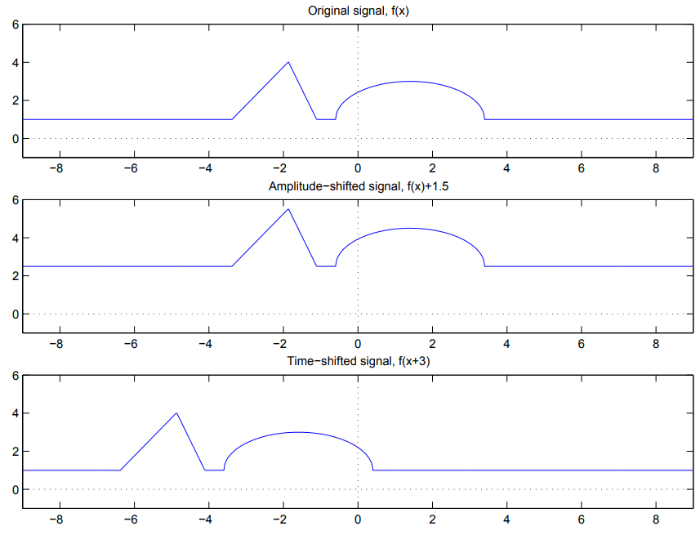
Some Basic Signal Operations

Slide 18
Some Basic Signal Operations
Amplitude scaling a signal to get ax(t) is simply multiplying x(t) with a constant signal a. However, a rather different operation is obtained when one scales the time domain. Namely, the signal x(at) is like the original signal, but with the time axis compressed or stretched (depending on whether a > 1 or a < 1). For negative values of a, the signal is “flipped” (or “reflected”) about the range axis, in addition to any compression or stretching.

Slide 19
Some Basic Signal Operations
For some functions, the reflection about the range axis leaves the function unchanged, that is, the signal is symmetric about the range axis. Formally, the property required for this is x(−t) = x(t) for all t. Such functions are called even. A related notion is that of an odd function, for which x(−t) = −x(t). These functions are said to be symmetric about the origin, meaning that they remain unchanged if they are first reflected about the range axis and then reflected about the domain axis.
The signal x(y(t)) is called the composition of the two functions x(·) and y(·). For each t, it denotes the operation of taking the value y(t) and evaluating x(·) at the time y(t). Of course, we can get a very different result if we reverse the order and consider y(x(t)). One other operation that is extremely useful is known as convolution.

Slide 20
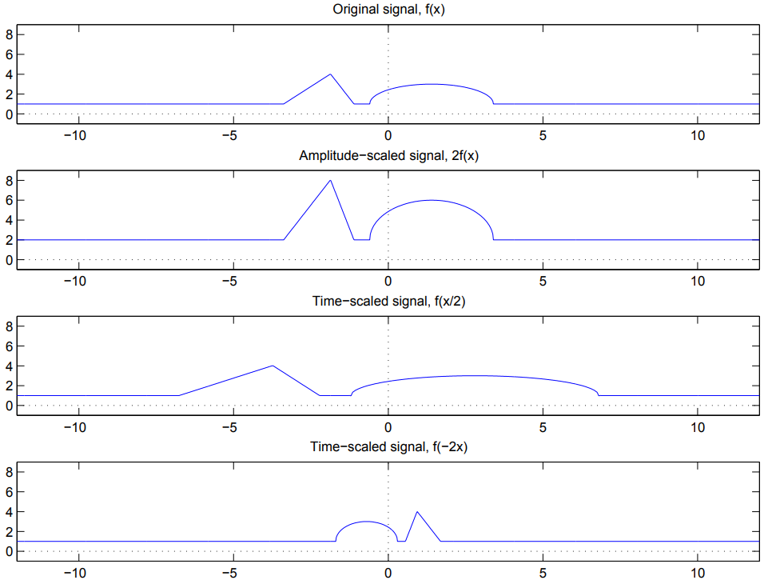
Some Basic Signal Operations

Slide 21
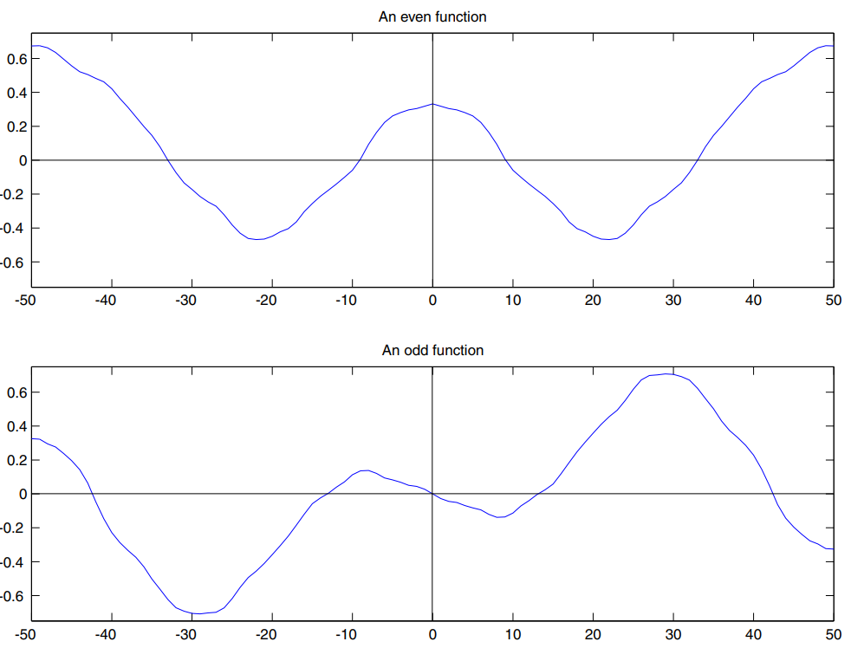
Some Basic Signal Operations

Slide 22
Noise
In many applications desired signals are subject to various types of degradations. These degradations can arise from a variety of sources such as limitations of the sensing device, random and/or unmodeled fluctuations of underlying physical processes, or environmental conditions during sensing, transmission, reception, or storage of the data. The term noise is typically used to describe a wide range of degradations. It is often useful to try and model certain properties of the noise. One widely used model is to assume that the original (desired) signal is corrupted by additive noise, that is, by adding another unwanted signal. Of course, if we knew the noise signal that was added, we could simply subtract it off to get back the original signal, and the noise would no longer be an issue. Unfortunately, we usually do not have such detailed knowledge of the noise signal.

Slide 23
Noise
More realistically, we might know (or assume) that the noise satisfies certain properties without knowing the exact values of the noise signal itself. It is very common to model the noise as random, and assume that we know something about the distribution of the noise. For example, we might assume that the noise is randomly (uniformly) distributed over some interval, or that it has a Gaussian (normal) distribution with a known mean and variance. Robustness to effects of noise can be a major design consideration for certain systems. This can be one reason why for many applications a digital system might be preferred over an analog one.

Slide 24
Some Common Signals
Perhaps the most basic and frequently used signal is a sinusoid defined by
x(t) = A sin(ωt)
Here A is the amplitude, and ω is the radian frequency. The units of ω are radians/sec so that when multiplied by time t (in sec) we get radians. An equivalent form for the sinusoid that is often used is
x(t) = A sin(2πft).
The frequency f is in units of Hertz (abbreviated Hz) which is sec⁻¹, or often called cycles per second. Of course, f and ω are related by ω = 2πf. Also, it’s clear that since
sin(θ + π/2) = cos θ, we could have equivalently written the sinusoid as
x(t) = A cos(2πf t − π/2).

Slide 25
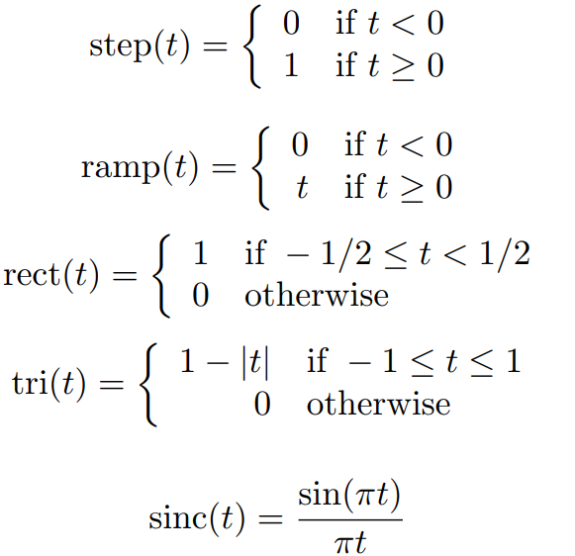
Some Common Signals
Some other signals that we will use on occasion and therefore give special symbols to are the step function, ramp, square wave, triangle wave, and the sinc function (pronounced like “sink”). These signals are defined by

Slide 26
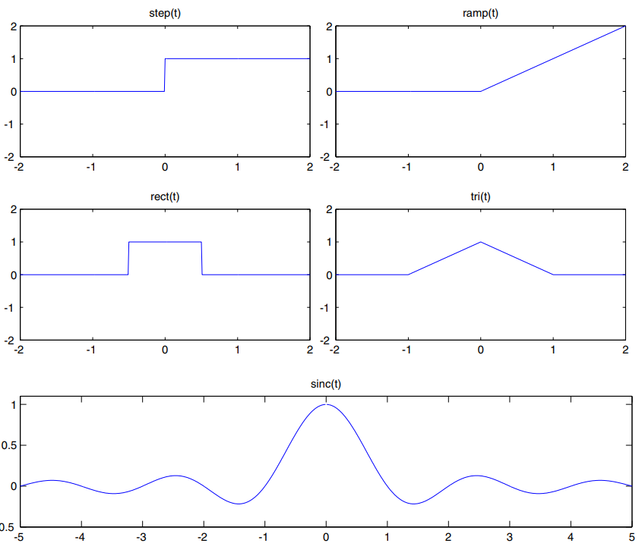
Some Common Signals
(a) Step function. (b) Ramp function. (c) Rectangle function.
(d) Triangle function. (e) Sinc function

Slide 27
End of Lecture-7

