Slide 1

Regression
Lecture-5
Additional chapters of mathematics
Dmitriy Sergeevich Nikitin
Assistant
Tomsk Polytechnic University
email: NikitinDmSr@yandex.ru

Slide 2
Pairs of values
So far we were concerned with random experiments in which we observed a single quantity (random variable) and got samples whose values were single numbers. In this section we discuss experiments in which we observe or measure two quantities simultaneously, so that we get samples of pairs of values (x₁, y₁), (x₂, y₂), …, (x_{n}, y_{n}). Most applications involve one of two kinds of experiments, as follows.

Slide 3
Regression analysis
In regression analysis one of the two variables, call it x, can be regarded as an ordinary variable because we can measure it without substantial error or we can even give it values we want. x is called the independent variable, or sometimes the controlled variable because we can control it (set it at values we choose). The other variable, Y, is a random variable, and we are interested in the dependence of Y on x. Typical examples are the dependence of the blood pressure Y on the age x of a person or, as we shall now say, the regression of Y on x, the regression of the gain of weight Y of certain animals on the daily ration of food x, the regression of the heat conductivity Y of cork on the specific weight x of the cork, etc.

Slide 4
Correlation analysis
In correlation analysis both quantities are random variables and we are interested in relations between them. Examples are the relation (one says “correlation”) between wear X and wear Y of the front tires of cars, between grades X and Y of students in mathematics and in physics, respectively, between the hardness X of steel plates in the center and the hardness Y near the edges of the plates, etc.

Slide 5
Regression analysis
In regression analysis the dependence of Y on x is a dependence of the mean μ of Y on x, so that μ = μ(x) is a function in the ordinary sense. The curve of μ(x) is called the regression curve of Y on x. In this section we discuss the simplest case, namely, that of a straight regression line
μ(x) = k₀ + k₁x. (1)
Then we may want to graph the sample values as n points in the xY-plane, fit a straight line through them, and use it for estimating μ(x) at values of x that interest us, so that we know what values of Y we can expect for those x. Fitting that line by eye would not be good because it would be subjective; that is, different persons’ results would come out differently, particularly if the points are scattered. So we need a mathematical method that gives a unique result depending only on the n points.

Slide 6
Least Squares Principle
A widely used procedure is the method of least squares by Gauss and Legendre. For our task we may formulate it as follows.
The straight line should be fitted through the given points so that the sum of the squares of the distances of those points from the straight line is minimum, where the distance is measured in the vertical direction (the y-direction).
General Assumption (A1)
The x-values x₁, x₂, …, x_{n} in our sample (x₁, y₁), (x₂, y₂), …,
(x_{n}, y_{n}) are not all equal.

Slide 7
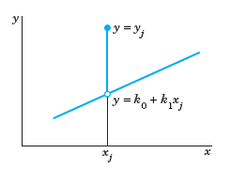
Least Squares Principle
From a given sample (x₁, y₁), (x₂, y₂), …, (x_{n}, y_{n}) we will now determine a straight line by least squares. We write the line as
y = k₀ + k₁x (2)
and call it the sample regression line because it will be the counterpart of the population regression line (1).
Now a sample point (x_{j}, y_{j}) has the vertical distance (distance measured in the y-direction) from (2) given by
|y_{j} – (k₀ + k₁x_{j})|
Vertical distance of a point (x_{j}, y_{j}) from
a straight line y = k₀ + k₁x

Slide 8
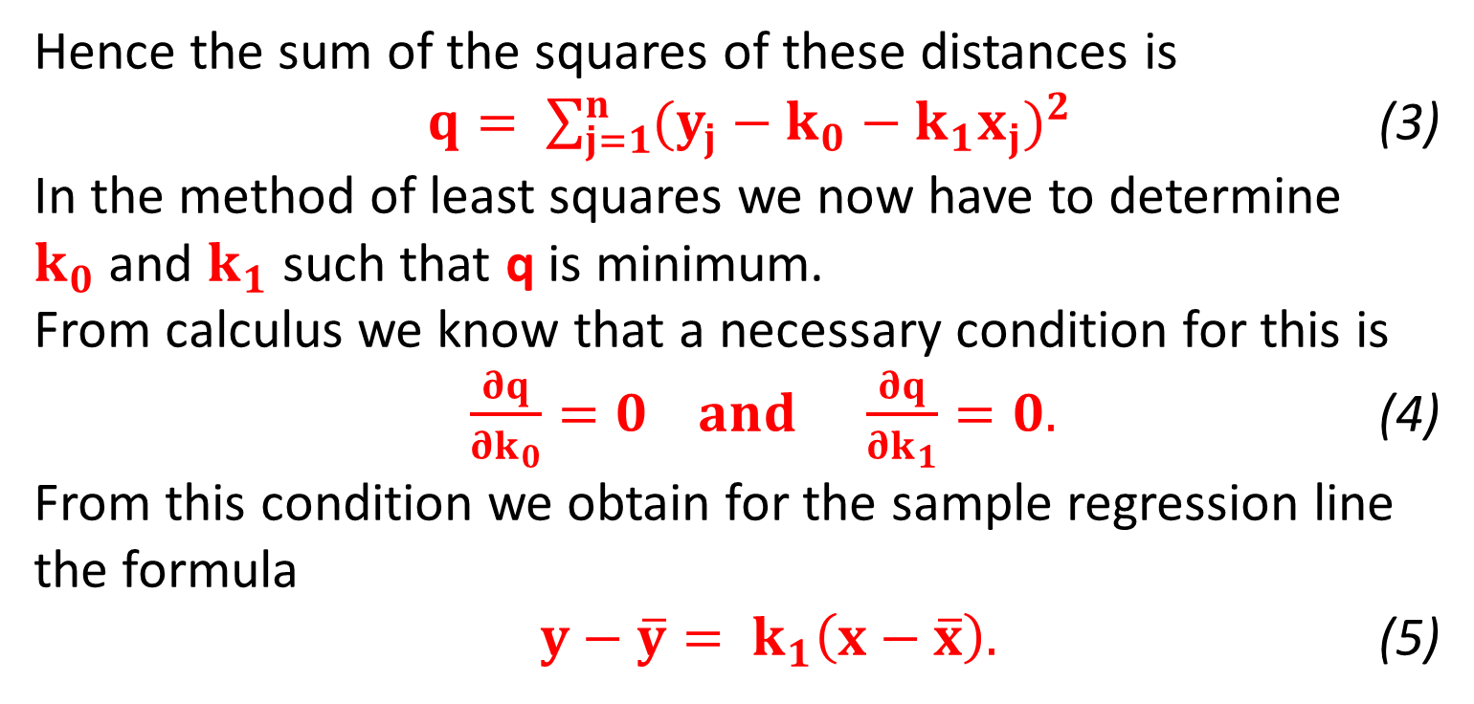
Least Squares Principle
Hence the sum of the squares of these distances is
$q= \sum_{j=1}^{n}{{(y_{j}−k_{0}−k_{1}x_{j})}^{2}}$ (3)
In the method of least squares we now have to determine $k_{0}$and $k_{1}$ such that q is minimum.
From calculus we know that a necessary condition for this is
$\frac{∂q}{∂k_{0}}=0 and \frac{∂q}{∂k_{1}}=0.$ (4)
From this condition we obtain for the sample regression line the formula
$y−\overline{y}= k_{1}\left(x−\overline{x}\right).$ (5)

Slide 9
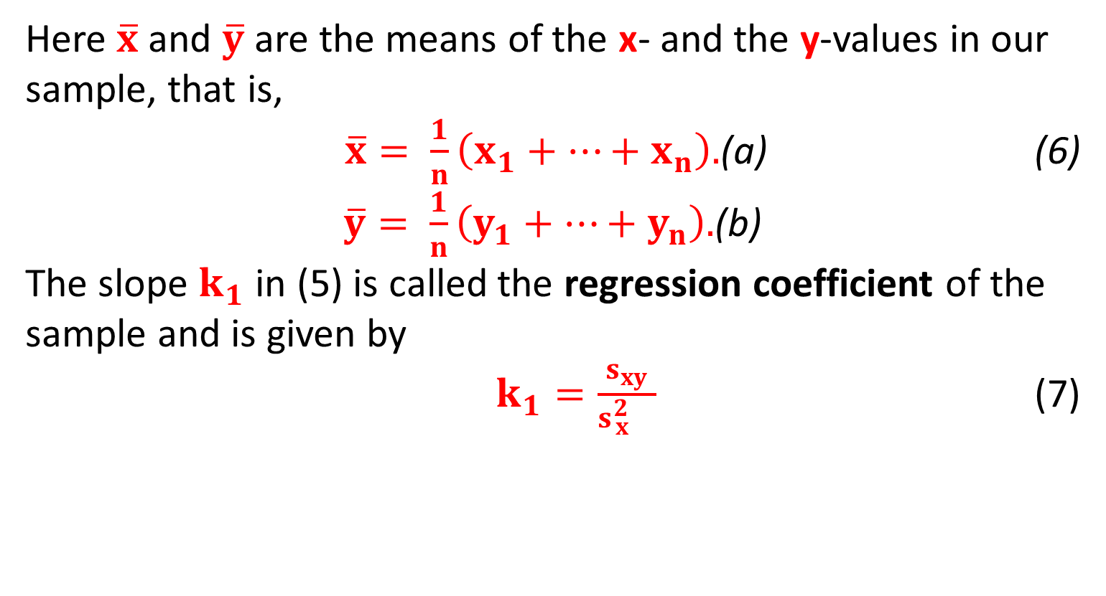
Least Squares Principle
Here $\overline{x}$ and $\overline{y}$ are the means of the x- and the y-values in our sample, that is,
$\overline{x}= \frac{1}{n}\left(x_{1}+…+x_{n}\right).$(a) (6)
$\overline{y}= \frac{1}{n}\left(y_{1}+…+y_{n}\right).$(b)
The slope $k_{1}$ in (5) is called the regression coefficient of the sample and is given by
$k_{1}=\frac{s_{xy}}{s{}_{x}^{2}{}}$ (7)

Slide 10
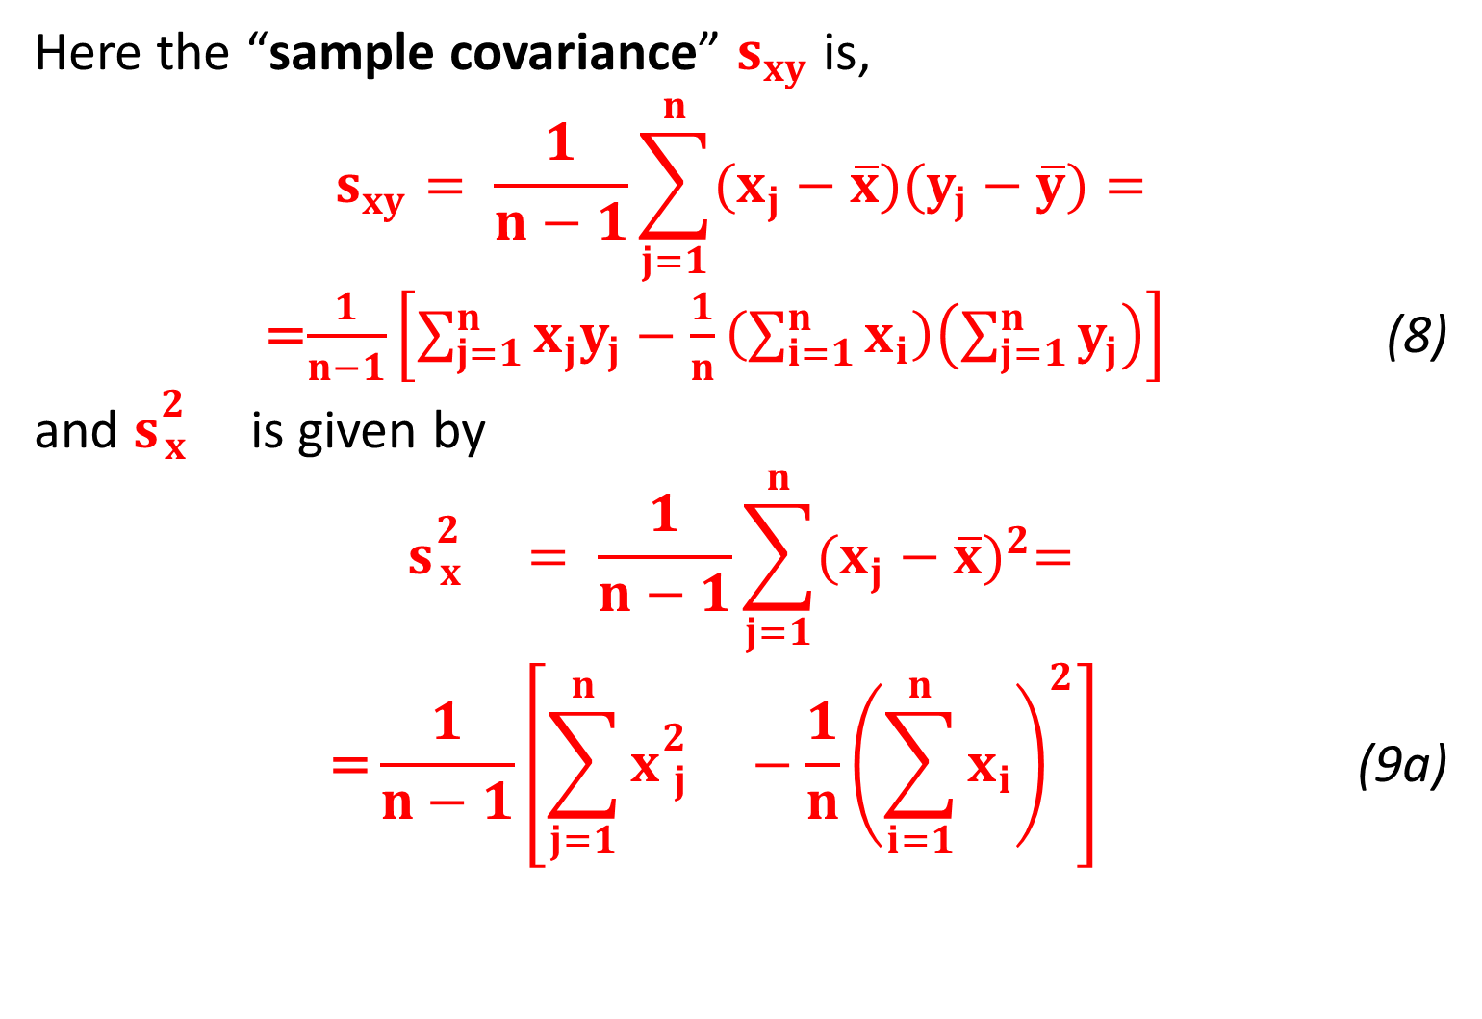
Least Squares Principle
Here the “sample covariance” $s_{xy}$ is,
$$s_{xy}= \frac{1}{n−1}\sum_{j=1}^{n}{(x_{j}−\overline{x})(y_{j}−\overline{y})=}$$
=$\frac{1}{n−1}\left[\sum_{j=1}^{n}{x_{j}y_{j}}−\frac{1}{n}\left(\sum_{i=1}^{n}{x_{i}}\right)\left(\sum_{j=1}^{n}{y_{j}}\right)\right]$ (8)
and $s{}_{x}^{2}{}$ is given by
$$s{}_{x}^{2}{}= \frac{1}{n−1}\sum_{j=1}^{n}{{(x_{j}−\overline{x})}^{2}=}$$
$$\text{=}\frac{1}{n−1}\left[\sum_{j=1}^{n}{x{}_{j}^{2}{}}−\frac{1}{n}{\left(\sum_{i=1}^{n}{x_{i}}\right)}^{2}\right] \text{ (}\text{9}\text{a}\text{)}$$

Slide 11
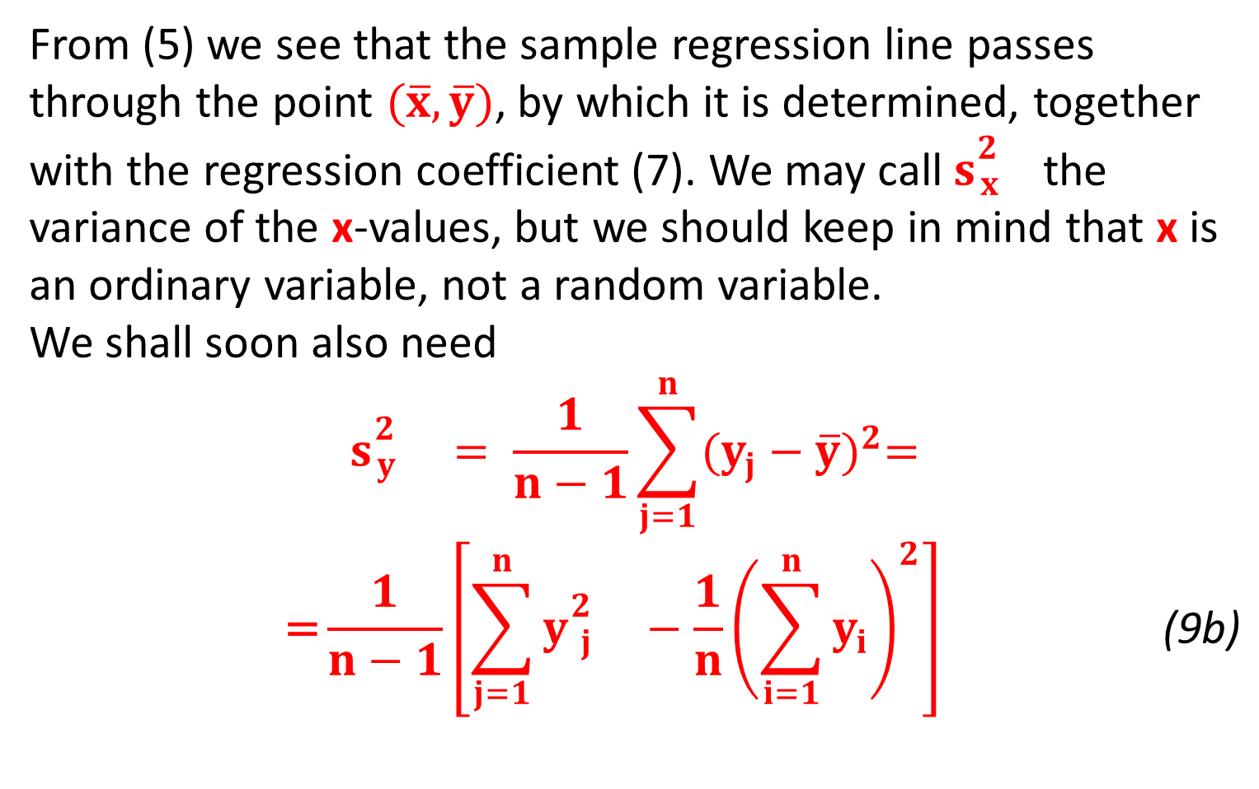
Least Squares Principle
From (5) we see that the sample regression line passes through the point $(\overline{x},\overline{y})$, by which it is determined, together with the regression coefficient (7). We may call $s{}_{x}^{2}{}$the variance of the x-values, but we should keep in mind that x is an ordinary variable, not a random variable.
We shall soon also need
$$s{}_{y}^{2}{}= \frac{1}{n−1}\sum_{j=1}^{n}{{(y_{j}−\overline{y})}^{2}=}$$
$$\text{=}\frac{1}{n−1}\left[\sum_{j=1}^{n}{y{}_{j}^{2}{}}−\frac{1}{n}{\left(\sum_{i=1}^{n}{y_{i}}\right)}^{2}\right] \text{ (9}\text{b}\text{)}$$

Slide 12
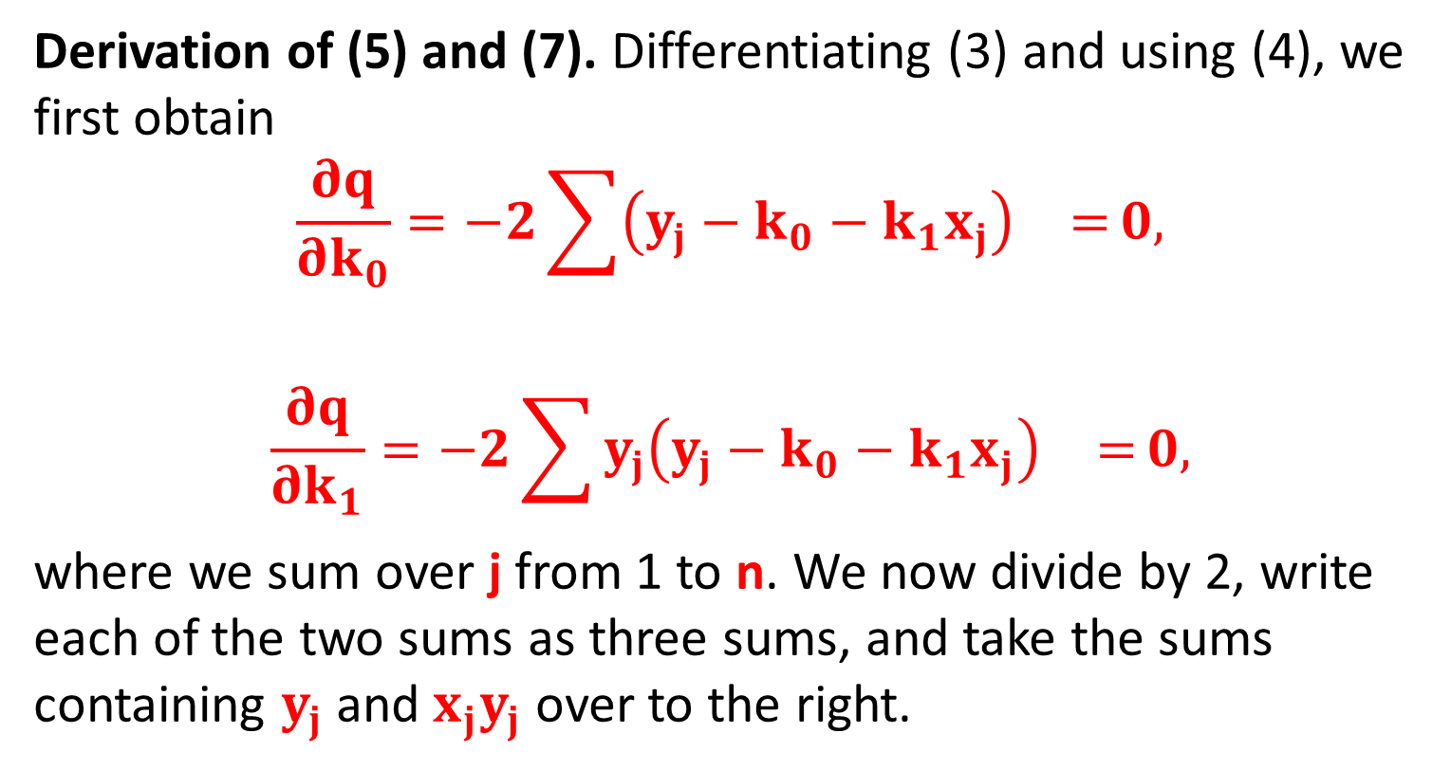
Least Squares Principle
Derivation of (5) and (7). Differentiating (3) and using (4), we first obtain
$$\frac{∂q}{∂k_{0}}=−2\sum{{\left(y_{j}−k_{0}−k_{1}x_{j}\right)}^{}=}0,$$
$$\frac{∂q}{∂k_{1}}=−2\sum{{y_{j}\left(y_{j}−k_{0}−k_{1}x_{j}\right)}^{}=}0,$$
where we sum over j from 1 to n. We now divide by 2, write each of the two sums as three sums, and take the sums containing $y_{j}$ and $x_{j}y_{j}$ over to the right.

Slide 13
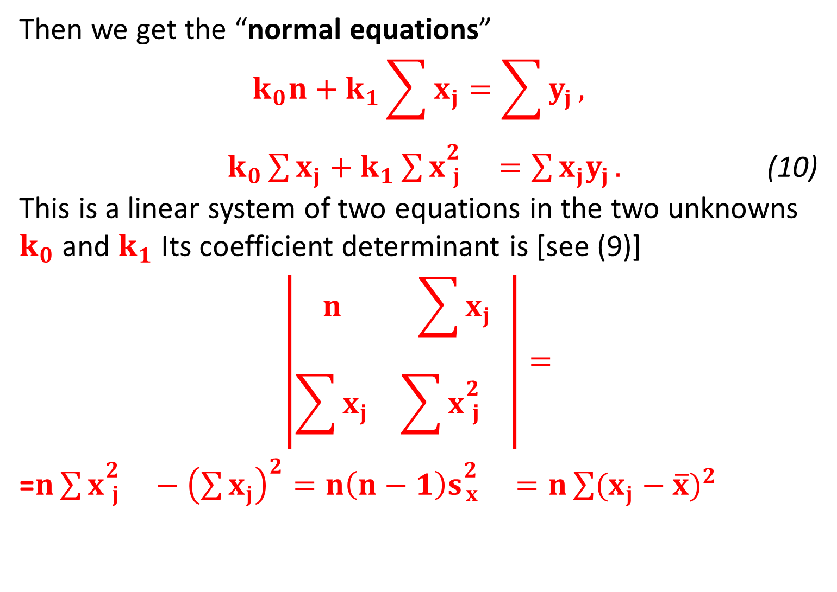
Least Squares Principle
Then we get the “normal equations”
$$k_{0}n+k_{1}\sum{x_{j}}=\sum{y_{j}},$$
$k_{0}\sum{x_{j}}+k_{1}\sum{x{}_{j}^{2}{}}=\sum{x_{j}y_{j}}.$ (10)
This is a linear system of two equations in the two unknowns $k_{0}$ and $k_{1}$ Its coefficient determinant is [see (9)]
$$\left|\begin{matrix}n & \sum{x_{j}} \\ \sum{x_{j}} & \sum{x{}_{j}^{2}{}}\end{matrix}\right|=$$
=$n\sum{x{}_{j}^{2}{}}−{\left(\sum{x_{j}}\right)}^{2}=n\left(n−1\right)s{}_{x}^{2}{}=n\sum{{(x_{j}−\overline{x})}^{2}}$

Slide 14
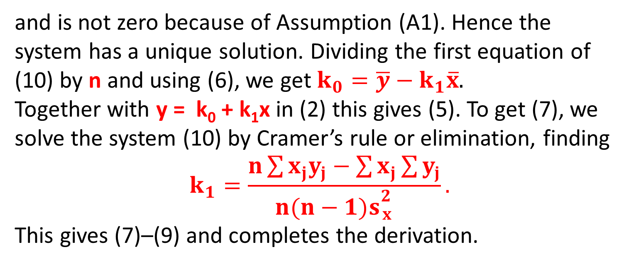
Least Squares Principle
and is not zero because of Assumption (A1). Hence the system has a unique solution. Dividing the first equation of (10) by n and using (6), we get $k_{0}=\overline{y}−k_{1}\overline{x}$.
Together with y = k₀ + k₁x in (2) this gives (5). To get (7), we solve the system (10) by Cramer’s rule or elimination, finding
$$k_{1}=\frac{n\sum{x_{j}y_{j}}−\sum{x_{j}}\sum{y_{j}}}{n(n−1)s{}_{x}^{2}{}}.$$
This gives (7)–(9) and completes the derivation.

Slide 15
Confidence Intervals in Regression Analysis
If we want to get confidence intervals, we have to make assumptions about the distribution of Y (which we have not made so far; least squares is a “geometric principle,” nowhere involving probabilities!). We assume normality and independence in sampling:
Assumption (A2)
For each fixed x the random variable Y is normal with mean (1), that is,
μ(x) = k₀ + k₁x. (12)
and variance σ² independent of x.
Assumption (A3)
The n performances of the experiment by which we obtain a sample (x₁, y₁), (x₂, y₂), …, (x_{n}, y_{n}) are independent.

Slide 16
Confidence Intervals in Regression Analysis
k₁ in (12) is called the regression coefficient of the population because it can be shown that, under Assumptions (A1)–(A3), the maximum likelihood estimate k₁ of is the sample regression coefficient k₁ given by (11).
Under Assumptions (A1)–(A3), we may now obtain a confidence interval for k₁, as shown below.

Slide 17



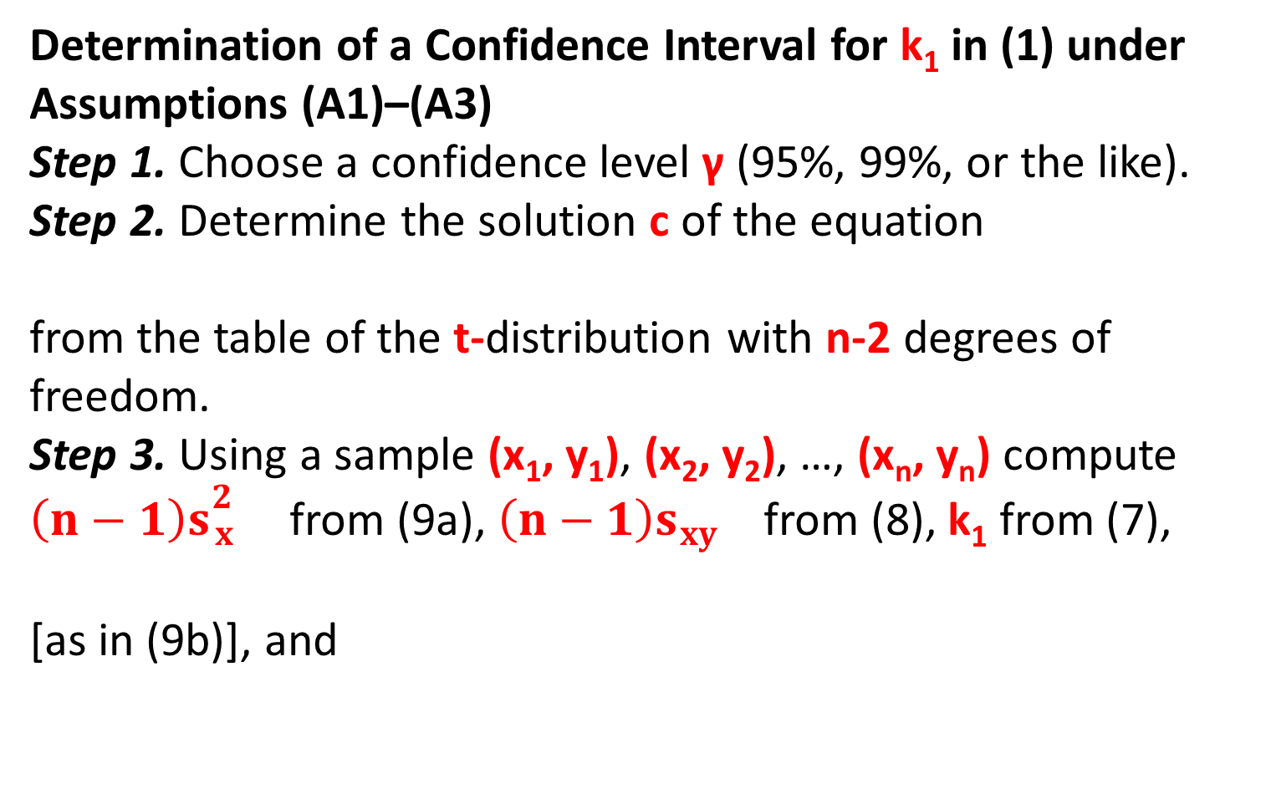
Confidence Intervals in Regression Analysis
Determination of a Confidence Interval for k₁ in (1) under Assumptions (A1)–(A3)
Step 1. Choose a confidence level γ (95%, 99%, or the like).
Step 2. Determine the solution c of the equation
from the table of the t-distribution with n-2 degrees of freedom.
Step 3. Using a sample (x₁, y₁), (x₂, y₂), …, (x_{n}, y_{n}) compute $\left(n−1\right)s{}_{x}^{2}{}$ from (9a), $\left(n−1\right)s{}_{xy}^{}{}$from (8), k₁ from (7),
[as in (9b)], and

Slide 18


Confidence Intervals in Regression Analysis
Step 4. Compute
The confidence interval is

Slide 19
End of Lecture-5

